Slide 1
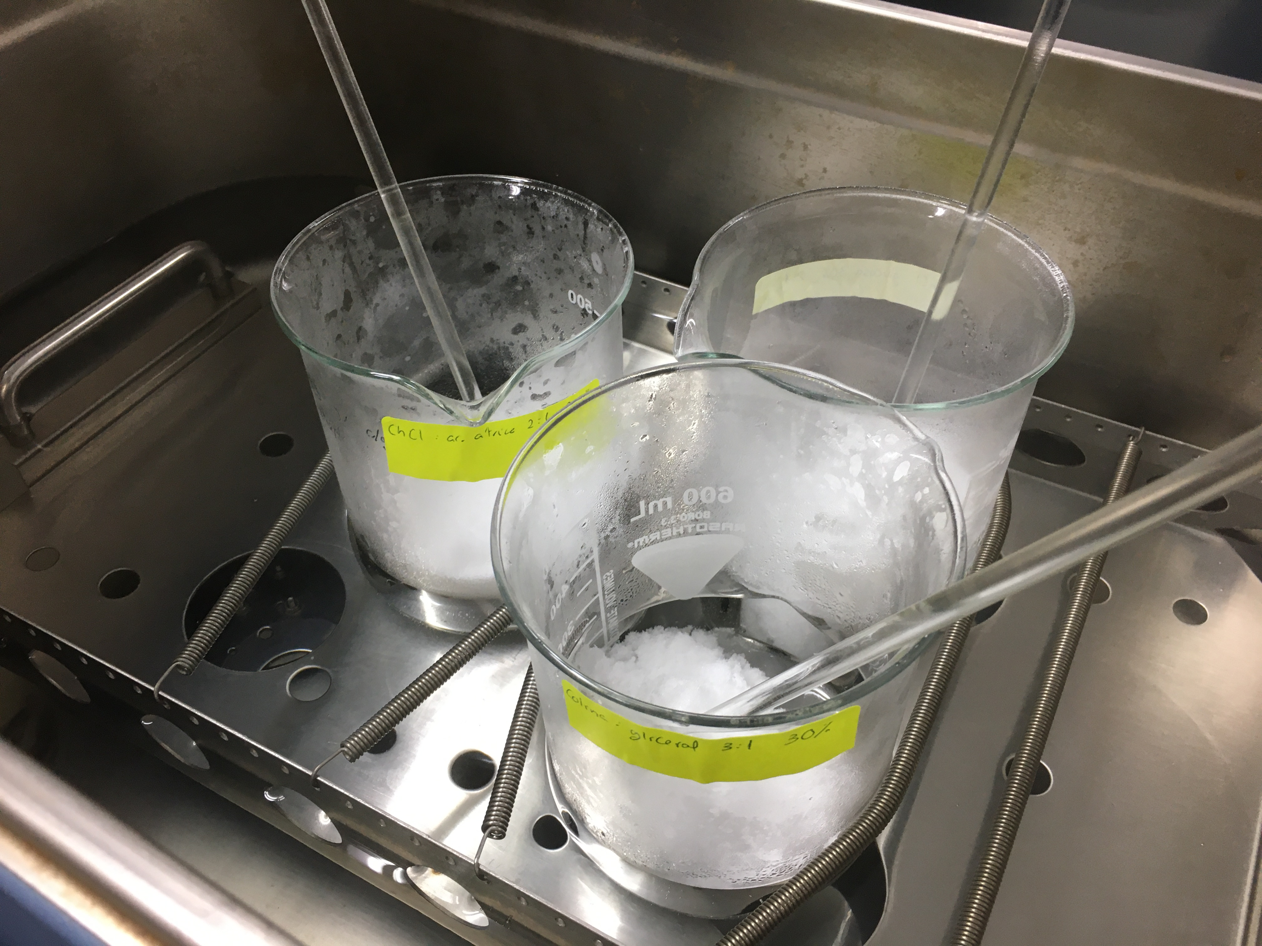
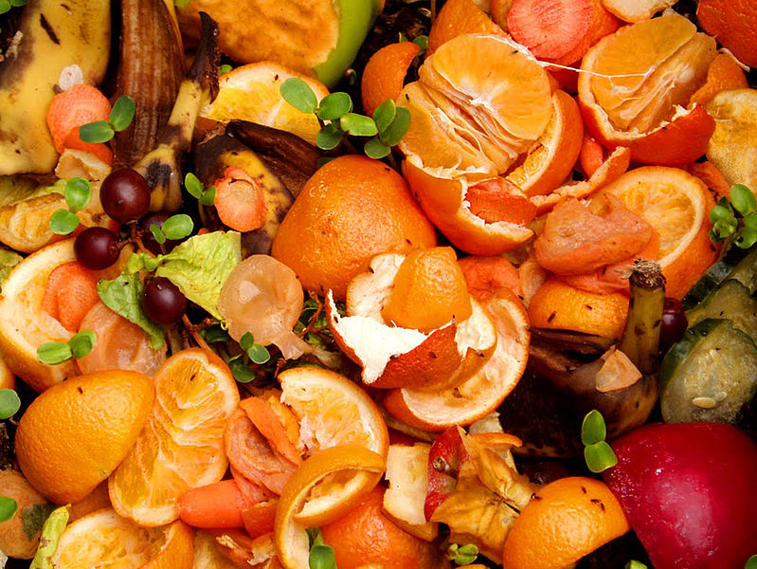
Assessment of the use of a selection of natural deep eutectic solvents in the extraction of polar bioactive compounds from orange peel
Authors: Tejero-Martínez, A., Martín, M.E., Malo-López, D., Frígola, A., Esteve, M.J., Blesa, J

Slide 2
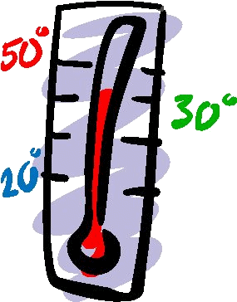
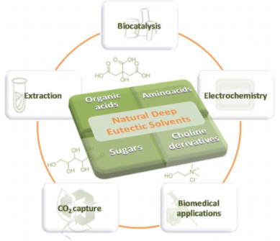
WHAT ARE “NADES”?
1º INTRODUCTION
CONTEXT: Concern for the environment
2 green solvent study sites: ILs and DES
DES
Eutectics Mixtures
Two compounds (solids)→ lowest melting point = Liquid phase at Eutectic temperature
NADES
Ideal ‘’Green’’ Solvents
Hydrophilic Character
Better extraction PF
Co-solvents
Less Viscosity
High mass transference
Raw Materials
Easy Preparation
Biodegradability

Slide 3
2º OBJECTIVES
Select 5 NADES, which showed the best results in their source articles as extractants of bioactive compounds on different plant residues, reversing the proportions of water and original NADES.
Perform an extraction on orange peel of bioactive compound, characterized as total phenols and antioxidant capacity, with the selection of NADES and compare them with a conventional extraction (Ethanol-Water 50%, v:v).
Check for changes in the stability of the 6 types of extracts over 4 weeks at a storage temperature of 4°C.

Slide 4
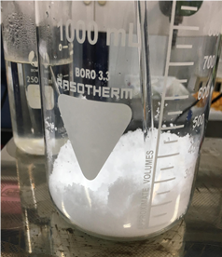
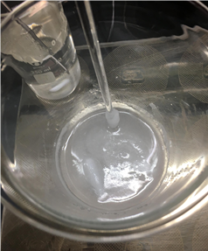
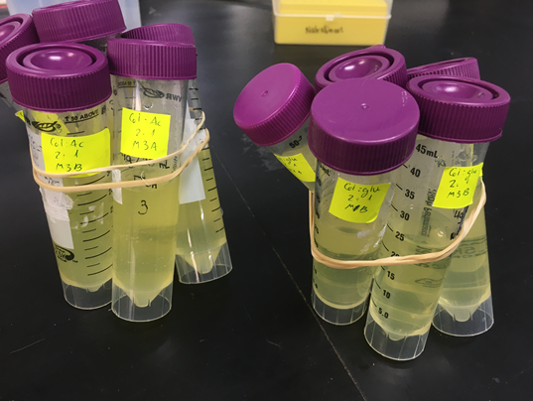
PREPARATION OF SAMPLES AND EXTRACTS
3º MATERIALS AND METHODS
Weigh the orange and separate the peel
Grind the peel and weigh 7g
Extraction (20 min) with magnet stirring
Centrifugation: 3000 rpm 10 min
Weigh NADES components according to molar ratios
Heating Plate (50-90ºC)
Dilute with water (70%, v:v)
Solid-Liquid Ratio (1:10)
Separating supernatant and skin
TOTAL: 36 samples
Conservation 4ºC

Slide 5
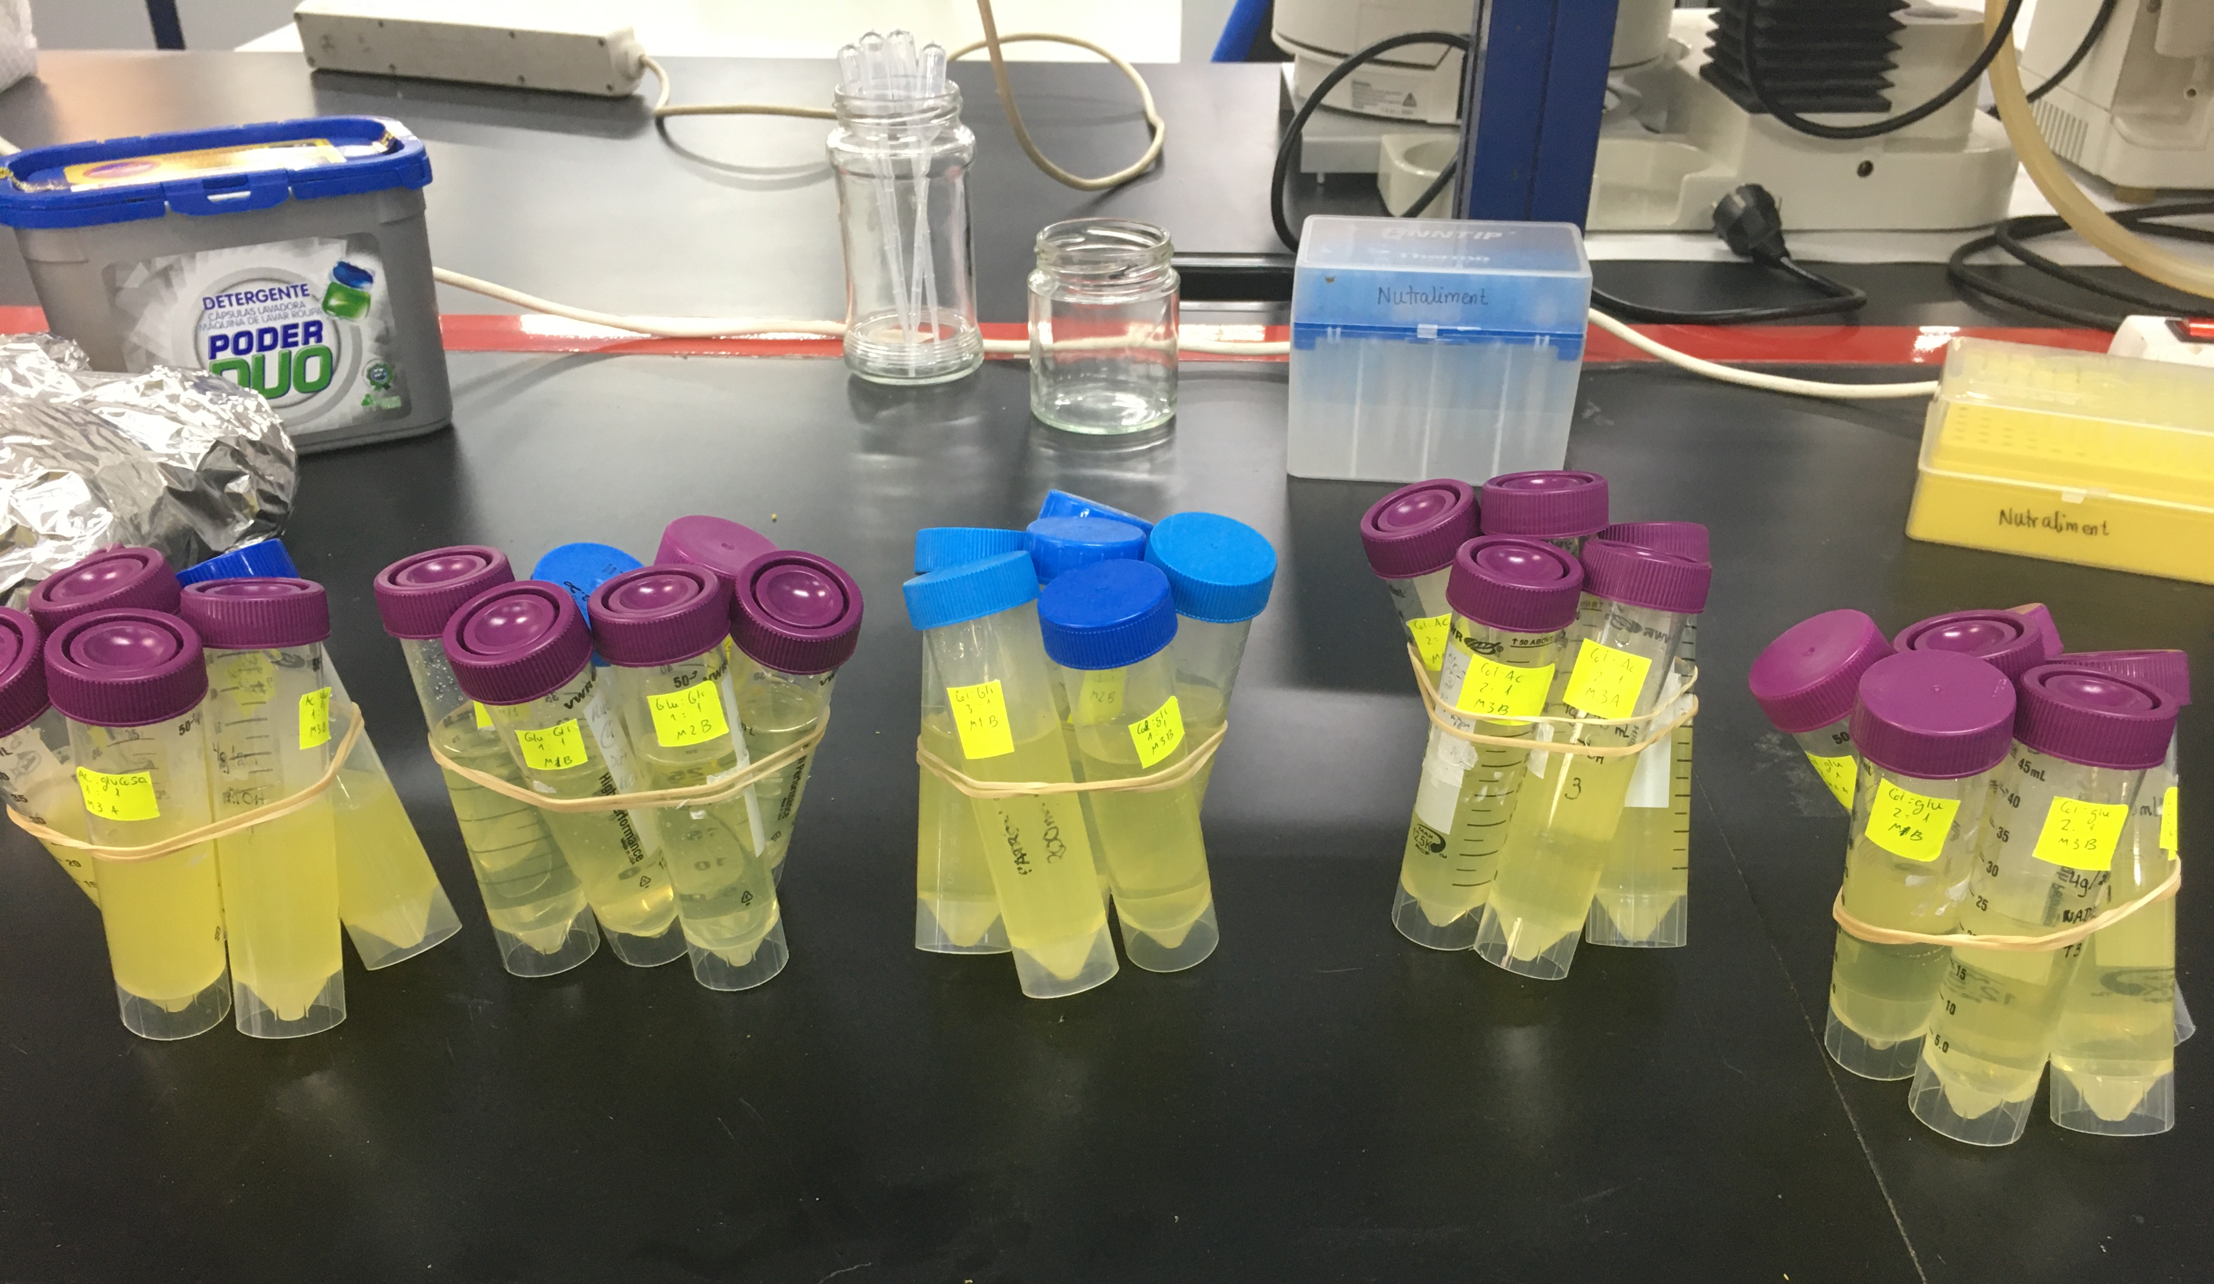
NADES SELECTED
3º MATERIALS AND METHODS
The best-performing NADES were selected on the basis of different studies
All NADES 70%
Citric Acid-Glucose 1:1
Choline-Citric Acid
2:1
Glucose-Glycerol
3:1
Choline-Glycerol
3:1
Solid-Liquid Ratio 1:10
Choline-Glucose
2:1
Extraction time: 20 min
A conventional extractant is used as a reference: Ethanol-Water (50%)

Slide 6
TOTAL PHENOLIC COMPOUNDS (TPC)
4º RESULTS
2 Groups: The lowest values ​​are showed by the choline combinations

Slide 7
TOTAL ANTIOXIDANT CAPACITY (TAC)
4º RESULTS
Better results: Glycerol combinations

Slide 8
STABILITY TEST
Significant differences from day 15
Reduction in all of them
4º RESULTS

Slide 9
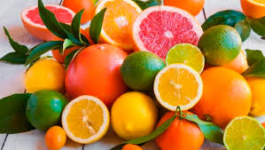
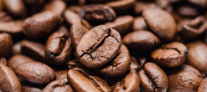
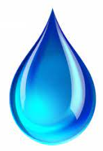
5º DISCUSSION
Comparation with some studies
TPC
REFERENCE SOLVENT
NOT COMPARED
5370 mg GAE/100 g DW
5100 y 5200 mg GAE/100 g FW
2710 mg GAE/100 g DW (ethanol)
4000 mg GAE/100 g FW (ethanol)
8701 y 6291 mg GAE/100 g DW
TAC
69 (lemon) y 96% (orange) DPPH reduction
59% DPPH reduction
Mouratoglou et al. (2016)
NADES 10%
Panić et al. (2021):
ChCl-Gly 50% ; Glu-Gly 80%
Ahmad et al. (2018)
NADES 50%
Kolarević et al. (2020)
NADES 20%
Jeong et al. (2015)
NADES 70%
Best extraction by NADES (AC-Glu) 5180 mg GA / 100 g DW.
And 4680 mg AG / 100 g DW for the Ethanol-Water.
Better results of the NADES with hydrophilic character.
MÁX. 52% DPPH reduction

Slide 10
Comparation with some studies: STABILITY
5º DISCUSSION
TPC
Retention of studies: 99-93% (Max.) And 85-66% (Min.)
TAC
Retention of studies: 99-97% (Max.) And 82-70% (Min.)
There have been significant reductions in all of them from day 15 at 4ºC. In the studies they were between 2-6 months.
The retention in this work: 94.6-83.7% in NADES and 79.7% (Ethanol-Water)
The retention in this work: 98.3-77.5% in NADES and 43.5% (Ethanol-Water)
There has been a correlation between the reduction of PFT and CAT in the NADES. Except Ethanol-Water.
Not compared with NADES!
This may indicate that Ethanol-Water extract has obtained other antioxidant compounds apart from polyphenols such as vitamin C and therefore there has been this difference in final TAC.

Slide 11
6º CONCLUSIONS
The highest TPC extraction was obtained by NADES AC-Glu with 5180 mg GAE / 100g DW with significant differences compared to the rest and the Ethanol-Water extract (50%, v: v) with 4680 mg GAE / 100g weight dried.
2. The highest TAC was obtained by the NADES whose combinations presented Gly (ChCl-Gly and Glu-Gly) with up to 52 and 45.8% reduction in DPPH but Ethanol-Water (50%, v: v) that achieved 29.2% reduction.
3. The retention of TPC in 4 weeks of analysis has been between 94.6 and 83.7% in the NADES while that of the Ethanol-Water (50%, v: v) decreased to 79.7%.
4. TAC retention in 4 weeks of analysis has been between 98.3 and 77.5% in the NADES while that of Ethanol-Water (50%, v: v) was the lowest with 43.5%.
5. It has been found that a higher proportion of water in NADES has led to better TPF and TAC extractions than most studies using smaller amounts.
6. The stability of TPC and TAC has been maintained until day 15 of analysis, showing correlation in the reduction of TPC with TAC except for the Ethanol-Water extract where other antioxidants have been able to intervene.

