Slide 1
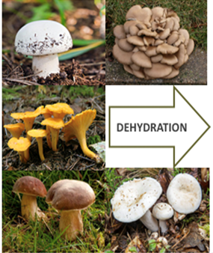
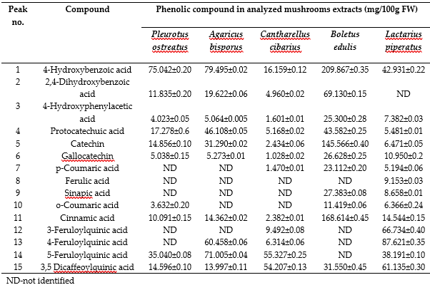
University of Agricultural Sciences and Veterinary Medicine Cluj-Napoca, 3-5 Mănăştur St., 400372 Cluj-Napoca, Romania.
Chemical characterization and biological activities of some wild edible mushrooms
Fogarasi Melinda *, Socaci Sonia, Farcas Anca, Semeniuc Cristina-Anamaria, Socaciu Maria-Ioana, Tibulca Dorin, Salagean Dan, Tofana Maria
INTRODUCTION
EXPERIMENTAL DESIGN
Over the last decade, the proven health-promoting abilities of different food classes, especially wild foods originated from unpolluted areas (i.e. mountains) gain the attention of consumers and food industry (Barros L. et al., 2008)
It is well known that, mushrooms are consumed as a delicacy for their texture and flavor and have an important nutritional value due to their high protein, essential amino acids and fibers content but a low fat content at the same time and proved to be effective mainly as antioxidants, anticancer and antimicrobial agents (Heleno S.A., et al., 2012).
Total Phenolic Content
Total Flavonoid Content
Antioxidant activity (ABTS)
UV-VIS
Phenolic Content (HPLC–DAD)
Chemical composition
RESULTS
Table 1. Total phenolic content, flavonoids and antioxidant activity of selected mushrooms
Table 2. Chemical composition of selected mushrooms
Mushroom species | TP mg GAE/100 g DW) | TF (mg QE/100 g DW) | ABTS uM Trolox/g DW
A. bisporus | 408.57±0.02^{c} | 40.56±0.05^{b} | 18.38±0.01^{c}
P. ostreatus | 519.22±0.04^{b} | 30.69±0.00^{c} | 27.17±0.00^{b}
C. cibarius | 104.91±0.03e | 20.53±0.03^{d} | 12.50±0.00^{d}
B. edulis | 806.58±0.00ª | 70.81±0.01ª | 97.09±0.01ª
L. piperatus | 113.06±0.02^{d} | 12.52±0.03e | 11.15±0.00e
CONCLUSIONS
Tabel 3. The phenolic content in analyzed mushrooms extracts determined by HPLC–DAD and expressed as mg acid Gallic equivalents per 1000 gr FW
It was established, that 4-hydroxybenzoic acid, cinnamic acid and 4-feruloylquinic acid are the major phenolic compounds in the analyzed mushrooms samples.
as an overall conclusion it can be stated that due to their wide range of bioactives, the selected mushrooms may be further exploited as functional ingredients in the composition of innovative food products and not only.
REFERENCES
- Barros, L., et al. (2008). "Wild and commercial mushrooms as source of nutrients and nutraceuticals." Food Chem Toxicol 46(8): 2742-2747.
- Heleno, S. A., et al. (2012). "Phenolic, polysaccharidic, and lipidic fractions of mushrooms from northeastern Portugal: chemical compounds with antioxidant properties." J Agric Food Chem 60(18): 4634-4640.
Acknowledgements:
This work was supported by the grant of Ministry of Research and Innovation, CNCS-UEFISCDI, project number PN-III-P1-1.1-PD-2019-0475

