Slide 1
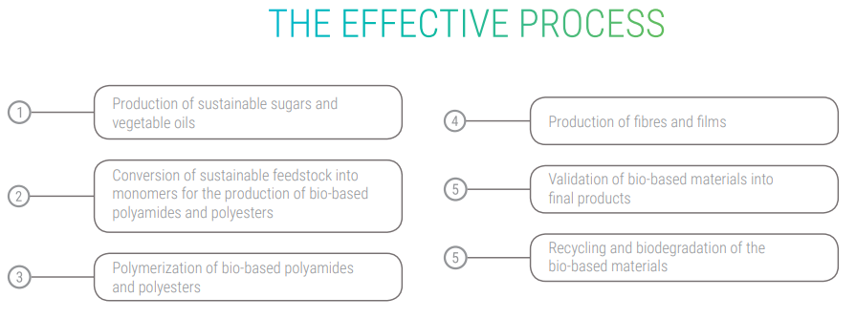
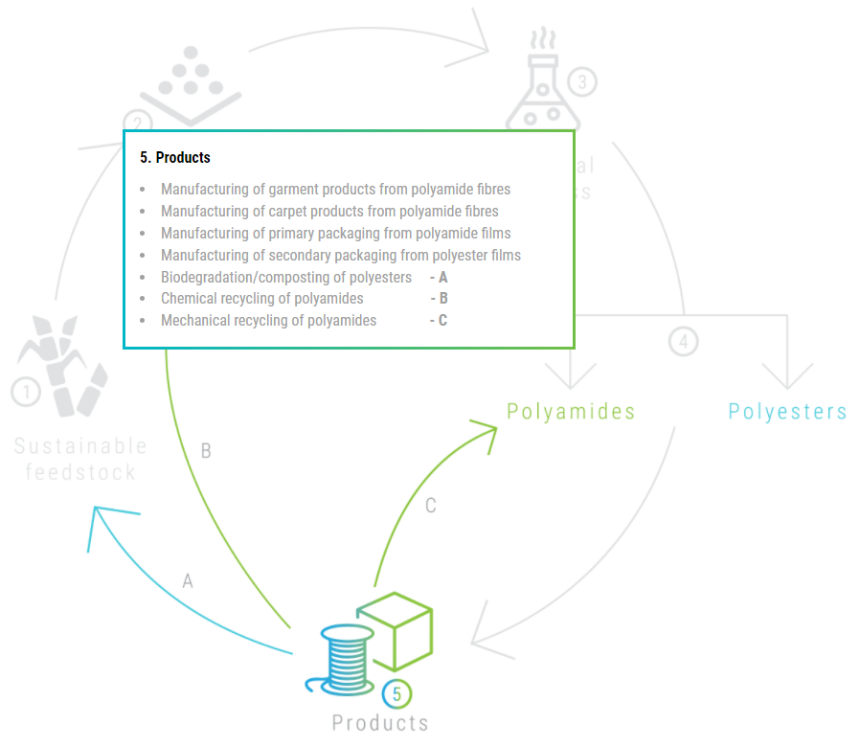
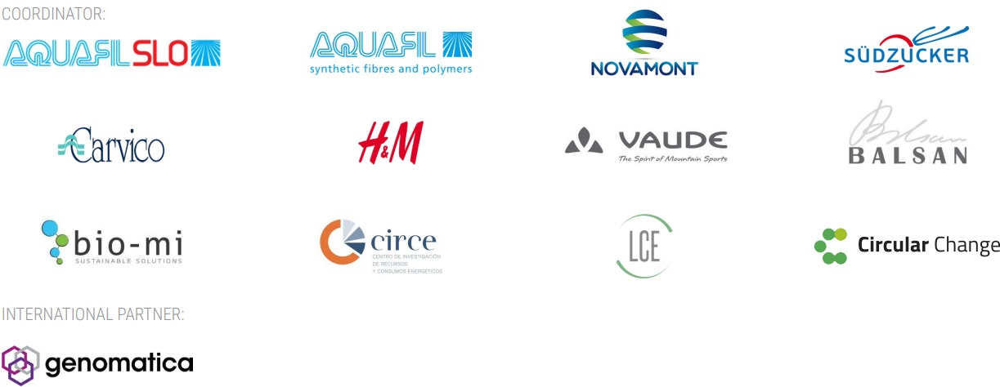
Eco-designed Fibres and Films from Biobased Polyamides and Polyesters for Sustainable Development
J. Guillen Angel¹, N. García-Polanco^{1*}
1. Fundación CIRCE, Parque Empresarial Dinamiza Avda. de Ranillas 3D, 1º Planta, 50018 Zaragoza, Spain
INTRODUCTION: Accumulation of plastic material in the environment has a negative impact on wildlife and humans. As most plastics are non-biodegradable and recycling is limited, if not impossible. This issue is addressed by a novel research project called EFFECTIVE, this project connects 12 companies and research institutes that have come together to redesign two of the most widely used materials today: polyamides and bio-polyesters.
OBJECTIVE:
The overarching objective of the EFFECTIVE project is to demonstrate innovative and economically viable routes for the production of bio-based polyamides and polyesters from renewable feedstocks to obtain fibres and compostable film packaging with enhanced properties, market competitiveness and increased sustainability. Also, the project intends to represent a key milestone towards the future industrialization of biobased fibres and films production in Europe foreseeing the mobilization of relevant investments by involved industry partners to develop new cases of biobased economy, interconnected with circular regenerative economy joining environmental sustainability and economic profitability.
RESULTS: The main expected results consist of:
Demonstration of the production of bio-based nylons, bio-based polyesters and biodegradable bio-materials from renewable.
Validation of bio-based nylons into yarns for carpet and garment manufacturing, as well as into compostable films for packaging applications.
Validation of biodegradable bio-materials from bio-based polyesters into compostable films for packaging applications.
Figure 2. The innovative process introduced by the EFFECTIVE.
CONCLUSIONS: The EFFECTIVE project is using various sustainable and renewable feedstocks as a starting point to produce biobased building blocks of high commercial interest. In addition, two parallel value chains have been established to convert the obtained biobased building blocks into polymeric fibres, materials and compostable films for the subsequent application into large consumer products.
Figure 1. The EFFECTIVE circle and production of biobased products.
Figure 3. Project partners
Bio based products: Bio-based products or materials are usually defined as products and materials from biological and renewable sources, such as plants. Raw materials like minerals and fossil fuels, despite being extracted from earth, are not considered in this category given the long period their production takes (i.e. beyond a century). This means that a plastic made out oil from petroleum is not bio-based, whereas a plastic made from vegetable oils is indeed a bio-based product. Nylon, for example, is a plastic that can be produced from both sources.
REFERENCES:
[1] http://www.effective-project.eu/
AKNOWLEDGEMENTS:
This project has received funding from the Bio Based Industries Joint Undertaking (JU) under grant agreement No 792195. The JU receives support from the European Union’s Horizon 2020 research and innovation programme and the Bio Based Industries Consortium.
*Corresponding author: nrgarcia@fcirce.es, circe@fcirce.es

