Slide 1
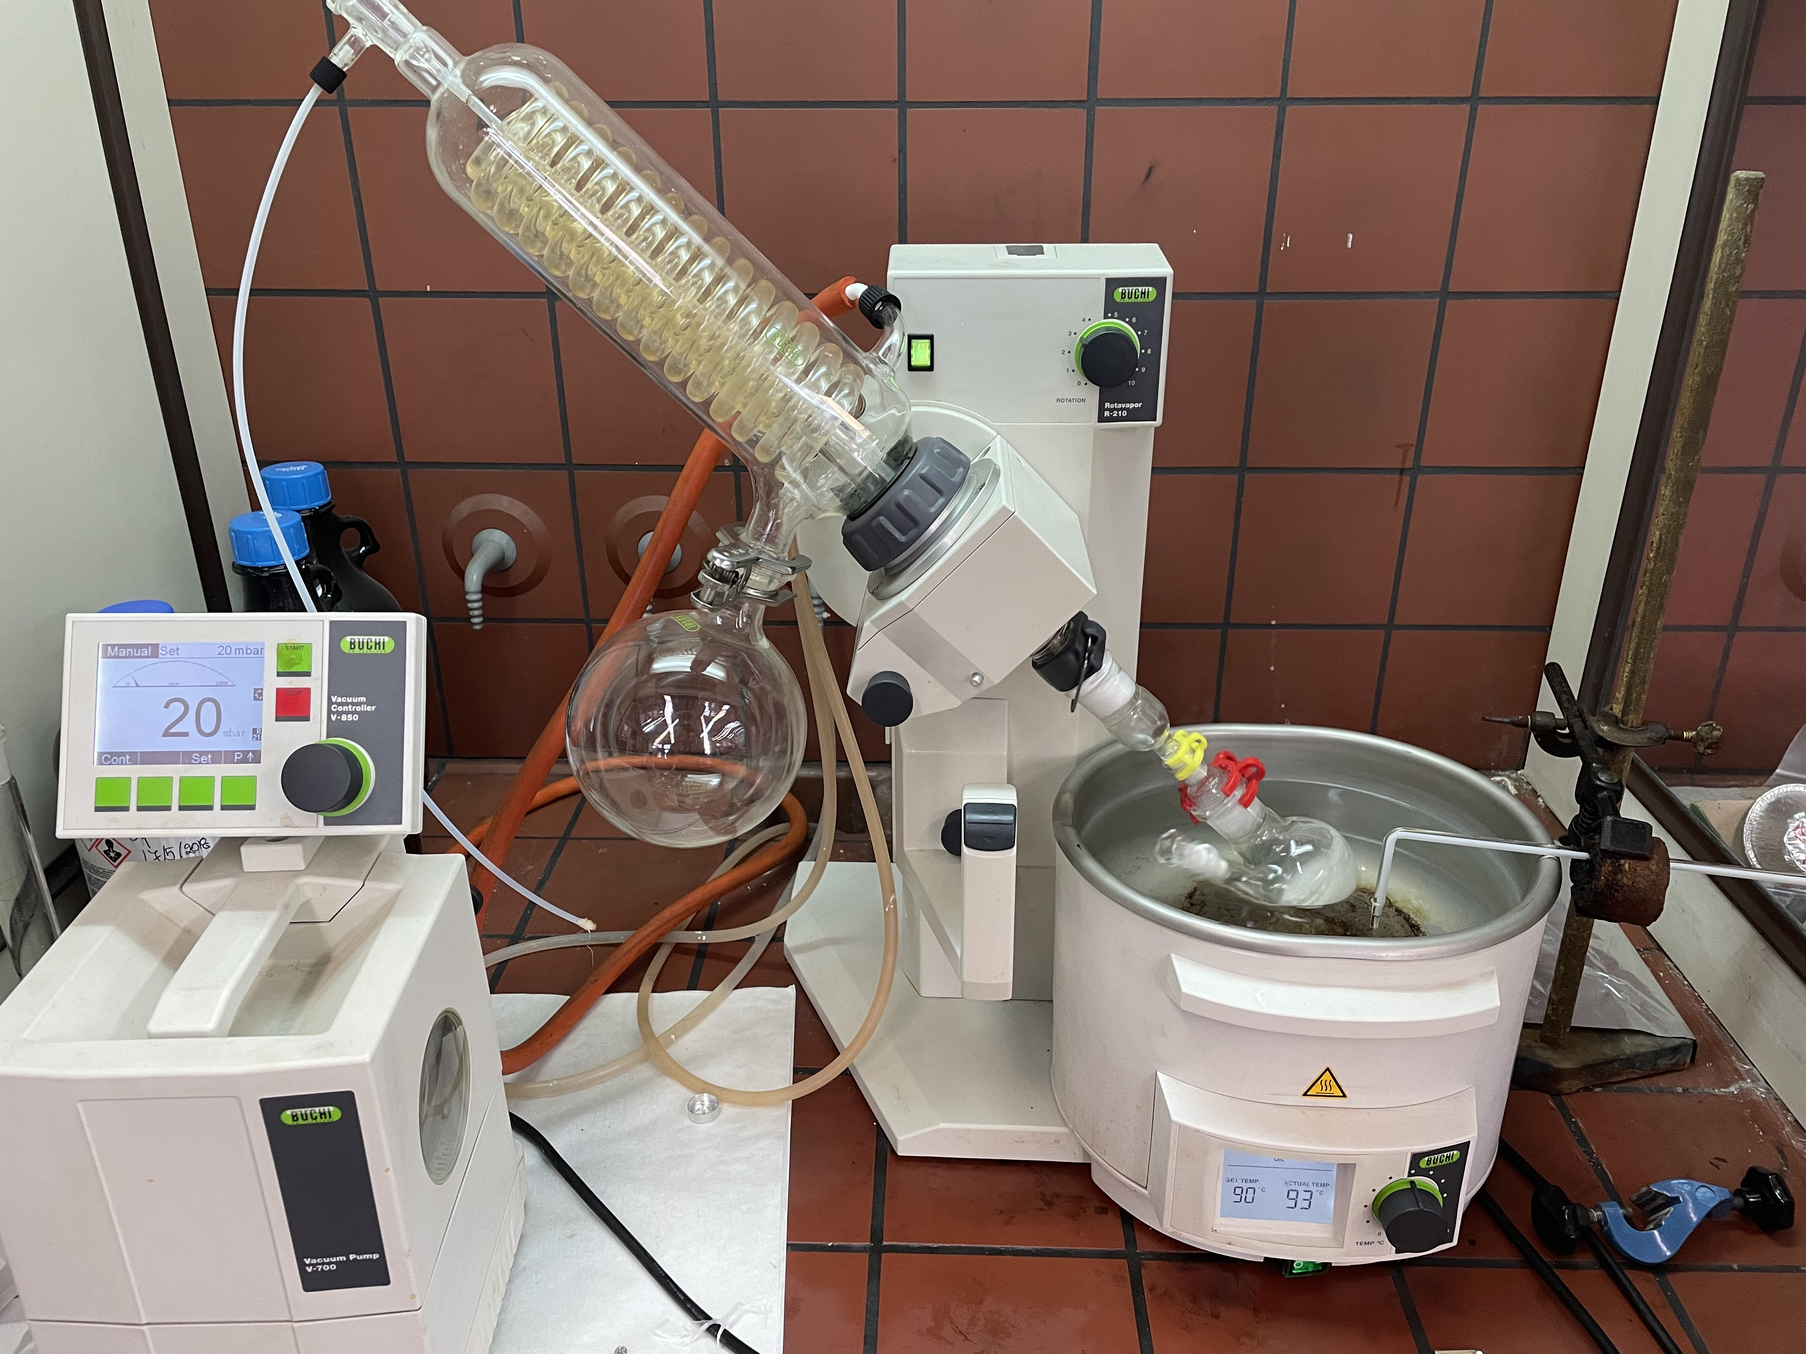
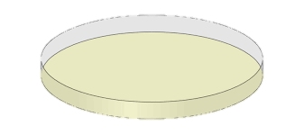
Evaluation of the parameters of poly(butylene succinate) enzymatic polymerization C. I. Gkountela, D. N. Markoulakis, D. M. Korres, S. N. Vouyiouka* Laboratory of Polymer Technology, School of Chemical Engineering, National Technical University of Athens, Greece, (*mvuyiuka@central.ntua.gr)
Introduction
Poly(butylene succinate) (PBS) is a bio-based and biodegradable polyester, that can be used in numerous applications, especially in the biomedical sector [1,2]. Even though green polymerization routes such as biocatalysis are being developed [3,4], there is a very limited literature on the enzymatic synthesis of PBS and in most of the works where high-molecular-weight PBS is produced, several drawbacks may impede the process scaling up. On that basis, an eco-friendly, solvent-free, enzyme-based process for the production of PBS was applied and the most important process parameters were evaluated.
Experimental part
N435
1,4 BDO DES
Figure 1. Apparatus for the production of PBS oligomers
Figure 2. Enzymatically synthesized PBS oligomer (scaled up,10 g)
Reaction: 40℃, 24h (1st stage)
Reaction: T , P , t₂ (2nd stage))
CHCl₃
PBS + N435
PBS + N435
Filtration, Drying
PBS oligomer
PBS + N435
Results and Discussion
Evaluated process parameters:
90 and 95°C
Reaction temperature
Optimum conditions: 90°C, 20 mbar, 2h
Pressure
$\overline{M_{w}}$at 90°C, $\overline{M_{w}}$ at 95°C
Reaction time
$\overline{M_{w}}$ at 90°C and 95°C
Figure 4. $\overline{M_{w}}$ and T_{m} of the enzymatically synthesized oligomers
Table 1. Scaled-up PBS oligomer’s properties
Figure 3. $\overline{M_{w}}$ of the enzymatically synthesized oligomers
$$\overline{M_{n}}$$ (g/mol) | $\overline{M_{w}}$ (g/mol) | T_{m1} (°C) | T_{c} (°C) | T_{m2} (°C) | T_{d,5%} (°C) | T_{d} (°C) | Residue (%)
1000 | 4700 | 104 | 57 | 103 | 258 | 387 | 1,44
The synthesized at 90 °C, 20 mbar, 2h product was successfully scaled up (ca. 10 g of product).
Conclusions
The bulk enzymatic polymerization route resulted in a PBS grade of $\overline{M_{w}}$ 4700 g/mol, crystallinity ca. 61% and melting points at ca. 104°C. This free of thermal degradation and metal catalyst residues grade is appropriate to be used in biomedicine applications where low controlled molecular weight is usually needed.
References
[1] Xu J, Guo B.H, Biotechnology Journal. 2010; 1149–1163.
[2] Gigli M, Fabbri M, Lotti N, Gamberini R, Rimini B, Munari A. European Polymer Journal. 2016; 75: 431–460.
[3] Douka A, Vouyiouka S, Papaspyridi L.M, Papaspyrides C.D. Progress in Polymer Science. 2018; 79: 1–25.
[4] Gkountela C, Rigopoulou M, Barampouti E.M, Vouyiouka S. European Polymer Journal. 2021; 143: 110197

