Slide 1
Oral Presentation
Forest Burned Area Mapping using Bi-Temporal Sentinel-2 Imagery Based on Convolutional Neural Network (Case Study: Golestan’s Forest)
Fattah Hatami Maskouni*
Seyd Teymoor Seydi
, University of Tehran

Slide 2
Outline
1. Introduction
2. Study Area
3. Proposed Method
4. Result
5. Conclusion
Introduction
Study Area
Proposed work
Results
Conclusion

Slide 3
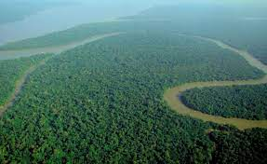
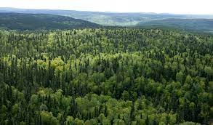
Forest Burned Area Mapping using Bi-Temporal Sentinel-2 Imagery Based on Convolutional Neural Network (Case Study: Golestan’s Forest)
1. Introduction
2. Study Area
3. Proposed Method
4. Result
5. Conclusion
Forest Area
Advantages
Forests nurture the soil
Forests absorb carbon
Forests provide food for millions
Forests are natural aqueducts
World's forests cover about 4 billion hectares.
Monitoring Forest Area

Slide 4
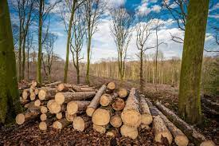
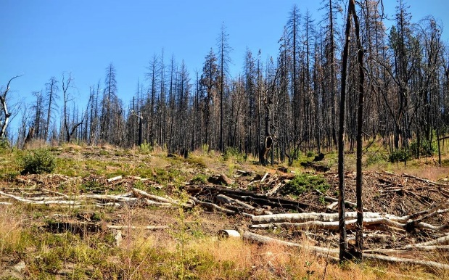
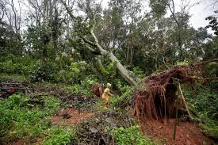
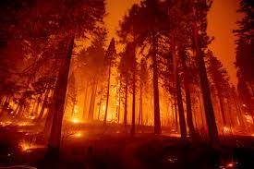
Forest Burned Area Mapping using Bi-Temporal Sentinel-2 Imagery Based on Convolutional Neural Network (Case Study: Golestan’s Forest)
1. Introduction
2. Study Area
3. Proposed Method
4. Result
5. Conclusion
Forest Destruction
Human Activity
Flood
Drought
Wildfire

Slide 5
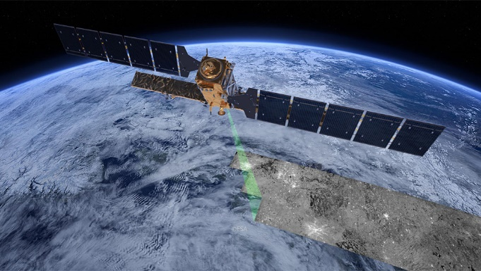
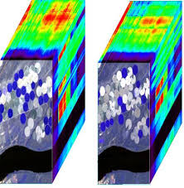
Forest Burned Area Mapping using Bi-Temporal Sentinel-2 Imagery Based on Convolutional Neural Network (Case Study: Golestan’s Forest)
1. Introduction
2. Study Area
3. Proposed Method
4. Result
5. Conclusion
Remote Sensing
Advantages:
Cost reduction, Fast, wide coverage
Operation System
Multispectral
Hyperspectral
SAR

Slide 6
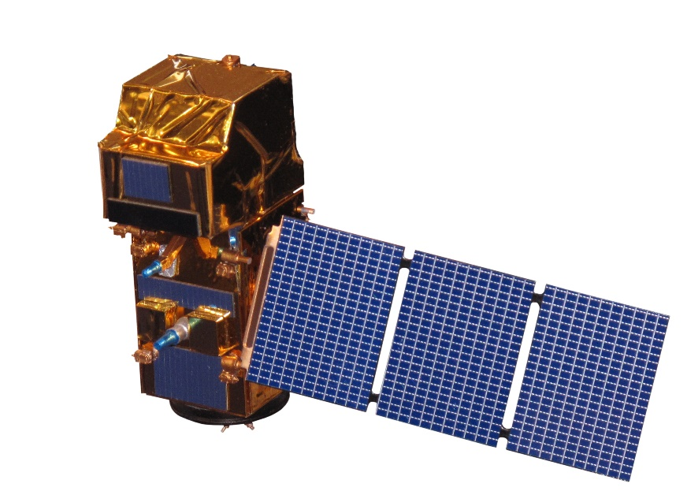
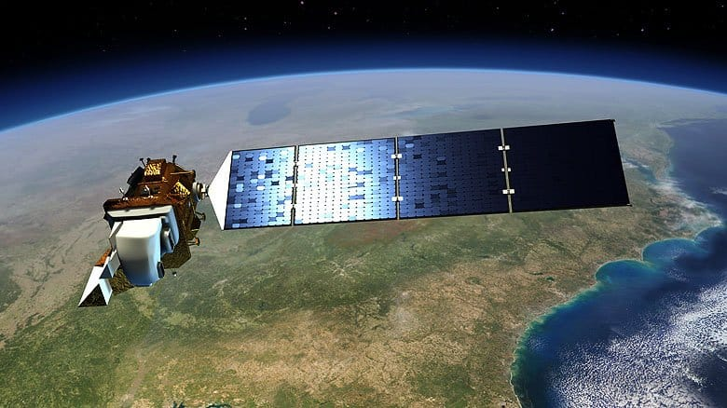
Forest Burned Area Mapping using Bi-Temporal Sentinel-2 Imagery Based on Convolutional Neural Network (Case Study: Golestan’s Forest)
1. Introduction
2. Study Area
3. Proposed Method
4. Result
5. Conclusion
Multispectral Remote Sensing Imagery
Sentinel-2
Landsat 8
Landsat-9

Slide 7
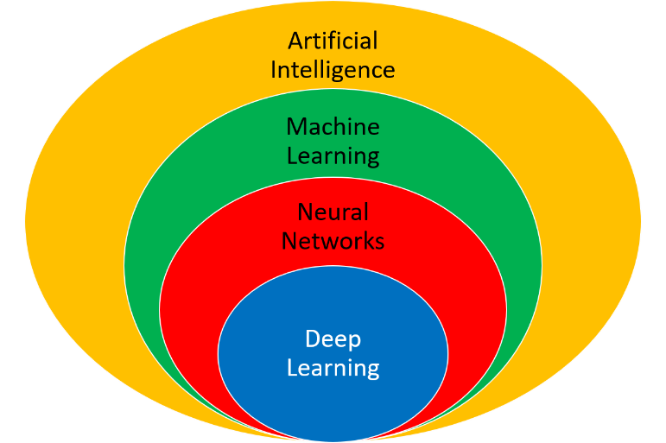
Forest Burned Area Mapping using Bi-Temporal Sentinel-2 Imagery Based on Convolutional Neural Network (Case Study: Golestan’s Forest)
1. Introduction
2. Study Area
3. Proposed Method
4. Result
5. Conclusion
Burned Area Mapping
Traditional Methods
SVM, Random Forest, KNN, MLP
Manually Feature Extraction (NDVI, BDI)
Thresholding
Deep Learning Based Methods
Automatic Feature Extraction
End-to-End Method
High Accuracy

Slide 8
Forest Burned Area Mapping using Bi-Temporal Sentinel-2 Imagery Based on Convolutional Neural Network (Case Study: Golestan’s Forest)
Study Area
Iran, Golestan’s Forest
North of Iran
October 2020
About 160 (Hectares) Burned
1. Introduction
2. Study Area
3. Proposed Method
4. Result
5. Conclusion

Slide 9
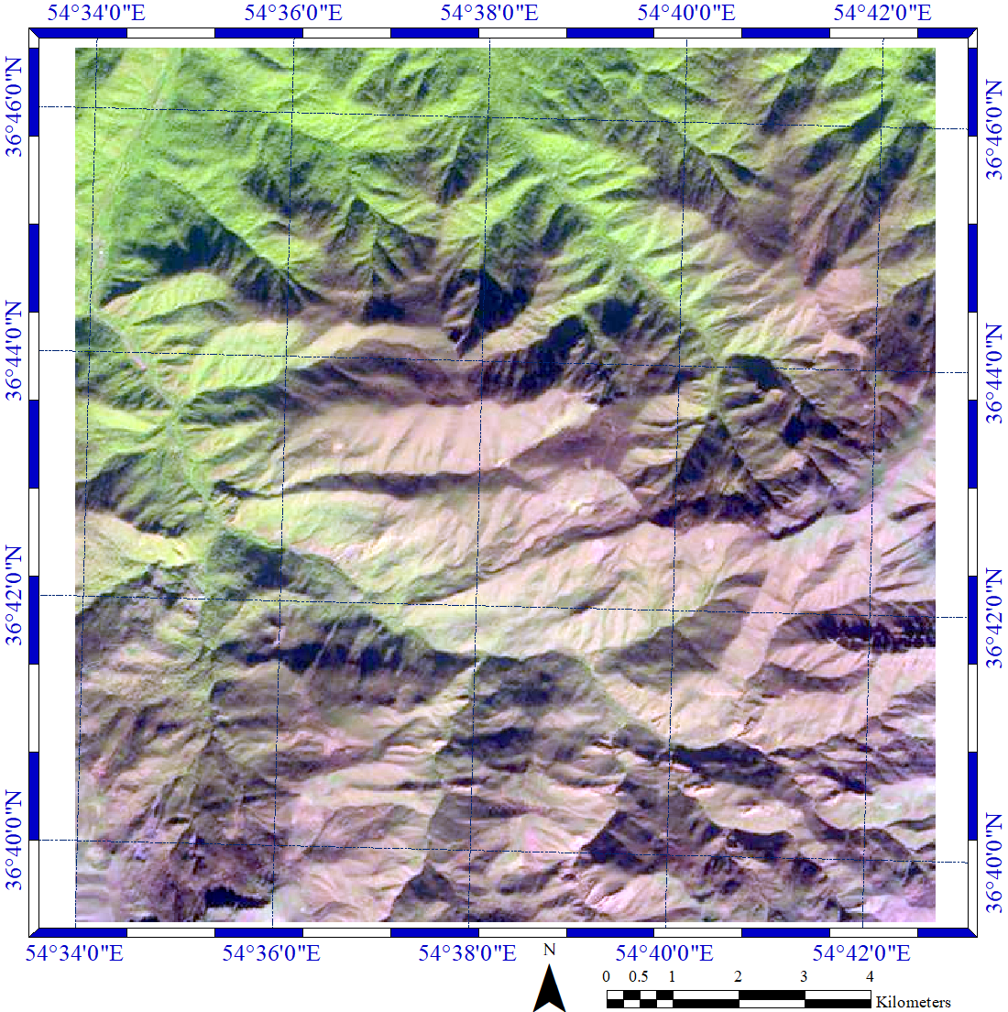
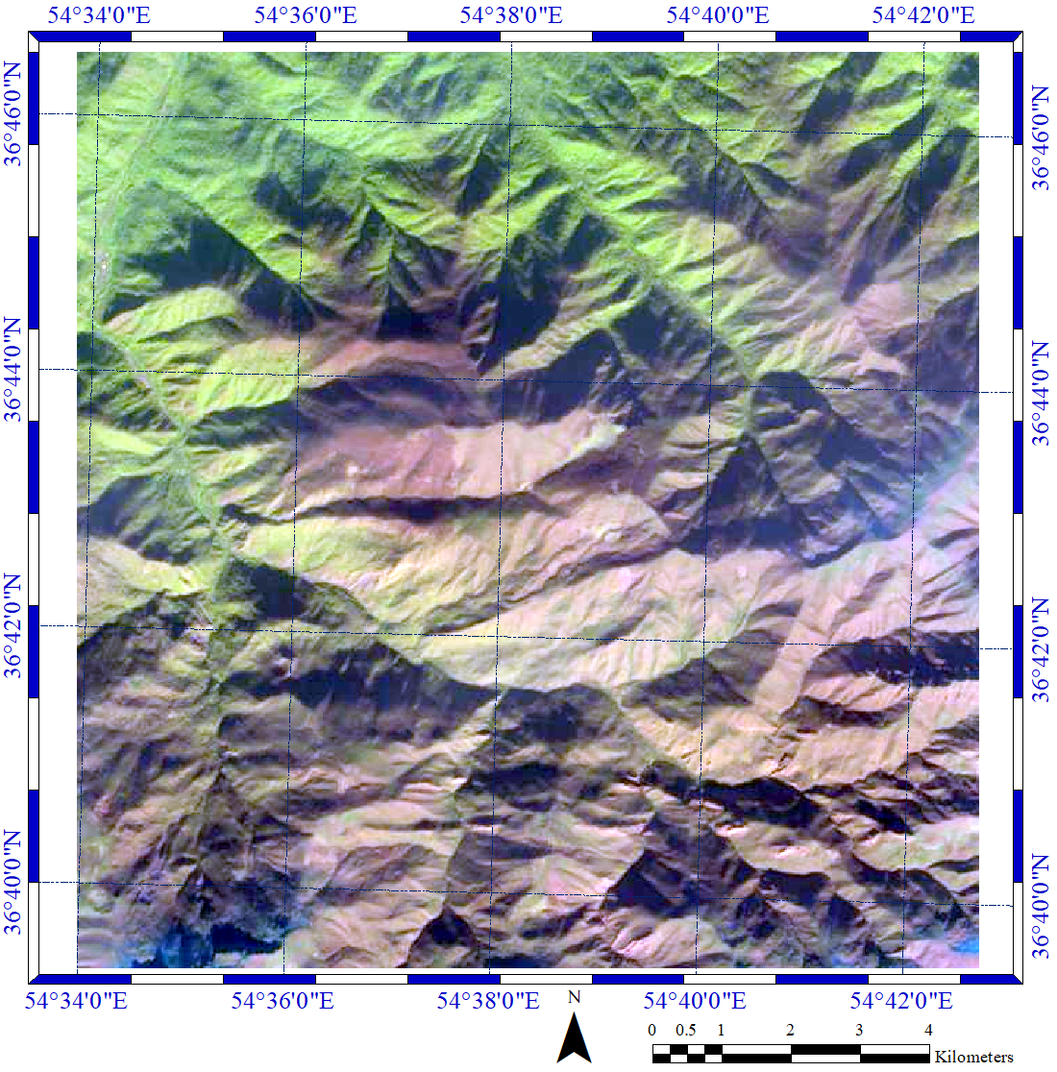
Forest Burned Area Mapping using Bi-Temporal Sentinel-2 Imagery Based on Convolutional Neural Network (Case Study: Golestan’s Forest)
Dataset
Sentinel-2
Pre-Fire, Post-Fire
1. Introduction
2. Study Area
3. Proposed Method
4. Result
5. Conclusion
The characteristics of dataset used in this research.
Type | Pre-Fire | Post-Fire
Data Size | 652×662 | 652×662
Number of Bands | 3 | 3
Spatial Resolution | 10 (m) | 10 (m)
Acquired Time | 31 October 2020 | 15 November 2020
(a) Pre-Fire
(b) Pre-Fire

Slide 10
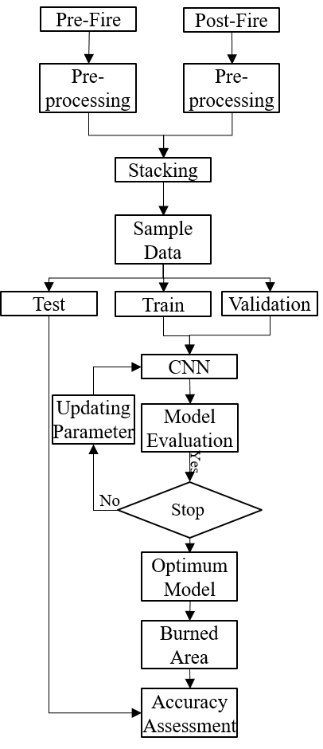
Forest Burned Area Mapping using Bi-Temporal Sentinel-2 Imagery Based on Convolutional Neural Network (Case Study: Golestan’s Forest)
1. Introduction
2. Study Area
3. Proposed Method
4. Result
5. Conclusion
General Framework
Pre-Processing
Model Training
Mapping
Accuracy Assessment

Slide 11
Forest Burned Area Mapping using Bi-Temporal Sentinel-2 Imagery Based on Convolutional Neural Network (Case Study: Golestan’s Forest)
1. Introduction
2. Study Area
3. Proposed Method
4. Result
5. Conclusion
Proposed Architecture
Feature Extractor
Classification

Slide 12
Forest Burned Area Mapping using Bi-Temporal Sentinel-2 Imagery Based on Convolutional Neural Network (Case Study: Golestan’s Forest)
1. Introduction
2. Study Area
3. Proposed Method
4. Result
5. Conclusion
Sample Data
Model Training: Training
Model Evaluation: Validation
Model Accuracy Assessment: Testing
Sample Data | Training | Validation | Testing
Burned Sample | 1,220 | 305 | 711
Not-Burned Sample | 1,108 | 276 | 461
Total Sample | 2,328 | 581 | 1,633

Slide 13
Forest Burned Area Mapping using Bi-Temporal Sentinel-2 Imagery Based on Convolutional Neural Network (Case Study: Golestan’s Forest)
1. Introduction
2. Study Area
3. Proposed Method
4. Result
5. Conclusion
Parameters Setting
Trial and Error
The optimum value of CNN parameters are: epochs= 500, weight initializer random, dropout rate=0.3, initial learning= 10-3, epsilon value =10-10, and mini-batch size=500, loss function= binary cross entropy, and optimizers= Stochastic gradient descent (SGD).

Slide 14
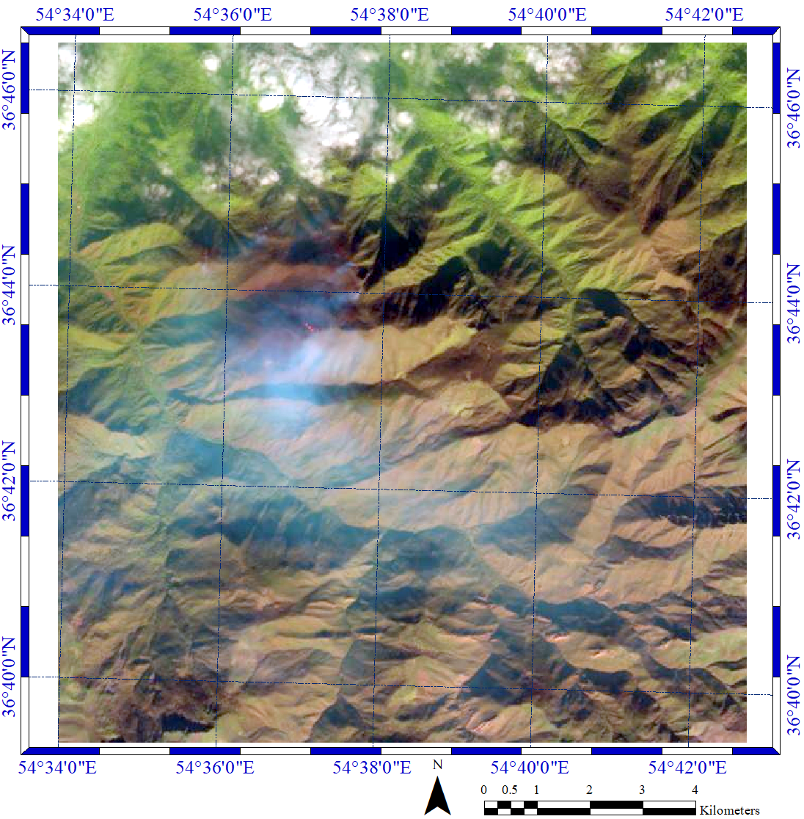
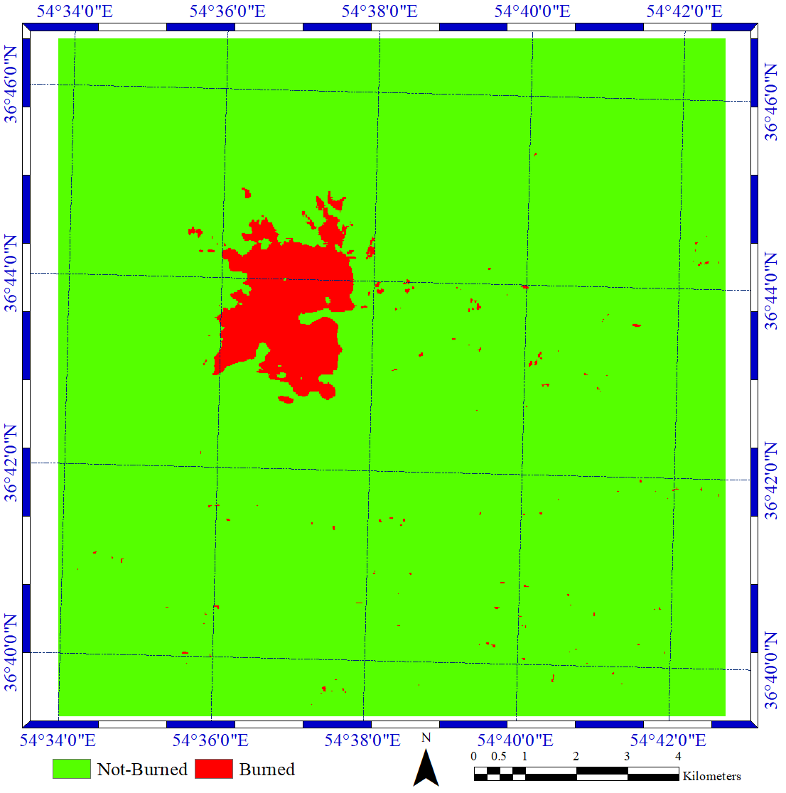
Forest Burned Area Mapping using Bi-Temporal Sentinel-2 Imagery Based on Convolutional Neural Network (Case Study: Golestan’s Forest)
1. Introduction
2. Study Area
3. Proposed Method
4. Result
5. Conclusion
Results

Slide 15
Forest Burned Area Mapping using Bi-Temporal Sentinel-2 Imagery Based on Convolutional Neural Network (Case Study: Golestan’s Forest)
1. Introduction
2. Study Area
3. Proposed Method
4. Result
5. Conclusion
Results
Accuracy Assessment:
Overall Accuracy: 91%
Burned Area: 168 (Hectares)

Slide 16
Forest Burned Area Mapping using Bi-Temporal Sentinel-2 Imagery Based on Convolutional Neural Network (Case Study: Golestan’s Forest)
1. Introduction
2. Study Area
3. Proposed Method
4. Result
5. Conclusion
High potential of Sentinel-2 in the burned area mapping.
CNN methods has provided high accuracy in mapping burned area.
Proposed framework is able to map the burned area only with 3 spectral bands.

Slide 17
Forest Burned Area Mapping using Bi-Temporal Sentinel-2 Imagery Based on Convolutional Neural Network (Case Study: Golestan’s Forest)
1. Introduction
2. Study Area
3. Proposed Method
4. Result
5. Conclusion
Thank you!

