Slide 1
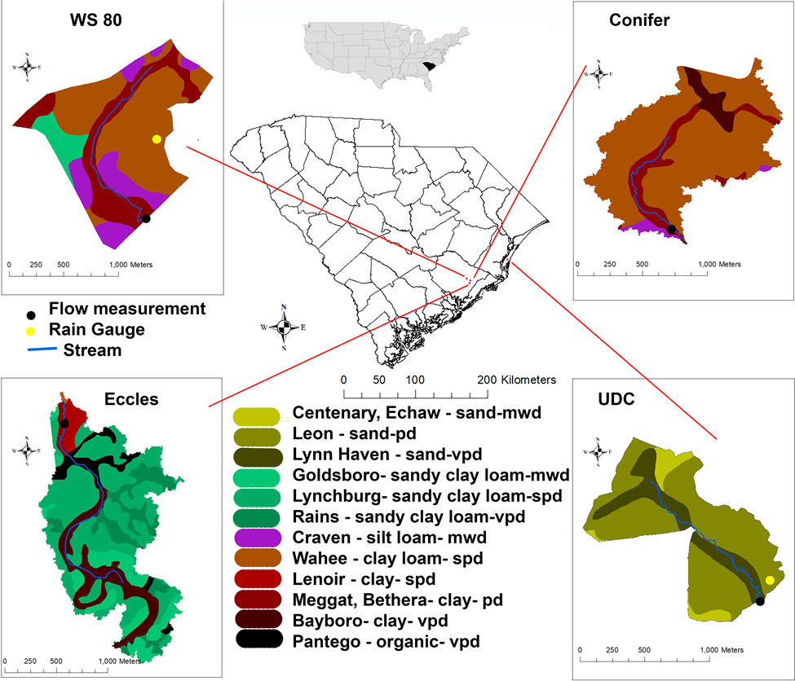
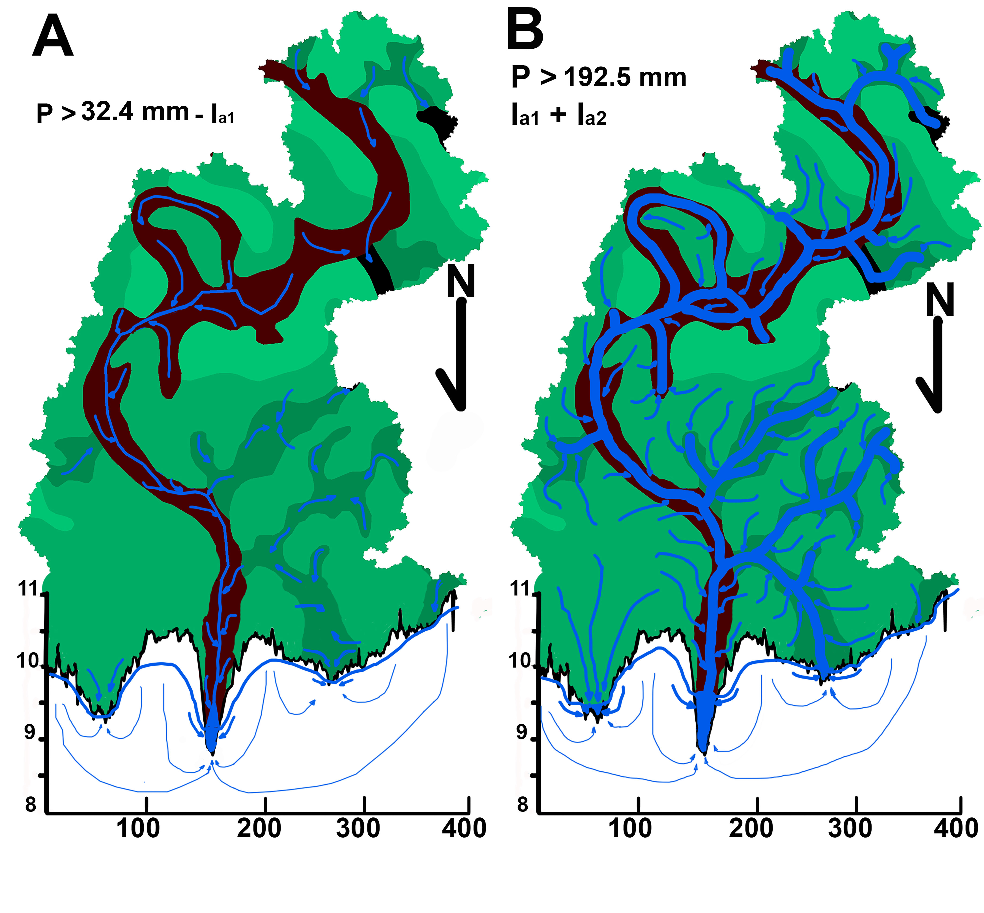
UNIVERSITY OF AGRICULTURE IN KRAKOW, POLAND¹
US FOREST SERVICE, U.S.A.²
COLLEGE OF CHARLESTON, U.S.A³
CLEMSON UNIVERSITY, USA⁴
ENGINEERING CONSULTANTS, CRAFTWATER ENGINEERING, U.S.A⁵
Storm Event Analysis of Forested Catchments on the Atlantic Coastal Plain using MSME, a Modified SCS-CN Runoff Model
Walega, A.¹, Amatya D.M.², Callahan T.³, Morrison A.³, Vulava V.³, Hitchcock D.R.⁴, Williams T.M.⁴, and Epps T.⁵
INTRODUCTION
RESULTS
The calibrated MSME model was able to accurately predict the estimated Q_{tot_pred} for the 2008-2011 storm events on the WS80 watershed, with calculated EF, RSR, and PBIAS of 0.80, 0.4, and 16.7%, respectively.
By applying the calibrated α value of 0.64 from the WS80 watershed to two other similar poorly drained watersheds, the MSME model satisfactorily predicted the estimated Q_{tot_pred} for both the Eccles Church (EF = 0.64; RSR = 0.57; PBIAS =28.9%) and Conifer (EF = 0.60; RSR = 0.58; PBIAS = 21.4%), watersheds, respectively. The MSME model, however, yielded unsatisfactory results (EF = -0.13, RSR = 2.06, PBIAS = 616.3%) on the UDC watershed with coarse textured deep sandy soils, indicating the likely association of the ‘α’ coefficient with soil drainage class, which was more clayey on three other watersheds.
Analysis linking water table elevation before the storm event, with the calibrated α for describing the proportion of saturated depth in soil profile, indicated a threshold for watershed-wide overland runoff generation. The results showed that Q_{surf_pred} is triggered only after rainfall and water table elevation reach their respective threshold values of 113 mm and 9.01 m, respectively, on WS80 (Fig. 2) but not on Eccles and Conifer watersheds. The WTE threshold was shown to be nearly the same for the three poorly drained watersheds but not on the well drained UDC watershed with lower site elevation.
These results demonstrate MSME model’s potential to predict direct runoff in poorly drained forested watersheds as reference for urbanizing coastal landscapes.
Event-based models using relatively readily available watershed parameters and rainfall data, like SCS-curve number (CN) originally developed for assessing surface runoff from upland agricultural catchments (Ponce and Hawkins, 1996; Soulis and Valiantzas, 2012), are often used for assessment of runoff (Q) and peak discharge (Q_{p}) from ungauged watersheds. However, there is a limited literature on their applications to evaluate event runoff on lands dominated by forest land cover, more so on flat coastal plain settings where most of the outflow (as shallow surface runoff and subsurface drainage) is driven by near-surface water or the shallow water table.
The main objectives of this study were (1) to calibrate the MSME model for the WS80 watershed, and (2) to validate its performance by predicting observed storm event Q_{tot} for the Conifer, Eccles Chuch and Upper Debidue Creek (UDC) watersheds without any calibration.
WATERSHEDS DESCRIPTION
Four first-order watersheds were studied: WS80 (1.60 km²), Eccles Church (2.10 km²), Conifer (1.15 km²), and Upper Debidue Creek (UDC) (1.00 km²). The hydrologic unit code (HUC) for the first three watersheds is 0305020103, and the HUC for UDC is 0302040804. The Eccles Church and Conifer watersheds within the third-order Turkey Creek (TC) watershed (52.4 km²) and the WS80 watershed (Fig. 1) are located in the USDA Forest Service Francis Marion National Forest (FMNF), approximately 60 km northeast of Charleston, SC (Morrison, 2016).
Both Turkey Creek and the first order watershed (WS80) are rural, forested watersheds with streams discharging to Huger Creek, a tributary of the East Branch of the Cooper River that ultimately drains into the Charleston Harbor (Fig. 1). The fourth watershed (UDC), located in coastal Georgetown County, South Carolina, is part of the freshwater portion of the Debidue Creek in the North Inlet estuary (Epps et al., 2013), and UDC drains into an area with existing suburban housing development and then into the North Inlet tidal saltwater estuary. All of these watersheds are characterized by low-gradient topography and shallow water table conditions.
Fig. 2. Relationships a) measured event total rainfall (P) and observed direct runoff (Q_{tot_obs}) and b) Q_{tot_obs} and predicted runoff (Q_{tot_pred}) for rainfall-runoff events, with a solid black line for 1:1 relationship, for the WS80 watershed.
Fig. 1. Location map of study watershed
Fig. 3. Conceptual diagram of runoff generation on the Eccles Church watershed in relation to MSME model results: a) situation where only shallow subsurface runoff is simulated, b) situation where both runoff (surface and subsurface) are simulated. Arrow sizes reflect volume of runoff.
MATERIAL AND METHODS
The model calibration was performed using 36 storm events from 2008 to 2015 on a 160-ha low-gradient forested watershed (WS80) on poorly drained soil. The model was further validated without calibration using data from 2011 to 2015 on two sites (115 ha (Conifer) and 210 ha (Eccles Church)) and from 2008-2011 on a third site, the 100 ha Upper Debidue Creek (UDC).
Direct runoff (Q_{tot_pred}) for all events on all four watersheds was predicted using the MSME model (Walega and Amatya, 2020). The model was also used to simulate both the subsurface saturated “streamside” (Q_{subs_pred}) and shallow “watershed-wide” surface overland runoff (Q_{surf_pred)} components of the direct runoff Q_{tot_pred}).
In the MSME model for this study, CN value was taken from published NRCS tables (USDA 1986) using the land cover and soil hydrologic group for different antecedent moisture conditions and a soil saturation coefficient ‘α’, obtained by calibration, was introduced to partition the Q_{tot_pred} into Q_{subs_pred} and Q_{surf_pred} (Walega and Amatya 2020).
The Nash-Sutcliffe (EF), RMSE-observations standard deviation ratio (RSR) and Percent bias (PBIAS) were used as goodness-of-fit measures to assess the performance of the models in predicting direct outflow
REFERENCES
Epps, T.H., Hitchcock, D.R., Jayakaran, A.D., Loflin, D.R., Williams, T.M., Amatya, D.M., 2013. Characterization of storm flow dynamics of headwater streams in the South Carolina lower coastal plain. J. American Water Resources Association. 49(1), 76–89.
Morrison, A.E., 2016. Storm Event Analysis at Varying Watershed Scales: Turkey Creek, Santee Experimental Forest, South Carolina. College of Charleston M.Sc. Thesis, Charleston, SC USA. 334 pp.
Ponce, V.M. & Hawkins, R.R. (1996). Runoff Curve Number: Has It Reached Maturity? J. of Hydrol. Eng. 1(1), 11–19.
Soulis, K.X., & Valiantzas, J.D. (2012a). Identification of the SCS-CN Parameter Spatial Distribution Using Rainfall-Runoff Data in Heterogeneous Watersheds. Water Resour Manage 27, 1737–1749.
USDA (1986). Urban hydrology for small watersheds. Tech. Release No. 55. Washington, DC: United States Department of Agriculture (USDA) Soil Conservation Service, Washington, USA.
Walega, A., Amatya, D.M., 2020. Modification of the SME-CN method for predicting event runoff and peak discharge from a drained forest watershed on the North Carolina Atlantic Coastal Plain. Trans. ASABE. 63(2). DOI: 10.13031/trans.13838.

