Slide 1
Effect of Clay Content on Sediment Suspension over Liquefied Sand-clay Mixed Bed under Waves
ECWS
2021
The 6th International Electronic
Conference on Water Sciences
15-30 NOVEMBER 2021|ONLINE
${\text{Jun} \text{Zhang}}^{a}$, ${\text{Qin} \text{Jiang}}^{a, ∗}$, ${\text{Changkuan} \text{Zhang}}^{a}$, ${\text{Lizhu} \text{Wang}}^{b}$
a. College of Harbor, Coastal and Offshore Engineering, Hohai University. Nanjing, Jiangsu, China
b. School of Marine Science and Engineering, Nanjing Normal University, Nanjing, Jiangsu, China

Slide 2
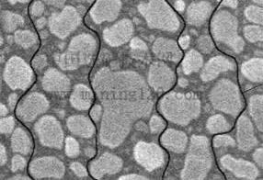
Introduction
Waves play a crucial role in sediment transformation
Some studies found the influence of pore pressure inside sandy seabed on sediment suspension
Previous studies focused on sediment incipient motion on clayey seabed surface
Seepage
Tzang et al. (2009), Cheng et al. (2012) and Jia et al. (2014) considered that excess pore-water pressure (EPP) accumulated under waves would cause not only seabed liquefaction but also net upward seepage flow. The seepage flow would take fine particles within bed to the water.
Mehta and Lee (1992) pointed out that sediment particles were moved by the lifting force, drag force, buoyant weight and cohesive force
However!
Few studies paid attention to the liquefaction (EPP accumulation) on sediment suspension of clayey bed

Slide 3
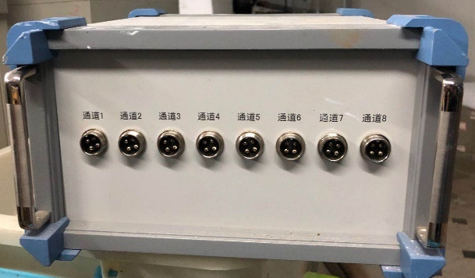
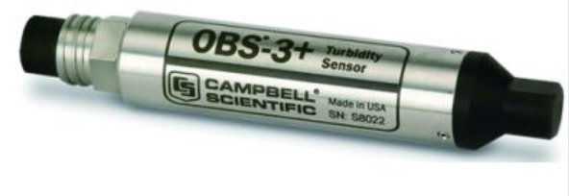
Methods
Wave flume experiments
CC of sand-clay bed: 2.4%,
4.9%, 7.7%, 9.9% and 14.2%
Water depth: 0.45m
Wave height: 0.14 m
Wave period: 1.6 s.
To clarify the influence of clay content (CC) on SSC above sand-clay seabed. Flume experiments were executed with fixed wave condition and various CC.
Sensors
Data collector
To record sediment suspension concentration (SSC)
To record pore-water pressure

Slide 4
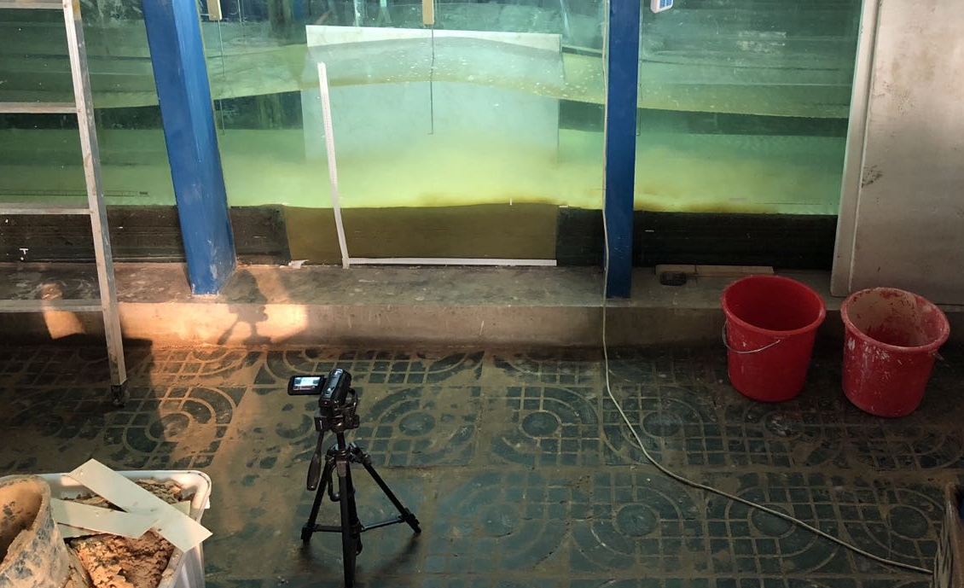
Methods
Tanks to mix soil samples
Calibration of OBS 3+ sensor
Handheld
mixer
Liquid clay
Mixer
OBS 3+
Clay + Water
Small tank
Mixing
Mixture of water and soil sample
Sand
Big tank
Bucket
A known quantity of well-mixed dry soil sample was dispersed into the bucket and was suspended in the water by mixer stirring. Meanwhile, OBS signal changes induced by increased SSC were recorded by the connected computer. This process was repeated with known increments of soil sample and the OBS signal were recorded and time-averaged accordingly.
The liquid clay was added into the mixing tank and running the mixer to form a uniformed soil sample. The prepared soil sample was placed in the trench of the flume subsequently.
2K camera to record experimental video

Slide 5
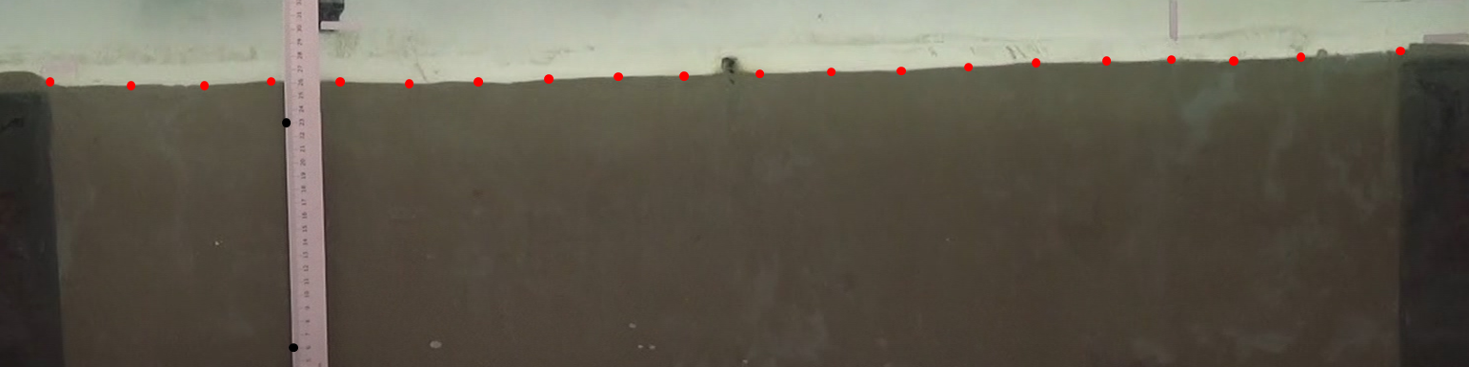
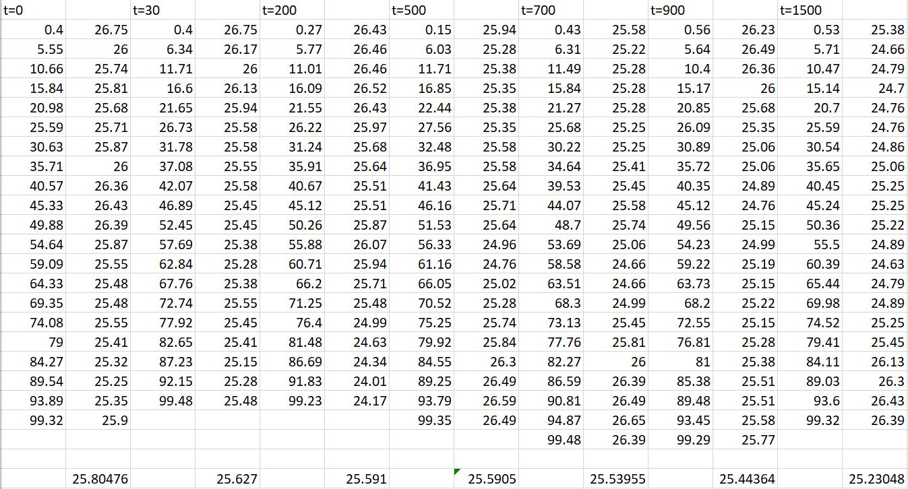
Methods
Measurement of seabed elevation
Seabed elevation
70s
200s
500s
700s
900s
1500s
Marks of ruler
CC4.9 t=70s
GetData APP
CC4.9 t=200s
Screenshots
from 2k video
Different time points
Coordinates of
elevation points
CC4.9 t=1500s
Average elevation
of CC4.9 at t=0

Slide 6
Results and Discussion
Seabed response under waves
Tzang (2009)
Sandy bed
Cheng (2012)
Sandy and Silty bed
Jia (2014)
Silty bed
CC (%) | ${\text{P}}_{\text{acc}}$ (kPa) | ${\text{σ}}_{\text{0}}$ (kPa) | SSC (g/L)
0 | 0.067 | 1.226 | 6.629
2.4 | 1.705 | 1.154 | 5.879
4.9 | 1.544 | 1.118 | 2.651
7.7 | 1.519 | 1.096 | 1.952
9.9 | 0.928 | 1.065 | 1.033
14.2 | 0.622 | 1.023 | 0.32
SSCliquefied>SSCnon-liquefied
Liquefaction
occurred
Cohesionless
seabed
This study
SSCliquefied>SSCnon-liquefied
Critical mean normal
effective stress
Seabed liquefy when
${\text{P}}_{\text{acc}}$ is bigger than ${\text{σ}}_{\text{0}}$
CC2.4-7.7
CC9.9-14.2
Clay content of
sand-clay mixed bed
Accumulation of
EPP at z=0.23m in
mixed bed with
different CC
WHY?
Suspended
sediment
concentration
SSCliquefied<SSCnon-liquefied
CC2.4-7.7
Sand

Slide 7
Results and Discussion
Sediment incipient motion
The horizontal force of sediment particle is almost unchanged, cause the wave condition and water depth are unchanged. So, the vertical force on particle should be analyzed.
The lifting force caused
by EPP accumulation
$$F_{L}=\frac{πD^{2}}{4}\frac{P_{acc}}{z}$$
Vertical forces on sediment particle
The drag force
CC (%) | $F_{L}$ (kPa) | $F_{c}$ (kPa) | W (kPa) | $F_{v}$ (kPa)
0 | 0.29 | 0 | 1.91 | -1.62
2.4 | 7.41 | 2.35 | 1.86 | 3.2
4.9 | 6.71 | 4.73 | 1.83 | 0.15
7.7 | 6.60 | 7.11 | 1.82 | -2.33
9.9 | 4.03 | 9.49 | 1.80 | -7.26
14.2 | 2.71 | 13.58 | 1.77 | -12.64
$$F_{D}=C_{D}\frac{πD^{2}}{4}\frac{ρ_{w}U_{fm}}{2}$$
Easy to
move
Hard to
move
The buoyant weight
The cohesive force
Dafalla’s (2013)results
were used here
Particles on the seabed surface with 2.4% and 4.9% CC were improved to suspend to the water, particles on the seabed surface with 9.9% and 14.2% CC were hard to move, and ${\text{F}}_{v}$ of CC7.7 is similar to that of sandy bed.
$$W=\frac{gπD^{3}}{6}γ′$$

Slide 8
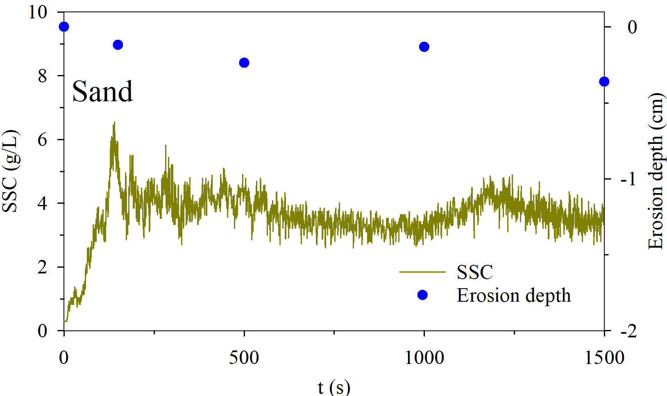
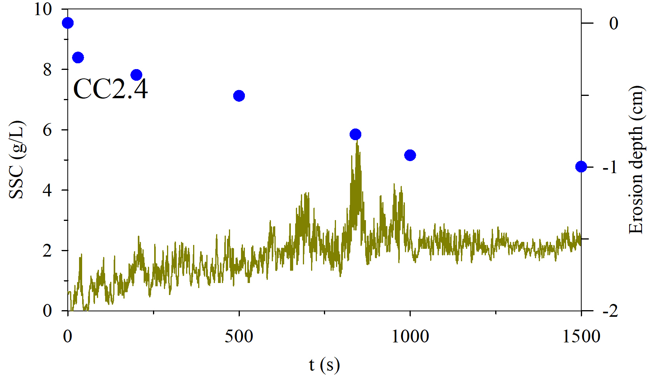
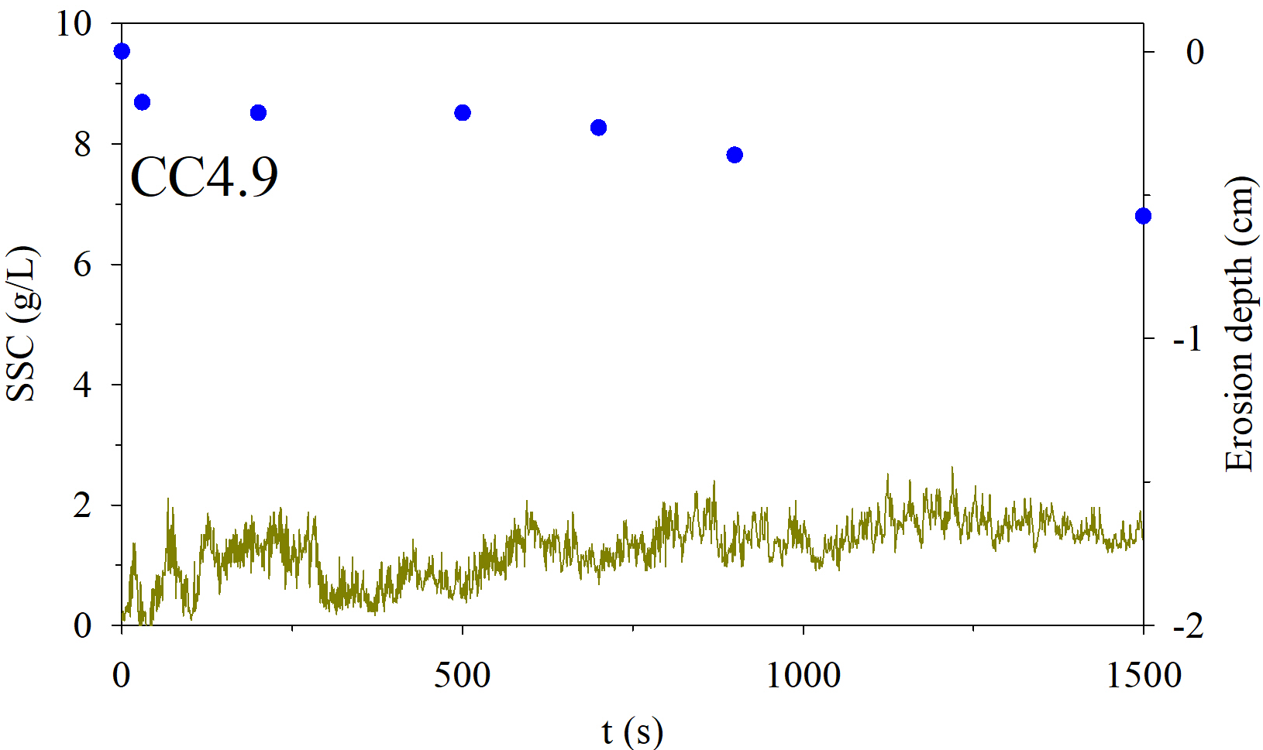
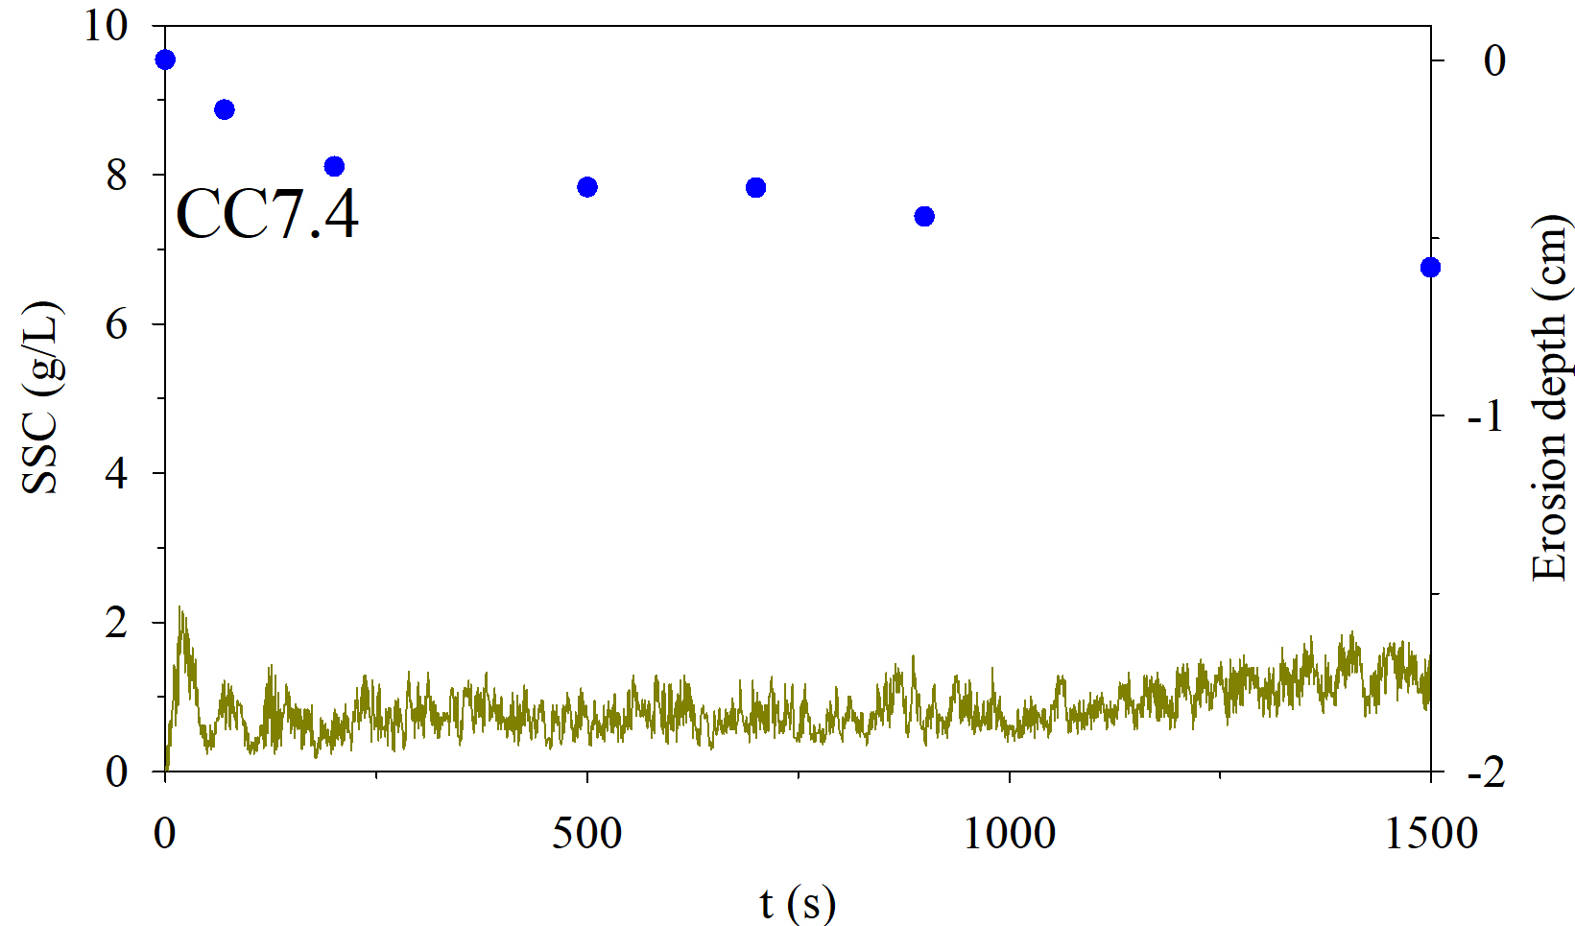
Results and Discussion
Erosion of mixed bed
SSCSand>SSCmixed
Erosion depthSand<Erosion depthmixed
The net upward gradient generated by EPP accumulation in the liquefied bed, which made more fine particles on bed surface or within bed suspended to the water compared with sandy bed.
But the cohesive force by clay made particles moved near the bed.
The sensor measured SSC in this study was set 3.5cm above the bed and it was set 1cm above bed in Tzang’s study. As the result, high density suspended sediment near bed surface was not detected by the OBS sensor over the liquefied bed.
Variation of SSC and seabed elevation
Seabed with 9.9% and 14.2% CC were not shown here, cause seabed elevation of these cases were unchanged.

Slide 9
Conclusion
1) The sediment incipient motion of mixed bed was mainly influenced by the cohesive force and lifting force in this study. Particles on the mixed bed with less than 5% CC suspended easily compare with sandy bed;
2) The SSC above the mixed bed decreased with the increase of CC, and the measured SSC of mixed beds are all less than that of sandy bed;
3) The elevation of non-liquefied mixed beds (CC9.9-14.2) were almost unchanged under waves due to the high cohesive strength among particles. The erosion of liquefied beds (CC2.4-7.7) were more than that of sandy bed, because the accumulation of EPP made more sediments suspended to the water.

Slide 10
Thanks for watching!

