Slide 1
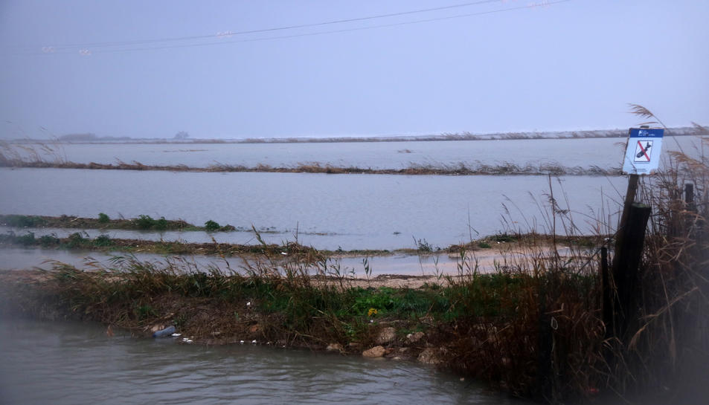
SLR-induced enhancement of the role of surges in coastal flooding in the Ebro delta.
R. Romero, M. Sanuy & J.A. Jiménez
^{rut.romero@upc.edu}
Laboratori d’Enginyeria Marítima
Universitat Politècnica de Catalunya·BarcelonaTech
Barcelona, Spain

Slide 2
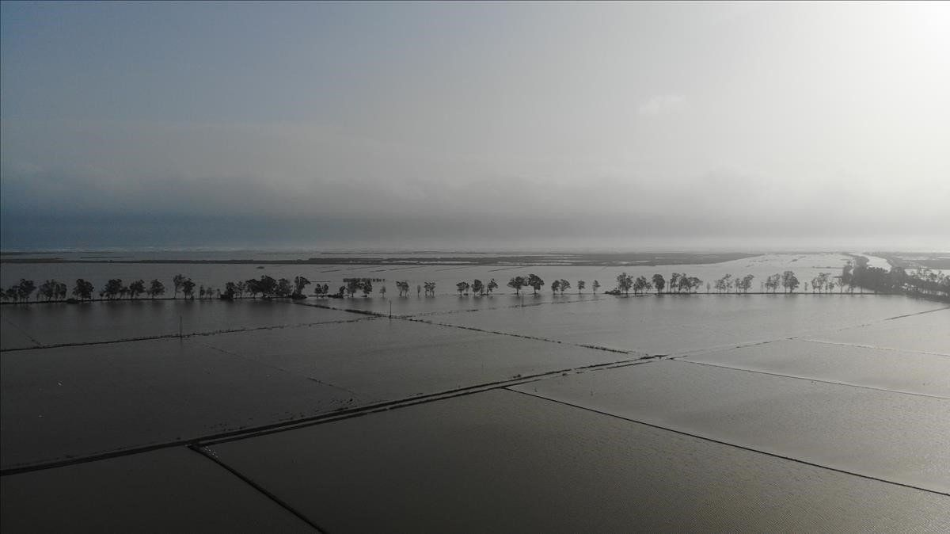
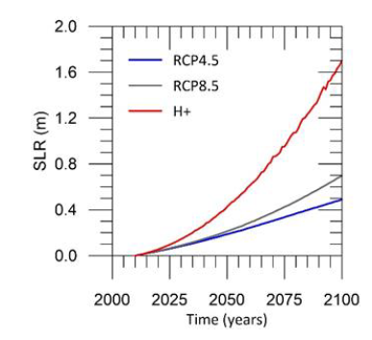
Introduction
SLR
Subsidence
↑ Flooding (frequency & intensity) of low-lying deltaic areas
Storms
Inundation of the Ebro delta plain during the impact of Gloria storm (01/2020) (source: El Periodico)
SLR projections (López-Doriga & Jiménez, 2020)
The increasing flooding (intensity & frequency) of low-lying coasts under the influence of sea level rise can be considered a serious threat, as it is a precursor to their permanent inundation and submergence (Nicholls, 2002).

Slide 3
One of the most sensitive areas to this impact are lowlands along the NW Mediterranean coasts, specially those sheltered from wave action and subjected to low-magnitude storm surges (max surges up to approx. 0.5 m ) which are seldomly inundated except under the impact of extreme storms.
Under these conditions, small changes in mean water level may imply a drastic change in their inundation regime, and as a consequence, in their risk profile to flooding.
Objective
To assess the influence of sea level rise on the storm surge-induced inundation regime (intensity) in a highly sensitive low-lying area of the Mediterranean, the Ebro delta.

Slide 4
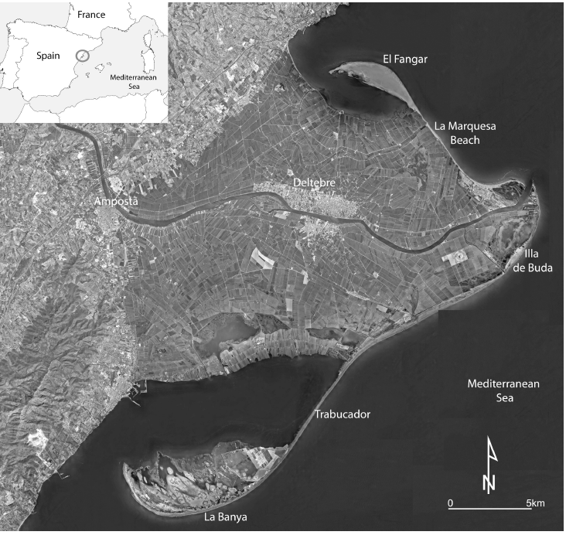
Study area
Ebro delta
NW Mediterranean
Microtidal range → 0.2 m
Low-lying area → (about 50 % of the plain below + 0.5 m elevation)
Main land use → 75% agriculture (rice)
Plain crisscrossed by channels and levees for rice fields.
Focus on Fangar Bay (passive shoreline) and sheltered from wave action.

Slide 5
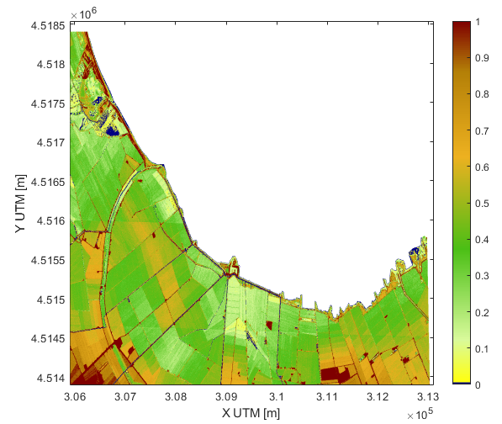
Inundation modelling
Strategy
Inundation modelling of the internal coast of the bay under the impact of an extreme storm solely by storm surge under current conditions and under given SLR scenarios.
LISFLOOD-FP (Bates et al. 2005)
Acceleration solver → convective acceleration negligible
Manning’s coefficient → arable soil
Without infiltration (water saturated soil)
Storm boundary conditions → complete time series of mean water level recorded during Gloria storm (96 h) (Puertos del Estado) (water level elevation record)
Water level scenarios → Storm surge/Total water level + 0, 5, 10, 15, 20 cm (to test impact of relatively low SLR)
Topography: DTM 5 x 5 (ICGC)

Slide 6
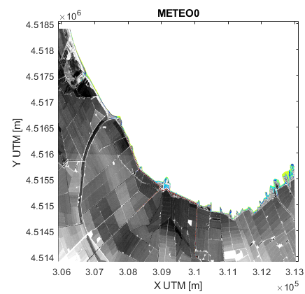
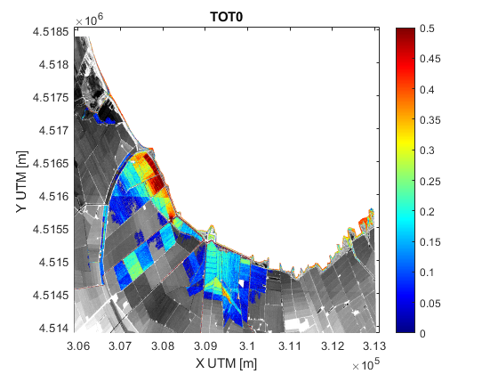
Results
Current conditions
Storm surge
Total Water Level

Slide 7
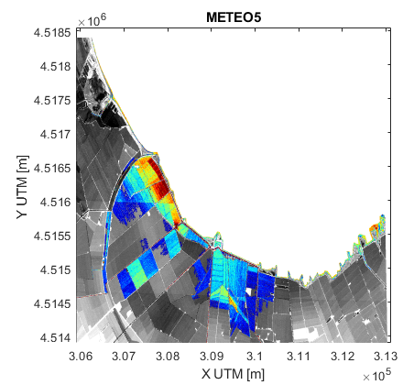
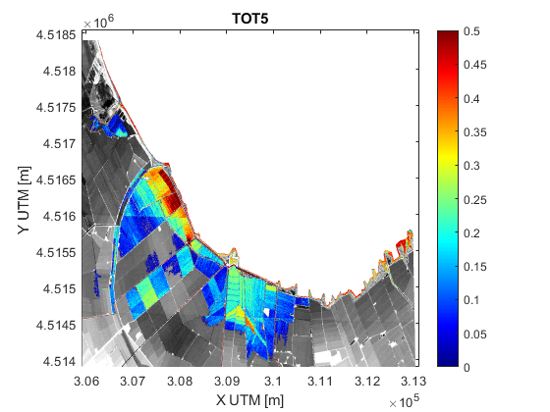
Results
SLR 5 cm
Storm surge
Total Water Level

Slide 8

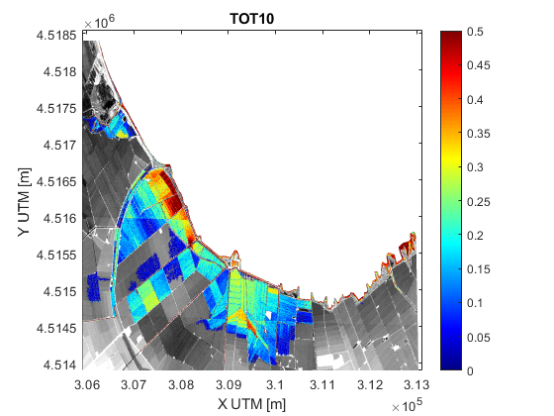
Results
SLR 10 cm
Storm surge
Total Water Level

Slide 9

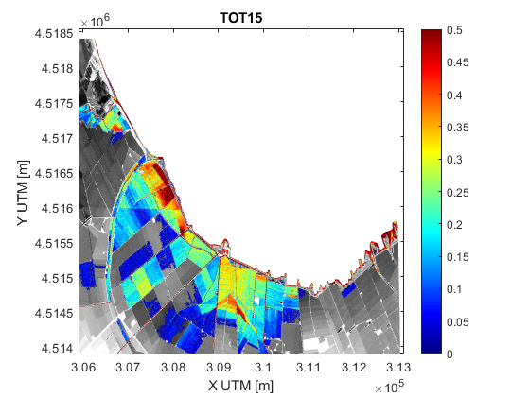
Results
SLR 15 cm
Storm surge
Total Water Level

Slide 10
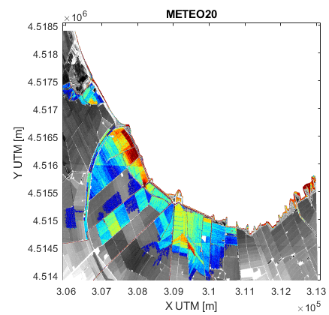
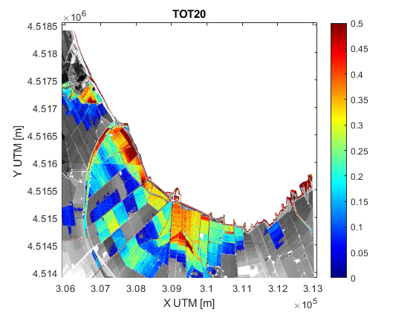
Results
SLR 20 cm
Storm surge
Total Water Level

Slide 11
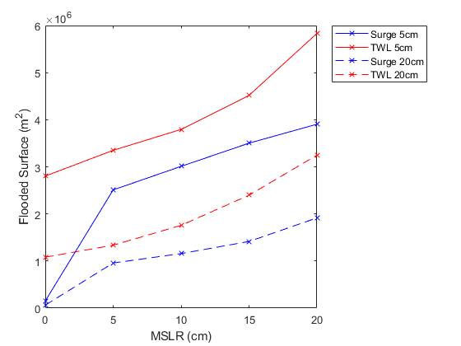
Results
Even though it is a microtidal environment, due to small magnitude of surges, the synergic action of astronomical tide and storm-surge is the driving force to flood the delta along the sheltered areas (without wave action).
Small variations in MWL induce significant increases of the flooded surface by storm surges. changes
The increase in MWL of 20 cm potentially doubles the surface flooded in the area.
Evolution of the surface flooded by storm surge under different SLR scenarios.

Slide 12
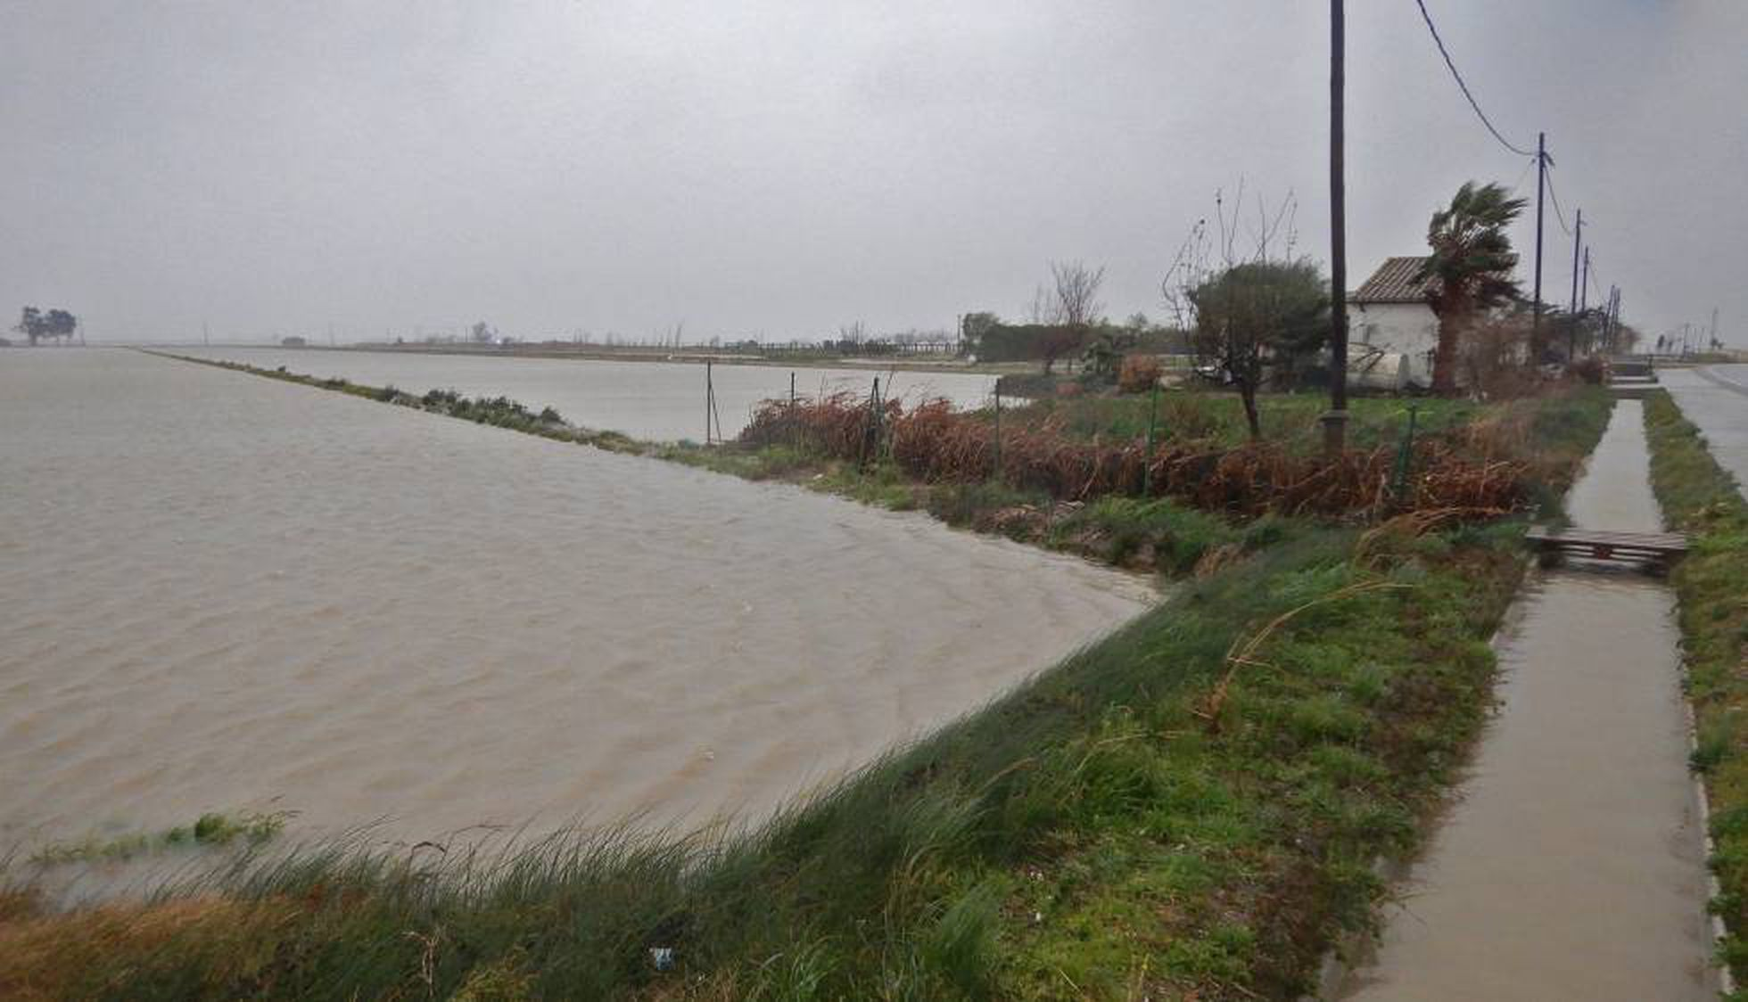
Results
The extension of the inundation in the deltaic plain is conditioned by the existence of a dense network of canals and dikes/levees associated with the rice pads, so that the extent of flooding is not necessarily proportional to the increase of water level →
  This is reflected in the results for cases of a SLR > 10 cm, where no proportional increase in flooded area is observed (faster increase).
(source: El Pais)

Slide 13
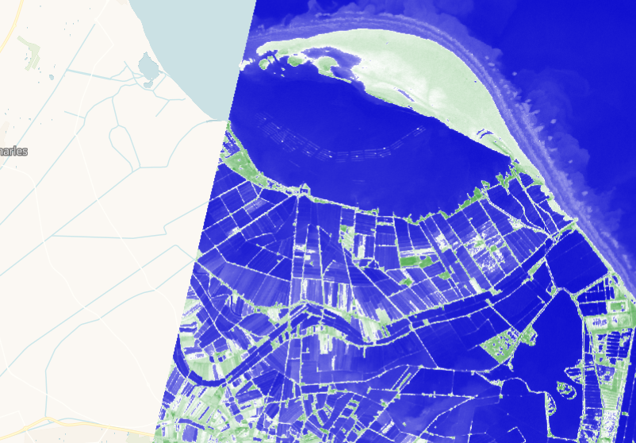
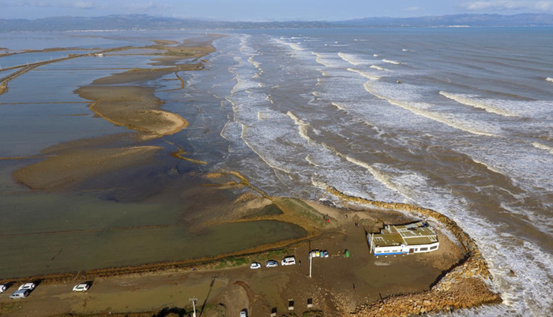
Results
In addition to the storm-surge component analyzed here, under the impact of extreme storms, the wave-induced breaching and overtopping of a narrow and low-lying beach will contribute significantly to floodwater volumes entering the deltaic plain.
(source: ACN)

Slide 14
Conclusions
Under current conditions, the inundation of the Ebro delta through sheltered areas such as inner bays during storms is mainly restricted to very extreme conditions where the synergic action of a small astronomical tide and highest values of storm surges contribute to total water levels exceeding the required threshold to inundate the area.
When considering the effect of sea level rise, the magnitude of the storm-induced flooding will significantly increase even under low SLR rates (e.g. for tested conditions, the inundated surface will double under just a SLR of 20 cm). This is critical since the inner shoreline along the bays is passive, and will not react/adapt to SLR (as the outer coast will do). Thus, it is expected an increase of the importance of these type of events in the area at a relatively short time horizon.
The existing network of channels and dikes segmenting the deltaic plain modulates the extension of the inundation as floodwater will be distributed through channels and/or confined within pads. This permits a rapid distribution of floodwater through the plain (reaching relative distant locations) but, at the same time, could be used to design “easy-to-implement” adaptation measures such as floodgates.

Slide 15



Acknowledgements
M-CostAdapt Project
http://mcostadapt.upc.edu
CTM2017-83655-C2-1-R
Data
Puertos del Estado
Institut Cartogràfic i Geològic de Catalunya

