Slide 1
6th International Electronic Conference on Water Sciences
MEASUREMENTS OF WAVE REDUCTION DUE TO ARTIFICIAL REEF WITH VARYING WIDTH ON AN ATOLL
Thuy Pham Thi^{1*}, Trung Le Hai ^{2*} , Tung Tran Thanh²
Ha Noi, 2021

Slide 2
Contents
1
Introduction
2
Experiment design
3
Results and discussion
4
Conclusions

Slide 3
1
Introduction
Coral reef types (Spalding, et al 2001) (M. S. M. D. Spalding, 2001)

Slide 4
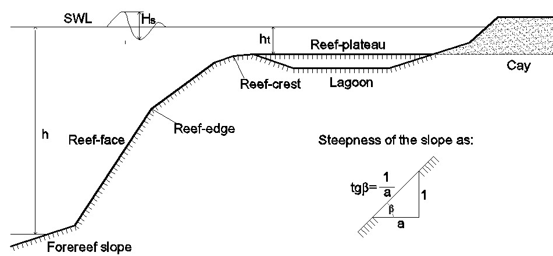
1
Introduction
A representative cross-section of a coral reef

Slide 5
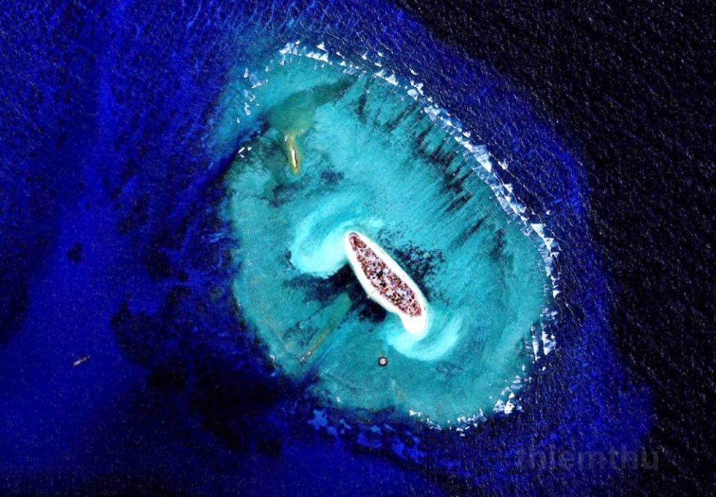
1
Introduction
A cay at Spratly Islands

Slide 6
1
Introduction
Previous researches about wave transmission:
Focused on the bio-environmental aspects of the reef.
But the hydrodynamic regime on the reef; The effects of reefs (height, width, porosity, etc.) on wave characteristics should also be considered.

Slide 7
1
Introduction
I. The purpose of this article
The 2D physical Model in wave flume:
Study the influence of some parameters of the reef on the wave propagation characteristics on the reef flat (B, Kr, wave spectrum).
Making recommendations on the effective reef width for wave reduction purposes.

Slide 8
2
Experiment design
Experiment set up

Slide 9
2
Experiment design
Table 1. Matrix of experimetal program
Model |  |  |  | Prototype
B(m) | Hs (cm) | Tp (s) | Rc (cm) | B(m) | Hs (cm) | Tp (s) | Rc (m)
1.90 | 10 | 1.5 | 0 | 28.5 | 1.5 | 5.81 | 0
1.50 | 12 | 1.7 | 5 | 22.5 | 1.8 | 6.58 | 0.75
1.20 | 15 | 1.8 | 10 | 18.0 | 2.25 | 6.97 | 1.5
0.80 | 18 | 1.9 |  | 12.0 | 2.7 | 7.36
0.45 | 20 | 2.1 |  | 6.8 | 3 | 8.13

Slide 10
3
Results and discussion
3.1. Wave spectrum variation across reef flat
Wave energy spectra Rc=10cm; H_{s} =12cm; T_{p}=1.9s

Slide 11
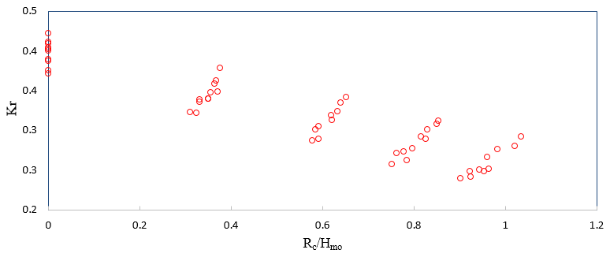
3
Results and discussion
3.2. Reflection wave
Figure 4. Relationship between Kr and Rc/Hmo when B=2m

Slide 12
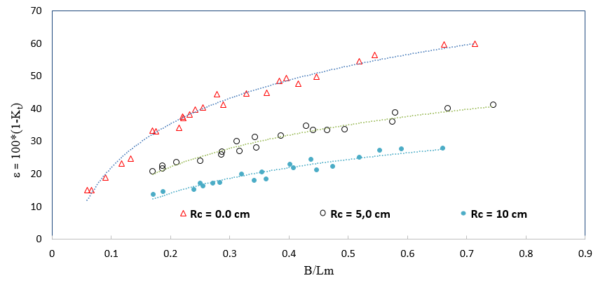
3
Results and discussion
3.3. Wave reduction due to artificial reef with varying width
Figure 4. Relationship between Kr and Rc/Hmo when B=2m

Slide 13
3
Results and discussion
3.3. Wave reduction due to artificial reef with varying width
+ B/L_{m} <0.2 (less than 03 rows of Reef Ball), Rc =0; ε%~15%-25%, the reef width is not less than 0.2L_{m}
+When the width of the reef crest rise, the wave reduction efficiency saw an increase dramatically of over 60%
+ B/L_{m} approaches to over 0.6. The trend of the graph tends to stretch horizontally.
It is recommended that the effective range of B :
1/5L_{m} ≤ B ≤ 03/5L_{m}.

Slide 14
4
Conclusions
When propagating from deep water into the platform, most of waves brake. Waves enormously attenuate, the secondary waves are formed and continue to transmit on the reef flat.
Moving on the reef flat of shallow water, the wave spectrum tends to stretch out towards the low frequencies. After passing through the field of Reef Balls, the wave spectrum becomes broader and lower.
Measurements derived reflection coefficient Kr varying between 0.25 and 0.42. Compared with other types of breakwaters, Reef Balls have a considerable ability to absorb incoming waves.
Due to the low water depth on the reef flat, wave reduction is governed more considerably by the field width rather than the freeboard of the Reef Balls. Experimental results indicate that the effective width of the Reef Balls field should be in order of 1/5 to 3/5 of the shallow water wave length.
To conclude, the obtained observations and measurements optimize the design of a Reef Balls field regarding wave reduction effect

