Slide 1



6th International Electronic Conference on Water Sciences (ECWS-6)
Coastal flood risk analysis in Turkey's Black Sea Region
Autors: Emilia Avram, Daniel Constantin Diaconu, Mustafa Tufekcioglu

Slide 2
1. Scientific context
6th International Electronic Conference on Water Sciences (ECWS-6)
A large proportion of the world's population lives in coastal areas and more people are expected to live in areas that are vulnerable to the effects of climate change [1-4].
As in many other parts of the world, floods are some of the most devastating extreme events in Turkey, often resulting in significant losses. In many cases floods have caused deaths, injuries and health deterioration [6].
Climate change is a major global problem with significant negative effects for coastal settlements. Risks include sea-level rise, increased frequency and intensity of storms [5].
The Geographic Information Systems (GIS) has had a significant role in flood hazard assessment and the identification of areas prone to floods and it is a crucial element for any mitigation strategy to the flood risk [7,8].
A vulnerability assessment of Turkey coastal areas regarding sea-level rise is needed both as part of coastal management policies for sustainable development and as a guideline for resource allocation for preparation of adaptation for the upcoming problems [9].

Slide 3
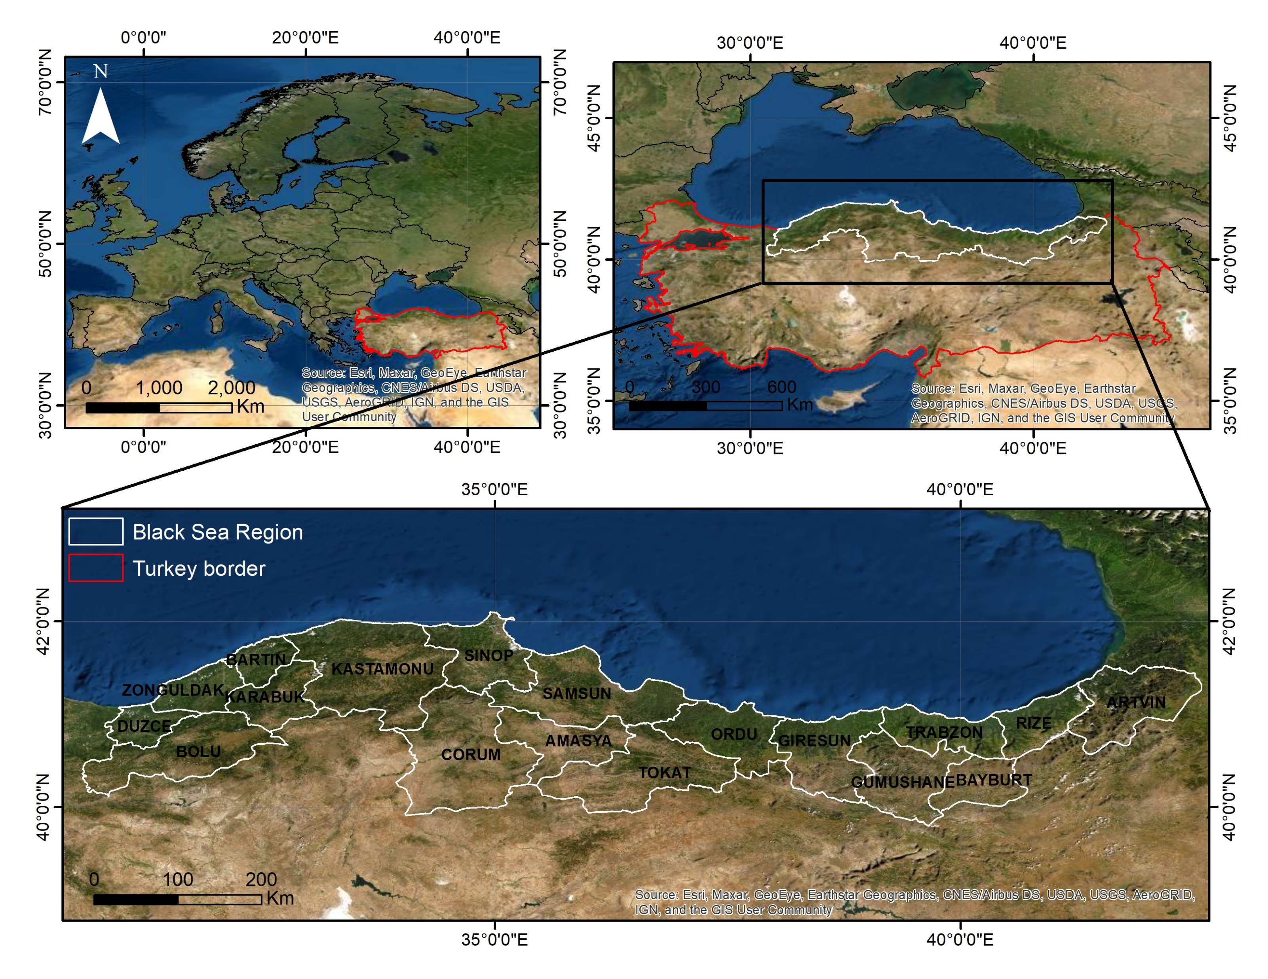
2. Study area
6th International Electronic Conference on Water Sciences (ECWS-6)
Figure 1. Study area

Slide 4
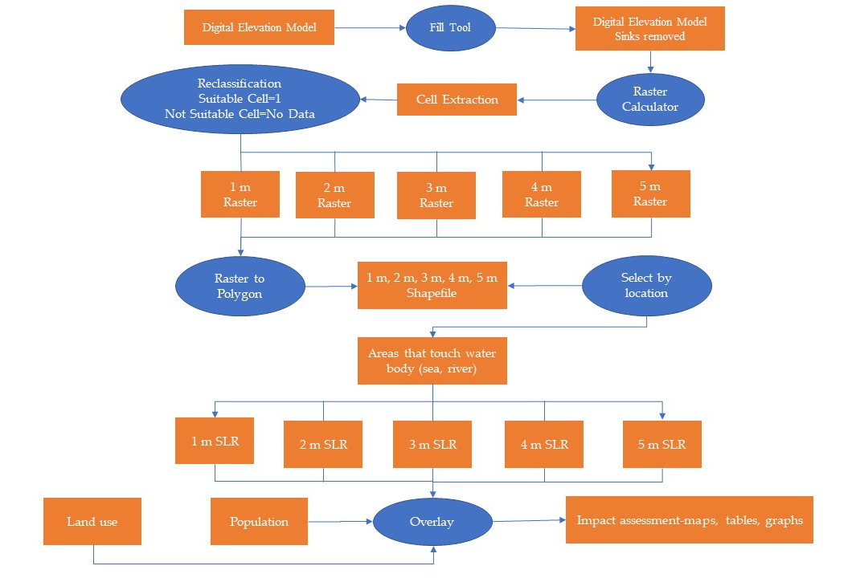
3. Methodology
6th International Electronic Conference on Water Sciences (ECWS-6)
Step 1
DEM processing
Step 2
Raster calculator and reclassification
Step 3
Raster to polygon and sea level rise scenarios
Step 4
Analysis the impact on the study area through spatial analysis
Figure 2. Methodology flowchart

Slide 5
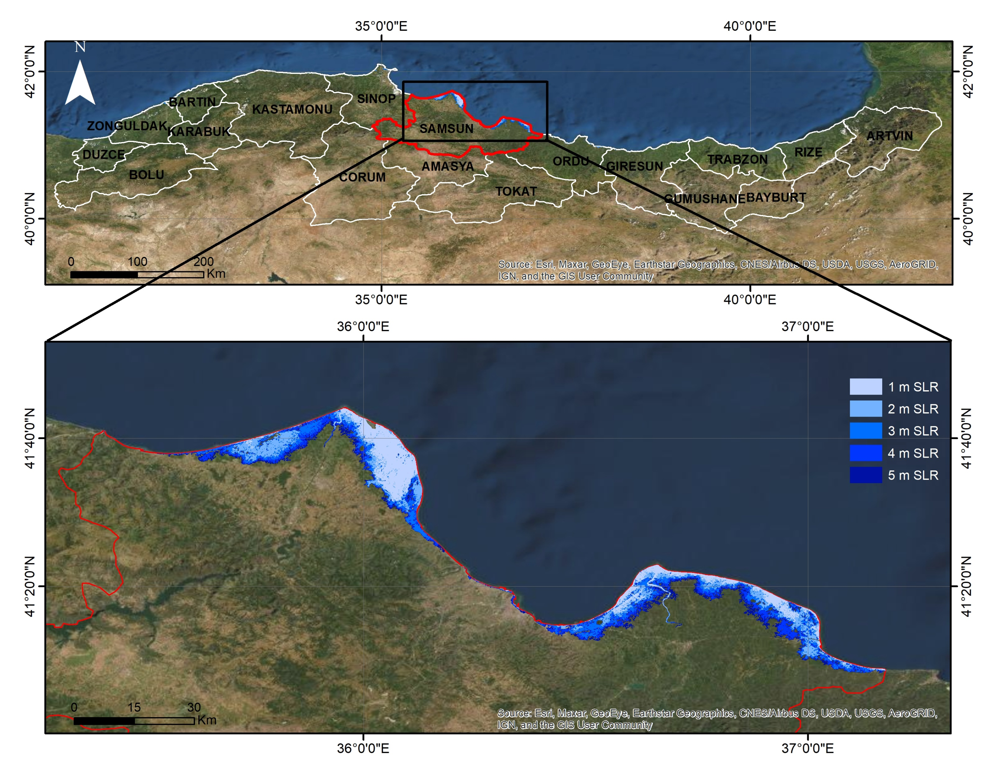
4. Results
6th International Electronic Conference on Water Sciences (ECWS-6)
Figure 4. Area affected (a) and number of inhabitants affected (b) for the five scenarios of sea level rise
Table 1. Land use categories affected for the five scenarios of sea level rise
Land use | 1m | 2m | 3m | 4m | 5m
Artificial surfaces | 1.2 sq km | 5.30 sq km | 13.8 sq km | 23.2 sq km | 29.8 sq km
Agricultural areas | 52.3 sq km | 149.4 sq km | 255.4 sq km | 355.2 sq km | 434.6 sq km
Forest and semi natural areas | 17.8 sq km | 32.9 sq km | 48.2 sq km | 57.9 sq km | 63.8 sq km
Wetlands | 66.4 sq km | 89.1 sq km | 93.1 sq km | 94.4 sq km | 94.9 sq km
Water bodies | 37.4 sq km | 40.1 sq km | 41.2 sq km | 42.4 sq km | 43.4 sq km
Figure 3. Modeling scenarios on the Samsun province coast

Slide 6
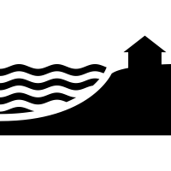
5. Discussions
6th International Electronic Conference on Water Sciences (ECWS-6)
Sea level rise along the Turkish coast is not significant as in some other areas around the world but there will be local vulnerability. Coastal erosion and flooding along Turkish shorelines are problems of national significance. Generally there is a lack of regional, national and specific data.
At this time, sea level rise scenarios are difficult to develop due to defective knowledge of the local and regional factors. All the uncertainties must be considered when explaining impact and response assessments [10].
The modeling presented offers an alternative to identify critical areas, where rising sea levels can have negative effects. The databases used are accessible and can be replicated to other areas. The proposed methodological plus contributes to the completion of these approaches with the spatial design of the phenomenon that can lead to a better understanding of the determinants of a certain level of negative impact of human communities.

Slide 7

6. Conclusions
6th International Electronic Conference on Water Sciences (ECWS-6)
The main objective of this research was to create potentially inundated coastal areas for Black Sea Region of Turkey. To quantify and to analyze visually the impact of sea level rise on Black Sea Region the Digital Elevation Model (DEM) was used. It was observed that coastal zone of Samsun province will be the most affected area.
In order to analyze the sea level rise impact and assess the damage, a model of inundated areas was created. This model in the form of five different sea level rise scenarios was then overlaid on three GIS layers (total surface, population and land use) to assess the impact.
This study presents a simulation of a different sea levels rise and can be considered by the authorities to implement measures to reduce negative effects.

Slide 8
References
6th International Electronic Conference on Water Sciences (ECWS-6)
1. Bunce, M.; Brown, K.; Rosendo, S. Policy misfits, climate change and cross-scale vulnerability in coastal Africa: how development projects undermine resilience. Environ. Sci. Policy 2010, 13, 485–497. doi:10.1016/j.envsci.2010.06.003
2. Lewis, J. Some realities of resilience: an updated case study of storms and flooding at Chiswell, Dorset. Disaster Prev. Manag. 2013, 22, 300–311. doi:10.1108/dpm-03-2013-0053.
3. Mehvar, S.; Filatova, T.; Dastgheib, A.; de Ruyter van Steveninck, E.; Ranasinghe, R. Quantifying economic value of coastal ecosystem services: a review. J. Mar. Sci. Eng. 2018, 6. doi:10.3390/jmse6010005.
4. Ferro-Azcona, H.; Espinoza-Tenorio, A.; Calderon-Contreras, R.; Ramenzoni, V.C.; Gomez País, M. de las M.; Me-sa-Jurado, M.A. Adaptive capacity and social-ecological resilience of coastal areas: a systematic review. Ocean Coast Manag. 2019, 173, 36–51. doi:10.1016/j.ocecoaman.2019.01.005.
5. Lieske, D. J.; Wade, T.; Roness, L. A. Climate change awareness and strategies for communicating the risk of coastal flooding: A Canadian Maritime case example. Estuar. Coast. Shelf Sci. 2014, 140, 83–94. doi:10.1016/j.ecss.2013.04.017.
6. Diaconu, D.C; Costache, R.; Popa, M.C.; An Overview of Flood Risk Analysis Methods. Water 2021, 13. doi:10.3390/w13040474.
7. Costache, R.; Tincu, R.; Elkhrachy, I.; Pham, Q.B.; Popa, M.C.; Diaconu, D.C.; Avand, M.; Costache, I.; Arabameri, A.; Bui, D.T. New neural fuzzy-based machine learning ensemble for enhancing the prediction accuracy of flood suscepti-bility mapping. Hydrol. Sci. J., 2020, 65, 2816-2837. doi: 10.1080/02626667.2020.1842412.
8. Yüksek, Ö.; Kankal, M.; Üçüncü, O. Assessment of big floods in the Eastern Black Sea Basin of Turkey. Environ. Monit. Assess., 2012, 185, 797–814. doi:10.1007/s10661-012-2592-2.
9. Özyurt, G.; Ergin, A. Application of Sea Level Rise Vulnerability Assessment Model to Selected Coastal Areas of Turkey, In Journal of Coastal Research. Proceedings of the 10th International Coastal Symposium, Lisbon, Portugal, 2010, Special Issue No. 56248-251.
10. Kuleli, T.; Şenkal, O.; Erdem, M. National assessment of sea level rise using topographic and census data for Turkish coastal zone. Environ. Monit. Assess. 2008, 156, 425–434. doi:10.1007/s10661-008-0495-z.

Slide 9
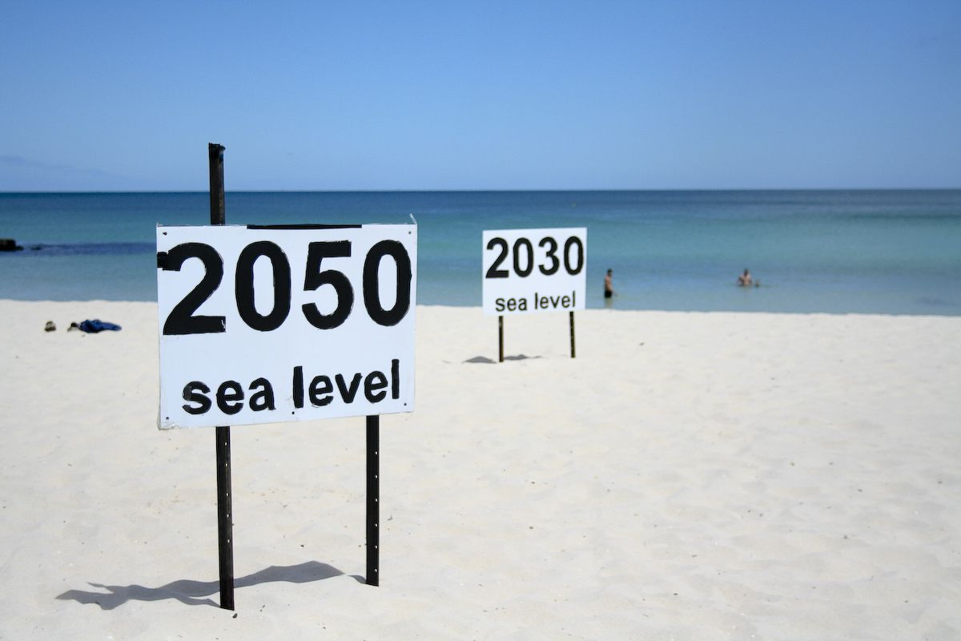
THANK YOU!

