Slide 1
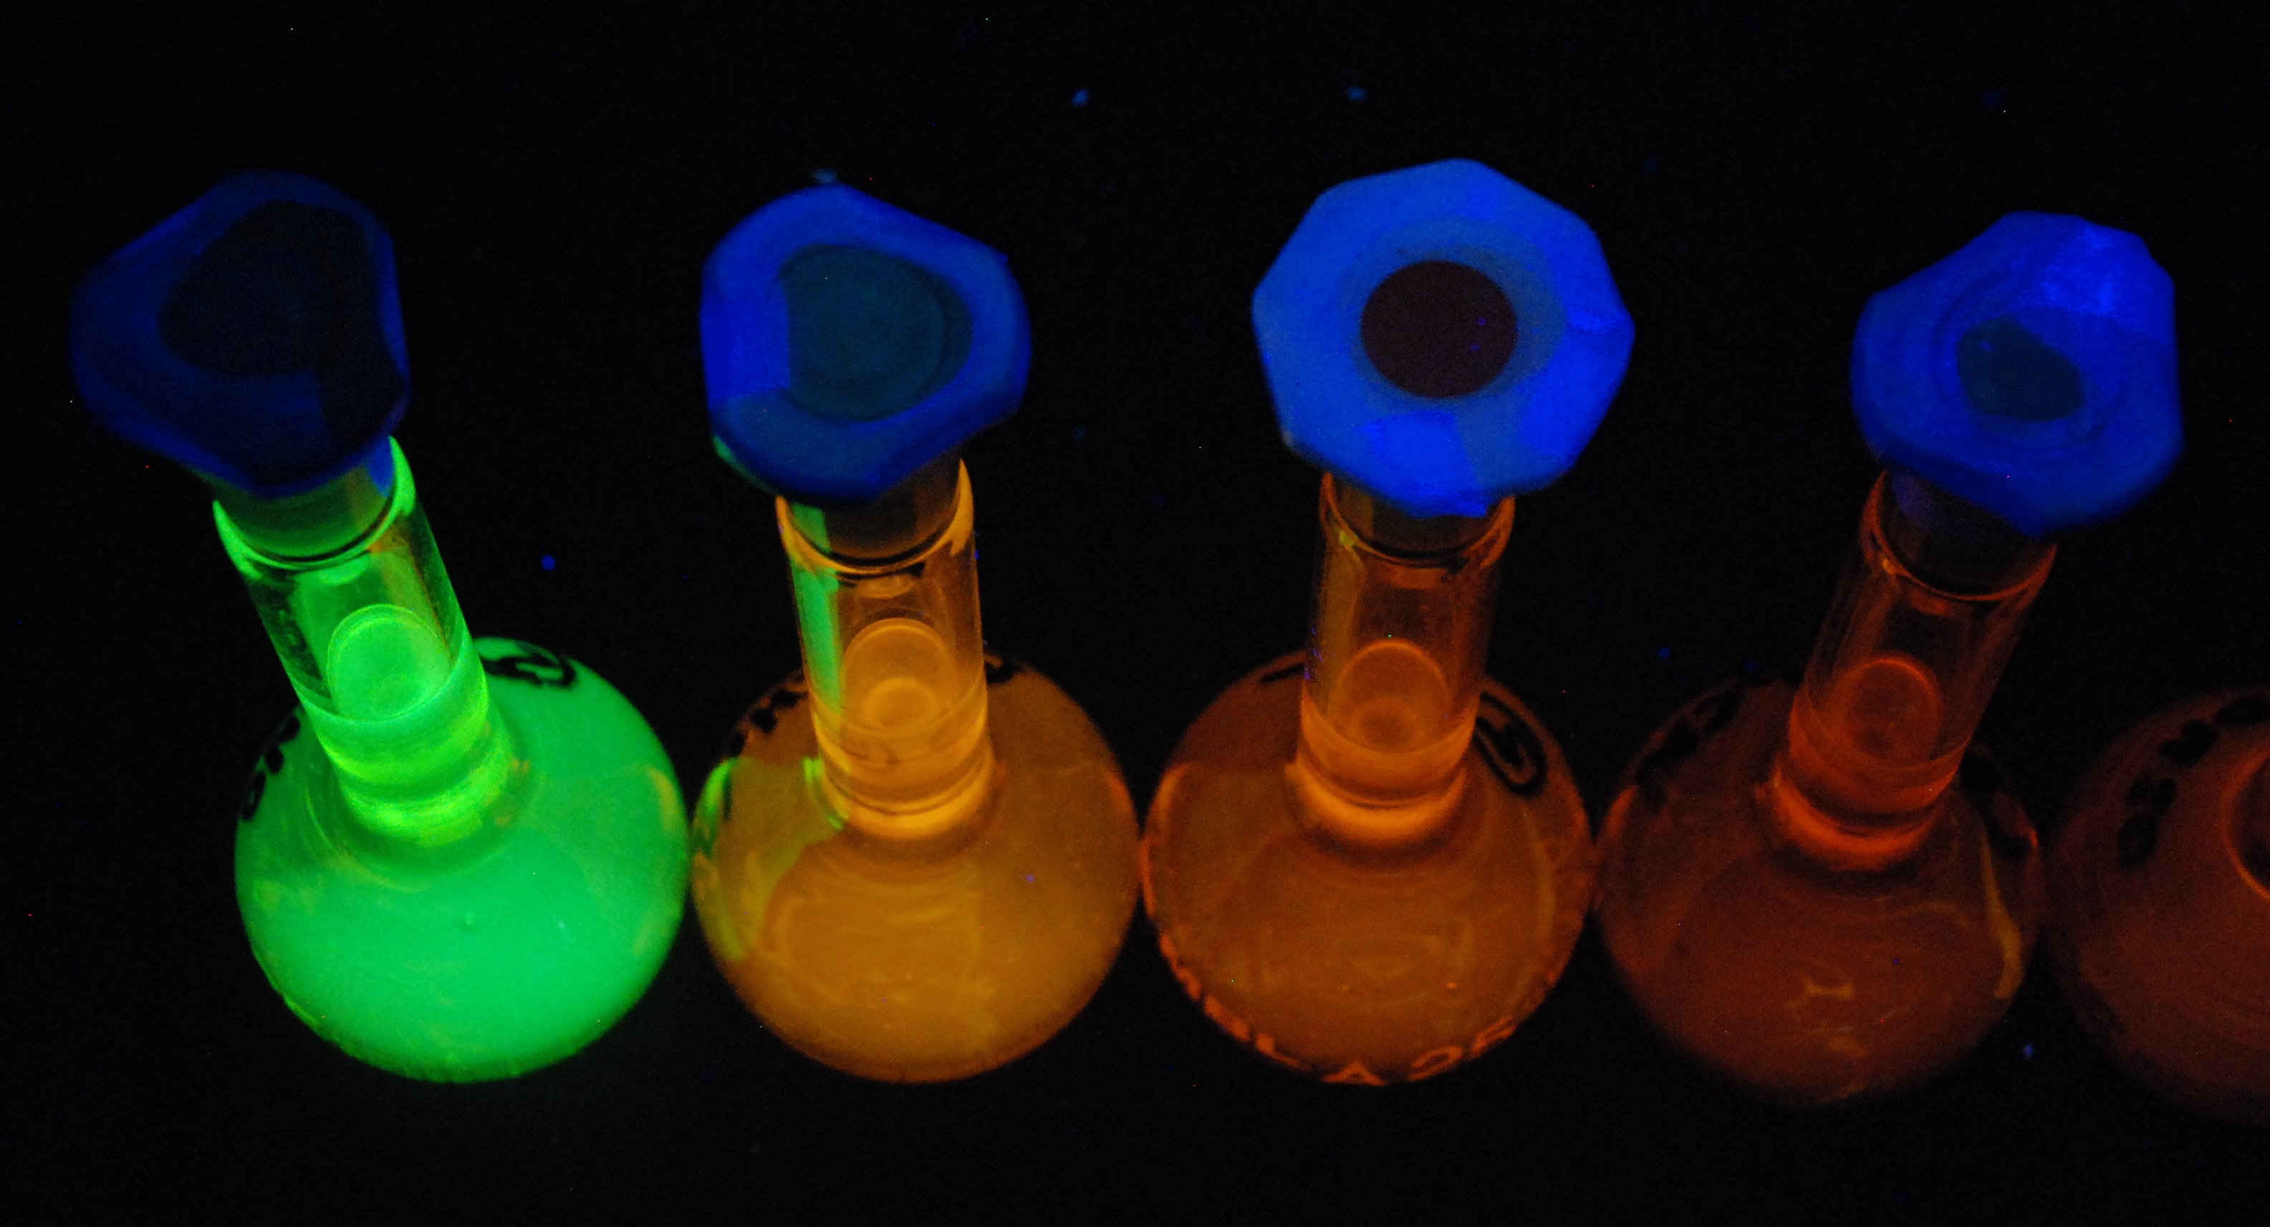
N,N-dimethyl-4-amino-2,1,3-benzothiadiazole: synthesis and luminescent solvatochromism
Valentina Ferraro ^{1,*}, Matteo Girotto ¹, Marco Bortoluzzi ¹
¹ Dipartimento di Scienze Molecolari e Nanosistemi, Università Ca’ Foscari Venezia, Via Torino 155, 30170 Mestre (VE), Italy. E-mail: valentina.ferraro@unive.it

Slide 2
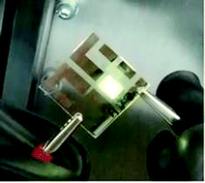
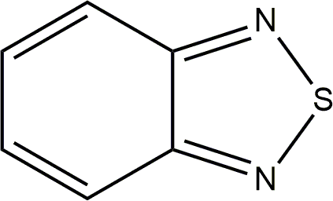
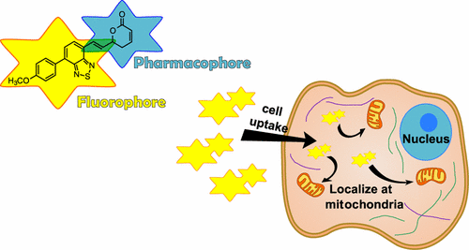
Herbicide, fungicide and antibacterial agents
B.A.D. Neto et al., Eur. J. Org. Chem. (2013) 228.
OLEDs
D. Volz et al., Green Chem. 17 (2015) 1988.
Y. Zhang et al., Sci. China Chem. 64 (2021) 341.
Dyes
A. Pazini et al., Tetrahedron Lett. 59 (2008) 2994.
Pazini et al., J. Mol. Struct. 1131 (2017) 181.
B. Bardi et al., J. Phys. Chem. C 121 (2017) 17466.
I. M. Paczkowski et al., J. Mol. Liq. 319 (2020) 114277.
N.R. Paisley et al., Mater. Chem. Front. 4 (2020) 555.
S. Gao et al., Chem. Eur. J. 26 (2020) 11013.
Polymeric photocatalysts
R. Li et al., ACS Catal. 8 (2018) 4735.
G.-B. Wang et al., Chem. Commun. 56 (2020) 12612.
Fluorescent probes and thermometers
S. Uchiyama et al., Chem. Eur. J. 18 (2012) 9552.
S. Uchiyama et al., Analyst 140 (2015) 4498.
I. Raitz et al., ACS Omega 2 (2017) 3774.
H. Appelqvist et al., Bioconjugate Chem. 28 (2017) 1363.
V.S. Souza et al., Sens. Actuators B. Chem. 321 (2020) 128530.
Solar and photovoltaic cells
Y. Wu, W. Zhu, Chem. Soc. Rev. 42 (2013) 2039.
S. Halliday et al., Prog. Polym. Sci. 70 (2017) 34.
C. Wang et al., Chin. J. Polym. Sci. 39 (2021) 525.
P. Zheng et al., New J. Chem. 45 (2021) 4443.

Slide 3
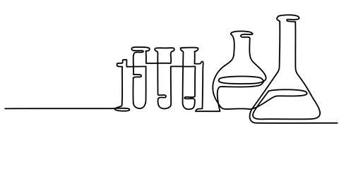
Synthesis
Step 1: Nitration
Step 2: Reduction
Step 3: Methylation

Slide 4
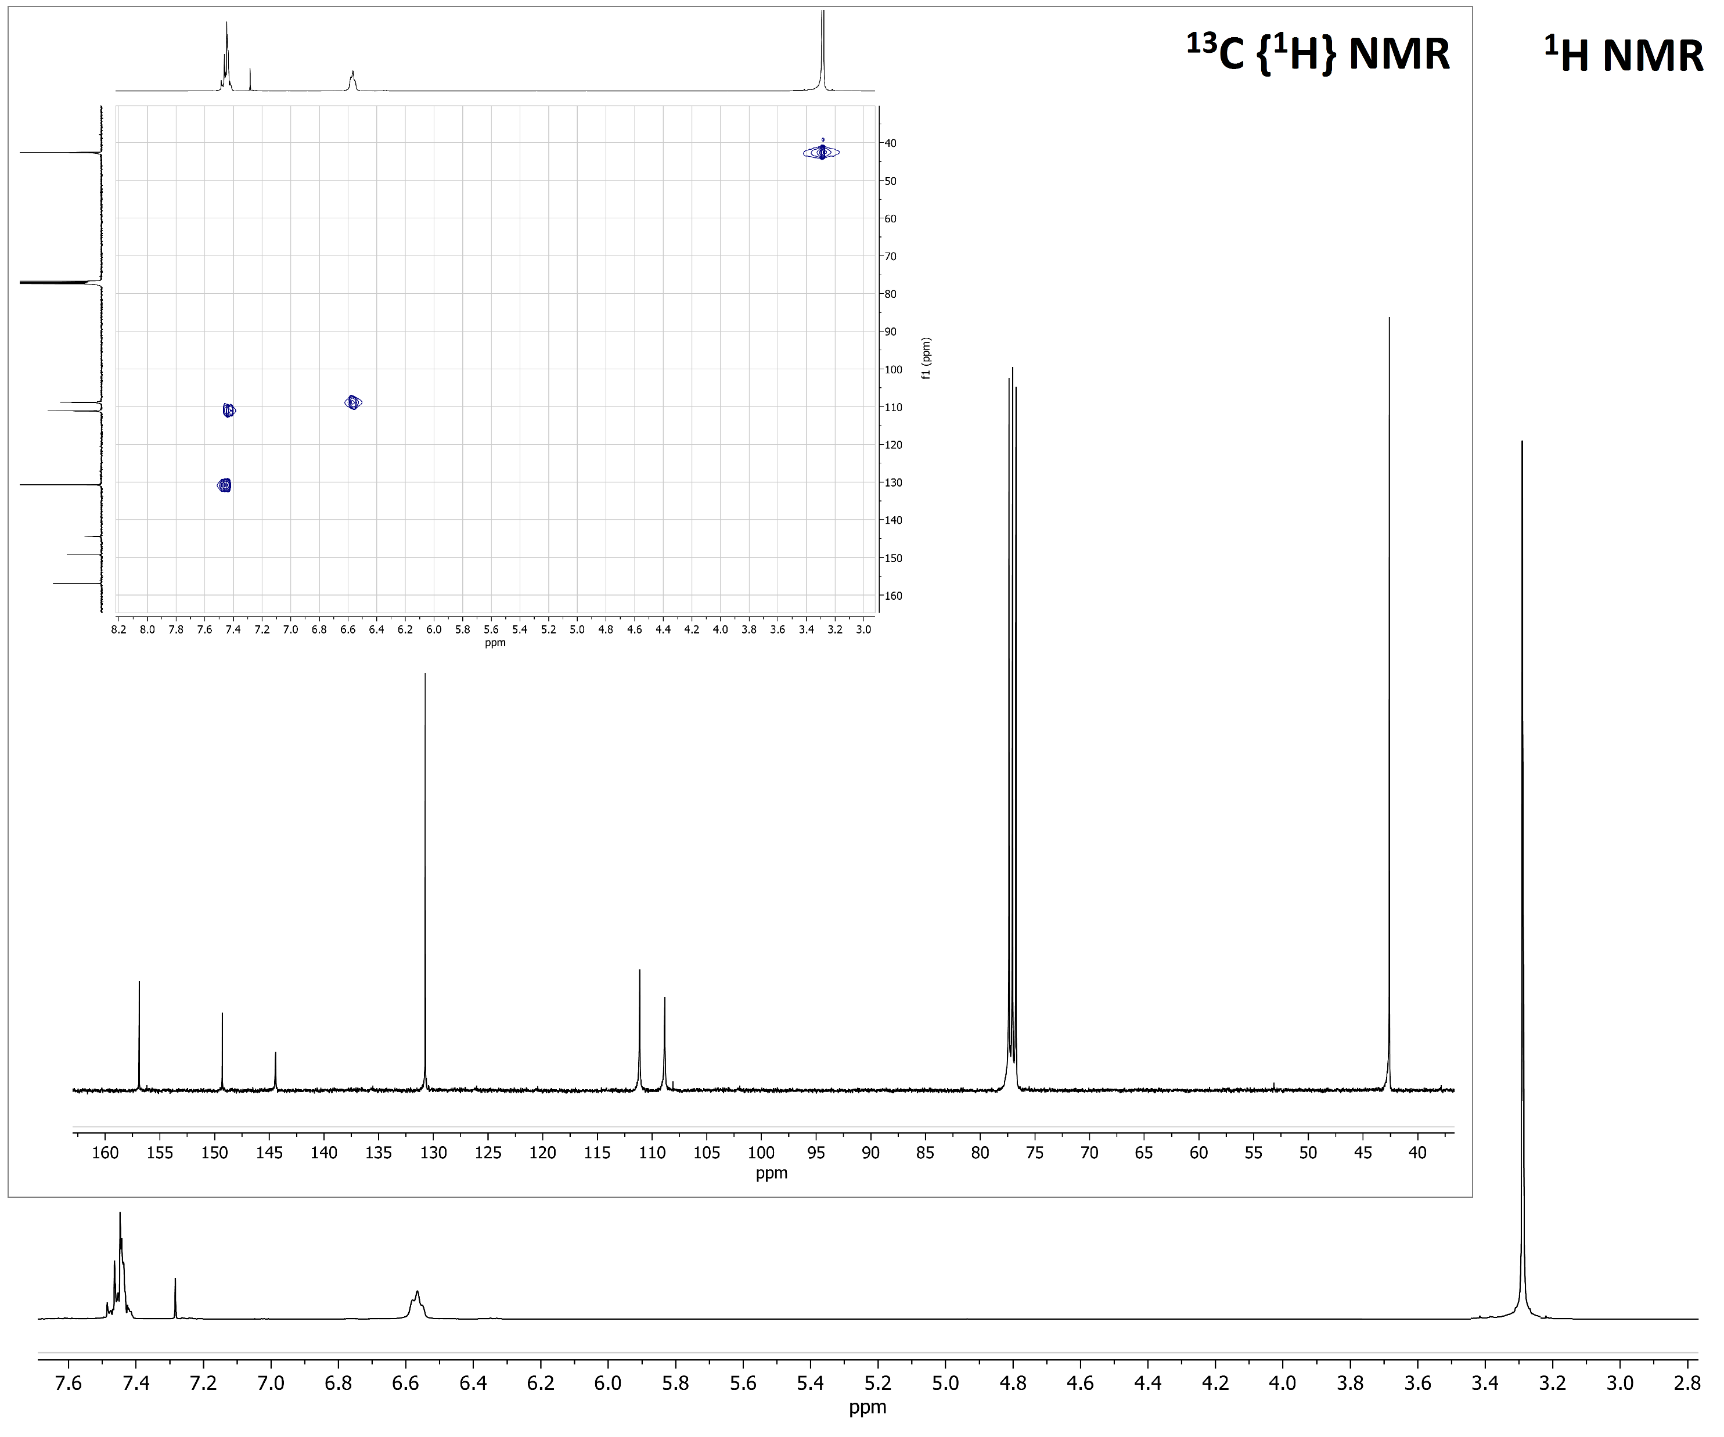
¹H NMR spectrum of BTD^{NMe2} in CDCl₃ at 298 K. Inset: ¹³C {¹H} NMR and ¹H-¹³C HSQC in CDCl₃ at 298 K

Slide 5
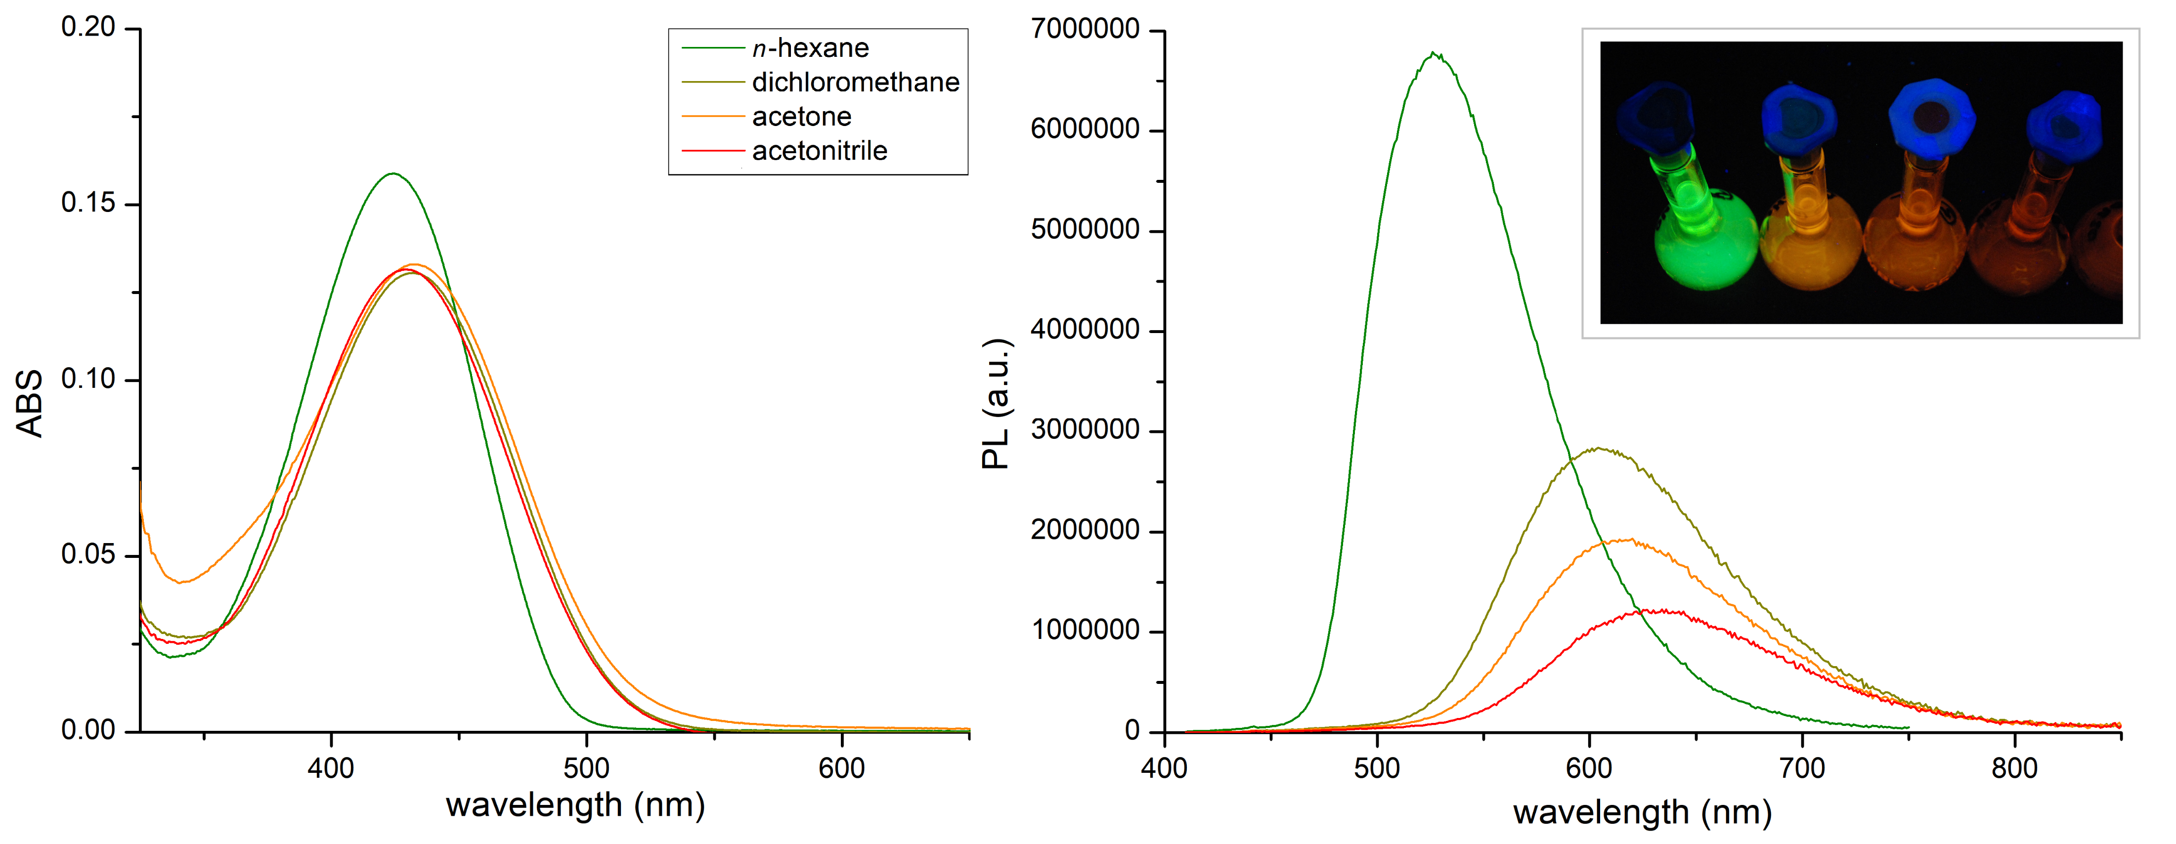
Spectroscopic characterization
Absorption and emission spectra of 5·10⁻⁵ M solutions of BTD^{NMe2} in different solvents recorded at room temperature.
Inset: picture of the solutions under UV light (λ_{excitation} = 365 nm).

Slide 6
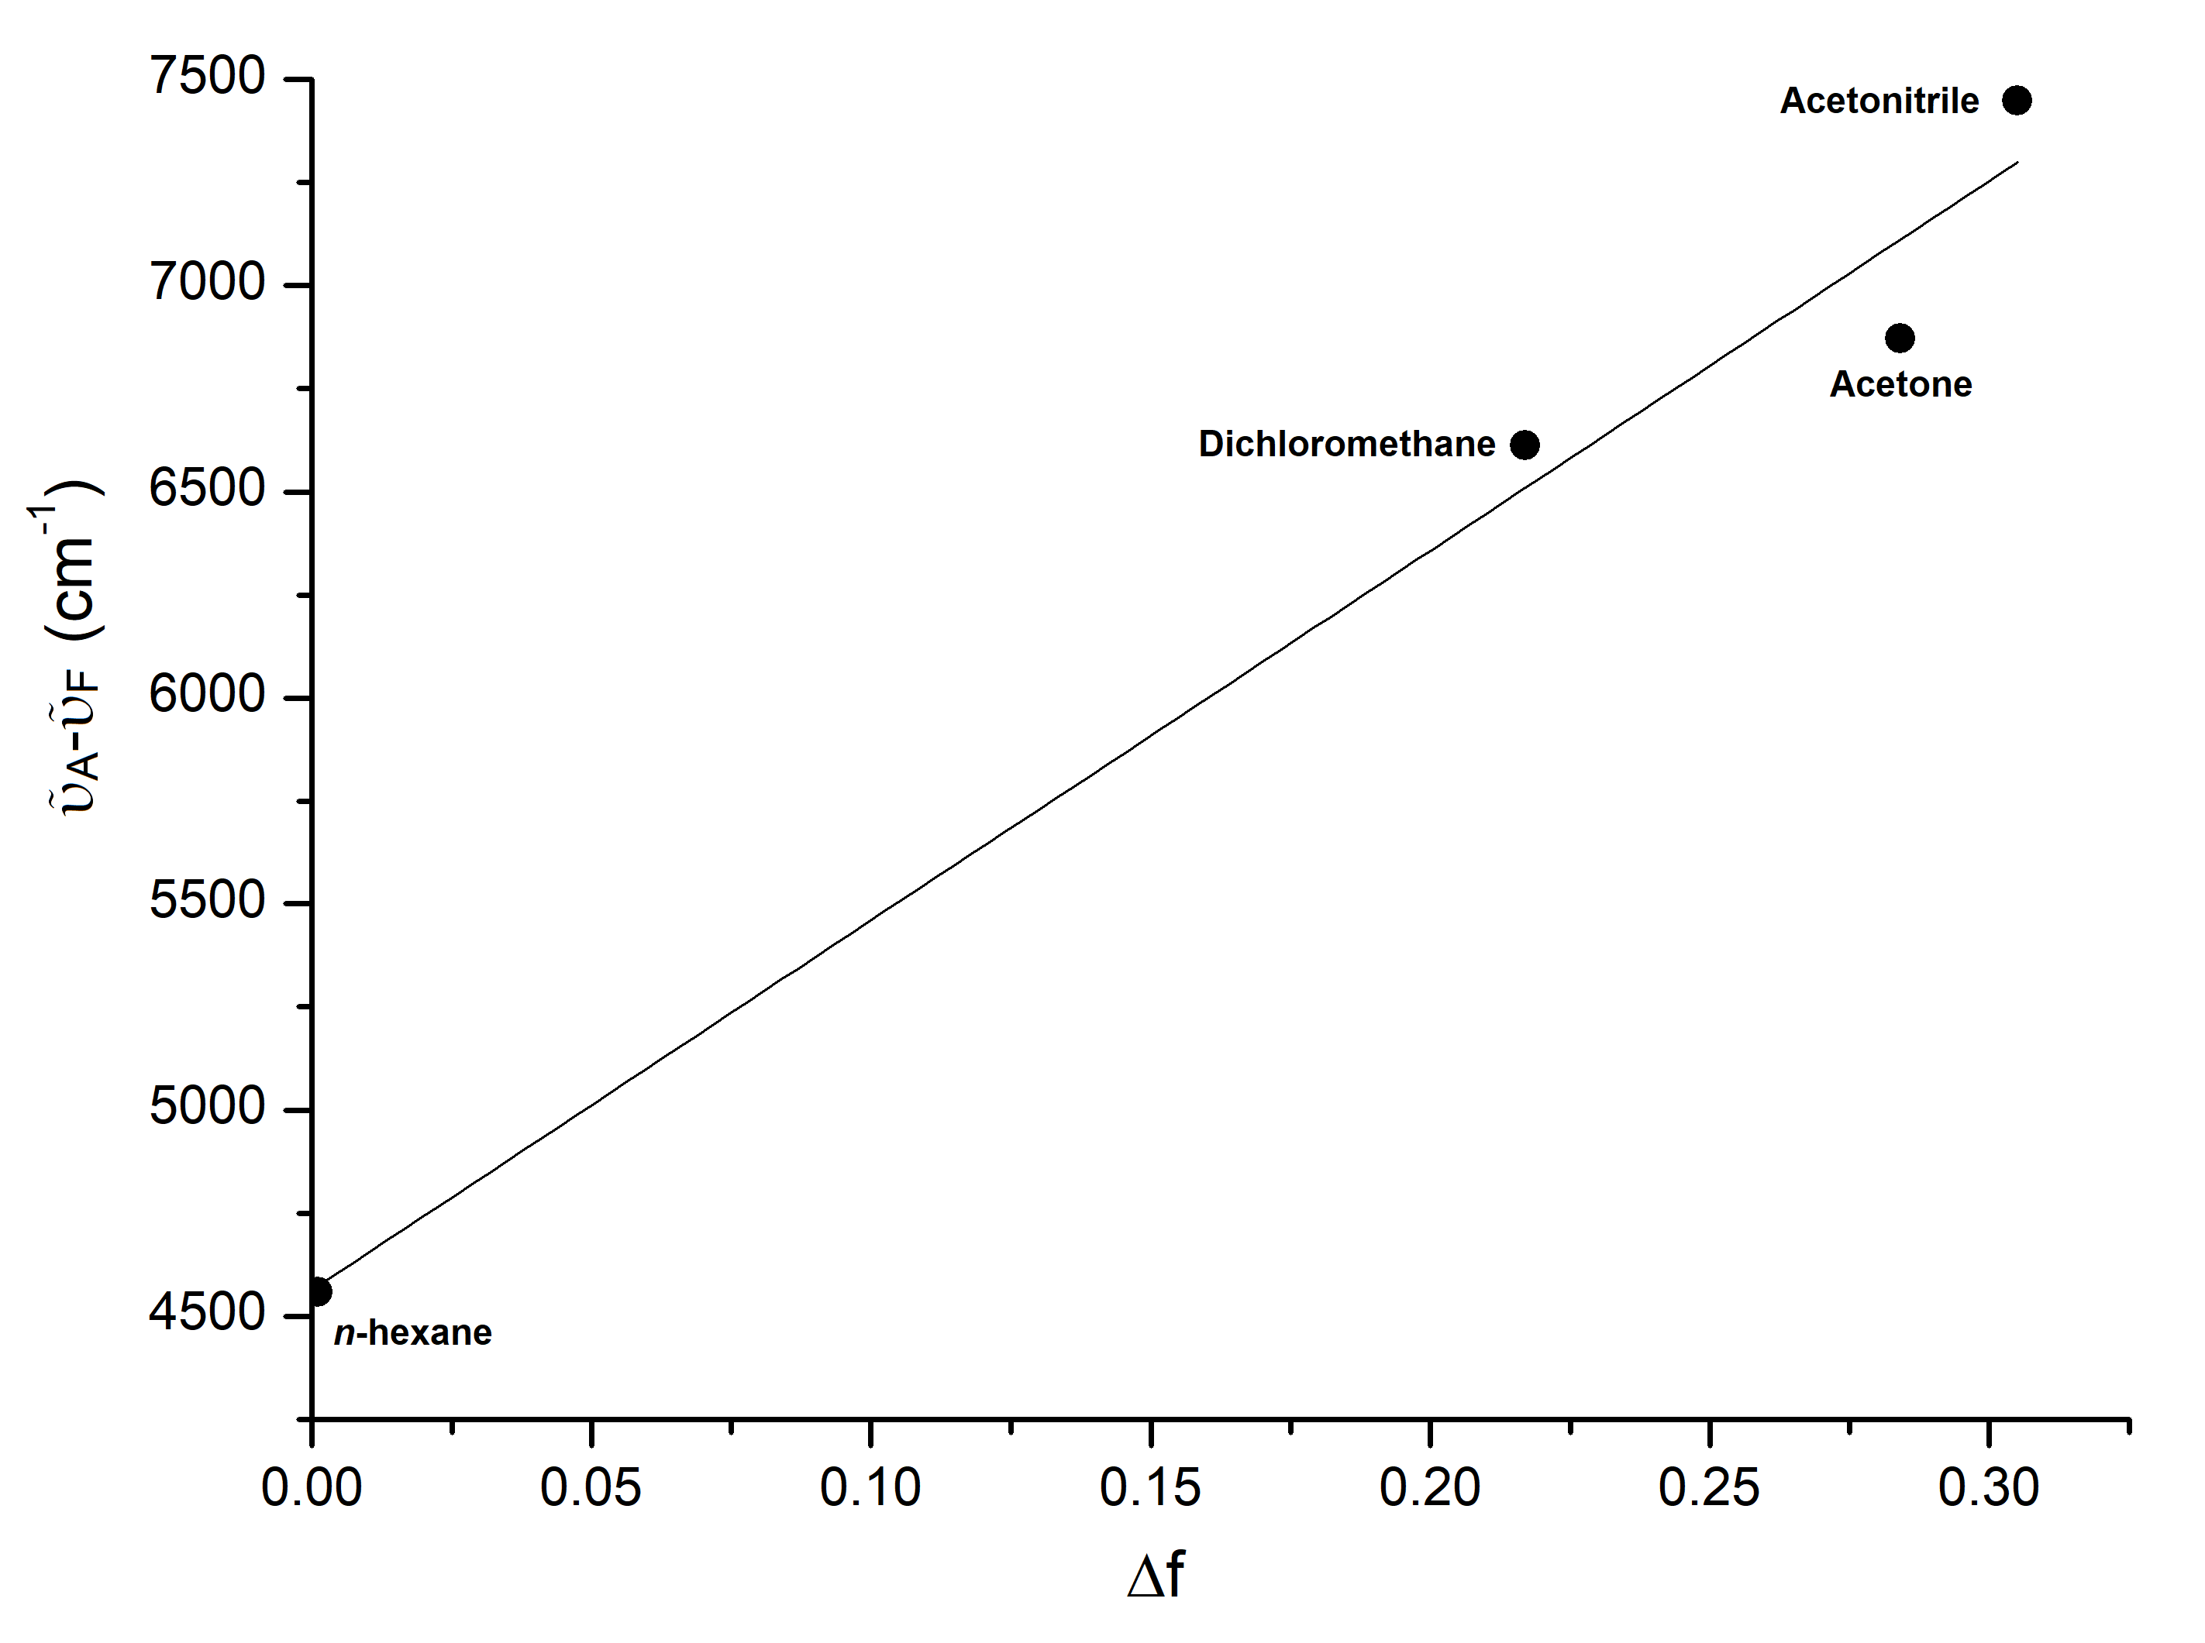
Solvent | ε | n | ABS max (nm) ª | PL max (nm) ^{b} | Stokes shift (cm⁻¹) | Φ_{F} (%) ^{c} | Orientation Polarizability
n-hexane | 1.9 | 1.375 | 424 | 526 | 4559 | 52 | 0.001
Dichloromethane | 8.9 | 1.424 | 432 | 604 | 6613 | 41 | 0.217
Acetone | 20.7 | 1.359 | 433 | 616 | 6872 | 23 | 0.284
Acetonitrile | 37.5 | 1.479 | 430 | 630 | 7448 | 16 | 0.305
ª 298 K. ^{b} λ_{excitation} = 390 nm, 298 K. ^{c} Data obtained using a solution of anthracene in ethanol as standard (Φ_{F} = 27%).

Slide 7
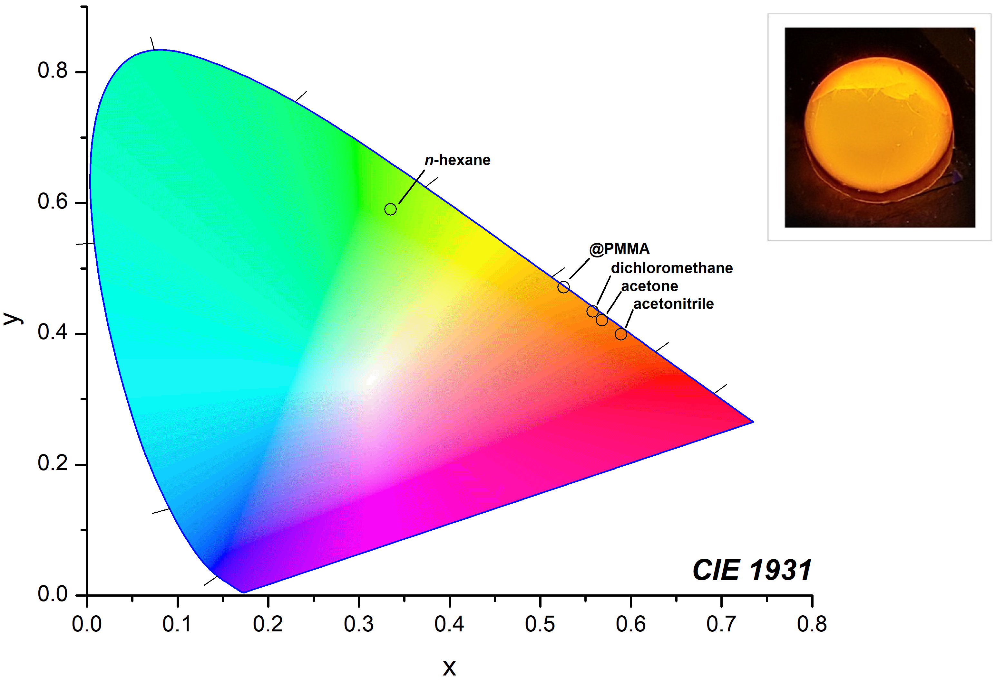
CIE 1931 chromaticity diagram of BTD^{NMe2} in different solvents and in PMMA (n-hexane: x = 0.335, y = 0.590; dichloromethane: x = 0.558, y = 0.434; acetone: x = 0.561, y = 0.421; acetonitrile: x = 0.589 , y = 0.399; @PMMA: x = 0.526, y = 0.471).
Inset: BTD^{NMe2}@PMMA excited at 365 nm.

Slide 8
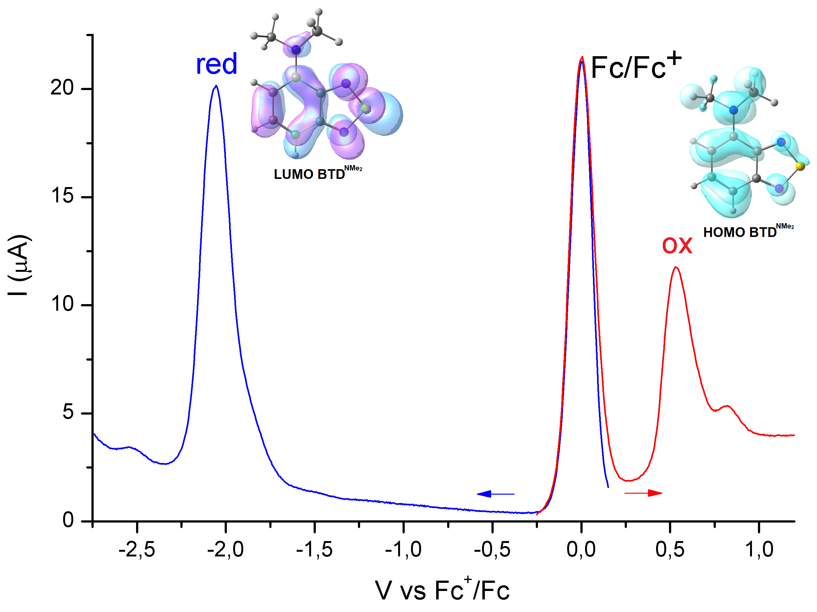
DFT calculations and voltammetry
Square wave voltammetry of BTD^{NMe2} (CH₃CN/LiClO₄, ferrocene as internal reference, blue line: reduction, red line: oxidation) and frontier molecular orbitals (surface isovalue 0.03 a.u.).

Slide 9
Conclusion
N,N-dimethyl-4-amino-2,1,3-benzothiadiazole (BTD^{NMe2}) was prepared from 2,1,3-benzothiadiazole in a three steps synthetic path that involved nitration, subsequent reduction and methylation.
The compound was fully characterized by means of nuclear magnetic resonance (NMR) and infrared spectroscopy.
The compound revealed to be highly fluorescent and characterized by a noticeable solvatochromism.
The emission features, rationalized on the basis of electrochemical measurements and DFT calculations, were maintained once embedded in polymethylmetacrilate.
The photoluminescence properties exhibited by BTD^{NMe2} make it a suitable candidate for advanced technology applications.

