Slide 1
In silico evaluation of new fluoroquinolones as possible inhibitors of bacterial gyrases in resistant Gram-negative pathogens
Manuel Alejandro Coba-Males ^{1,} *, Javier Santamaría-Aguirre ^{2,} * and Christian D. Alcívar-León ¹
¹ Facultad de Ciencias Químicas, Universidad Central del Ecuador, Quito 170521, Ecuador; macoba@uce.edu.ec (M.A.C.-M); cdalcivar@uce.edu.ec (C.D.A.-L)
² Facultad de Ciencias Químicas, Universidad Central del Ecuador, Quito 170521, Ecuador; DNA Replication and Genome Instability Unit, Grupo de Investigación en Biodiversidad, Zoonosis y Salud Pública (GIBCIZ), Instituto de Investigación en Zoonosis-CIZ; jrsantamaria@uce.edu.ec (J.S.-A).
*Correspondence: macoba@uce.edu.ec (M.A.C.-M); jrsantamaria@uce.edu.ec (J.S.-A)
Presented at the 25th International Electronic Conference on Synthetic Organic Chemistry, 15 November – 30 November 2021; Available online: https://ecsoc-25.sciforum.net.

Slide 2
Abstract
The work seeks to identify molecules with inhibitory activity against the DNA gyrase of gram-negative microorganisms resistant to fluoroquinolones. Previously designed compounds were used to study antimicrobial potential in silico. Molecular docking was performed with 9 new ciprofloxacin analog molecules, optimized through the PM6/ZDO theory level, in GyrA Wild Type (WT) and Mutant Type (MT) of C. jejuni, E. coli (6RKU PDB ID), N. gonorrhoeae, P. aeruginosa, S. enteritidis, and S. typhi. The molecule with the highest affinity for GyrA was selected based on its binding free energy and inhibition constant. In addition, a retrospective docking was carried out, to guarantee the correct affinity of the ligand to the receptor at the defined binding site. The results show a molecule with greater affinity for GyrA of 5 microorganisms, showing a binding free energy of less than -7.0 kcal/mol, suggesting a good antibacterial activity in silico.
Keywords: Molecular Docking / Fluoroquinolones / DNA gyrase / Bacterial resistance

Slide 3
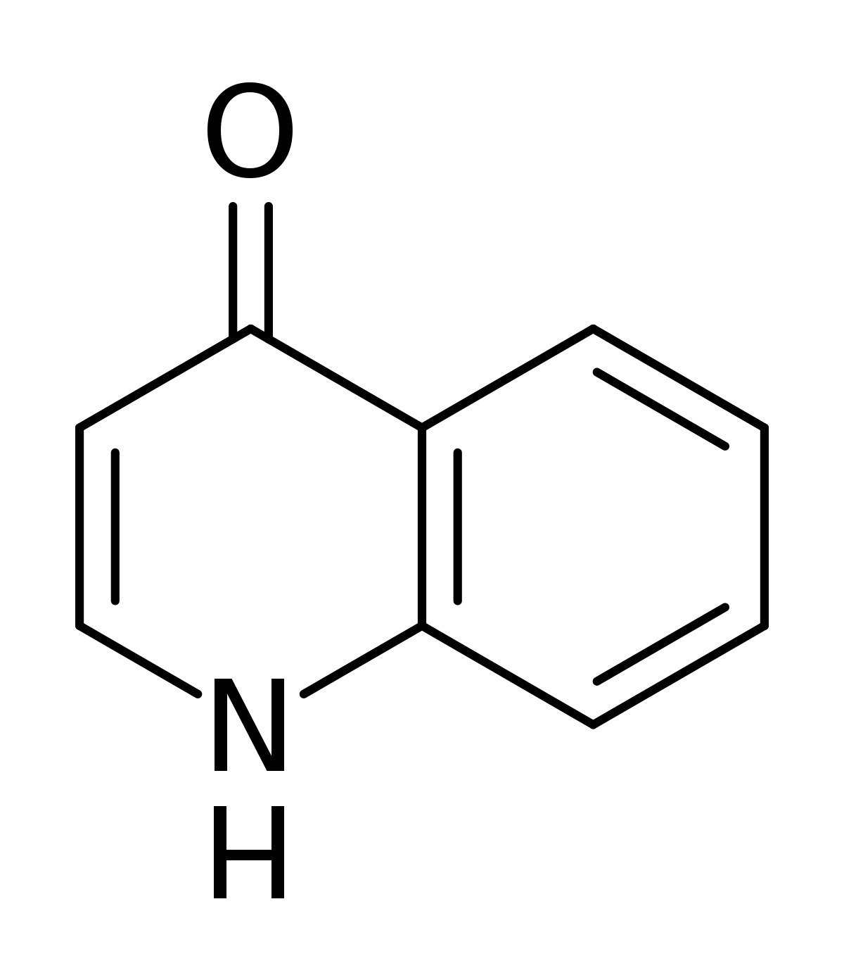
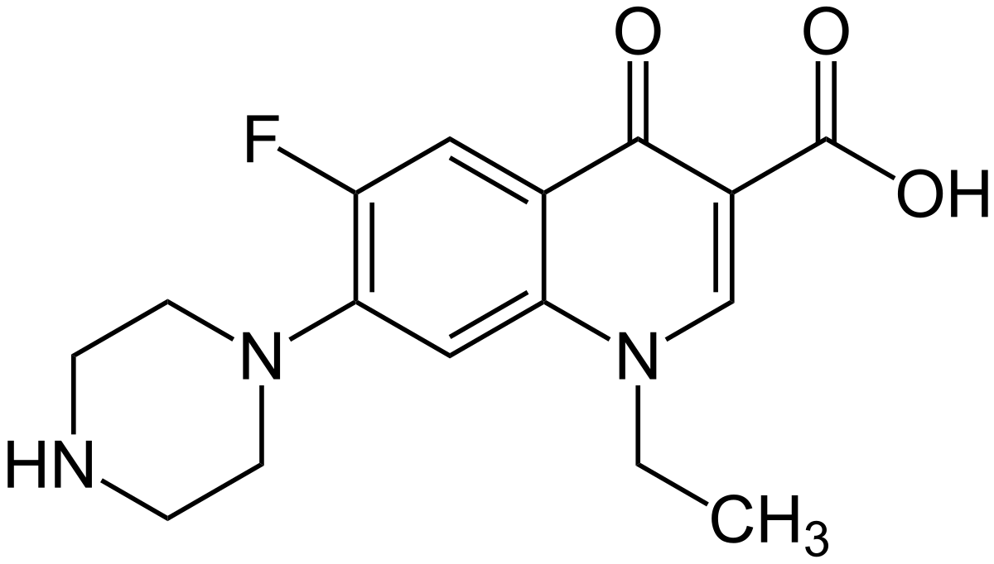
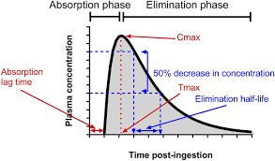
Introduction
Fluoroquinolones are synthetic fluorinated antibiotics that are born from a common basic chemical structure called 4-quinolone
Norfloxacin was the first fluoroquinolone obtained in 1980 by the addition of a fluorine atom at position 6 of the quinolone pharmacophore group
4-quinolone
Norfloxacin
Fluoroquinolones Advantages
Quick absorption in the gastrointestinal tract
High serum concentrations in 1 - 2 h
High bioavailability
Large volume of distribution
Low affinity for proteins
Plasma half-life about 1,5 - 17 h
Tom N. Lea-Henry, Jane E. Carland, Sophie L. Stocker, Jacob Sevastos, Darren M. Roberts. Clinical Pharmacokinetics in Kidney Disease, Clin J Am Soc Nephrol 2018, 13, p. 1086

Slide 4
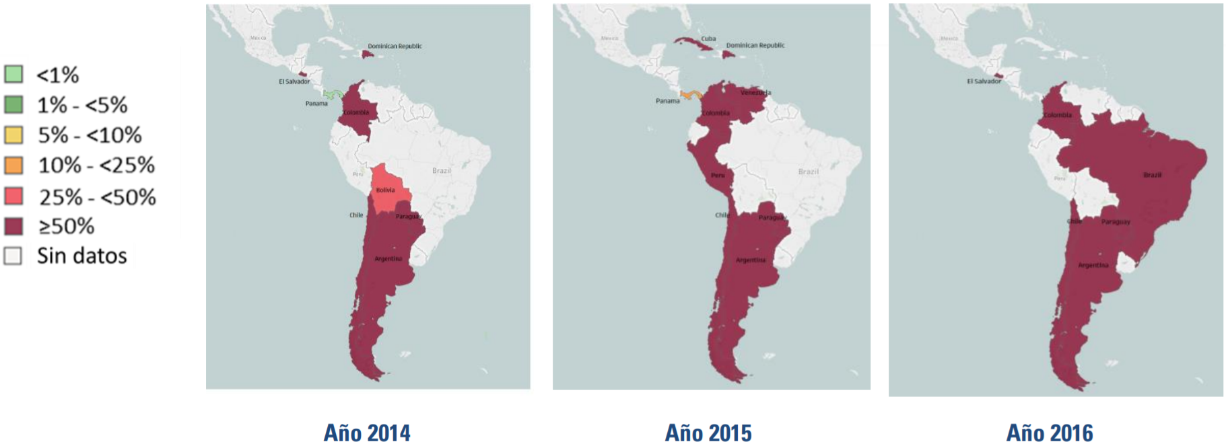
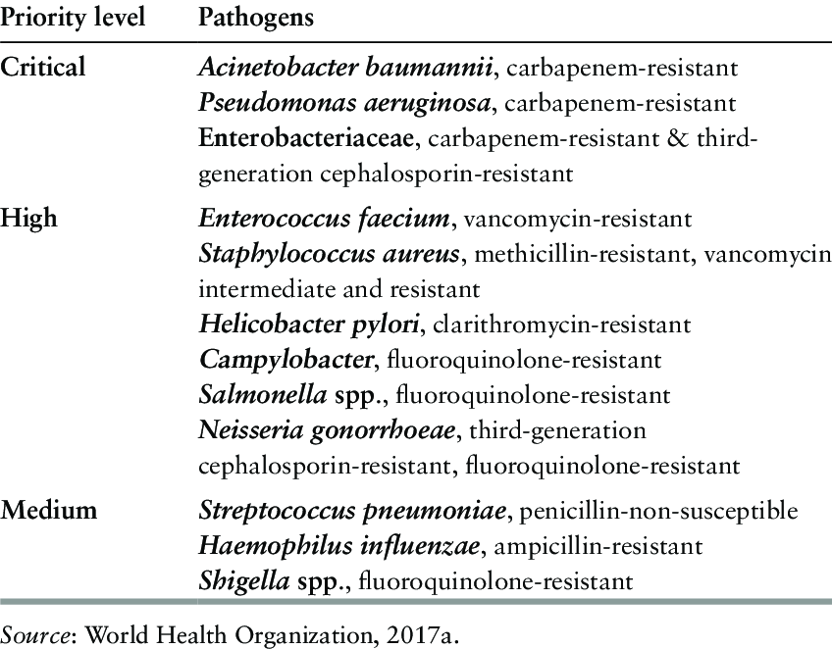
Introduction
Study of bacterial resistance carried out in 15 Latin American countries during 2014-2016
Average ≥ 50% of non-sensitivity in gram-pathogens to fluoroquinolones in Brazil, Paraguay, Argentina, Chile, Colombia, and Peru.
https://www.paho.org/es/documentos/magnitud-tendencias-resistencia-antimicrobianos-latinoamerica-relavra-2014-2015-2016
In 2017 was published the first list of priority antibiotic-resistant pathogens, with the aim of encouraging R&D of new molecules
https://www.who.int/news/item/27-02-2017-who-publishes-list-of-bacteria-for-which-new-antibiotics-are-urgently-needed

Slide 5
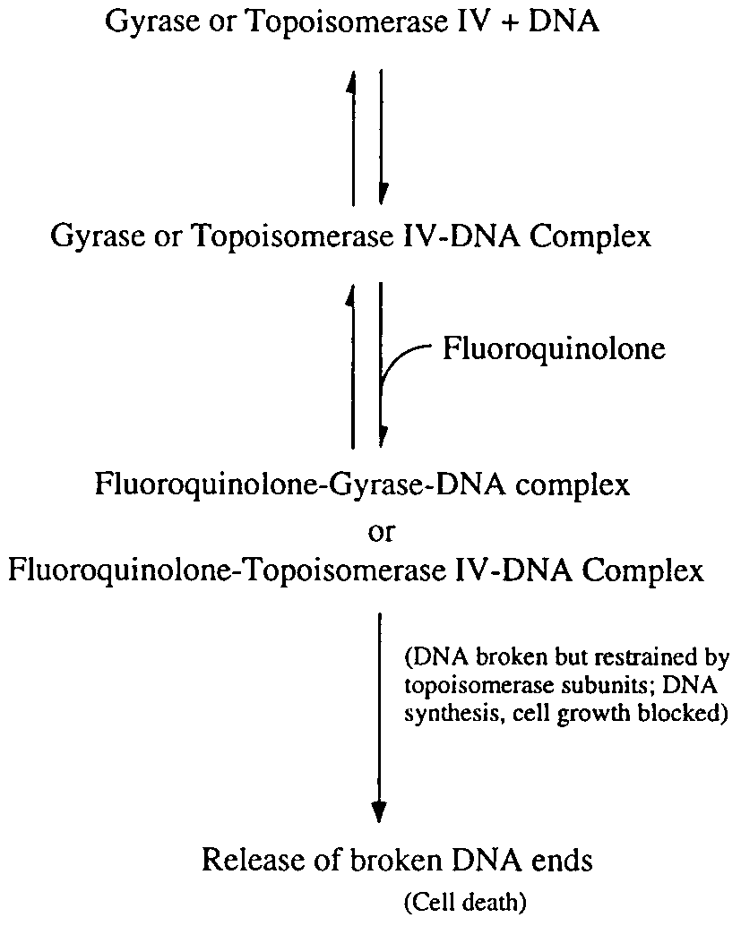
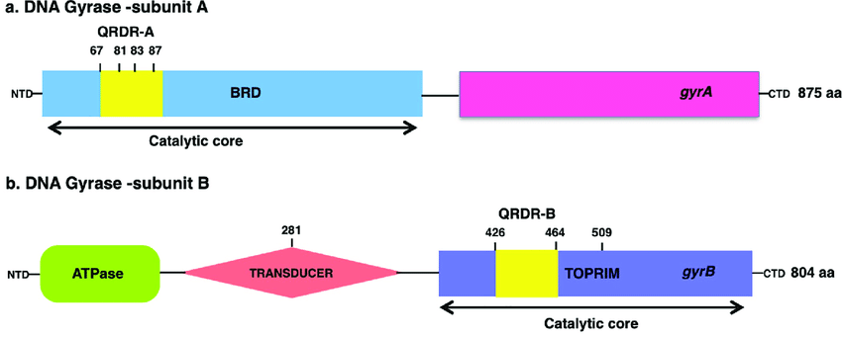
Introduction
Mechanism of action of fluoroquinolones
DNA girasa is a type II topoisomerase exclusive to prokaryotic organisms composed of two subunits A (GyrA) and two subunits B (GyrB) with ATPase activity
Bhatnagar, K.; Wong, A. The mutational landscape of quinolone resistance in Escherichia coli, 2019, PLoS ONE, 14, p. 7
Zhao, X., C. Xu, J. Domagala, and K. Drlica. DNA topoisomerase targets of the fluoroquinolones: a strategy for avoiding bacterial resistance. Proc. Natl. Acad. Sci. USA, 1997, 94, p. 13992
Some models based on observation and coupling calculations have established the Quinolone Resistance Determining Region (QRDR) in N-terminal domain of GyrA as the binding site for fluoroquinolones
Fluoroquinolones bind to a region near Tyr-122 in the N-terminal domain of the GyrA subunits of the DNA gyrase

Slide 6
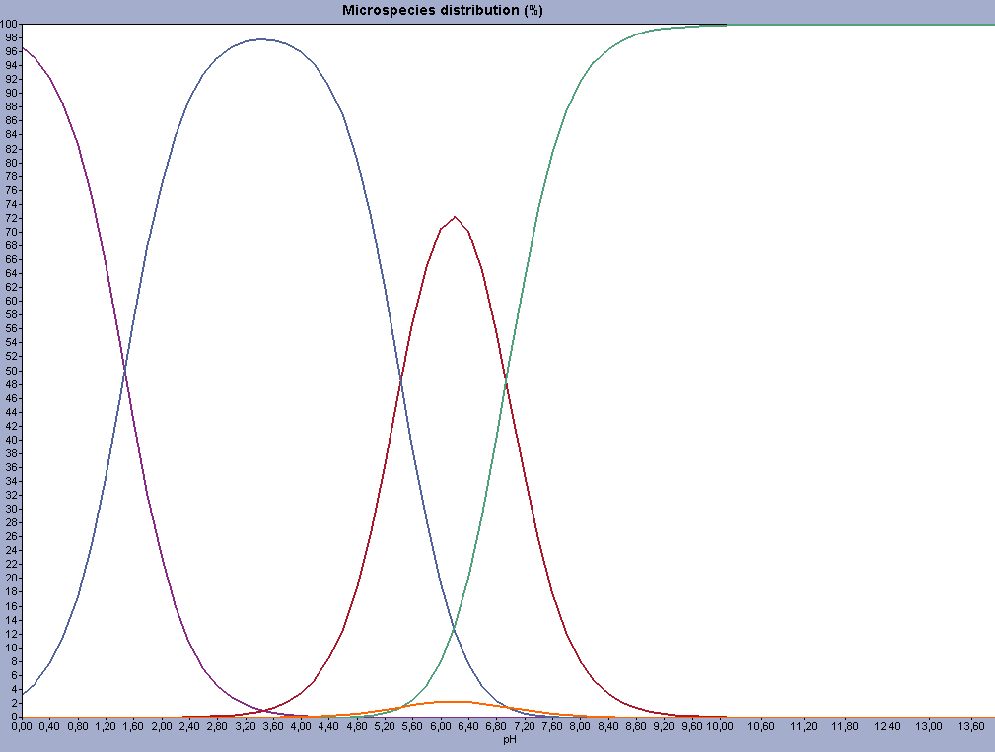
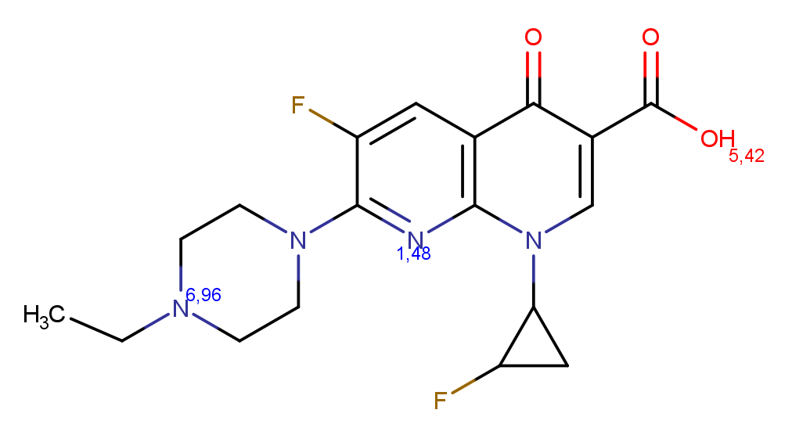
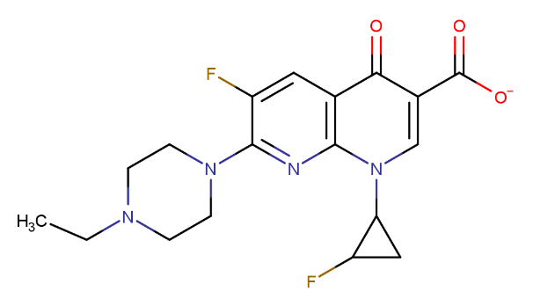
Results
The study evaluated 9 new fluoroquinolones as possible inhibitors of DNA gyrase in resistant gram-negative pathogens using computational methods
General characteristics of the ligands
The capacity with the fluoroquinolones penetrate the cell membrane is a complex process that depends on physical and chemical factors
At pH 7.0 predominate the basic ionic form with a distribution of 51,79% over the other microspecies
pKa for Molecule 1
Fluoroquinolones cross the membranes by passive transport at physiological pH, being important to know the ionization state in which they are due to their amphoteric nature

Slide 7
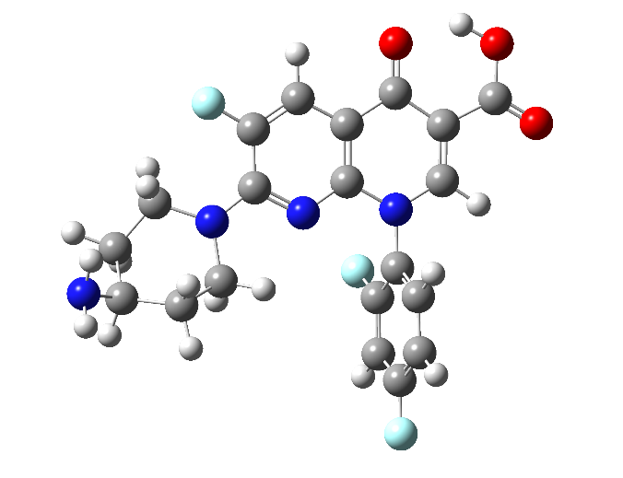
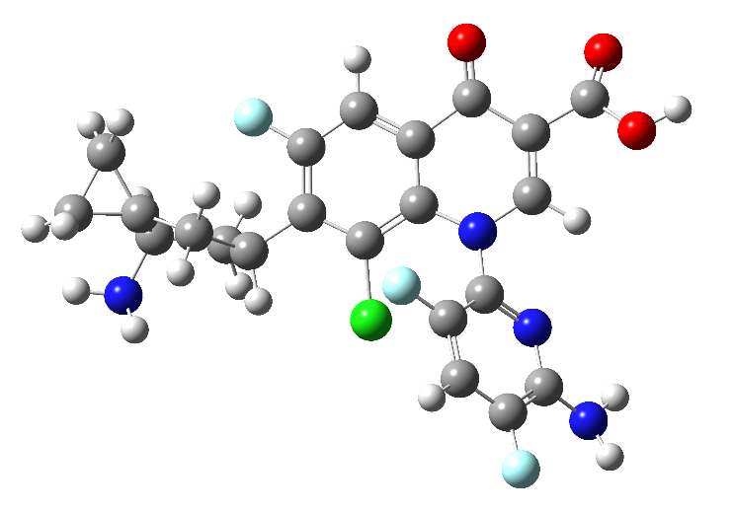
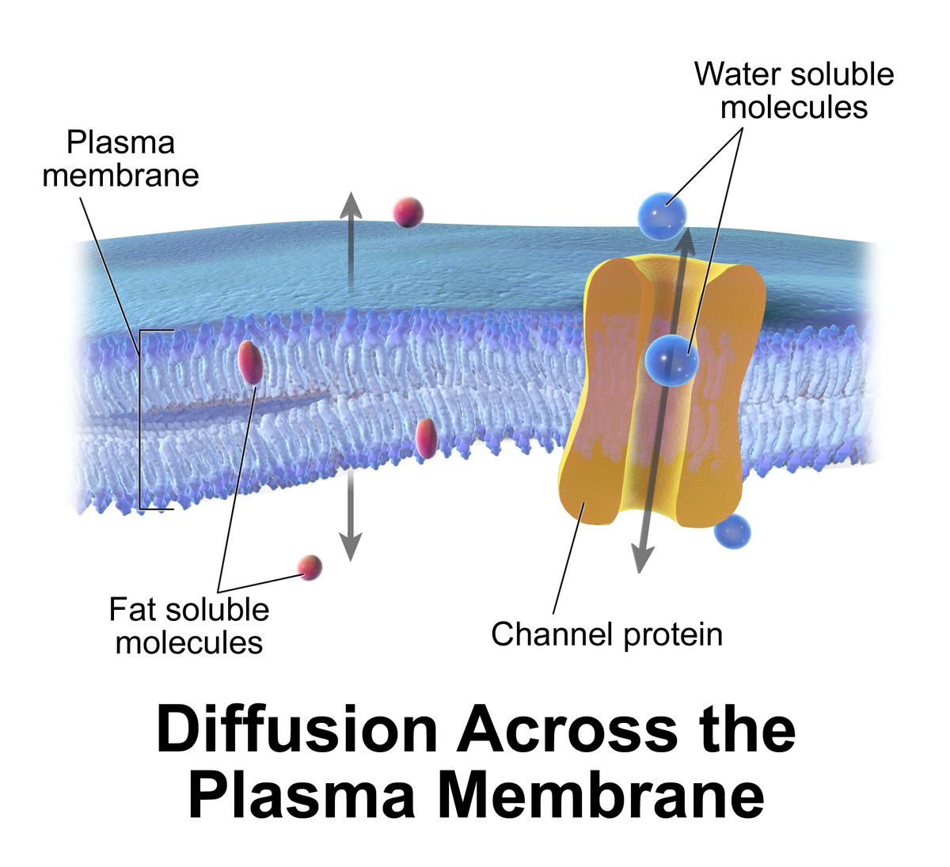
Results
General characteristics of the ligands
At pH 7.0 basic ionic form → Molecule 1, 2, 5, 6, 8
At pH 7.9 zwitterionic form → Molecule 3, 4, 7, 9
However, minimum energy structures of molecules 3 and 7 showed the neutral form how the most stable conformation, reaching energy values of -81,015 and -74,914 kcal/mol respectively
This is probably due to the spatial arrangement of their atoms to provide more stability to the molecule in the gas state.
Molecule 3
Molecule 7
These molecules cross the lipid bilayer is usually done only with non-ionized forms
https://en.wikipedia.org/wiki/Passive_transport

Slide 8
Results
General characteristics of the ligands
The identity percentages obtained from the multiple alignment of sequences in the GyrA WT and GyrA MT is more than 50% in all comparisons, this indicate a structural homology between all subunit A of DNA gyrase
The sequences were aligned based on the E. coli GyrA (6RKU PDB ID) as a reference
The alignment on QRDR shows a high conservation of amino acids, which suggests a high affinity of the same molecule for the gyrase of different microorganisms

Slide 9
Results
Molecular Docking
Molecular Docking Results in GyrA MT of Campylobacter jejuni
From values of free binding energy, inhibition constant, total intermolecular energy and electrostatic energy, the lowest quintile was calculated for each parameter and a threshold value was obtained from this preliminary result, with it a score was established that allowed the identification of a group of better molecules
 | Binding Free Energy (kcal/mol) | Inhibition Constant (µM) | Total Intermolecular Energy (kcal/mol) | Electrostatic Energy (kcal/mol)
Min. | -7,14 | 5,82 | -8,93 | -2,2
Max. | -5,06 | 194,14 | -6,26 | -0,32
R | 2,08 | 188,32 | 2,67 | 1,88
R/5 | 0,416 | 37,664 | 0,534 | 0,376
Threshold Value | -6,724 | 43,484 | -8,396 | -1,824
Min.: The minimum value obtained among all the data
Max The maximum value obtained among all the data
R: Difference between the maximum value and the minimum value
R/5: Lowest quintile
Threshold Value: Min. – (R/5)

Slide 10
Results
Molecular Docking
Molecular Docking Results in GyrA MT of Campylobacter jejuni
Molecule | Microorganism | Binding Free Energy (kcal/mol) | Inhibition Constant (µM) | Total Intermolecular Energy (kcal/mol) | Electrostatic Energy (kcal/mol)
7 | C. jejuni MT | -7,14 | 5,82 | -8,93 | -1,22
7 | C. jejuni WT | -7,64 | 2,51 | -9,43 | -0,83
7 | E. coli MT | -7,45 | 3,44 | -9,24 | -1,3
7 | E. coli WT | -7,44 | 3,54 | -9,23 | -1,24
3 | N. gonorrhoeae MT | -6,81 | 10,21 | -8,3 | -2,53
7 | N. gonorrhoeae WT | -7,11 | 6,14 | -8,9 | -1,74
7 | P. aeruginosa MT | -8,13 | 1,1 | -9,92 | -1,51
7 | P. aeruginosa WT | -7,95 | 1,48 | -9,74 | -1,43
5 | S. enteritidis MT | -7,91 | 1,58 | -9,11 | -0,99
5 | S. enteritidis WT | -7,75 | 2,1 | -8,94 | -0,87
7 | S. typhi MT | -7,38 | 3,92 | -9,17 | -1,2
7 | S. typhi WT | -7,38 | 3,89 | -9,17 | -1,27
Here summarized the best values of the parameters and shows molecule 7 as the one with the highest affinity against GyrA of each microorganism

Slide 11
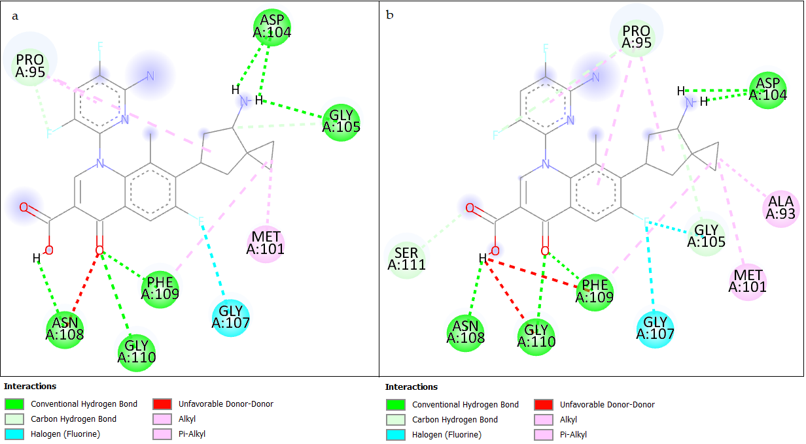
Results
Molecular Docking
Results of Interactions in Molecular Docking
The residues involved in the interaction with the molecule 7 within QRDR allowed to establish similarities
E. coli
S. typhi
For E. coli and S. thypi, share interactions in residues Pro95, Met101, Asp104, Gly105, through hydrogen bridges
The interactions are strong in the binding of fluoroquinolone to the enzyme
The interactions occurs with the carboxyl group of position 3, the carbonyl group in C₄, and the amino group of the side chain on C₇

Slide 12
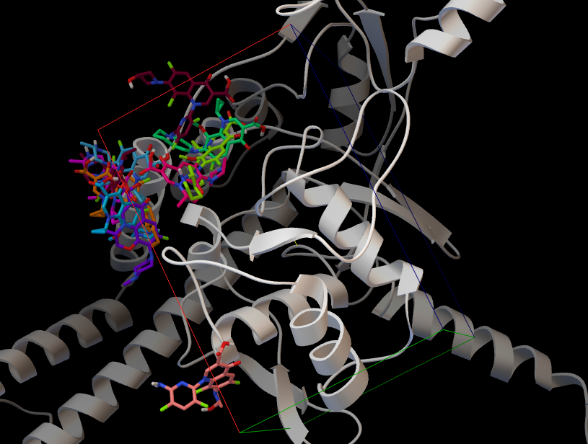
Results
Retrospective Docking
Carried out from a library of ligands and decoy molecules observing the binding sites in which the coupling of the molecules with activity takes place primarily in GyrA through blind docking
The image shows some modes in which the ligand binds to the receptor (GyrA of E. coli) after observational analysis of a total of 15 conformations
The positions where occurs the docking with four fluroquinolones are in an area too close to the region covered by the grid defined as the binding site of the new molecules.

Slide 13
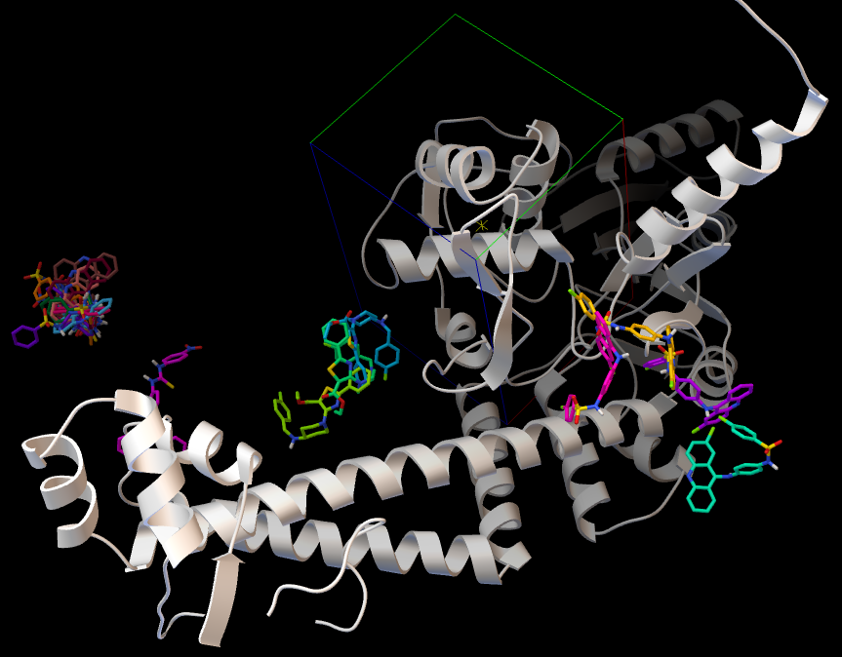
Results
Retrospective Docking
Exist a diverse affinity of inactive molecules by different sites throughout the structure of Gyr A of E. coli
The positions of the different couplings generated in the blind docking with inactive compounds in relation to the position covered by the grid, it was observed that several conformations are far from the QRDR.
This assure the existence of a degree of affinity between the new molecules and the GyrA with reliable molecular docking results

Slide 14
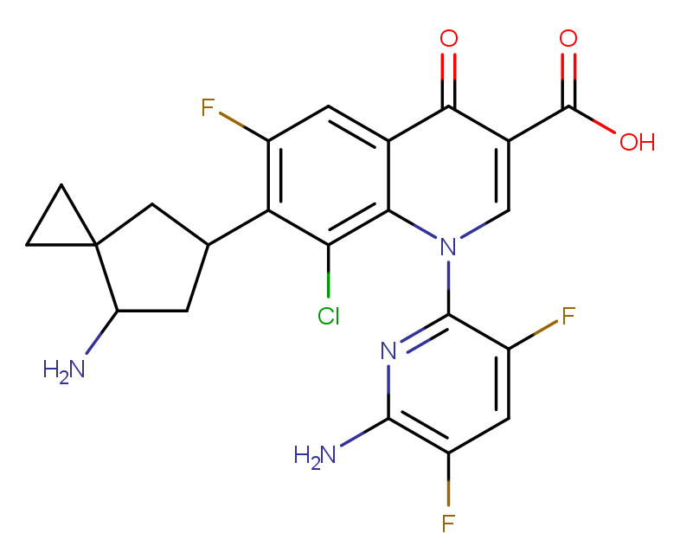
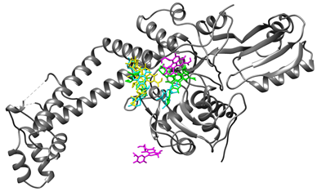
Conclusions
The results of molecular docking point to molecule 7 as the largest affinity against the subunit A of the DNA gyrase wild type and mutant type of Campylobacter jejuni, Escherichia coli, Pseudomonas aeruginosa, and Salmonella enterica serovar typhi
The molecule 7 showed better affinity parameters with respect to its analog ciprofloxacin.
Retrospective docking ensures that the affinity shown by new molecules to GyrA has a good degree of reliability, as several conformations of active compounds bind to an area very close to QRDR

Slide 15
Thank You!

