Slide 2
Molecular Docking Study of Flavonoids to Block the Aryl Hydrocarbon Receptor
Oscar Collado García^{1,2,3,*}, Hans De Winter², Paul Cos³, Maria João Matos^{4,5}, Eugenio Uriarte^{4,6}, Gabriel Llaurado Maury⁷, Jorrit De Waele⁸, Glay Chinea Santiago⁹ and Enrique Molina^{1,2,3}
¹ Department of Chemistry, Faculty of Applied Sciences, University of Camagüey, Camagüey 74650, Cuba
² Laboratory of Medicinal Chemistry, University of Antwerp, Antwerp BE-2610, Belgium
³ Laboratory of Microbiology, Parasitology and Hygiene (LMPH), University of Antwerp, Antwerp BE-2610, Belgium
⁴ Department of Organic Chemistry, Faculty of Pharmacy, Universidade Santiago de Compostela, 15782 Santiago de Compostela, Spain
⁵ CIQUP/Department of Chemistry and Biochemistry, Faculdade de Ciências, Universidade do Porto, 4169–007 Porto, Portugal
⁶ Institute of Applied Chemical Sciences, Autonomous University of Chile, Santiago de Chile 7500912, Chile
⁷ Center for Industrial Biotechnology (CEBI), Universidad de Oriente, Santiago de Cuba 90500, Cuba
⁸ Oncology Research Group (CORE), University of Antwerp, Antwerp BE-2610, Belgium
⁹ Bioinformatics Group, Center for Genetic Engineering and Biotechnology, Havana, Cuba
* Mobile phone: +3252490219. E-mail: ogcolladogarcia@gmail.com

Slide 3
Abstract: The Anti-HIF flavonoids have been described with antitumor activity by interfering with a presumed antioxidant mechanism through direct and indirect ways of overexpression of Hypoxia Inducible Factor (HIF-1α). The aryl hydrocarbon receptor (AhR) is a protein homologous to HIF-1α and is overexpressed in smoking patients suffering from lung and breast cancer. The interaction of thirteen flavonoids with the AhR has been evaluated by molecular docking. The AhR:ARNT model obtained by SwissModel was used for docking with the MOE 2019.01 program, as well as several servers for the determination of protein-protein interactions and alanine mutations. Different interaction sites were identified for blocking the AhR: functional ARNT, the interface between the bHLH and PAS-A domains, being important. The blocking capacity to AhR:ARNT is between 50-60% for flavonoids 4’,7-dihydroxy-flavone, fisetin, luteolin, 5-hydroxy-2-(4´-hydroxy)-7-methoxy-flavonone, flavone, apigenin, galangin and 7-hydroxy-5-methoxy-flavonone. None of the flavonoids evaluated interact with the PAS-B domain (AhR active site). All the studied flavonoids interact with AhR, except flavone, and to ARNT except the compounds 3,7-dihydroxy-flavone and kaempferol. The best flavonoid for blocking the formation of the AhR:ARNT heterodimer proved to be fisetin, which is found in food sources such as strawberries, apples and grapes, and has shown the ability to reduce pro-cancer inflammatory markers in colorectal cancer patients and lung cancer.
Keywords: Flavonoids, Molecular Docking, Aryl Hydrocarbon Receptor.

Slide 4
Introduction
The aryl hydrocarbon receptor (AHR), which is also known as the dioxin receptor, is a basic transcription factor that contains helix-loop-helix (bHLH) and Per-Arnt-Sim (PAS). It is present in numerous animal species, including humans, and activates gene expression in a ligand-dependent manner. Ligand binding in the PAS-B domain of AHR leads to nuclear translocation and heterodimerization with the AHR nuclear translocator protein (ARNT). This AHR:ARNT heterodimer binds to DNA sequences, called xenobiotic-responsive elements (XRE), that are distributed in the enhancer regions of dioxin-responsive genes and regulate the expression of target genes. The binding of the ligand to AHR occurs on the PAS-B domain. AHR:ARNT dimerization involves interactions between its bHLH and PAS domains, and DNA binding occurs primarily through its basic domains. AHR is overexpressed in patients with lung and colorectal cancer. The search for new antitumor compounds is an important research area to improve effectiveness, increase survival, as well as to decrease multidrug resistance, adverse reactions and mortality in these patients [1-6].
Taking this into account and considering that flavonoid compounds are well known and have characteristics that have made them attractive for cancer research, we proceeded to determine by molecular docking the interaction of flavonoids with the receptor AHR to block the formation of the functional heterodimer.

Slide 5
Materials and Methods
Molecular docking: A database created of flavonoids was used for modeling, thus a model obtained by SwissModel Web Server of the AHR receptor and its heterodimer complex with ARNT using as the crystal structure of ARNT (PDB: 4zp4) and the AHR sequence. For molecular modeling visualization, presentation of complexes, poses and interactions, the MOE 2019.01 program was used. The server programs Cocomaps (bioCOmplexes Contact MAPS) was used for the determination of atomic contacts between protein interfaces of the AHR:ARNT. Important amino acid residues for protein-protein interaction as well as flexibility of alanine mutations were determined with Robetta and Rosetta Backrub web servers.
A positive control was used as proof of concept for the antiproliferative activity in the lung cancer cell line (A549) and for the identification of a new binding site, 5,7-diacetoxy-3-phenylcoumarin.

Slide 6
Results
PAS-B domain
AHR
ARNT
PAS-A domain
bHLH domain
PAS-B domain
PAS-A domain
bHLH domain
Figure 1. Structural architecture of the interaction of the monomers AHR and ARNT for the formation of the functional heterodimer AHR:ARNT modeled by SwissModel.

Slide 7
Active flavonoids. AHR monomer
AHR
AHR:ARNT
NEW
Potential active site
-90°
Figure 2. Interaction of flavonoids at the interface of the bHLH and PAS-A domains of AHR modeled by SwissModel. bHLH-PAS-A (Yellow color), PAS-A (Red color).

Slide 8
NEW
Potential active site
Figure 3. Interaction of flavonoids at the interface of the bHLH and PAS-A domains of AHR modeled by SwissModel. A: bHLH-PAS-A (Yellow), PAS-A (red).

Slide 9
Active flavonoids. ARNT monomer
Figure 4. Interaction of flavonoids at the interface of the bHLH and PAS-A domains of ARNT.

Slide 10
Table 1. Structures of flavones and flavonols active to block the formation of the functional heterodimer AHR:ARNT. Percentages of probability of the activity estimated by molecular docking.

Slide 11
Table 2. Structure of active flavonones to block the formation of the functional heterodimer AHR: ARNT. Percentages of probability of the activity estimated by molecular docking.
Isoflavone
Compound 18: Genistein. AHR:ARNT Prob (%): 40
Compound 19: Resveratrol. AHR:ARNT Prob (%): 30

Slide 12
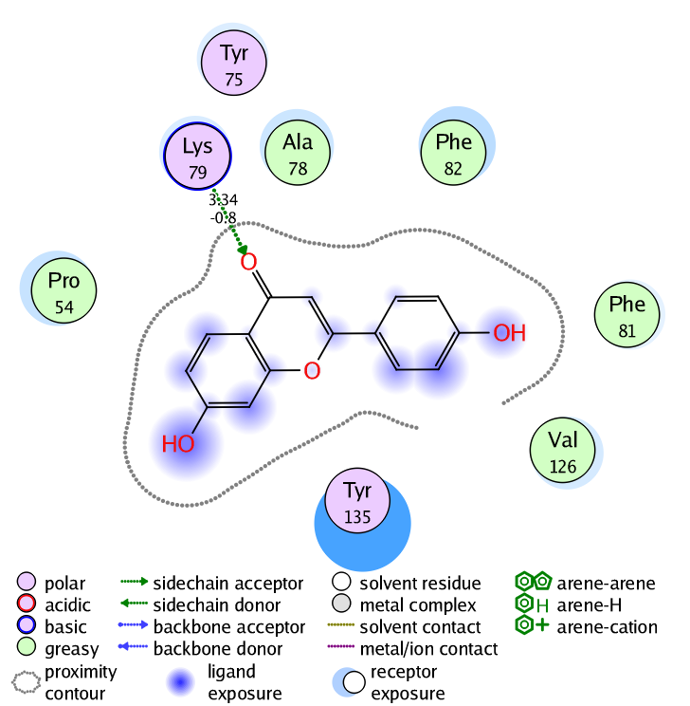
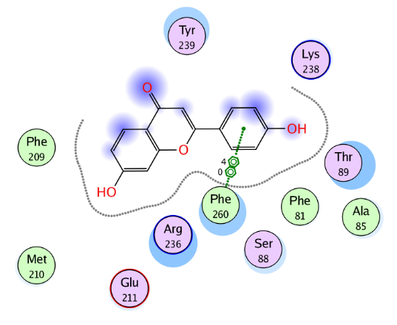
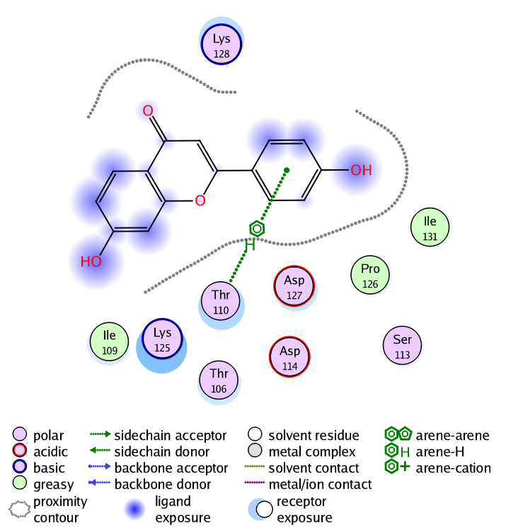
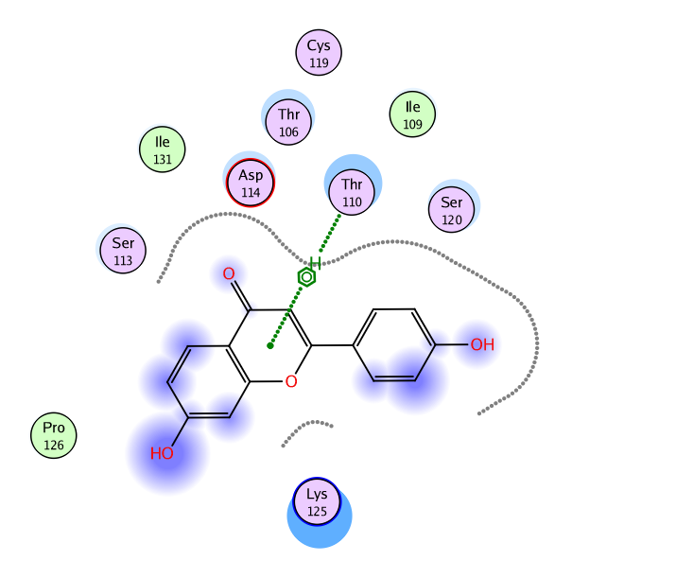
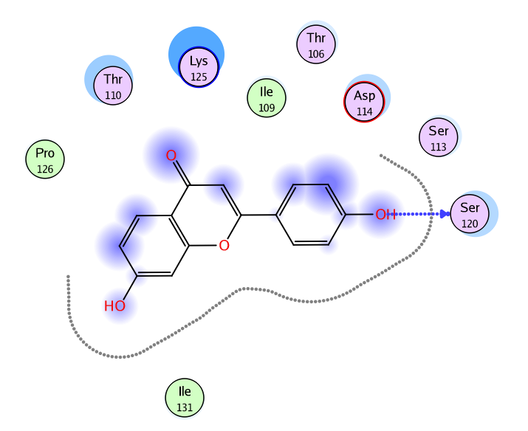
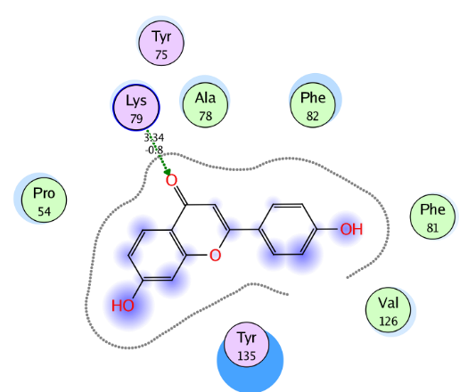
Active flavonoids with a probability of blockage greater than 50 %
AHR
ARNT
Pose 2
Pose 3
Pose 1
Pose 2
Pose 5
Pose 3
Figure 5. Interaction network between monomeric proteins AHR, ARNT and the studied compound 1.

Slide 13
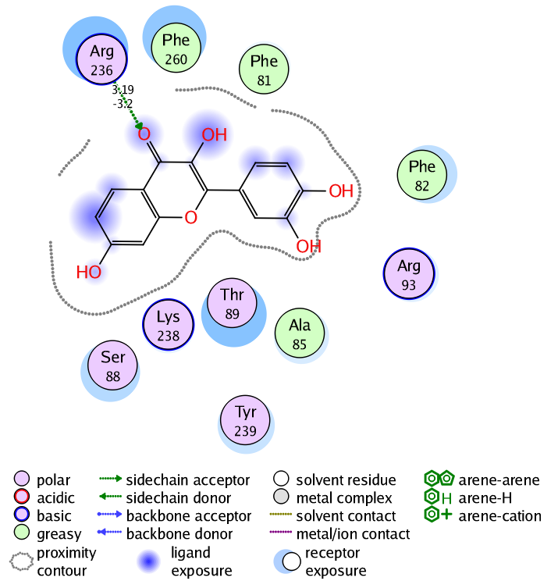
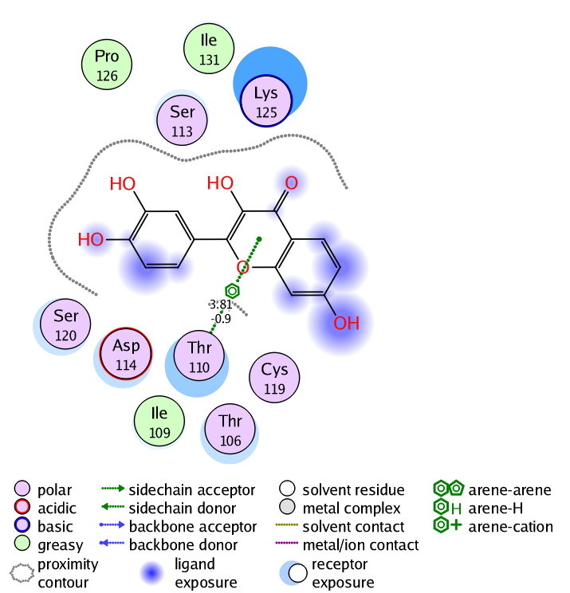
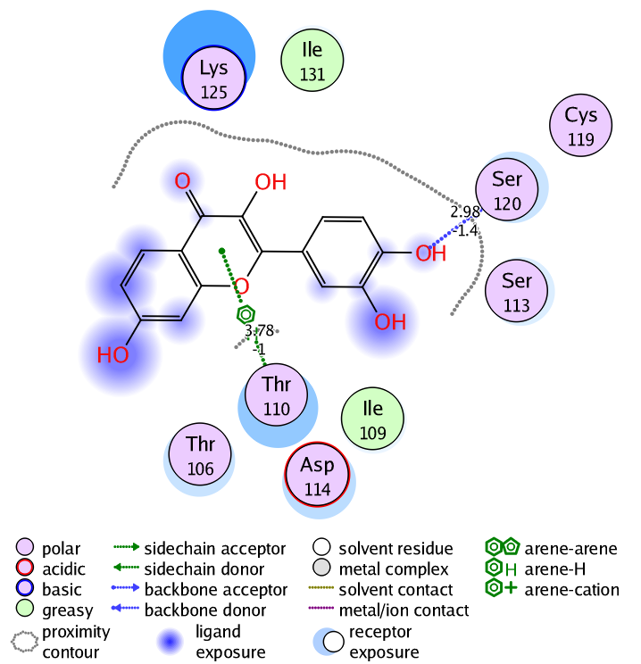
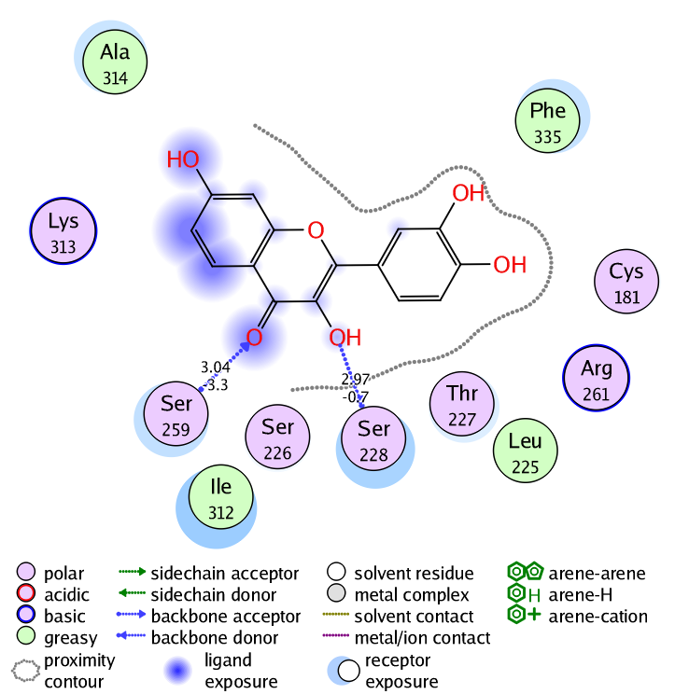
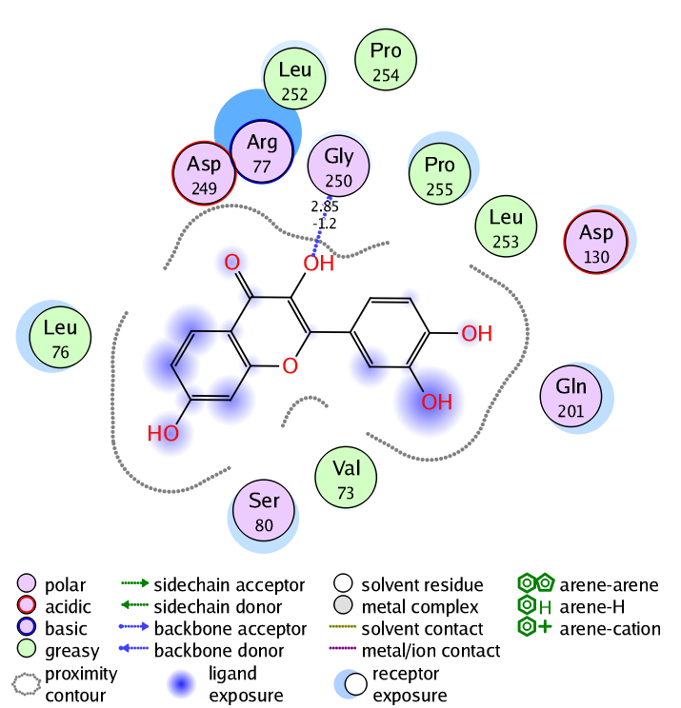
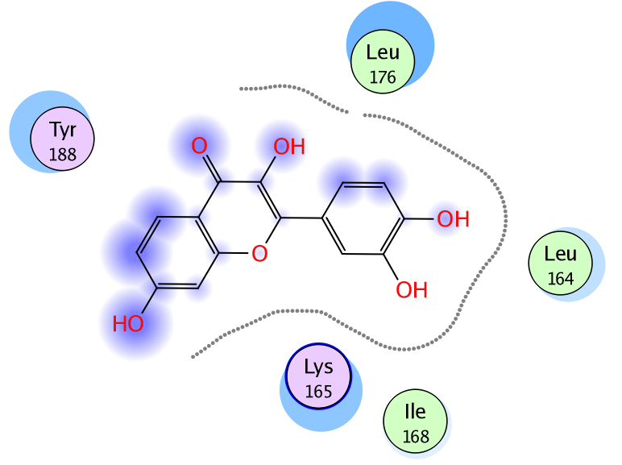
Active flavonoids with a probability of blockage greater than 50 %
AHR
ARNT
Pose 1
Pose 2
Pose 3
Pose 5
Figure 6. Interaction network between monomeric proteins AHR, ARNT and the studied compound 2.

Slide 14
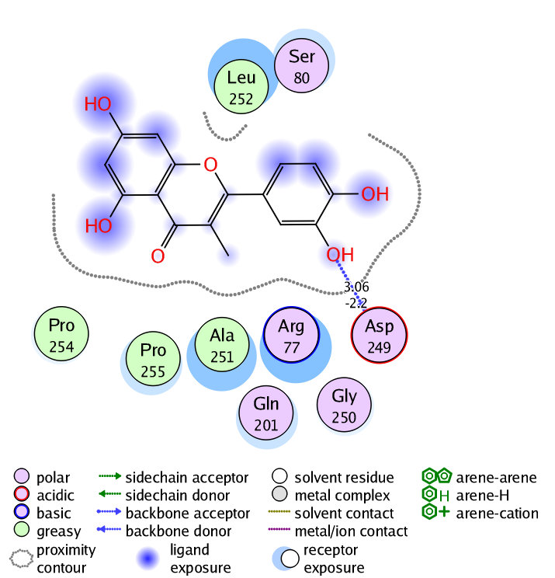
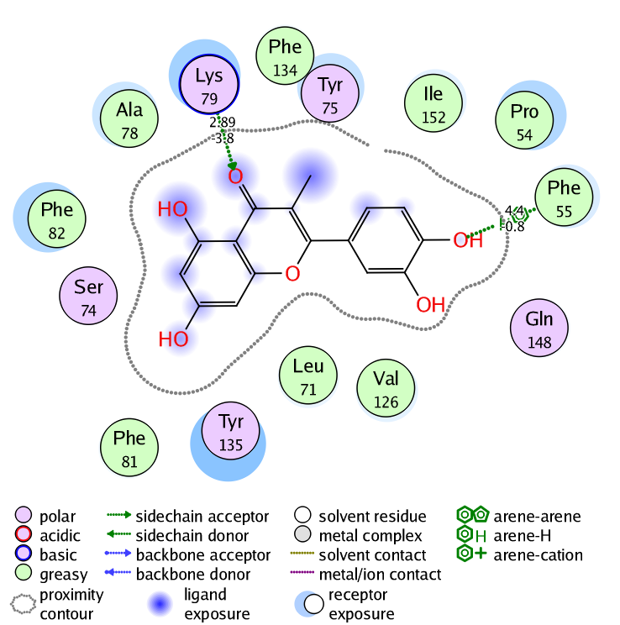
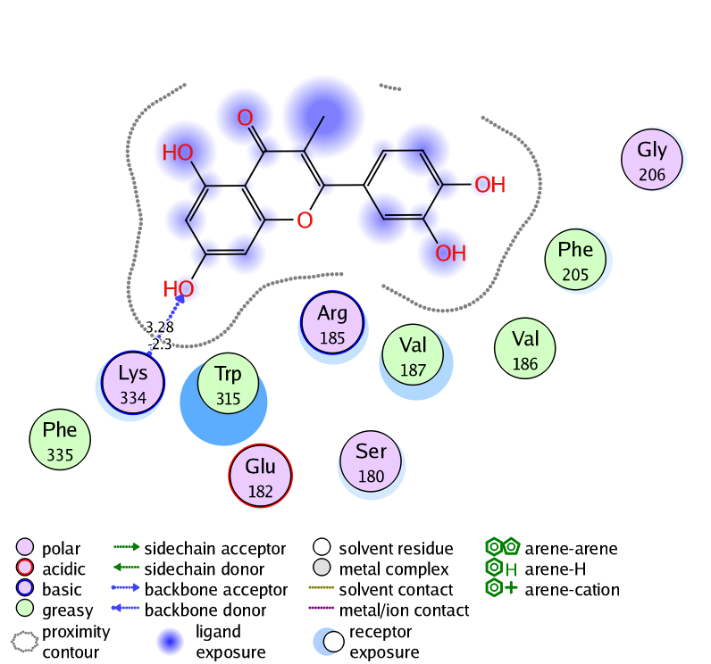
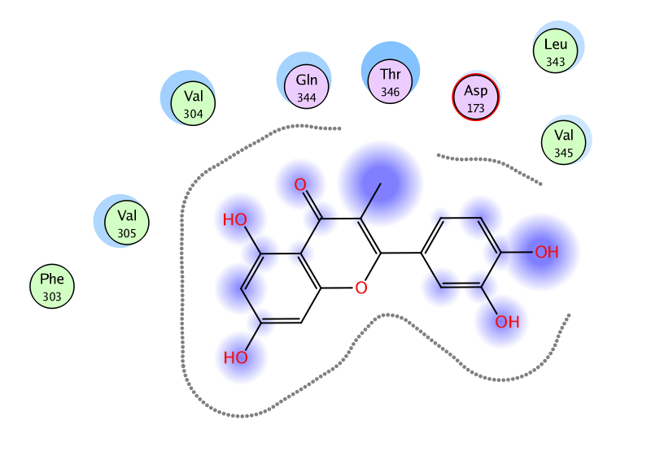
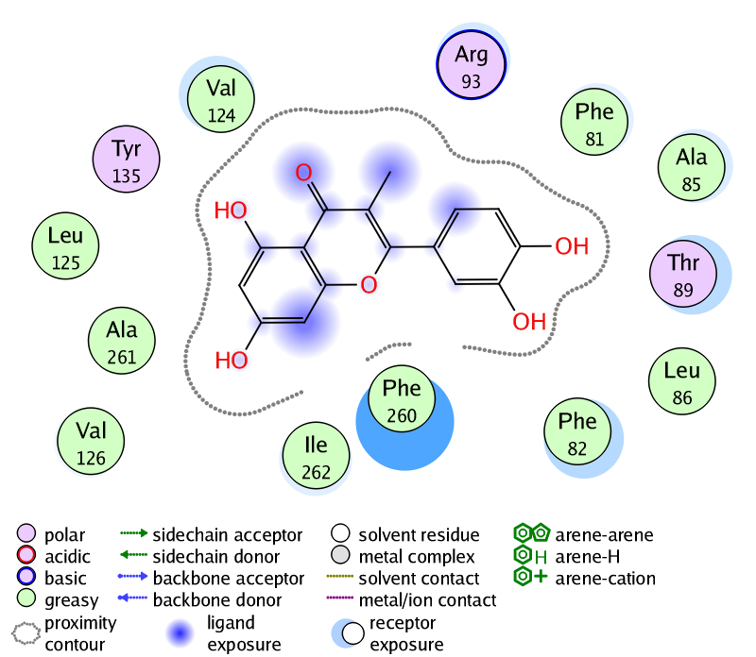
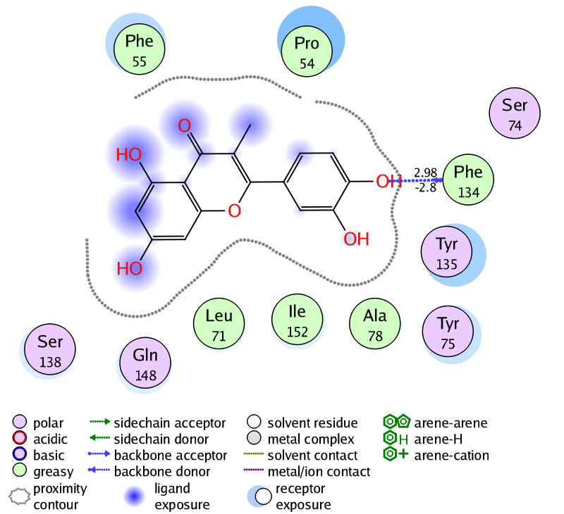
Active flavonoids with a probability of blockage greater than 50 %
AHR
ARNT
Pose 1
Pose 2
Pose 1
Pose 3
Pose 4
Pose 3
Figure 7. Interaction network between monomeric proteins AHR, ARNT and the studied compound 3.

Slide 15
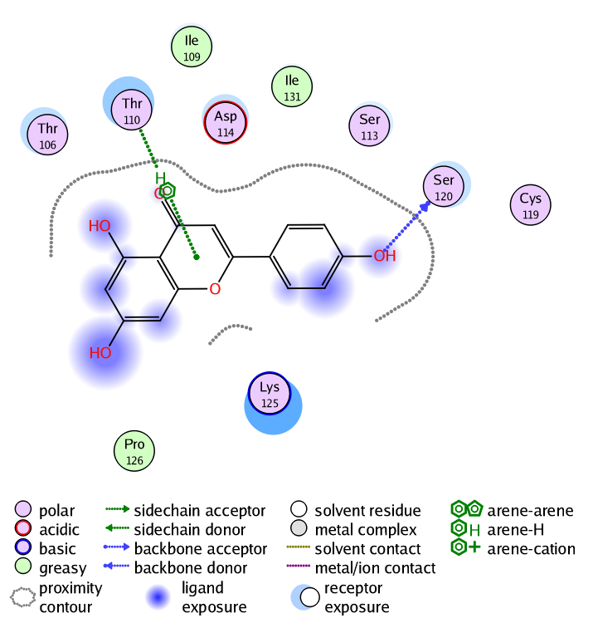
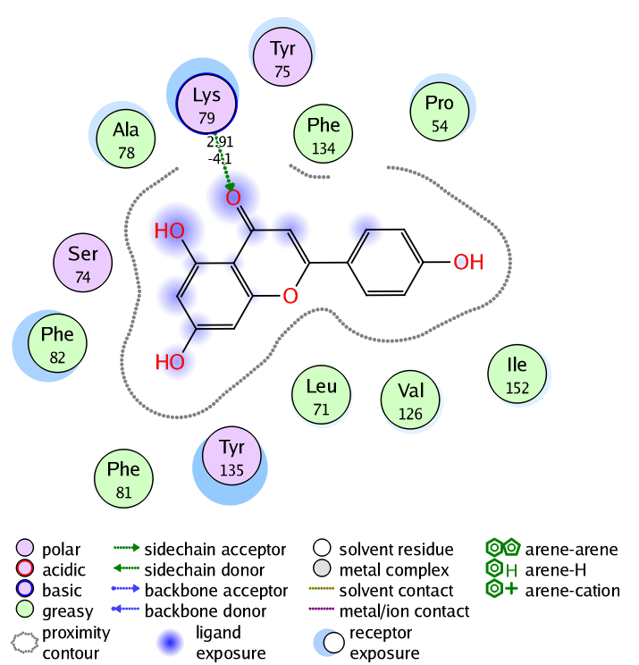
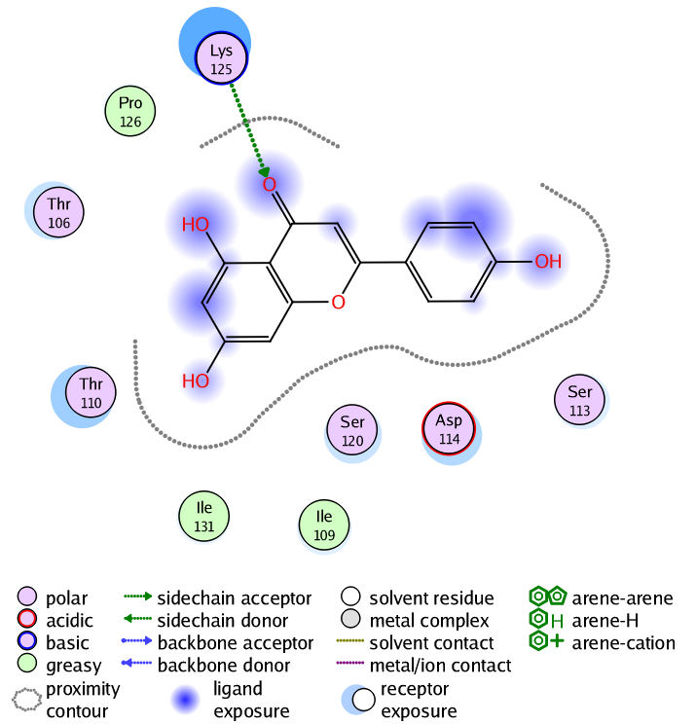
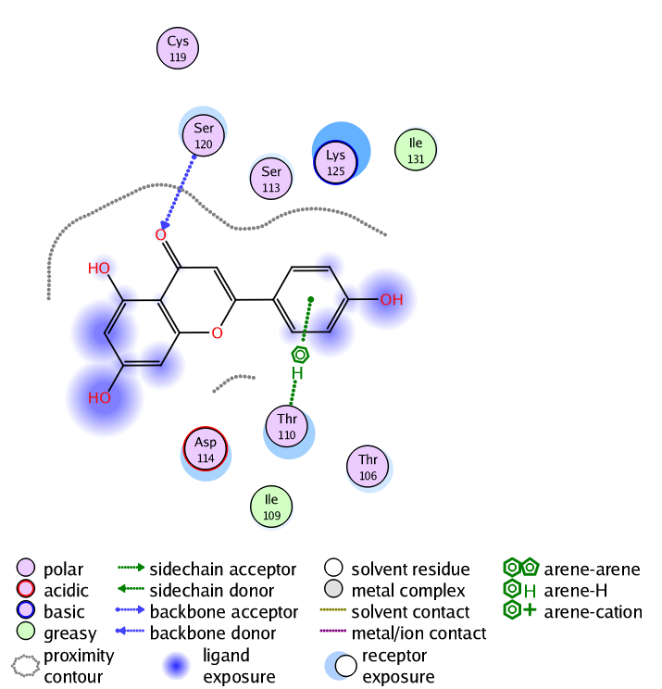
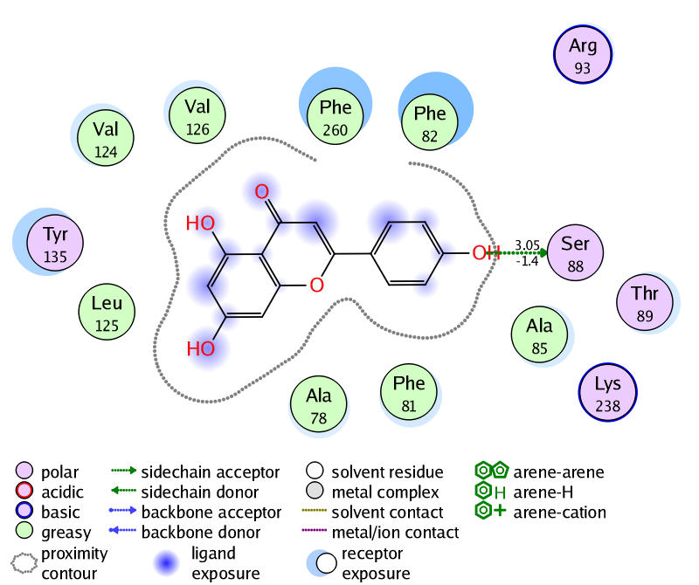
Active flavonoids with a probability of blockage greater than 50 %
AHR
ARNT
Pose 2
Pose 1
Pose 2
Pose 4
Pose 3
Figure 8. Interaction network between monomeric protein AHR, ARNT and the studied compound 4.

Slide 16
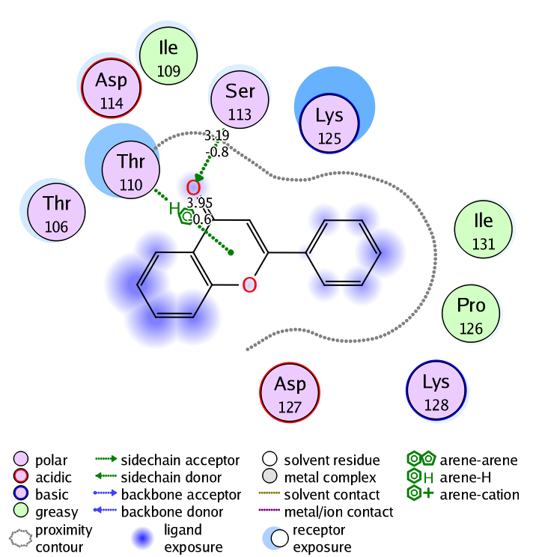
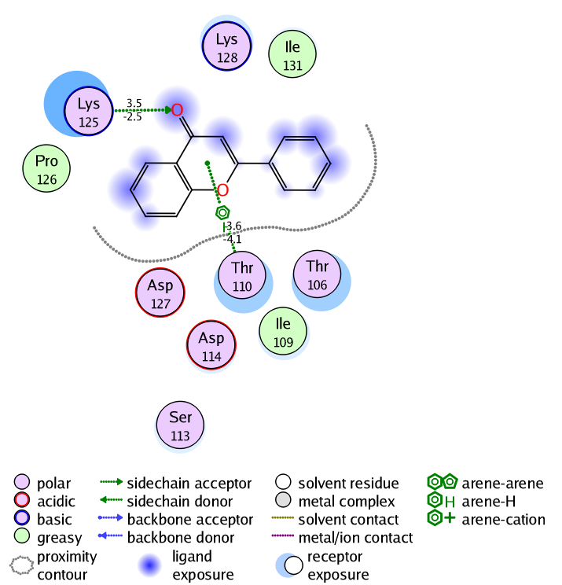
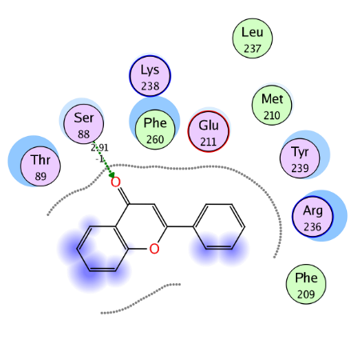
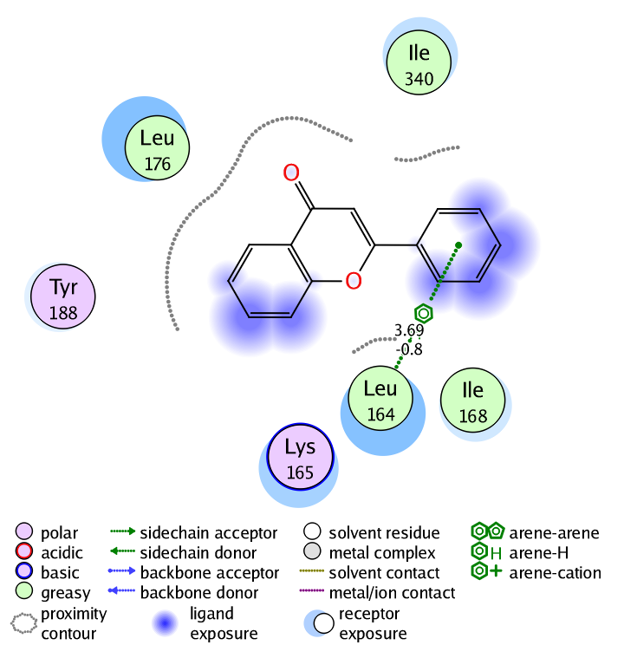
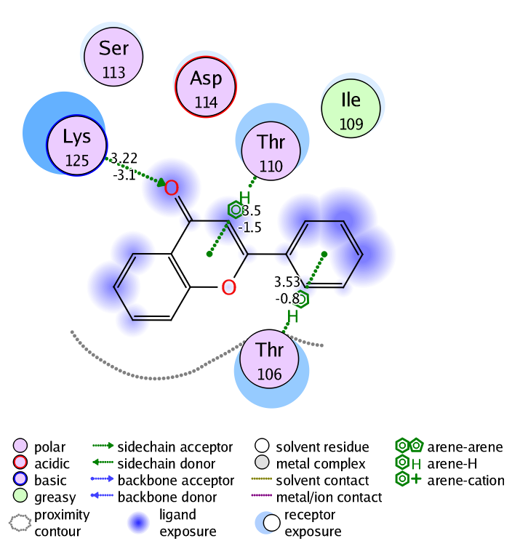
Active flavonones with a probability of blockage greater than 50 %
ARNT
Pose 1
Pose 2
AHR
Pose 5
Pose 3
Pose 5
Figure 9. Interaction network between monomeric proteins AHR, ARNT and the studied compound 5.

Slide 17
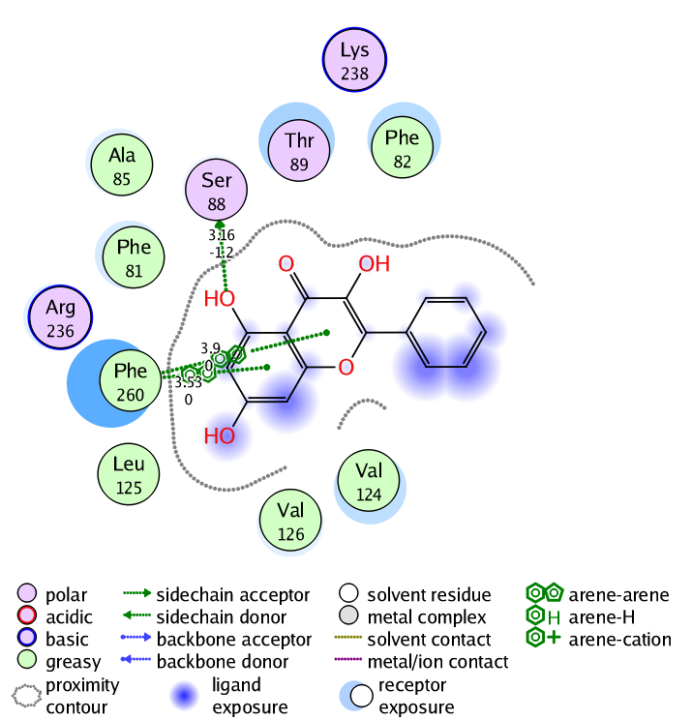
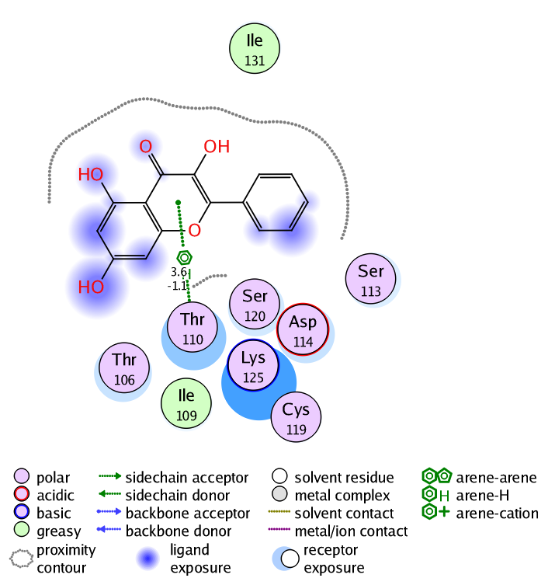
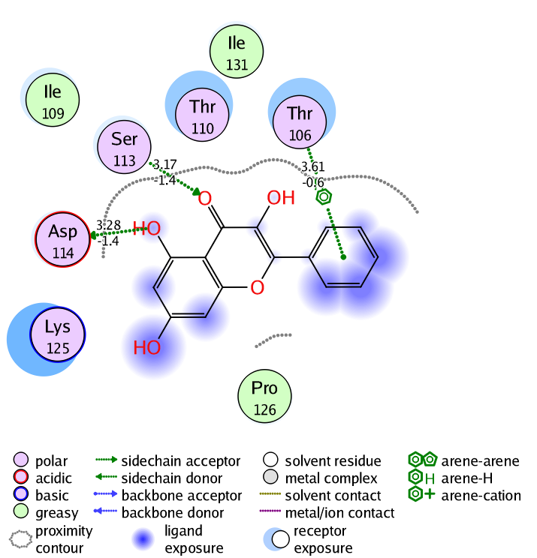
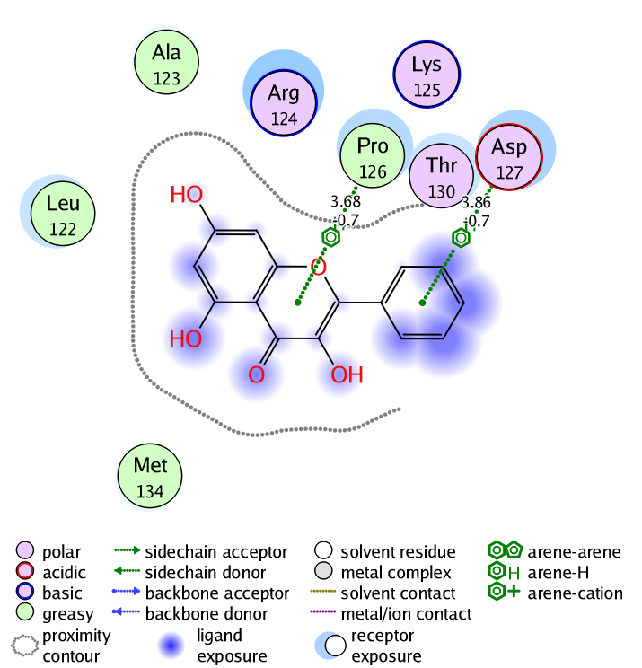
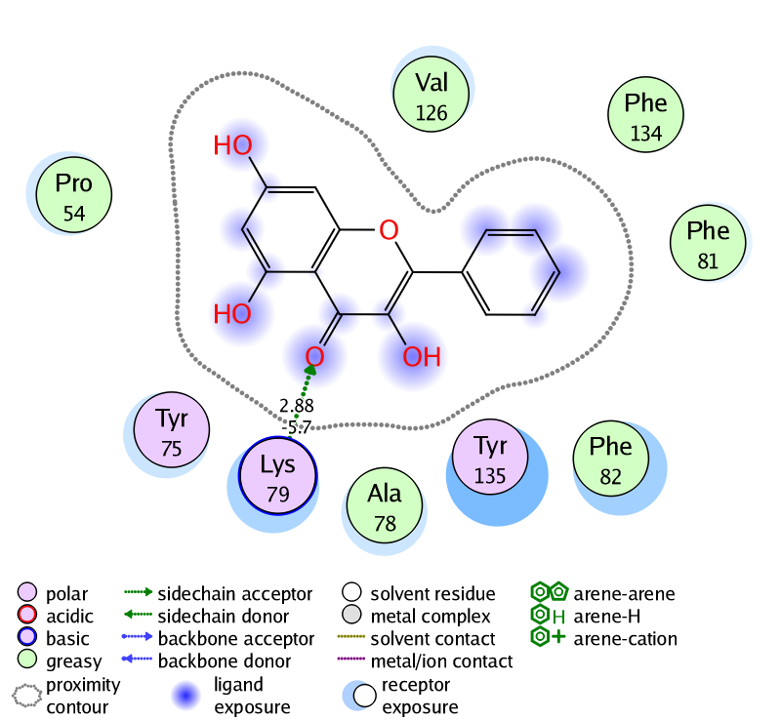
Active flavonones with a probability of blockage greater than 50 %
AHR
ARNT
Pose 3
Pose 1
Pose 2
Pose 4
Pose 3
Figure 10. Interaction network between monomeric protein AHR, ARNT and the studied compound 6.

Slide 18
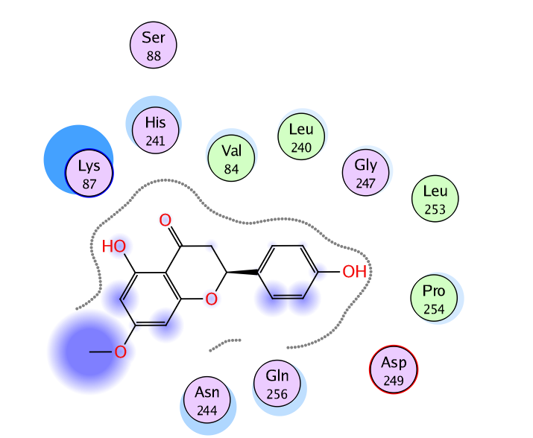
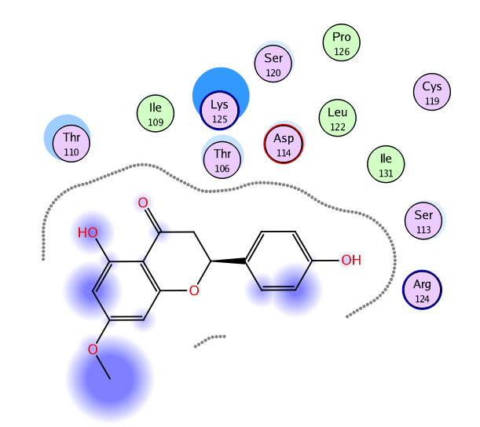
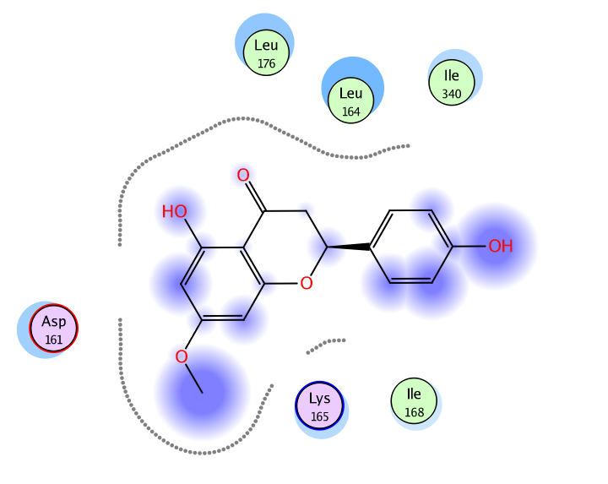
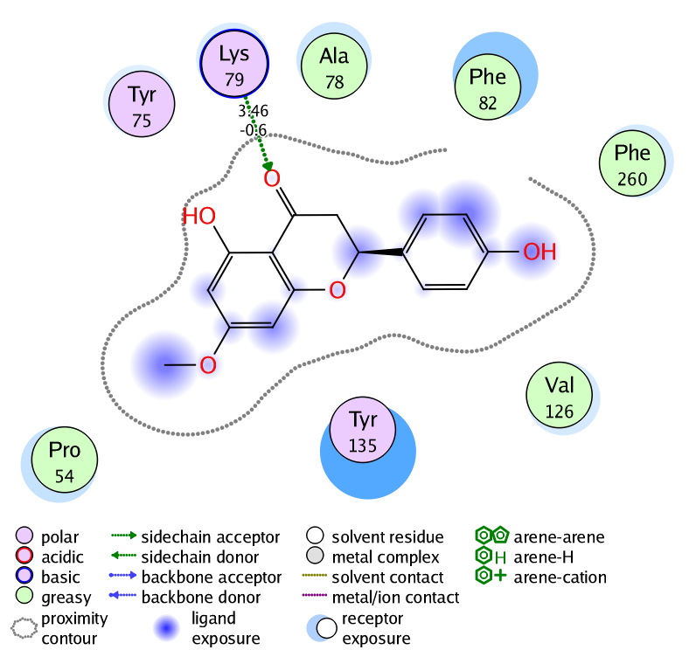
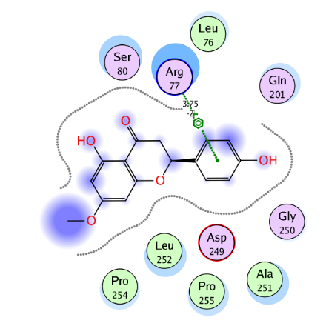
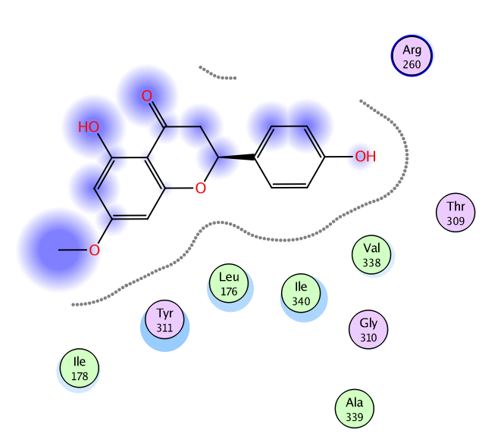
Active flavonones with a probability of blockage greater than 50 %
AHR
ARNT
Pose 2
Pose 4
Pose 1
Pose 2
Pose 5
Pose 3
Figure 11. Interaction network between monomeric protein AHR, ARNT and the studied compound 15.

Slide 19
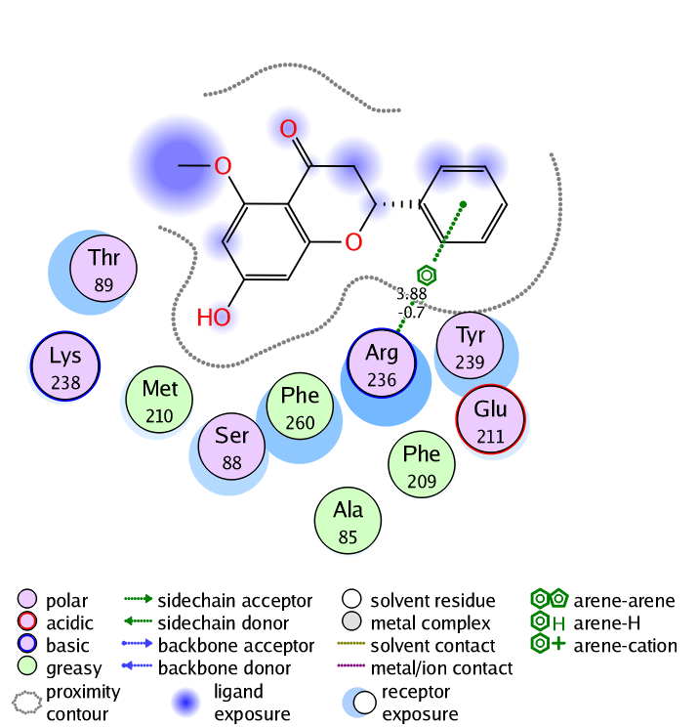
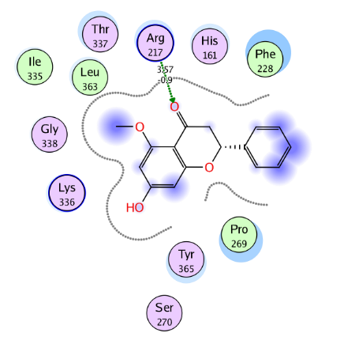
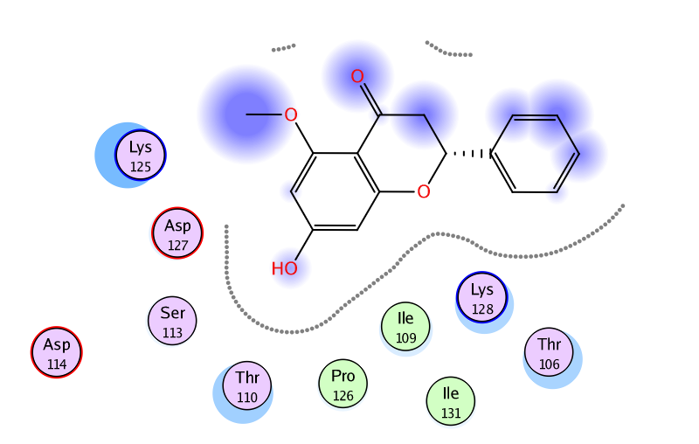
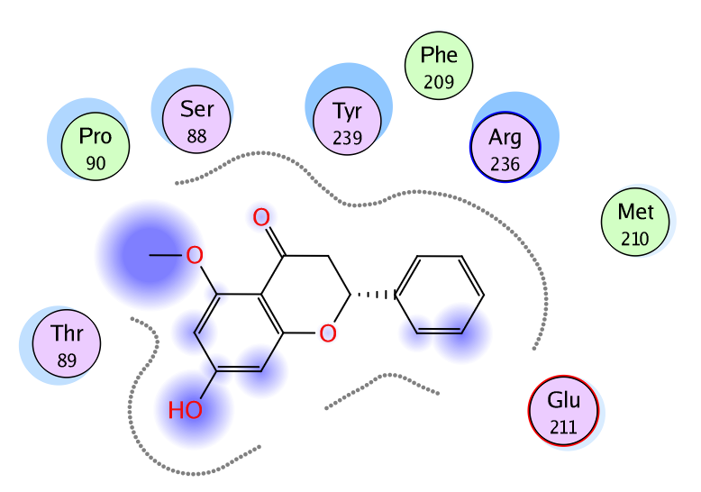
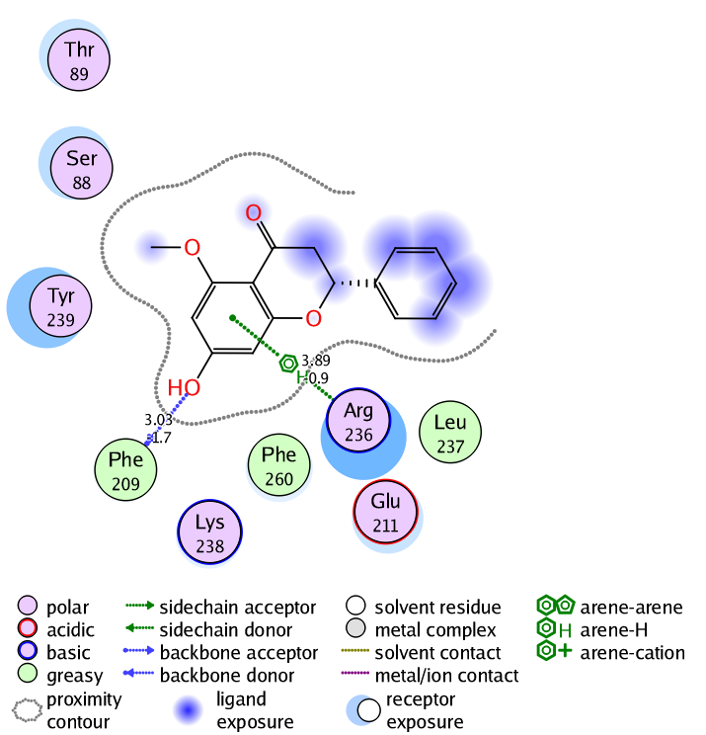
Active flavonones with a probability of blockage greater than 50 %
AHR
Pose 1
Pose 2
ARNT
Pose 1
Pose 3
Pose 4
Figure 12. Interaction network between monomeric protein AHR, ARNT and the studied compound 16.

Slide 20
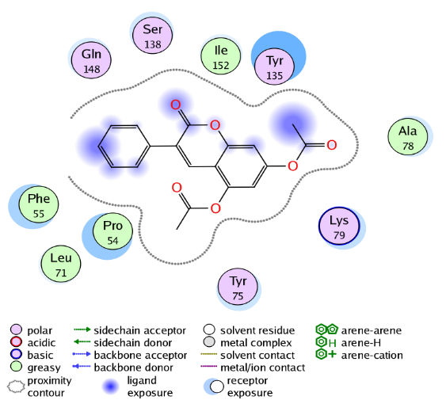
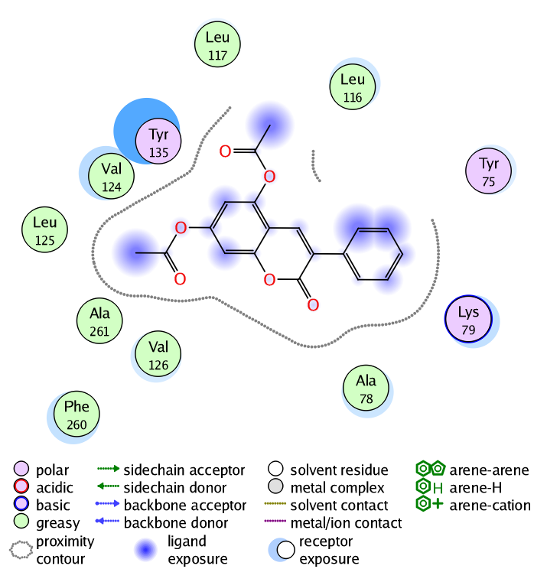
Proof of concept
NEW
Pose 3
Compound 20
Pose 4
5,7-diacetoxy-3-phenylcoumarin
Activity (% prob): Active (40)
Table 3. Antiproliferative activity of compound 20 on a lung cancer cell line (A549).

Slide 21
Conclusions
Eight flavonoids with potential activity blocking the AHR:ARNT heterodimer were identified by molecular docking, with probability percentages between 50-60 %. The flavonoid interactions at the interface surfaces of the bHLH and PAS-A domains of AHR and ARNT proved to occur by hydrogen bonding and hydrophobic type fundamentally, without binding to the PAS-B domain of AHR. A new surface binding site is proposed at the level of the bHLH/PAS-A interface as the most likely site to which 74% of the studied flavonoids bind to the interfere with the formation of the complex. Glycosylated flavonoids showed AHR:ARNT blocking percentages of less than 50%. In the case of flavonones, the incorporation of a hydroxyl group in position R4’ increases the activity by 30%. It is estimated that the flavonoids identified as active display antiproliferative activity in lung cancer cells (A549) due to the structural similarity with the nucleus of the evaluated coumarin, which presented a blocking percentage of the AHR:ARNT of 40%, binding to the same site of the AHR surface interface.

Slide 22
References
Salzano M, Marabotti A, Milanesi L, Facchiano A. Human aryl-hydrocarbon receptor and its interaction with dioxin and physiological ligands investigated by molecular modelling and docking simulations. Biochem Biophys Res Commun. 2011; 413(2): 176-81. doi: 10.1016/j.bbrc.2011.08.039. Erratum in: Biochem Biophys Res Commun. 2012 Feb 24; 418(4):852.
Denison MS, Soshilov AA, He G, DeGroot DE, Zhao B. Exactly the same but different: promiscuity and diversity in the molecular mechanisms of action of the aryl hydrocarbon (dioxin) receptor. Toxicol Sci. 2011; 124(1): 1-22. doi:10.1093/toxsci/kfr218.
Wu D, Potluri N, Kim Y, Rastinejad F. Structure and dimerization properties of the aryl hydrocarbon receptor PAS-A domain. Mol Cell Biol. 2013; 33(21): 4346-4356. doi:10.1128/MCB.00698-13.
Corrada D, Soshilov AA, Denison MS, Bonati L. Deciphering Dimerization Modes of PAS Domains: Computational and Experimental Analyses of the AhR:ARNT Complex Reveal New Insights Into the Mechanisms of AhR Transformation. PLoS Comput Biol 2016; 12(6): e1004981. doi:10.1371/journal.pcbi.1004981.
Corrada D, Denison MS, Bonati L. Structural modeling of the AhR:ARNT complex in the bHLH-PASA-PASB region elucidates the key determinants of dimerization. Mol Biosyst. 2017;13(5): 981-990. doi: 10.1039/c7mb00005g.
Goya-Jorge E, Jorge Rodríguez ME, Veitía MS-I, Giner RM. Plant Occurring Flavonoids as Modulators of the Aryl Hydrocarbon Receptor. Molecules 2021, 26, 2315. doi:10.3390/molecules26082315.

