Slide 1
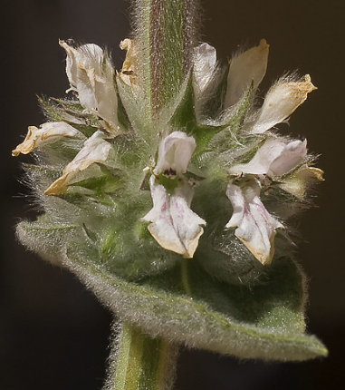
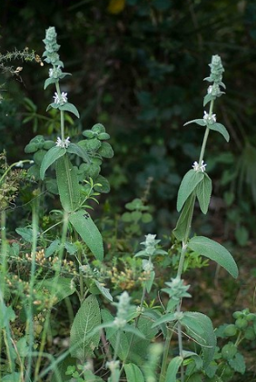
Quantitative Analysis of total phenolic and flavonoid contents from Stachys mouretii leaves extracts
Abdelmoughite Ouakil¹, Soumaya El ismaili², Ouafaa El Mahdi²,Amal Maurady³, Brahim El Bali¹ and Mohammed Lachkar¹
¹Engineering Laboratory of Organometallic and Molecular Materials, Faculty of Sciences, Sidi Mohammed Ben Abdellah University, Po. Box 1796 (Atlas), 30000 Fez, Morocco.
²University Sidi Mohamed Ben Abdellah, Faculté Polydisciplinaire de Taza, B.P. 1223 Taza gare. Laboratoire Ressources Naturelles et Environnement, Morocco.
³Laboratory of Innovative Technologies, Civil Engineering Department, ENSA of Tangier.
Objectives
Our interest is focused in particular on :
Extraction of the leaves of Stachys mouretti with different solvents.
Preliminary phytochemical analysis
Analyzed total phenolic and flavonoid contents.
Introduction
results
Stachys mouretii is an endemic plant of Morocco belonging to the Lamiaceae family. The genus Stachys L. is one of the largest genera of the Lamiaceae (also known as Labiatae), and it consists of approximately 300 species displaying a remarkable range of variation. It is mainly distributed in the warm temperate regions of the Mediterranean and south-west Asia, with secondary distributions in North and South America and Southern Africa.
Different Stachys species, which are known as betony, woundwort or mountain tea in folk medicine and used in the preparations of yogurt or jelly or traditionally as flavorings and seasonings. Furthermore, plants of this genus have been used for centuries as herbal remedies in the treatment of several complaints. (1).
In recent years, pharmacological studies on different taxa of this genus demonstrated some effects of extracts or isolated components such as anti-inflammatory, antitoxic, antibacterial, antioxidant and cytotoxic. Many other Stachys are used for the healing of skin, stomach, ulcer, asthma, rheumatic diseases and vaginal tumors (1,2). Phytochemical studies on Stachys species reported the presence of phenylethanoid glycosides, iridoids, triterpenoids, steroids, diterpenes, flavonoids, fatty acids, polysaccharides and other secondary metabolites.
We have chosen Stachys mouretii as the object of our study since no investigation has been carried out on this species to date.
Percentage yield of crude extracts
After 12h continuous hot extraction of powder leaves of Stachys mouretii in hexane, 24h in ethyl acetate and 24h in methanol different amounts were obtained. The amounts that have been found are 3.9g of hexanic extract, 5.5g of ethyl acetat extract and 18,8g of methanolic extract.
Fig. 1: Yields of Hexae, Ethyl acetate and Methanol extracts of Stachys mouretii.
Total phenols content (TPC)
The TPC of the various leaves extract is expressed in terms of GAE and presented in figure 2. The TPC were calculated using the following linear regression equation obtained from the standard plot of gallic acid
Methods
where y is absorbance and x is the amount of gallic acid in µg
Collection of plant material : The leaves of Stachys mouretii were collected in April 2018 from Talasmtan forest in the region of Ouazzane. Then, they were thoroughly washed with water to remove dust and dried under the shade at room temperature for 7 days. The dried leaves were ground using kitchen blender to obtain the course powder and kept in an air tight container till further use
Preparation of extracts :The dried powdered leaves of Stachysmouretii (160g) were extracted exhaustively by Soxhlet method with increasing polarity of solvents (hexane, ethyl acetate and methanol).
Determination of total phenols by Folin-Ciocalteu reagent method
Folin-Ciocalteu reagent was used to determine the total phenolic content of the various organic crude extracts Gallic acid was used as a reference standard Gallic acid was used as a reference standard for plotting calibration curve. A volume of 0.5 mL of the plant extract (100 μg/mL) was mixed with 1.5 mL of Folin-Ciocalteu reagent and were neutralized with 3 mL of sodium carbonate solution (7.5%, w/v) The reaction mixture was kept in dark at room temperature for 30 min with intermittent shaking for color development. The absorbance of the resulting blue color was at fixed wavelength of 765 nm. The TPCs were determined using linear regression equation obtained from the standard plot of gallic acid measured by using double beam UV-Vis spectrophotometer.
Estimation of total flavonoid content (TFC) by aluminum chloride colorimetric method
TFC in crude extracts was determined by the reported procedure of Madaan et al. and quercetin was used as a standard to construct the calibration curve. Briefly 10 mg of quercetin was dissolved in methanol and then diluted. The diluted standard solutions of quercetin or plant extracts (0.5 mL) of different concentration were separately mixed with 1.5 mL of 95% ethanol, 0.1 mL of 10% aluminum chloride, 0.1 mL of 1 mol/L potassium acetate and 2.8 mL of distilled water in a test tube. The test tubes were incubated for 30 min at room temperature to complete the reaction. The absorbance of the reaction mixture was measured at 415 nm with double beam UV-Vis spectrophotometer against blank. A typical blank solution contained all reagents except aluminum chloride which is replaced by the same amount of distilled water. The amount of flavonoid was calculated from linear regression equation obtained from the quercetin calibration curve
y = 0,0171x + 0,2091
Fig. 2: TPC of ethyl acetate and methanol extracts from the leaves of Stachys mouretii.
Total Flavonoids content (TFC)
The TFCs of the various crude extracts are expressed in terms of The TFC of QE and are presented in Table 3. The TFC were calculated using the following linear regression equation obtained from the standard plot of quercetin:
Fig. 2: TPC of ethyl acetate and methanol extracts from the leaves of Stachys mouretii.
Conclusion
Ethyl acetate extract of Stachys moureti was found to contain the highest phenolic and flavonoids content
The phytochemical screening of Stachys mouretii leaves extracts revealed the richness of this plant in potentially bioactive compounds such as, sterols/steroids, terpenes/terpenoids, flavonoids, and polyphenols and the separation of these compounds is currently in progress.
Ethyl acetate extract of Stachys moureti was found to contain the highest phenolic and flavonoids content
Leaves of Stachys moureti are the rich source of phenolic compounds that can play an important role in preventing the progression of many diseases.

