Slide 1
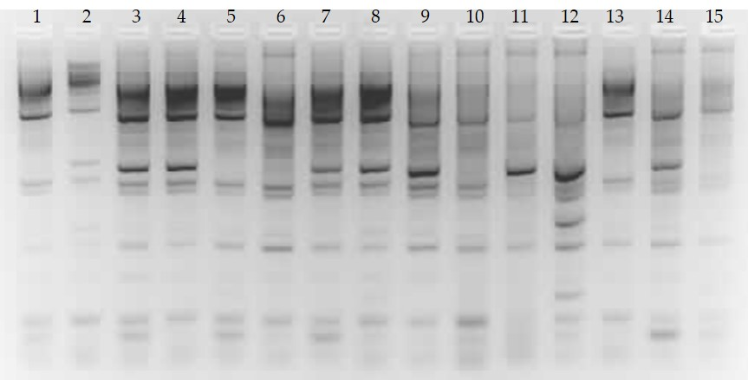
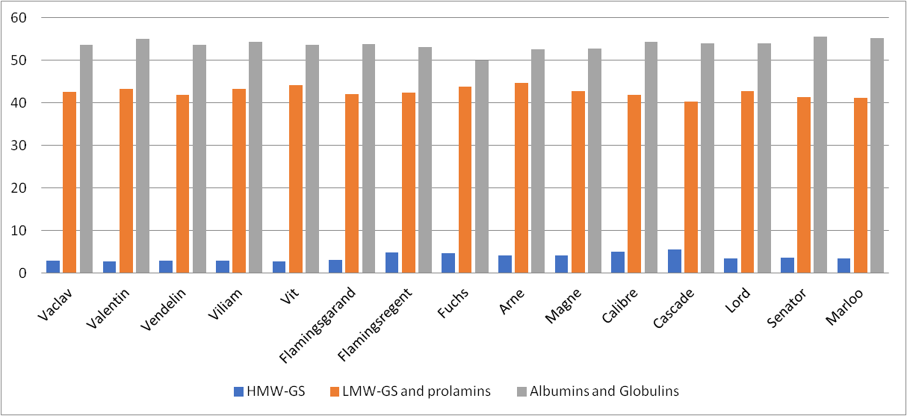
MicroRNA-based and proteomic fingerprinting of Avena sativa L. genotypes
Katarína Ražná ¹*, Zdenka Gálová ², Želmíra Balážová², Milan Chňapek² and Ľubomír Harenčár ¹
¹ Faculty of Agrobiology and Food Resources, ² Faculty of Biotechnology and Food Sciences, Slovak University of Agriculture in Nitra, Tr. Andreja Hlinku 2, 949 76 Nitra, Slovak Republic, e-mail: katarina.razna@uniag.sk
The aim: To analyze genetic diversity by miRNA-based markers and proteomics approach with emphasis to characterize the added value of oats genotypes.
Material: 15-days old plants of 15 oat varieties (Avena sativa L.) obtained from seeds provided by the Gene Bank of Seed Species of the Slovak Republic NPPC VÚRV in Piešťany.
Methods:
miRNA markers selection and primers design according to the methodology Fu et al. (2013) and Yadav et al. (2014)
microRNA-based marker assay (Fu et al., 2013; Yadav et al., 2014; Ražná, Hlavačková, 2017)
SDS-PAGE according to the methodology of Wrigley (1992).
Results:
In total 849 miRNA-based loci were amplified by six types of miRNA-based markers.
Markers involved to photosynthesis regulation, growth, and biomass production (miR408, miR156) generated 40% of all amplified loci.
Stress-responsive markers (miR398 and miR858) generated 31% of all amplified loci.
Markers associated to nutrition accumulation and homeostasis (miR827 and miR399) generated 29% of all amplified loci.
SDS -PAGE analysis allows to detect the genetic diversity of tested oat genotypes based on glutelin polymorphism
A
Figure 1. A representative genome fingerprinting of oat samples based on electrophoretic separation of "touch-down" PCR products amplified by miR408-based primers. Genotypes: 1 – Arne, 2 – Calibre, 3 – Cascade, 4 - Flamingsgarand, 5 – Flamingsregent, 6 – Fuchs, 7 – Lord, 8 – Magne, 9 – Marlov, 10 – Senator, 11 – Vaclav, 12 – Valentin, 13 – Vendelin, 14 – Viliam, 15 – Vit.
B
Figure 2. Percentage of protein fraction in genotypes of oat analyzed by SDS-PAGE.
Acknowledgments: This publication was supported by the project VEGA No. 1/0291/21, KEGA No. 026SPU 4/2021, KEGA No. 027SPU-4/2021 and by the Operational program Integrated Infrastructure within the project Drive4SIFood ITMS 313011V336.
Conclusion: The genome screening points out that all tested genotypes should have sufficient genetic background in order the provide biomass while having the adaptation potential to environmental conditions. From this point of view, we can assume that genotypes Magne (SWE) and Vaclav (SVK) have available higher stress adaptation potential as the number of of amplified loci of the stress-sensitive markers miR398, miR858 and miR408 was the highest. On the other side, in genotype Vendelin (SVK) was observed the lowest amplification of several markers (miR156-, miR408- and miR827) associated to plant growth and nutrition homeostasis.
The 2nd International Electronic Conference on Plant Sciences–10th Anniversary of Journal Plants

