Slide 1
Quantification and immunolocalization of auxin in Prunus dulcis (Mill.) D. A. Webb micrografts †
Sandra Caeiro ¹*, Tércia Lopes ¹, Ana Pedrosa ¹, André Caeiro ¹, Rita Pires ², Ana Faustino ^{2,3}, Armindo Rosa ⁴, António Marreiros ⁴, Jorge Canhoto ¹, Liliana Marum ^{2,3} and Sandra Correia ¹
¹ University of Coimbra, Centre for Functional Ecology, Department of Life Sciences, Calçada Martim de Freitas, 3000-456 Coimbra, Portugal
² Centro de Biotecnologia Agrícola e Agro-Alimentar do Alentejo (CEBAL)/Instituto Politécnico de Beja (IPBeja), 7801-908 Beja, Portugal.
³ MED – Instituto Mediterrâneo para a Agricultura, Ambiente e Desenvolvimento, CEBAL, 7801- 908, Beja, Portugal.
⁴ Direcção Regional de Agricultura e Pescas do Algarve, Apartado 282, Patacão, 8001-904 Faro, Portugal.
* Corresponding author: caeirosandra@hotmail.com;

Slide 2
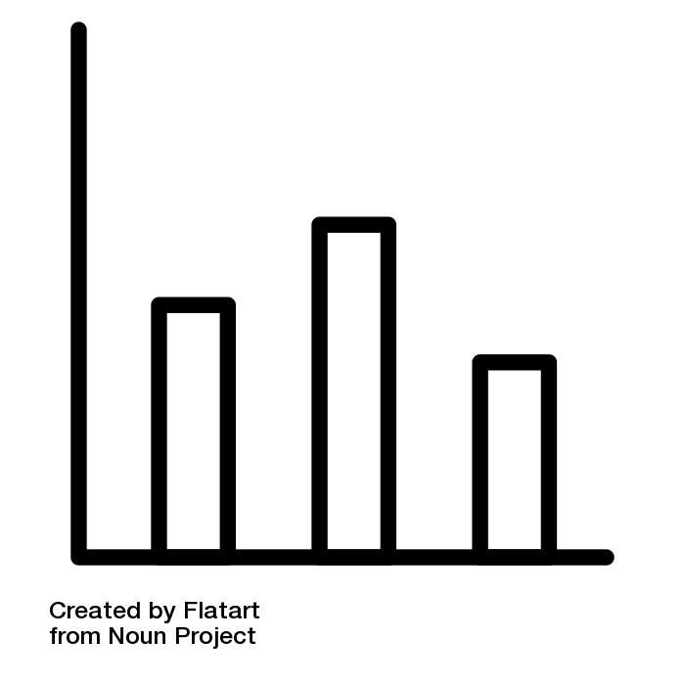
Quantification and immunolocalization of auxin in Prunus dulcis (Mill.) D. A. Webb micrografts †
Grafting
Auxin
Auxins
Scion
Lack of information on axin role in almond grafting
Rootstock
Arabidopsis thaliana
Influence of scion IAA content on micrografting success
Quantification of IAA
Almond micrografts
Bitter almond x bitter almond
Bitter almond x Canhota
IAA distribuition affected by 21 days after micrografting
Immunolocalization of IAA

Slide 3
Abstract: In recent years almond production has increased due to the strong tendency of consumers towards plant-based products. The grafting propagation method is the most widely used for this Prunus species to increase production and fruit quality. During grafting, the plant vasculature is severely damaged thus affecting auxin transport. However, once the scion and the rootstock join, a complex process involving cell division and differentiation of vascular tissues establishes communication between the two parts. Nevertheless, wound healing and auxin-induced regulatory mechanisms involved in scion-rootstock interactions remain largely unknown. Thus, this work aimed to quantify and immunolocalize IAA (indole-3-acetic acid) in almond trees micrografts, before and 21 days after micrografting, an in vitro technique that allows a rapid graft union formation using in vitro established scions and rootstocks.
To achieve this goal, scions and rootstocks were in vitro established and micropropagated. Micrografts were successfully achieved from bitter almond homografts and bitter almond rootstocks x Canhota (Portuguese traditional variety). IAA quantification performed through Ehrlich reaction, showed a scion content of 1.292±0.448 μg IAA/ mg FW (Canhota) and 5.505±1.179 μg IAA/ mg FW (bitter almond) before micrografting, and the potential influence of these levels on micrograft success. Through IAA immunolocalization a possible accumulation at the graft union in the scion part was observed. The results obtained here are a step forward to the understanding of how scion and rootstock communicate in different almond tree micrograft combinations and how their communication is associated with graft success.
Keywords: Almond, Auxins, Immunohistochemistry, Indole-3-acetic acid, Micrografts

Slide 4
Introduction
Grafting is one of the main Prunus dulcis (Mill.) D. A. Webb propagation methods
Graft union formation
Scion
Ruptured cells collapse
Tissue adhesion
Cell dedifferentiation and division - Callus formation
Rootstock
Regeneration of vascular tissues
[3]
Auxins are reported to be involved in the development of successful graft unions.
[5]
Auxin accumulation in the grafted zone is followed by cell differentiation and vascular reconnection between scion and rootstock.
[6]

Slide 5
Introduction
Objective
Evaluate auxin role in grafting of P. dulcis
through
Quantification and immunolocalization of endogenous indole-3-acetic acid (IAA)
in
Almond micrografts
Bitter almond x bitter almond
Bitter almond x Canhota

Slide 6
Results
Micrografting
Scion
21 days after micrografting
Stock
Scale bar, 1 cm
Scale bar, 1 cm
Bitter almond x bitter almond
60% success
Bitter almond x Canhota 90% success
MS + 3% w/v sucrose

Slide 7
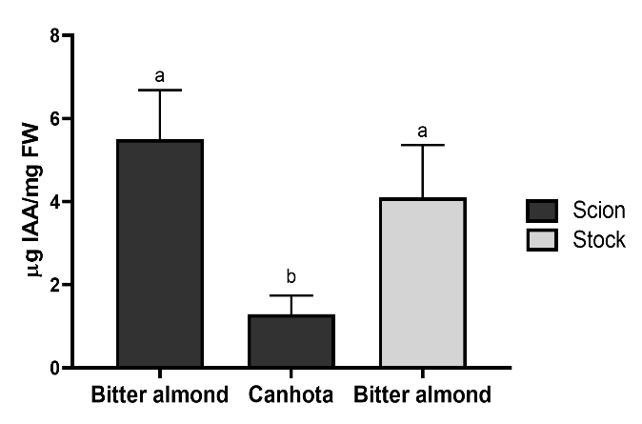
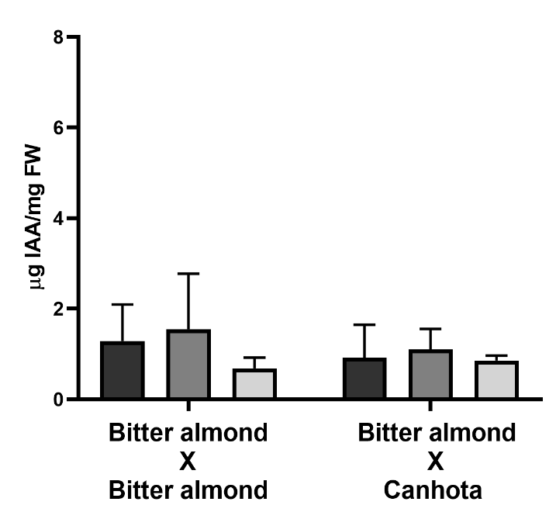
Results and discussion
IAA quantification
Cut but ungrafted scions and rootstock
21 days after establishment
Scions used for micrografting with the same rootstock
Tendency for IAA accumulation at the graft union
Diferent micrografting success rates
Role of auxins in graft compatibility and vascular regeneration
[6,7]
Potential influence of initial scion IAA content on micrografting success

Slide 8
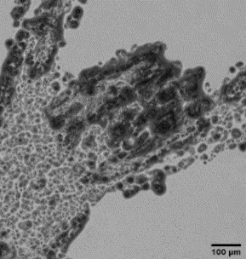
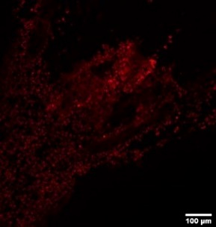
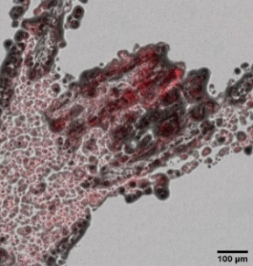
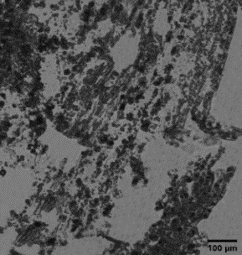
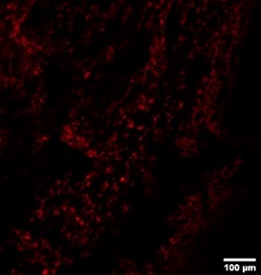
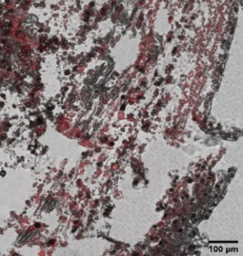
Results and discussion
IAA immunolocalization
Intensive IAA detection in the shoot apex
Auxin synthesis in plants young growing regions
[10]
Canhota
A
i
ii
iii
Scion
IAA distribution apparently unaffected
B
i
ii
iii
Rootstock
Bitter almond

Slide 9
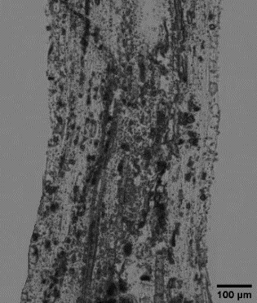
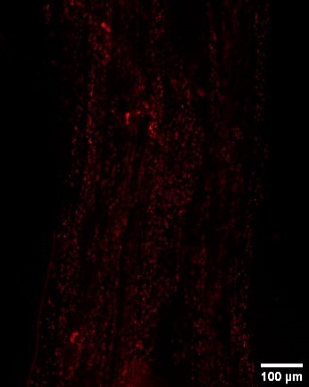
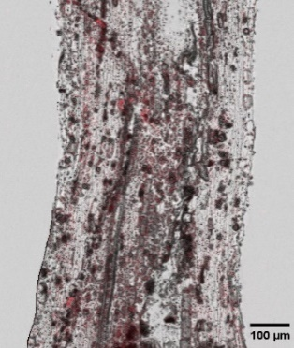
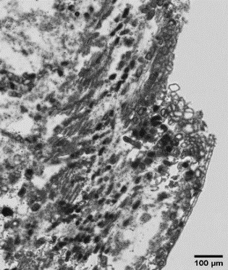
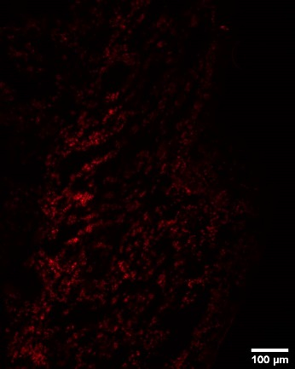
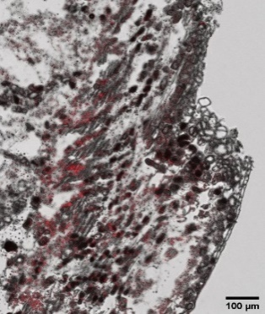
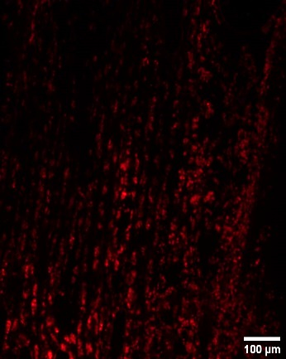
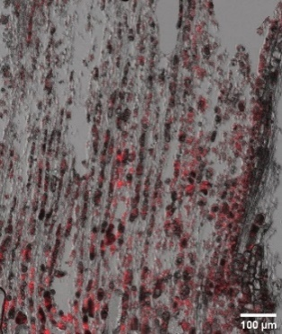
Results and discussion
IAA immunolocalization
i
ii
iii
Bitter almond
x
bitter almond
Scion
i
ii
iii
Union
Auxin accumulation in the scion
i
ii
iii
Depletion in the rootstock
[7]
Rootstock
IAA distribution apparently affected by the initial cut

Slide 10
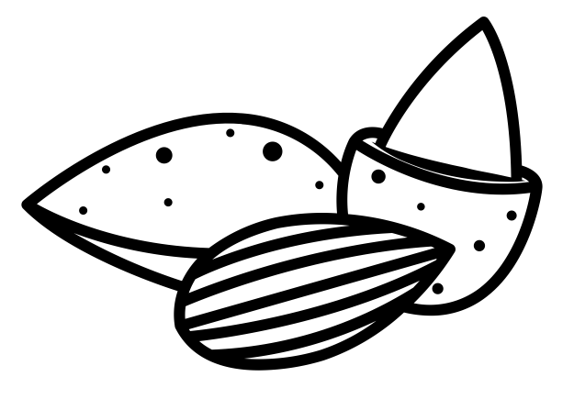
Conclusions
Possible influence of scion IAA initial levels on micrografting success
Tendency for IAA accumulation at the graft union 21 days after micrografting
IAA distribution dynamics possibly affect by 21 days after micrografting
Base for future studies on the molecular communication between scion and rootstock in almond grafts

Slide 11
Acknowledgments
We thank Associação de Viveiristas do Distrito de Coimbra for the plant material provided and Dr. Mónica Zuzarte and Dr. Teresa Rodrigues for their help with microscopy methodologies.
This work was made in the scope of CULTIVAR project (CENTRO-01-0145-FEDER-000020), co-financed by the Regional Operational Programme Centro 2020, Portugal 2020 and European Union, through European Fund for Regional Development (ERDF); Inov-Amendo-AL: Microenxertia in vitro de amendoeiras selecionadas para a promoção do amendoal no Alentejo (ALT20-03-0246-FEDER-000068) supported by Program Alentejo 2020, through the European Fund for Regional Development (ERDF), within the scope of the Collective Action Support System - Transfer of scientific and technological knowledge. Domain of Competitiveness and Internationalization. Authors also acknowledge Centre for Functional Ecology, FCT for Contrato – Programa to L. Marum (CEECINST/00131/2018) and FCT for UIDB/05183/2020.

