Slide 1
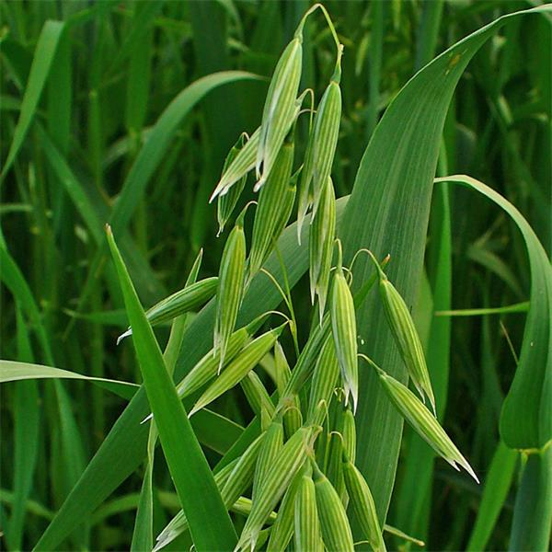
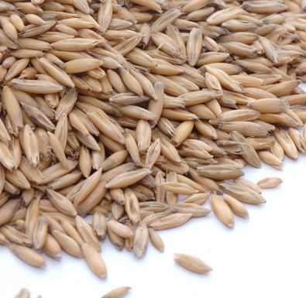
Genetic diversity of oat genotypes using SCoT markers
Milan Chňapek, Lucia Mikolášová, Martin Vivodik, Zdenka Gálová, Zuzana Hromadová, Katarina Ražná, Želmíra Balážová*
Faculty of Biotechnology and Food Sciences, Slovak University of Agriculture in Nitra, Tr. Andreja Hlinku 2, 949 76 Nitra, Slovak Republic, e-mail: zelmira.balazova@uniag.sk
The aim: The aim of our work was to analyze DNA polymorphism and genetic variability in the collection of 22 oat genotypes (Avena L.) using 7 SCoT markers.
Material: 22 oat genotypes (20 genotypes of Avena sativa L. and 2 genotypes of Avena nuda L.) originating from nine different European countries and Canada.
Methods:
extraction of DNA of oat with GeneJET Plant Genomic DNA Purification Mini Kit,
PCR using 7 SCoT markers (SCoT8, SCoT9, SCoT12, SCoT23, SCoT26, SCoT28, SCoT29) done according to Collard a Mackill (2009),
visualisation of SCoT fragments using 1,5 % agarose gel stained with EtBr,
a dendrogram prepared based on hierarchical cluster analysis using UPGMA algorithm, statistical program SPSS v.17,
for the assessment of the polymorphism PIC values calculated according to Weber (1990).
Figure 1. Dendrogram of 22 oat genotypes using 7 SCoT markers.
Table 1. Statistical characteristics of the SCoT markers used in oat.
SCoT marker | Number of all fragments | Number of polymorphic fragments | Percentage of polymorphic bands (%) | PIC
SCoT8 | 7 | 5 | 71.42 | 0.674
SCoT9 | 6 | 4 | 66.66 | 0.537
SCoT12 | 6 | 2 | 33.33 | 0.305
SCoT23 | 5 | 4 | 80.00 | 0.390
SCoT26 | 6 | 4 | 66.66 | 0.547
SCoT28 | 4 | 3 | 75.00 | 0.519
SCoT29 | 6 | 4 | 66.66 | 0.567
Average | 5.71 | 3.71 | 65.67 | 0.506
Total | 40 | 26
Figure 2. Oat (Avena sativa L.)
Acknowledgments: This work was supported by the project VEGA No. 1/0291/21, KEGA No. 026SPU-4/2021, KEGA No. 027SPU-4/2021 and by the project: Drive4SIFood 313011V336, cofinanced by the Euruopean Regional Development Fund.
Conclusion:
Average value of PIC for used SCoT markers was higher than 0.5 that means sufficient polymorphism detected in the chosen oat genotypes. In the UPGMA dendrogram 22 oat genotypes were divided into two main clusters (I, II). Genetically the closest were two varieties, Alf originating from Germany and Amursky utes originating from Russia, grouped in the subcluster Ia. Two genotypes of naked oats (Hronec, Izak) grouped closely in the subgroup Ia. SCoT markers revealed as a powerful tool for assessment of genetic diversity in oat cultivars.

