Slide 1
Title of the Presentation
Overexpression of Plant Specific Insert from cardosin B (PSI B) in Arabidopsis correlates with cell responses to stresses
Inês Moura ¹, Susana Pereira ^{1,2}, Ana Séneca ^{1, 2}, José Pissarra ^{1,2} and Cláudia Pereira ^{1, 2} *
¹ Faculdade de Ciências da Universidade do Porto, Rua do Campo Alegre, s/nº, 4169-007, Porto.
² GreenUPorto - Sustainable Agrifood Production Research Center, Rua do Campo Alegre, s/nº, 4169-007, Porto, Portugal.
* Correspondence: cpereira@fc.up.pt

Slide 2
Abstract: Under abiotic stress, several changes occur in cells both regarding their physiology and cellular mechanisms. Plants have developed modifications in the production and trafficking of proteins and remodelling of endomembranes to overcome stress conditions. The alteration of the targeting of proteins to the vacuole by shifting their transport towards an unconventional, Golgi-independent, route is a good example. Plant Specific Inserts (PSIs) are known to mediate such routes and our goal was to evaluate if transgenic Arabidopsis plants overexpressing PSI B respond differently when subjected to different abiotic stresses (osmotic, oxidative, salt, and metal). The results obtained point to a differential expression of PSI B-mCherry depending on the type of stress and a decrease of cellular and cytoplasmatic movement in all stress conditions.
Keywords: Abiotic stress; Plant Specific Insert; protein trafficking; unconventional routes.

Slide 3
Introduction
Climate change
Abiotic Stress
Stomatal closure
Decreased photosynthetic activity
Altered cell wall elasticity
ROS production

Slide 4
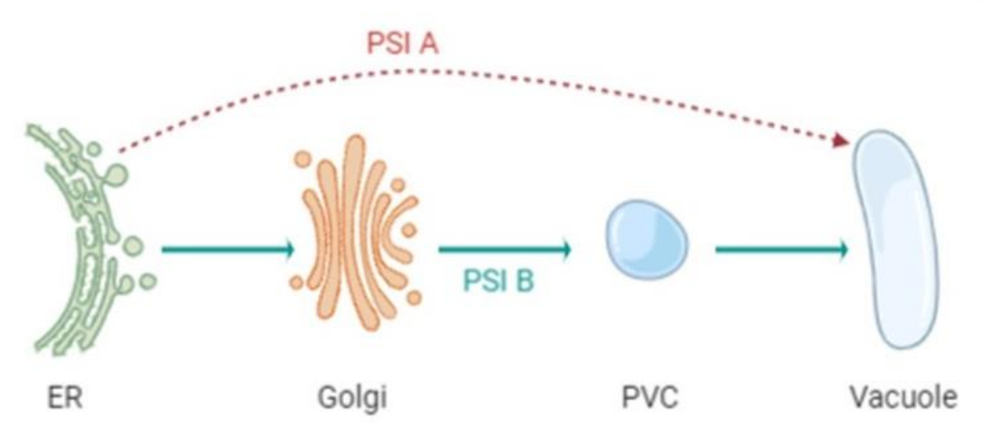
Introduction
Plant Specific Insert
Independent domain, with approximately 100 aminoacidic
ability to interact with membranes
Highly conserved in innumerous species
redirect secreted proteins to the vacuole through different pathways

Slide 5
Goal:
Study the expression levels of PSIB and its biosynthetic pathways in transgenic Arabidopsis plants overexpressing this domain coupled to m-Cherry fluorescent protein, in physiological and under abiotic stress conditions

Slide 6
Arabidopsis thaliana transformation
Germination in
different stress
conditions
cDNA
Preparation
Root biometrical analysis
qPCR
Experiments

Slide 7
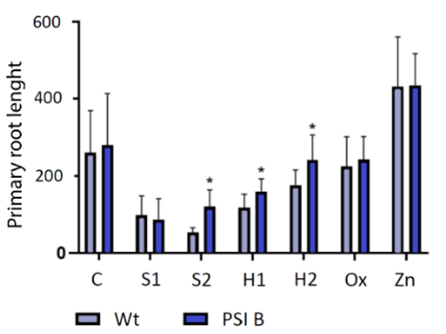
Results
PSI B expression changes in plants under abiotic stress
S1- decrease in root development in both plants (Wt and PSI B)
S2- significative increase in the size of roots in plants overexpressing PSI B
H1 and H2- same tendency as S2
Ox and Zn- no changes are observed

Slide 8
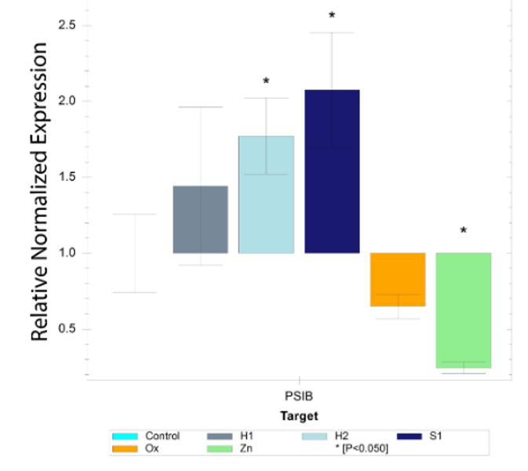
Results
PSI B expression changes in plants under abiotic stress
PSI B-mCherry is upregulated in both H1, H2 and S1
PSI B-mCherry is downregulated in Ox and Zn

Slide 9
Discussion
PSI B expression changes in plants under abiotic stress
At high salt conditions, there is a significant increase in the root length in the transformed plants, suggesting an increased stress tolerance that may be triggered at certain concentrations
The higher and mild water stress conditions also showed to have significant changes in roots length.
increased tolerance in order to mitigate the negative effects of environmental adversities

Slide 10
Discussion
PSI B expression changes in plants under abiotic stress
The downregulation of PSI B-mCherry on Ox and Zn stress, reinforces the importance of this domain in Water and salinity stress, and may indicate a role in processes related with cellular homeostasis and water control.
Overexpression in salt and mild hydric stress suggests that degradation of storage proteins occurs in order to overcome and tolerate these restricted conditions.
The PSI may then be associated with the defense and developmental system, and yet operate by distinct mechanisms

Slide 11
Discussion
PSI B expression changes in plants under abiotic stress
Analysis of PSI B-mCherry localization in roots showed a marked decrease in intracellular and cytoplasmic movements under all stress conditions
Can vesicle movement be inhibited by stress?

Slide 12
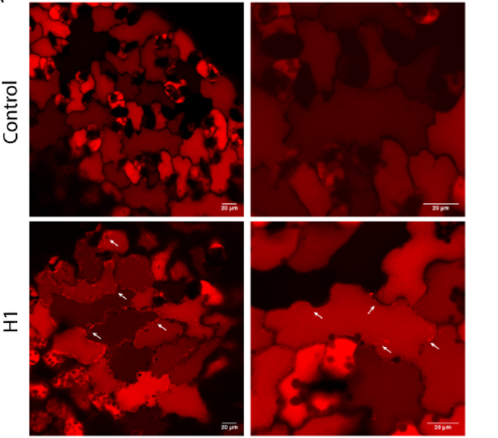
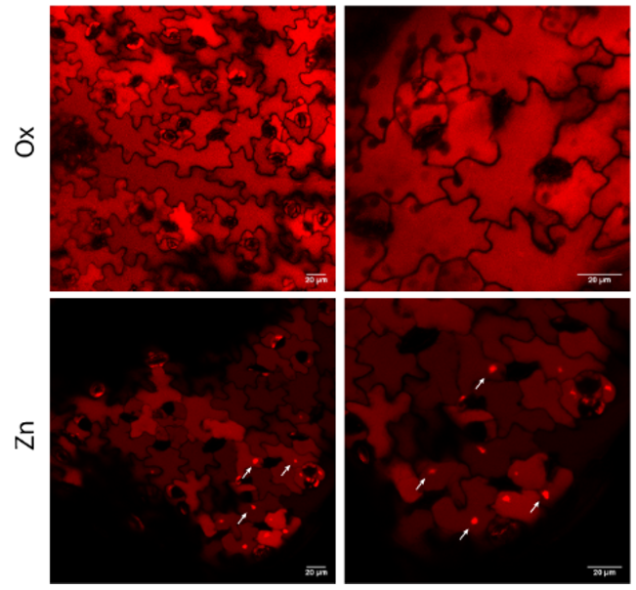
Discussion
PSI B expression changes in plants under abiotic stress

Slide 13
Conclusion
PSI B has an active role in adaptation and eventually tolerance mechanisms against abiotic stress

Slide 14
Supplementary Materials
Movement of PSI B-mCherry-labeled compartment
Control
H1

Slide 15
Supplementary Materials
Movement of PSI B-mCherry-labeled compartment
Ox
Zn

Slide 16
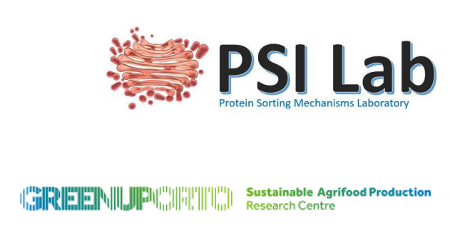
Acknowledgments
This research was performed in the frame of the scientific project PTDC/BIAFBT/32013/2017, funded by the Portuguese Foundation for Science and Technology (FCT) and also supported by national funds through FCT, within the scope of UIDB/05748/2020 and UIDP/05748/2020.

