Slide 1
Title of the Presentation
Information Processing Limitations In Humans and Machines
Birgitta Dresp-Langley
Centre National de la Recherche Scientifique CNRS, ICube UMR 7357, Strasbourg University, France
birgitta.dresp@unistra.fr

Slide 2
Introduction
Information Theory (1949): “Information is aimed at resolving uncertainty in complex systems.” At this stage, computers as we know them today did not exist.
Problem: the general information theory premise specifies neither the nature of « information », nor the nature of « complexity » or « uncertainty ».
Shannon-Weaver Law: Uncertainty in information systems increases linearly with the amount or complexity (in bit units) of information transmitted or generated (Shannon, Weaver. The mathematical Theory of communication, University of Illinois, Urbana III, 1949).
Hick-Hyman Law: Uncertainty in psychophysical systems is directly reflected by the time of human response to stimuli in the environment, which increases with stimulus complexity. Hick. Quarterly Journal of Experimental Psychology. 1949; 4 (4:1): 11–26. Hyman (1953). Journal of Experimental Psychology. 45 (3): 188-196.
Minds vs machines: The concepts of information and uncertainty relate to complexity in physical (« machines ») and living systems (« brains »/« minds »).
Artificial Intelligence (AI): different levels of functional complexity and autonomy

Slide 3
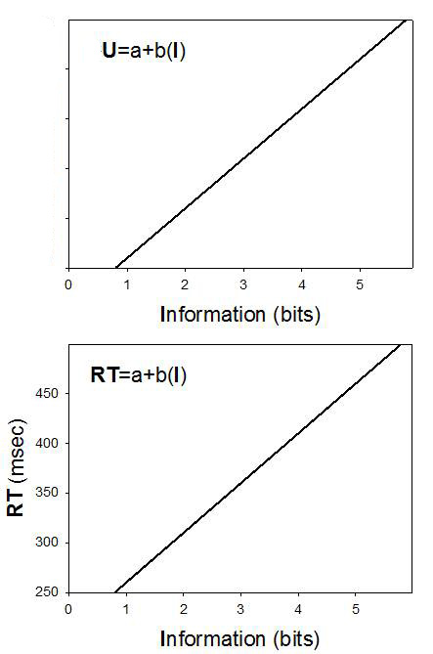
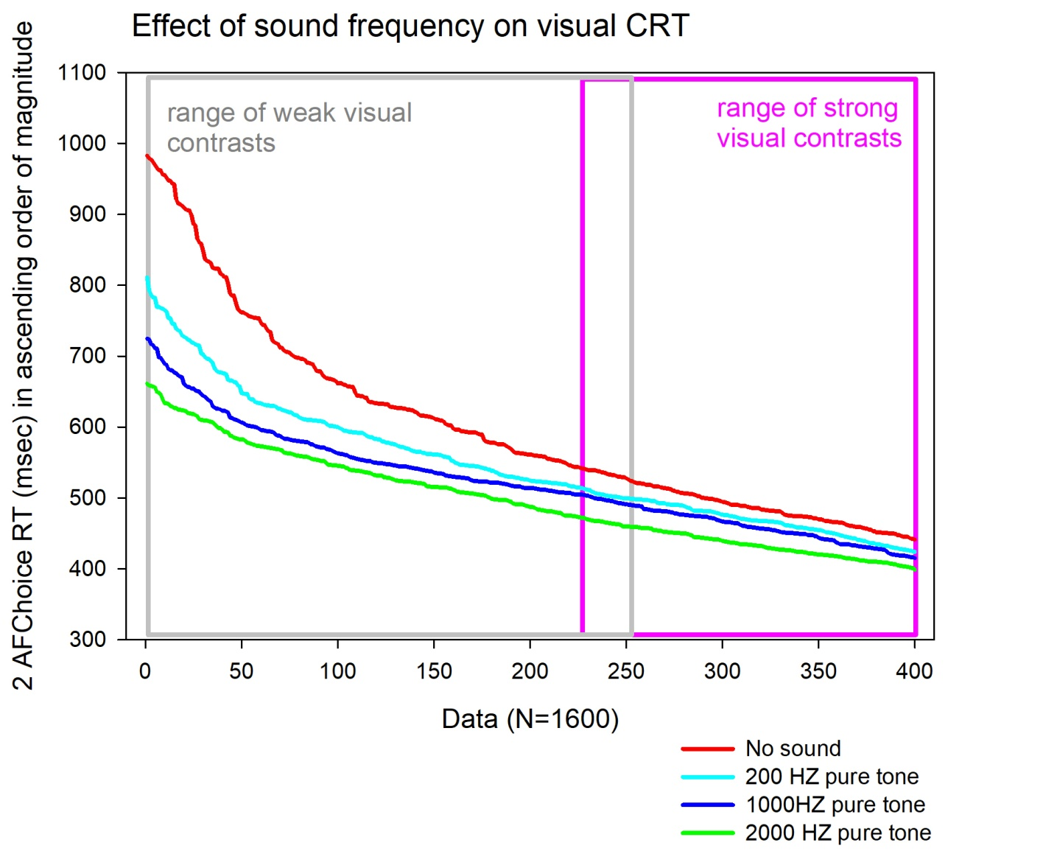
Sensory
Uncertainty
(Piéron H.
The Sensations. 1952;
Yale University Press)
Shannon, Weaver, 1949, top;
Hick, 1949; Hyman, 1953, bottom
Uncertainty (U)
Dresp-Langley B, Monfouga M. Combining Visual Contrast Information with Sound Can Produce Faster Decisions. Information. 2019; 10(11):346.
Visual Choice Response Time

Slide 4
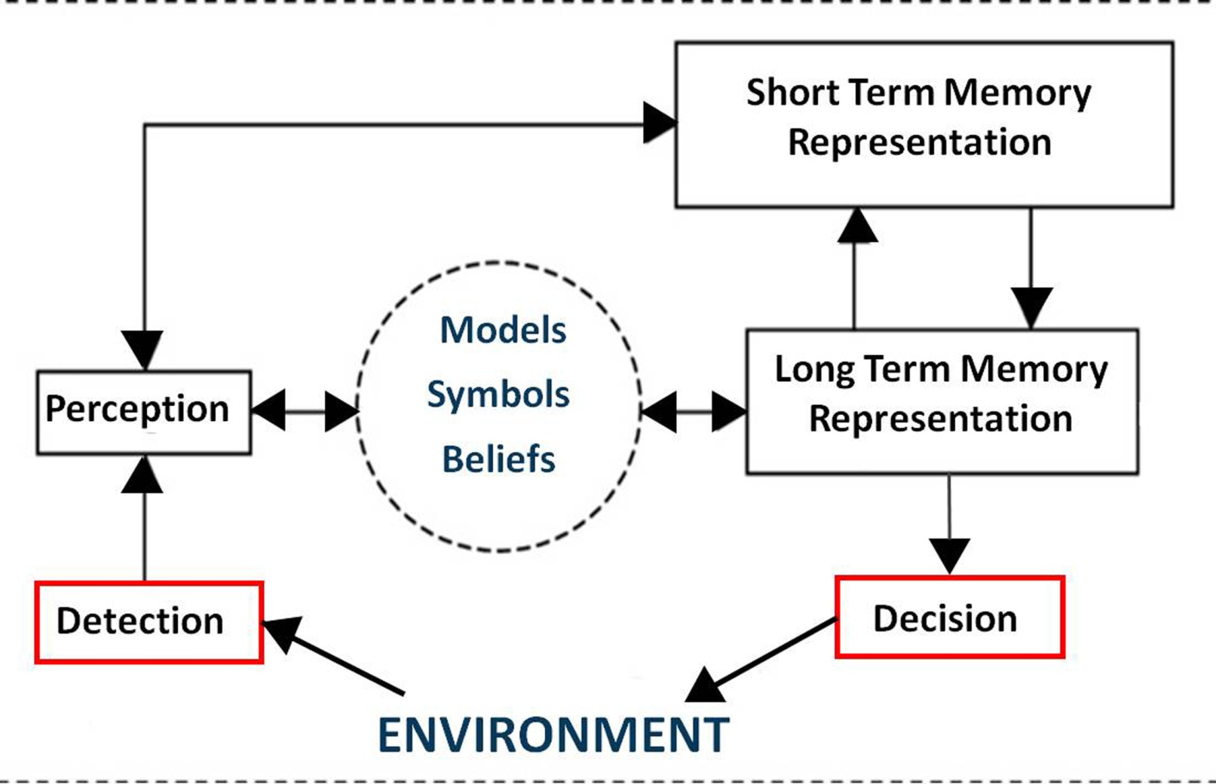
Cognitive Uncertainty
Cognitive uncertainty corresponds to system states that require regulation of representations of the environment in order to obtain better prediction and adaptation
Mushtaq F, Bland AR, Schaefer A. Uncertainty and cognitive control. Front Psychol. 2011;2:249.
In humans, functional interaction between conscious and non-conscious cognitive workspaces enables decision making
Dresp-Langley, B. Why the Brain Knows More than We Do: Non-Conscious Representations and Their Role in the Construction of Conscious Experience. Brain Sci. 2012; 2: 1-21.

Slide 5
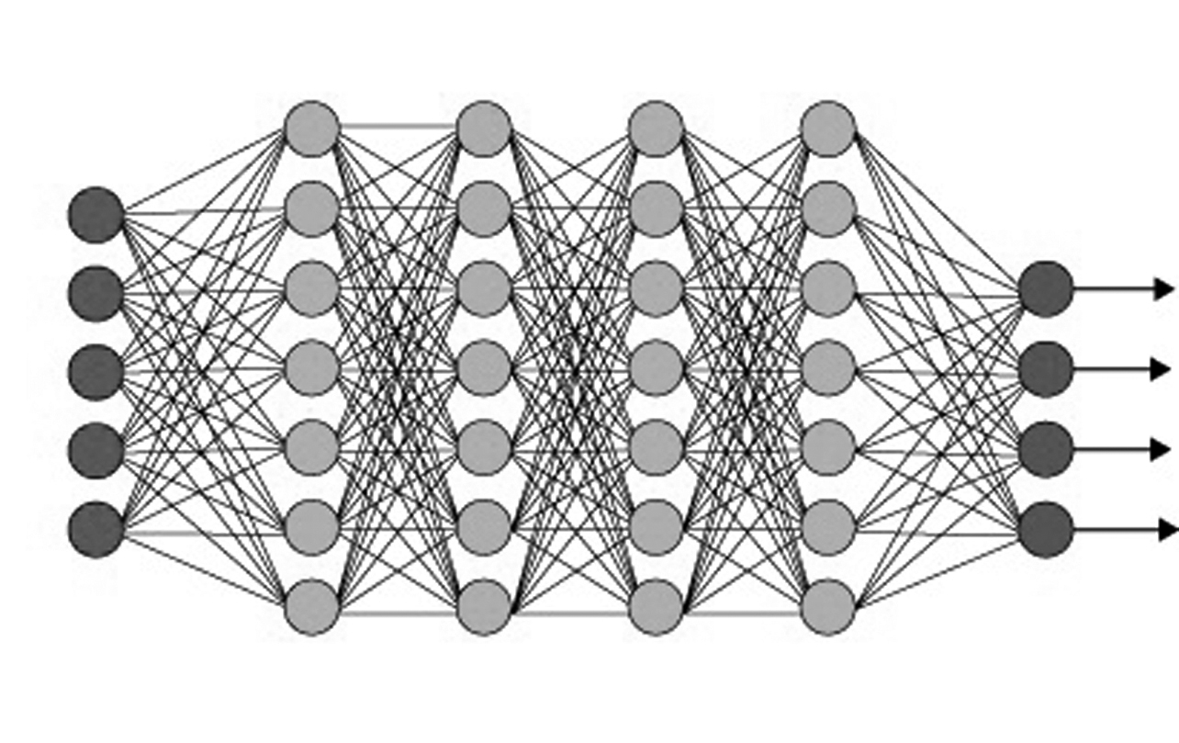
Uncertainty in
Neural Networks
complexity of the data
complexity of functional
architecture
complexity of learning algorithms
complexity of input and output
dimensionality
input
output
D N N
input
synaptic weights
Example: SOM represents a distribution of input data vectors using a finite set of models. The quantization error (QE) of an input vector can be expressed as the Euclidean norm of the difference between input vector and best-matching model.
Kohonen , Nieminen, Honkela T. On the Quantization Error in SOM. Lecture Notes in Computer Science. 2009; 5629. Springer, Berlin, Heidelberg
S O M
output

Slide 6
Uncertainty In
Artificial Intelligence
Level 1 AI: Human controlled - ‘human on the loop’: human agent initiates and controls all steps in the process
Level 2 AI: Semi-autonomous - ‘human in the loop’: human has control over some of the steps in the process
Level 3 AI: Fully autonomous AI - ‘no human in the loop’: human has no control over any step in the process
Boulanin , Verbruggen. Mapping the development of autonomy in weapon systems. 2017;
Stockholm International Peace Research Institute.
Level 1 and Level 2 AI combine sensory and cognitive uncertainty in the human with the design specific uncertainty of the AI system
This does not straightforwardly imply that Level 3 AI
is more reliable or « trustworthy »

Slide 7
Conclusions
Shannon & Weaver’s post-war Information Theory is challenged by contemporary cognitive neuroscience and the rise of neural network learning and AI
A novel conceptual framework for what is to be understood by « information », « complexity », and « uncertainty » needs to be carved out
The processing constraints and limitations of human brains and machines need to be studied in domain and application specific contexts
The conscious processing limitations of a human agent in any context are compensated for by non-conscious processes that run in massively parallel, dedicated resonant networks of the human brain
Interactions between « conscious » and « non-conscious » cognitive workspaces cannot (yet?) be implemented in current AI
Under conditions of critically high uncertainty, the human expert can
resort to decisions on the basis of intuition, the machine (AI) can not

Slide 8
Acknowledgments
Thank you

