Slide 1
Title of the Presentation
Cristián Castillo-Olea ¹*, Roberto Conte-Galvan ¹, Jose Juan Parcero ² ,Alexandra Gómez-Siono ³and Ornela Bardhi⁴
¹ Ensenada Center for Scientific Research and Higher Education; castillo.cristian@uabc.edu.mx, conte@cicese.mx
² Medica Norte Hospital ; jjparcerovaldes@gmail.com
³ School of Engineering CETYS University, Mexicali, Baja California, Mexico 2; alexandra.siono@cetys.edu.mx
⁴ Independent Researcher, Albania; alenroidhrab@gmail.com
* Correspondence: cristian.castillo2@gmail.com; Tel.: +52 (55) 7430-2237

Slide 2
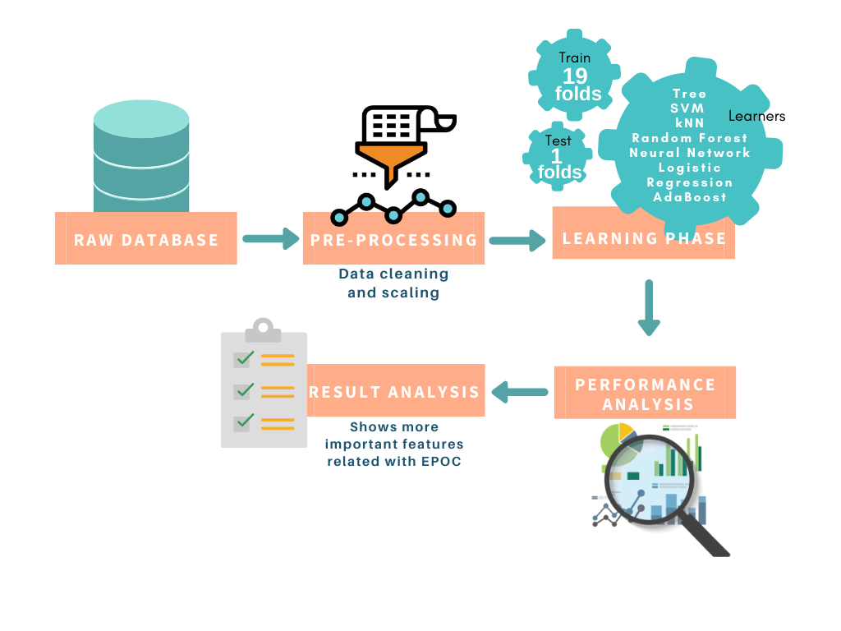
Prediction of Chronic Obstructive Pulmonary Disease using machine learning techniques: A Case Study from Baja California, Mexico

Slide 3
Abstract:
Chronic Obstructive Pulmonary Disease (COPD) is a chronic inflammatory disease of the lungs that obstructs airflow from the lungs. Symptoms include difficulty breathing, coughing, mucus production, and wheezing. The study was conducted with 769 patients. A total of 48.70% were women, and 51.29% were men. The average age of the patients enrolled was 60 years. The research included 67 variables considering the medical history and biochemical data. The objective is to evaluate chronic obstructive disease. We used automatic learning techniques to assess and identify the patient's determinant variables. The following classifiers were used: Vector Support Machines (SVM), K-Nearest Neighbors (kNN), Decision Tree, Random Forest, Neural Network, AdaBoost, and Logistic Regression. The model suggests that the determining variables for COPD in treated patients are the following: TA_dist, Cholesterol level, LDL levels, Dyslipidemia, Bradycardia, Venous Insufficiency, Systolic Dysfunction, Cardiac Arrhythmia, Vasomotor Headache, Smoking, and Esophageal Achalasia. Therefore, they are considered relevant in the decision-making process for choosing treatment or prevention. The analysis of the relationship between the presence of the variables and the classifiers used to measure COPD revealed that the Logistic Regression classifier, with the variables TA_dist, Cholesterol level, LDL levels, Dyslipidemia Bradycardia, Venous Insufficiency, Systolic Dysfunction, Cardiac Arrhythmia, Vasomotor Headache, Smoking, and Esophageal Achalasia, showed an accuracy of 0.90, precision 0.87 and an F1 score of 0.89. Therefore, we can conclude that the Logistic Regression classifier gives the best results for evaluating the determining variables for COPD assessment.
Keywords: machine learning; EPOC; prediction.

Slide 4
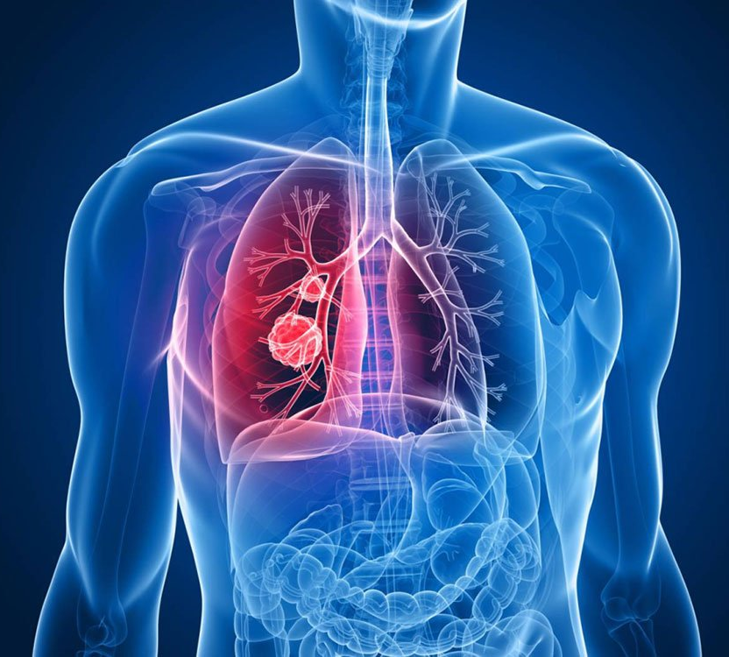
Introduction
Chronic Obstructive Pulmonary Disease (COPD) is an ailment that mainly affects people with smoking habits, but also this disease has great importance in people with a hereditary history of COPD. This disease causes fast lung wear, which in turn decreases mobility and the people who have it become dependent on a daily dose of a minimum of 18 hours per day of oxygen. In 2017 COPD was the fourth cause of death as it affected about 600 million people around the world, and it is estimated that by 2030 it will become the fifth cause of disability in the world population.

Slide 5
Materials and Methods
The database provided data about the cholesterol and LDL levels in each patients, since the values were continued, we decided to categorize them into three categories for cholesterol and two for LDL
Cholesterol Levels
Desirable: less than 200
High: 200 and 239
Very High: 240 and more
LDL Levels
Healthy: Less than 100
Not Healthy: More equal 100

Slide 6
Materials and Methods
Machine Learning
Learners:
k-Nearest Neighbours (kNN)
Decision Tree (DT)
Support Vector Machine (SVM)
Random Forest (RF)
Multi-layer Perceptron Neural Network (MLPNN)
Logistic Regression (LR)
AdaBoost (AB)
Database description
Location: Medical Norte Hospital in Baja California, Mexico.
Sample: 769 Patients
Variables: 67
Metrics Evaluation
Parameters:
Accuracy
Precision
F1 Score
Recall
Models: 7

Slide 7
Results
Tree classification
Table 1. Decision tree variables
The first analysis after pre-processing the database was tree classification or decision tree. For this analysis, all the variables in the pre-processed database were used and the decision tree shown in its first fifth levels the following variables in Table 1.
Target COPD
Level 1 | Smoking habits
Level 2 | Bradycardia
Level 3 | Cholesterol
Level 4 | Obesity
Level 5 | TA_distolic
Level 6 | Age
Level 7 | LDL levels

Slide 8
Results
Cross-validation
Table 2. Highest scores from dataset.
After the selection of the top-five variables, other features throwed by the decision tree were used iteratively and using cross validation. The combination with higher scores was selected as the dataset with important variables related to COPD. The highest scores are shown in Table 2.
Model | ACC | F1 | Precision
kNN | 0.799 | 0.729 | 0.749
Tree | 0.865 | 0.851 | 0.869
SVM | 0.835 | 0.826 | 0.859
Random Forest | 0.878 | 0.875 | 0.883
Neural Network | 0.873 | 0.873 | 0.869
Logistic Regression | 0.900 | 0.899 | 0.870
AdaBoost | 0.862 | 0.869 | 0.873

Slide 9
Results
Cross-validation
As seen in Table 2, the analysis revealed that the Logistic Regression algorithm got the highest scores with an accuracy of 0.900, an F1 of 0.899, and a precision of 0.870.These scores were given by using the following variables:
TA dist
Cholesterol levels
LDL levels
Dyslipidemia
Bradycardia
Venous Insufficiency
Systolic Dysfunction
Cardiac Arrhythmia
Vasomotor Headache
Smoking habits
Esophageal Achalasia

Slide 10
Results
Cross-validation
Learner | Parameters
RF | Number of trees: 10, minimum subsets split: 5, maximum tree depth: unlimited.
kNN | Number of neighbours: 3, metric: euclidean, weight: uniform
SVM | Type: SVM Regression, C=1, Ɛ=0.1, Kernel= Radial Basis Function (RBF), exp (-auto|x-y|²), numerical tolerance: 0.001
MLPNN | Hidden layers: 100, activation: ReLu, solver: Adam, alpha: 0.0001, maximum iterations: 200, replicable training: True.
NB | Naïve Bayes
AB | Base estimator: tree, number of estimators: 50, algorithm (classification): Samme.r, loss (regression): Linear
DT | Type: binary tree, internal nodes < 5, maximum depth: 100, splitting: 95%.

Slide 11
Results and Discussion
There is research that studies the CT scan using automatic learning techniques, which evaluate Thoracic CT Texture, and the results are between 0.82 and 0.88 of precision [20]. A study on COPD with similar technical characteristics to our study [21] used three classifiers: Random Forest, Gradient Boosting, and Logistic Regression, with Random Forest as the best classifier, obtained an accuracy of 0.82. The article for the measurement of variables involved in the COPD, using Logistic Regression, RF and XGBoost were show results between 0.787 and 0.801 analyzed 54 variables in this study.
In our study on the diagnostic detection of COPD with 67 variables from 769 patients were analyzed, obtaining an accuracy of 0.900, precision of 0.870, and an F1 score of 0.890, which is the harmonic mean of accuracy and recovery, using the logistic regression algorithm. With this analysis, variables like diastolic blood pressure, cholesterol levels, LDL levels, Dyslipidemia, bradycardia, venous insufficiency, systolic dysfunction, cardiac arrhythmia, vasomotor headache, smoking habits, and esophageal achalasia were found closely related to COPD.

Slide 12
Conclusions
In this research, patients diagnosed with COPD showed how Machine Learning (ML) techniques could be used to assess respiratory biomedical variables and thus learn to identify, analyze, and suggest appropriate evidence-based treatment. The experimental data was initially sorted, evaluated, and tested. After that, it was iteratively used to train ten different models, with the Logistic Regression and Random Forest models showing the highest results of the comprehensive data sets. They revealed that the Logistic Regression algorithm got the highest scores with an accuracy (ACC) of 0.900, a F1 of 0.890, and precision 0.870. This study illustrates how ML techniques can help medicine and healthcare professionals with useful computer tools to improve and more efficiently care for lung diseases, providing more accurate diagnosis and treatment options for patients. ML-supported diagnosis can also provide physicians and healthcare personnel with accurate tools to help identify potential patients in risk, as well as to provide second-opinion diagnosis support.

Slide 13
Acknowledgments

