Slide 1
Optimal Tuning of Natural Frequency to Mitigate Multipath Propagation Interference in Multiuser Chaotic Communication
Louka Kovatsevits
University of Aberdeen
Email: l.kovatsevits.19@abdn.ac.uk
Murilo Da Silva Baptista
University of Aberdeen

Slide 2
Optimal Tuning of Natural Frequency to Mitigate Multipath Propagation Interference in Multiuser Chaotic Communication

Slide 3
ABSTRACT
In this work, we study a wireless communication system designed to handle multi users, each communicating with their own frequency bands. We analyze the performance of the system - its information capacity – while considering different number of users, and different configurations for the multipath propagation scenarios for each user and their base frequency. Our interest is to discover worst- (blind spots) and best-case scenarios (maximal information transmission). Our results show that a prior effective choice of parameters, such as the natural frequency of the chaotic signal, lead to significant throughput improvement and, in some cases, even enable an error-free communication. It is often to be expected that physical constrains in the channel may block higher-frequency signals used in standard non-chaotic communication systems. For our chaos-based communication system, we show that a significant wireless channel constraint, the multipath propagation, becomes less disruptive, the higher the frequency of the user. That is a win-win result. Not only does the higher frequency allow more information to be transmitted, but it also prevents multipath interference. Moreover, there is an ideal relationship between the time of propagation for the signals with the user natural frequency that results in a communication with no interference due to multipath, thus effectively creating a wireless communication system with similar gains as that obtained for wired communication where multipath propagation is not a significant issue.
Keywords: Chaos based communication, wireless , multipath propagation

Slide 4
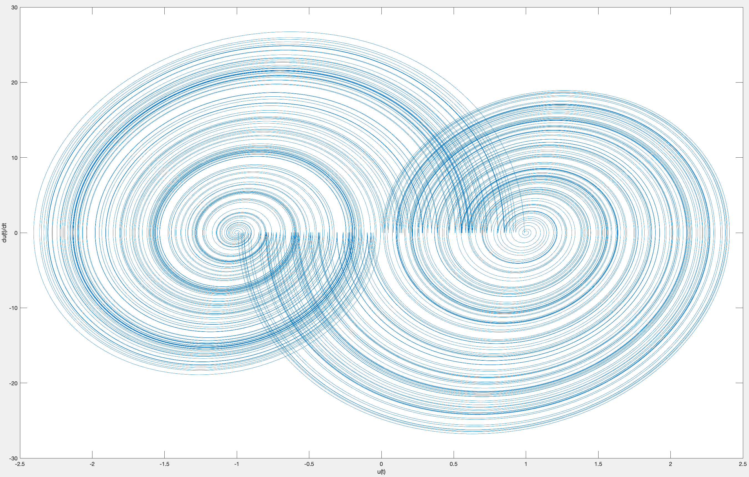
What is chaos?
$$\frac{du(t)}{dt}$$
u(t)

Slide 5
Some of the advantages of chaos based communication
The information transmitted is fully preserved,multiple signals can arrive at the same time and their information can be successfully retrieved.
The received signal has the same topological features of transmitted signal thus decoding is trivial and without error.
Faster
Lighter
Ease of wideband communication system implementation
Robustness to multi-path fading
Better security

Slide 6
The original hybrid system in [1]
$$\overset{··}{u}-2β\overset{·}{u}+(ω^{2}+β^{2})(u-s(t))=0$$
Where:
$u$ : is the signal voltage
Transitions in the discrete state s(t) can only occur when t=n*T for $n∈N$
s(n)=-1 and s(n)=1 encode bits 0 and 1 respectively of the information transmitted
$ω=2π/T$ is the angular frequency
$β$ is a fixed parameter: $0<β≤log2/T$
$β=log2/T$ will produce chaotic oscillations with values ranging between -1 and 1
When transitions in the discrete dynamics occur , guard condition is always $\overset{·}{u}=0$ and s(t) acquires its value from: s(t)=sgn(u) :
$$sgn(u)=\{\begin{aligned}\text{+1},u(t)≥0 \\ \text{-1},u(t)<0\end{aligned}$$

Slide 7
The original hybrid system in [1]
Offers an exact analytical solution :
$$u(t)=s_{n}+(u_{n}-s_{n})e^{β(T-n)}(cosωt-\frac{β}{ω}sinωt)$$
But considers signals with frequency 1Hz.
And a shift map type return map:
$$r_{n+1}=e^{β}r_{n}-(e^{β}-1)s_{n}$$
That assumes a system with not multipath propagation.

Slide 8
General equations that extends the work in (1)
Now we introduce a general analytical solution that extends the work in [1], which can assume any value for period T:
$$u(t)=s(n)+(u(n)-s(n))e^{β(t-n*T)}(cosωt-(\frac{β}{ω})sinωt)$$
Which was proved when the appropriate time rescale $dt(γ)=γdt(γ=1)$ was applied.
As a result a general return map was also made possible in [3] which consider multipath propagation:
$$r_{n+1}=e^{βT}r_{n}-\overset{L-1}{\underset{l=0}{∑}}a_{l}(e^{βT}s_{n^{′}}-K_{l}s_{n^{′}}-s_{n^{′}+1}+s_{n^{′}+1}K_{l})$$
Where :
$$n^{′}=n-⌈{τ_{l}}/T⌉$$
$$K_{l}=e^{-β(τ_{l}-⌈\frac{τ_{l}}{T}⌉T)}[cos(\frac{2πτ_{l}}{T})+\frac{β}{ω}sin(\frac{2πτ_{l}}{T})]$$
$τ$ is the delay of an indirect signal that causes multipath fading
L is the number of signals received

Slide 9
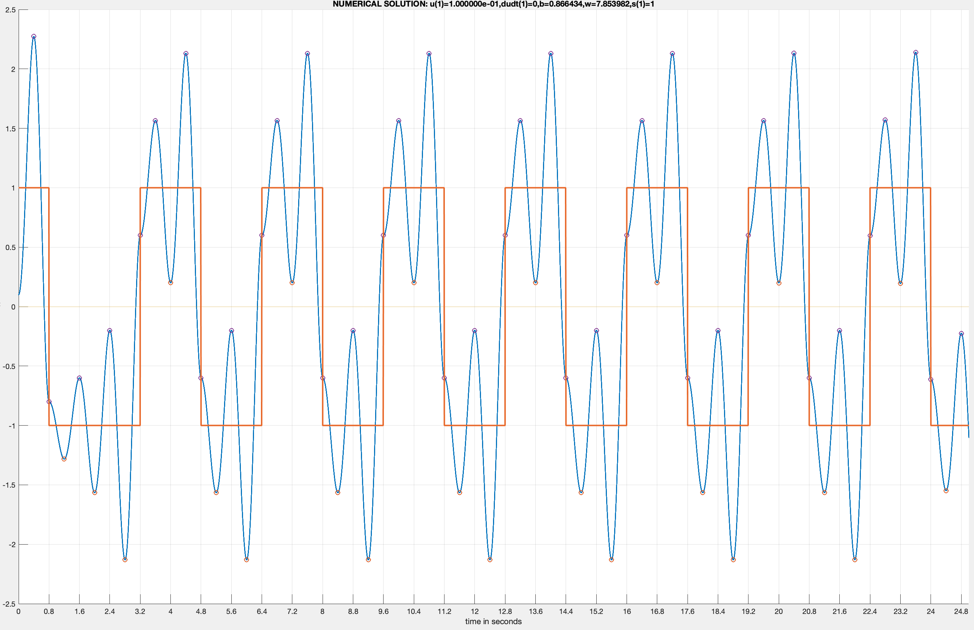
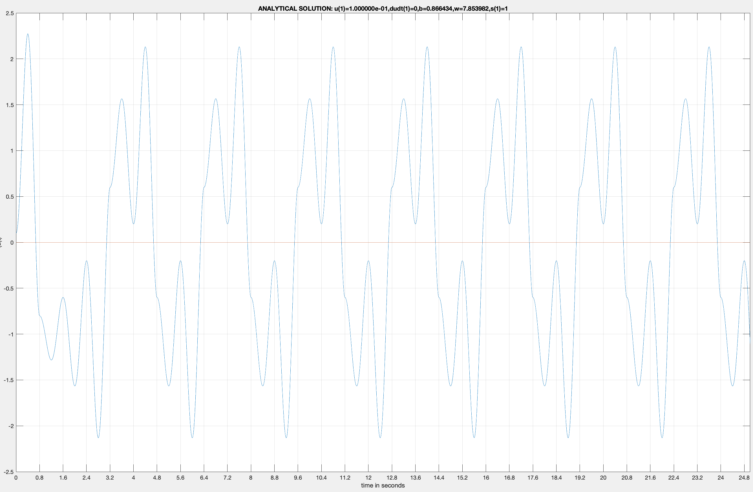
A comparison between the numerical and analytical solution when transmitting a signal with period 0.8s
u(t)
u(t)
Time in seconds
Time in seconds

Slide 10
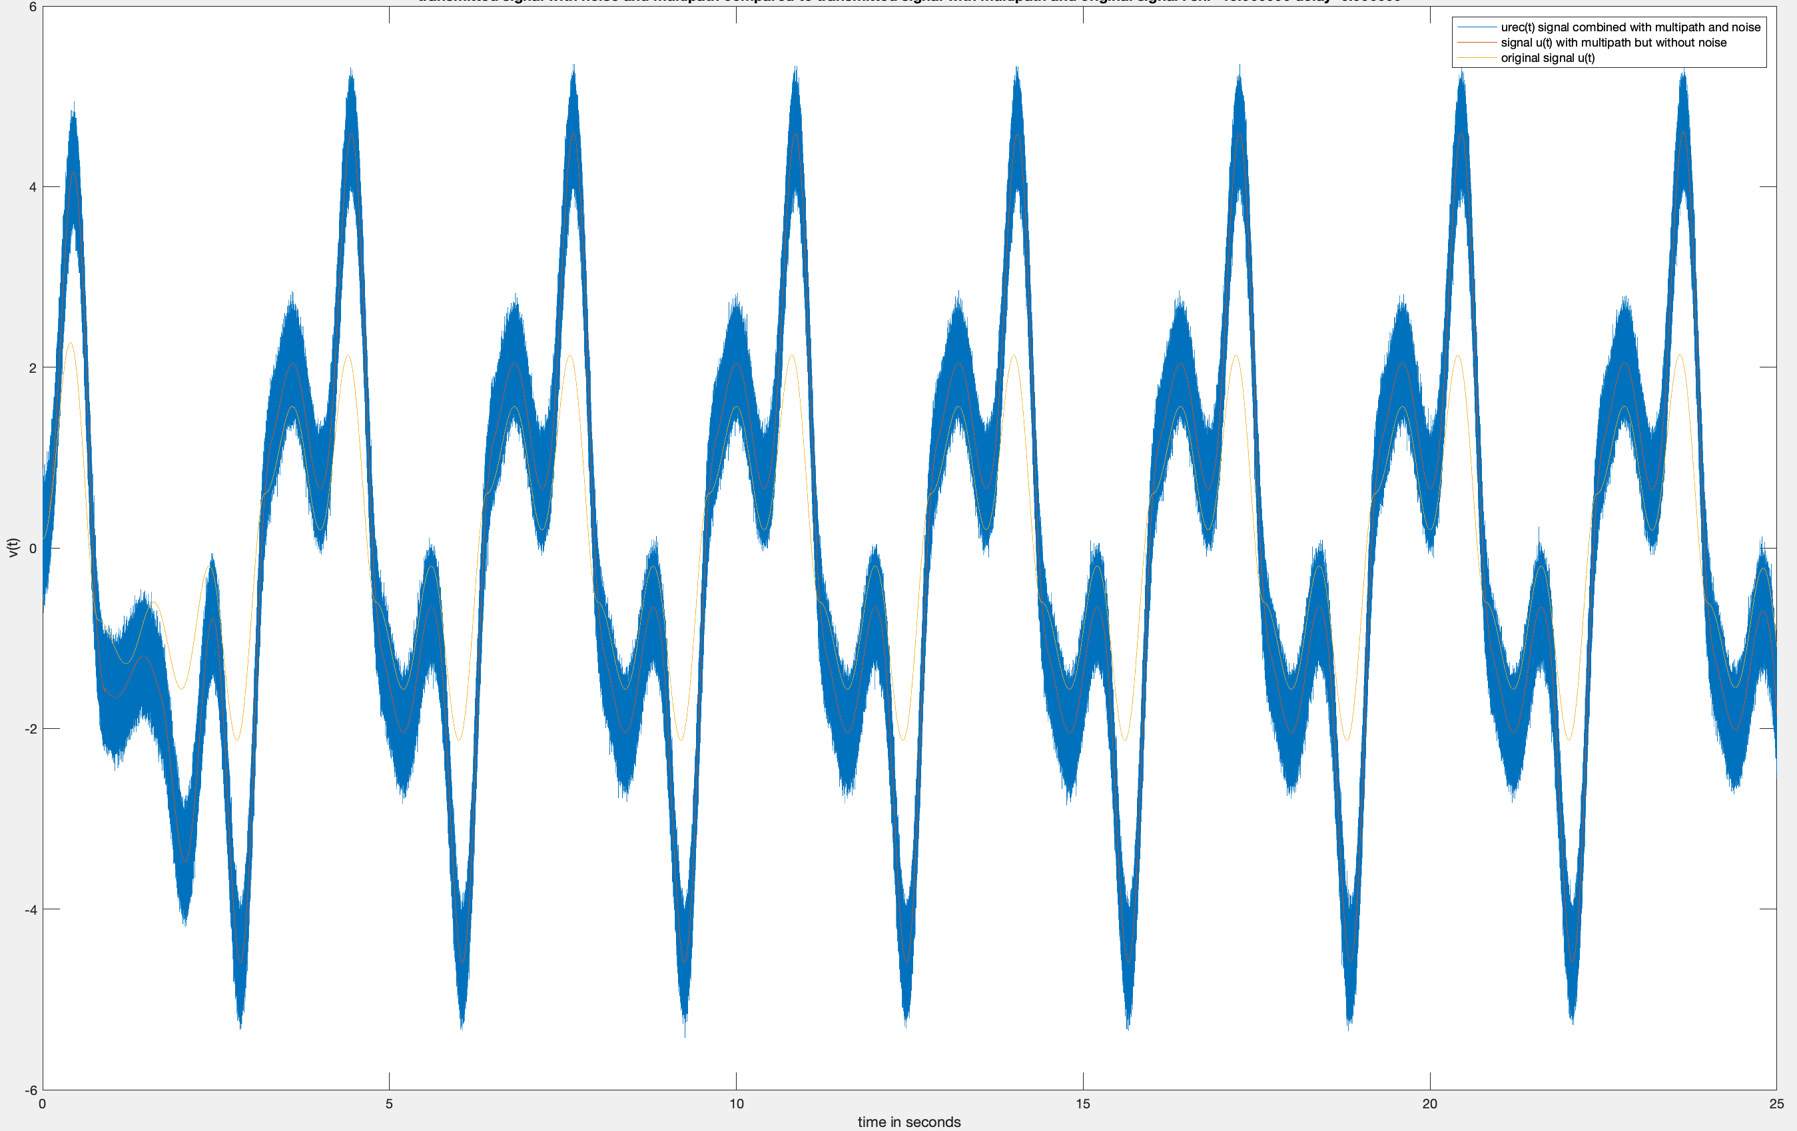
The aim of the rescaled system
We wish to understand multi path
propagation in depth and find ways to improve
communication affected by it.
Which variables affect it?
What are the best and worst cases of multi path?
Can they be avoided?
Can they be addressed?
In this figure a comparison between waveform oscillations of the direct signal and the combined received signals affected with and without noise obtained from the numerical integration of the hybrid dynamical system for $β=ln2/T$and T=0.8 seconds with snr=15db, can be seen.

Slide 11
The communication system we examine
The communication system we will be discussing about is a point to point communication system affected by multipath and noise.However this communication system is equivalent to a network with multiple transmitters that have the same frequency, different amplitudes and one receiver.
The only difference is that instead of transmitting signals at the same time with different attenuation, we transmit signals with different amplitude.
So each line in the return map will encode 1 bit of information for every transmitter instead of encoding information of past symbols(the effect of multipath)
This communication system is re-scalable.Frequency, time and the time delays of the indirect signals can all be re-scaled and if they were to be multiplied by the same constant during the process of re-scaling, would have the exact results this work provided.

Slide 12
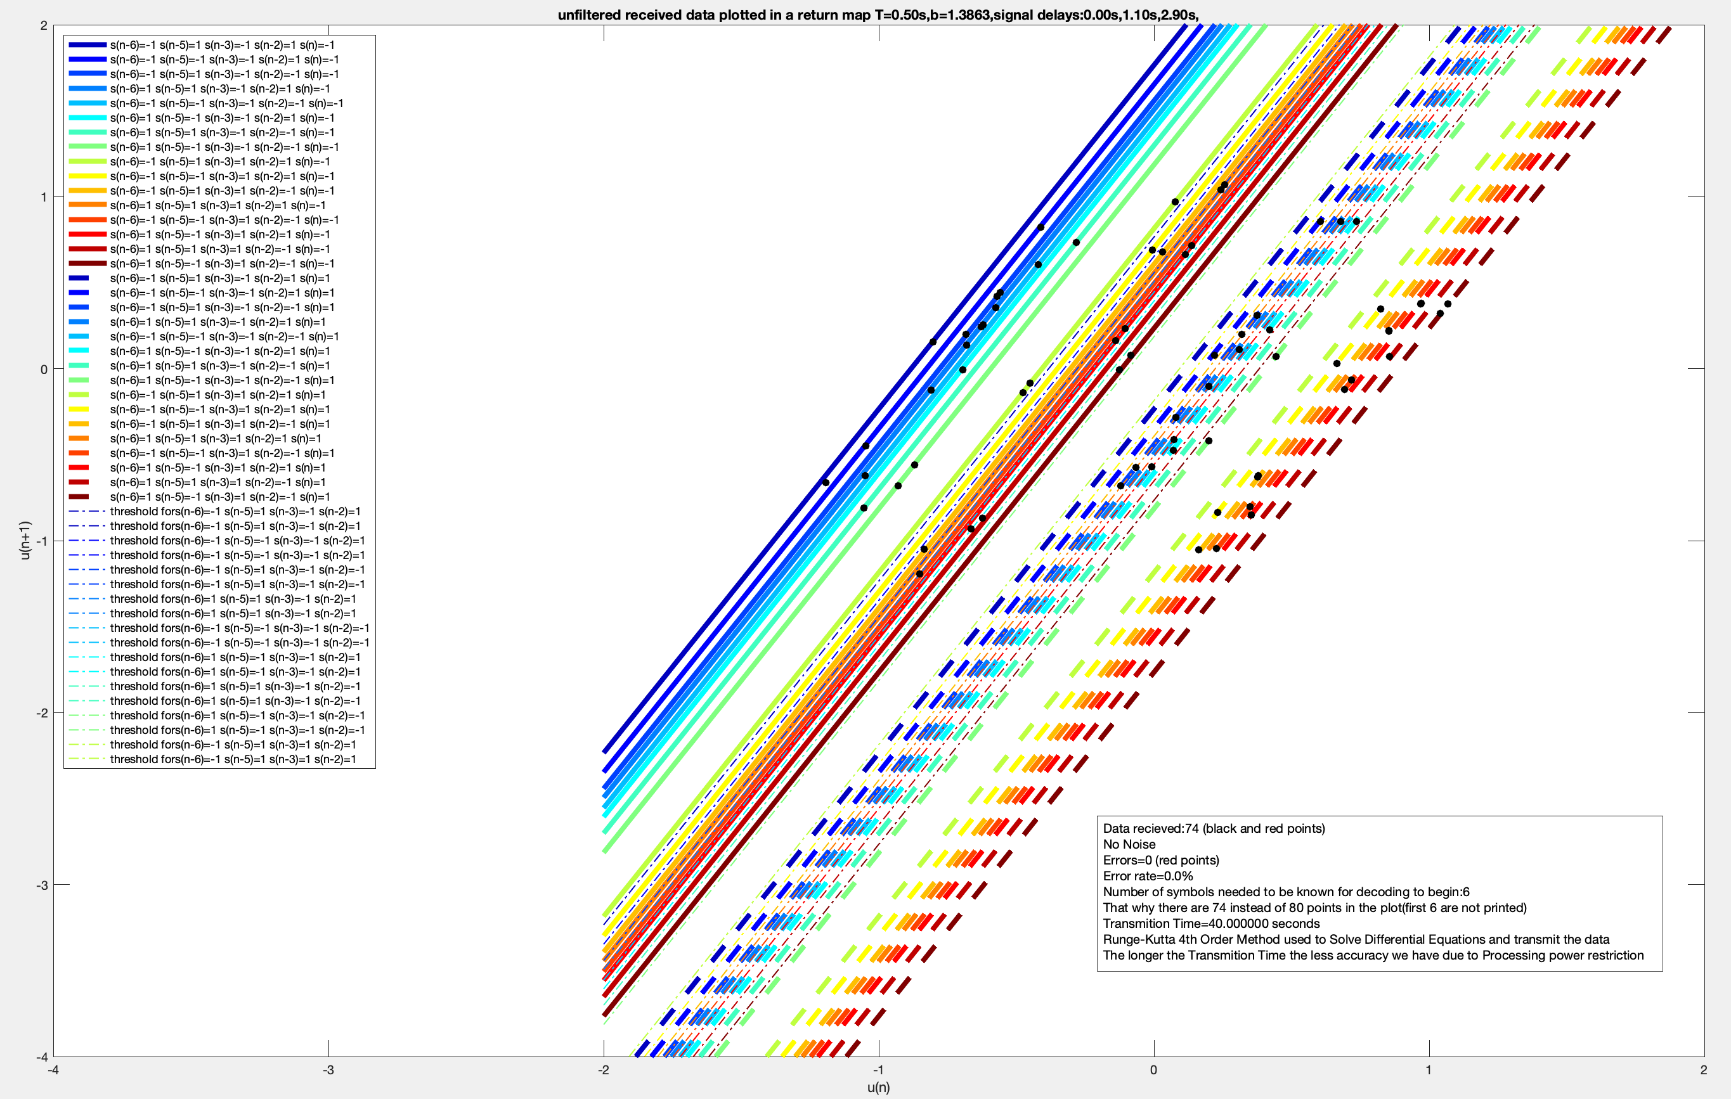
The new Return Map

Slide 13
The new Return Map
In order to to construct the return map and be able to decode the :
Number of indirect signals
The delays of the indirect signals
must be known so that the :
Number of return map lines
The information each line encodes
can be calculated .

Slide 14
CREATING THE RETURN MAP(PART 1)
The number of return map lines can be calculated with the following equation:
$$N_{R}=2^{1+|C|}$$
Where :
$N_{R}$ is the number of return map lines.
$|C|$ denotes the cardinality of set C and $|C|$+1 is the number of bits all return map line store.
$$C=\{⌈\frac{t_{i}}{T}⌉,⌈\frac{t_{i}}{T}⌉+1:⌈\frac{t_{i}}{T}⌉>0,⌈\frac{t_{i}}{T}⌉+1>0,∀i∈\{1,..,t_{l}\}\}$$

Slide 15
CREATING THE RETURN MAP(PART 2)
Each one of the $N_{R}$ lines encodes $|C|+1$ bits {$b_{1},b_{2},...,b_{|C|+1}$}, so the final step for completing the return map is to assign values for each one of the $b_{1},b_{2},...,b_{|C|+1}$ bits of each line.That can be achieved by exploiting the linear form of the return map:
$$c_{i}=\overset{L-1}{\underset{l=0}{∑}}a_{l}(e^{βT}s_{n^{′}}-K_{l}s_{n^{′}}-s_{n^{′}+1}+s_{n^{′}+1}K_{l})|∀i∈\{1,N_{R}\}$$
Each bit $b_{i}$ refers to a different past or present symbol $s_{n-x_{i}}$ ,where $x_{i}$ is equal to the $i$-th biggest unique element in C.
From the magnitude of $c_{i}$ we can identify the return map line we wish to encode .
The values of the bits $b_{1},b_{2},...,b_{|C|+1}$ that will be used for the encoding are equal to the values of the symbols with unique past or present indexes that were used for the calculation of the $c_{i}$.

Slide 16
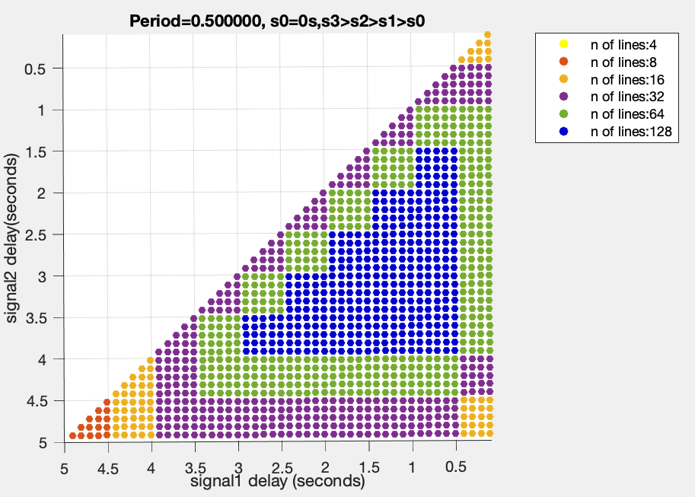
WHAT AFFECTS THE NUMBER OF LINES
From the nature of the $N_{R}$ equation, it can be seen that the maximum number of return map lines that can be produced by k indirect signals is:
$$N_{R_{max}}=2^{1+2k}$$
However every time of the two conditions listed below is satisfied the number of lines will decline by half
If $i≠j$ and $c_{i}=c_{j}$ (This happens exclusively when $τ_{l}=nT$)
If time delays $τ_{l}≠τ_{k}$ produce symbol indexes that are equal $(n_{l}^{′}=n_{k}^{′})$

Slide 17
WHY IS THE RETURN MAP AND ITS LINES IMPORTANT(Part 1)?
Enables Decoding without a matched filter.
If the receiver receives at the same time information from n users with the same frequency, each bit of information the lines encode will refer to a different user, so the data from n users can be decoded simultaneously.
In case of multipath propagation the lines encode also past information, a feature that can be exploited in various ways:elevating the bit rate , error correction algorithms etc.

Slide 18
WHY ARE THE RETURN MAP AND THE LINES IMPORTANT(Part 2)?
Decoding is based on how big the area the sections created by a threshold line cover, the bigger the distance between two candidate lines(lines with same past symbol information), the bigger the area of the two sections,the less the system is prone to errors.
As a result when the system is affected by noise and multi path, the bit error rate is highly dependent on the distance every candidate line has with its pair.
In the next three slides we will observe the three different scenarios that can occur.

Slide 19
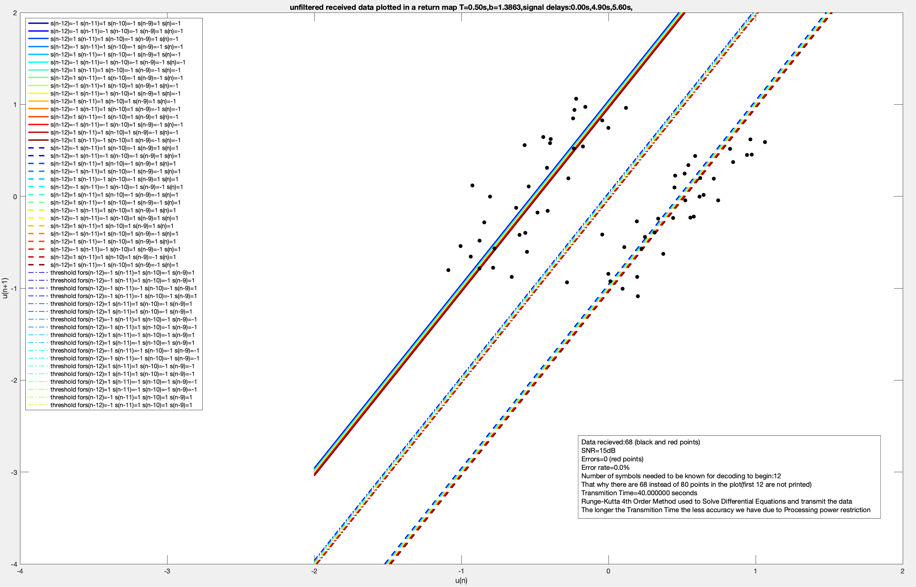
THRESHOLD LINES CLUSTERED TOGETHER IN THE MIDDLE(SCENARIO A)

Slide 20
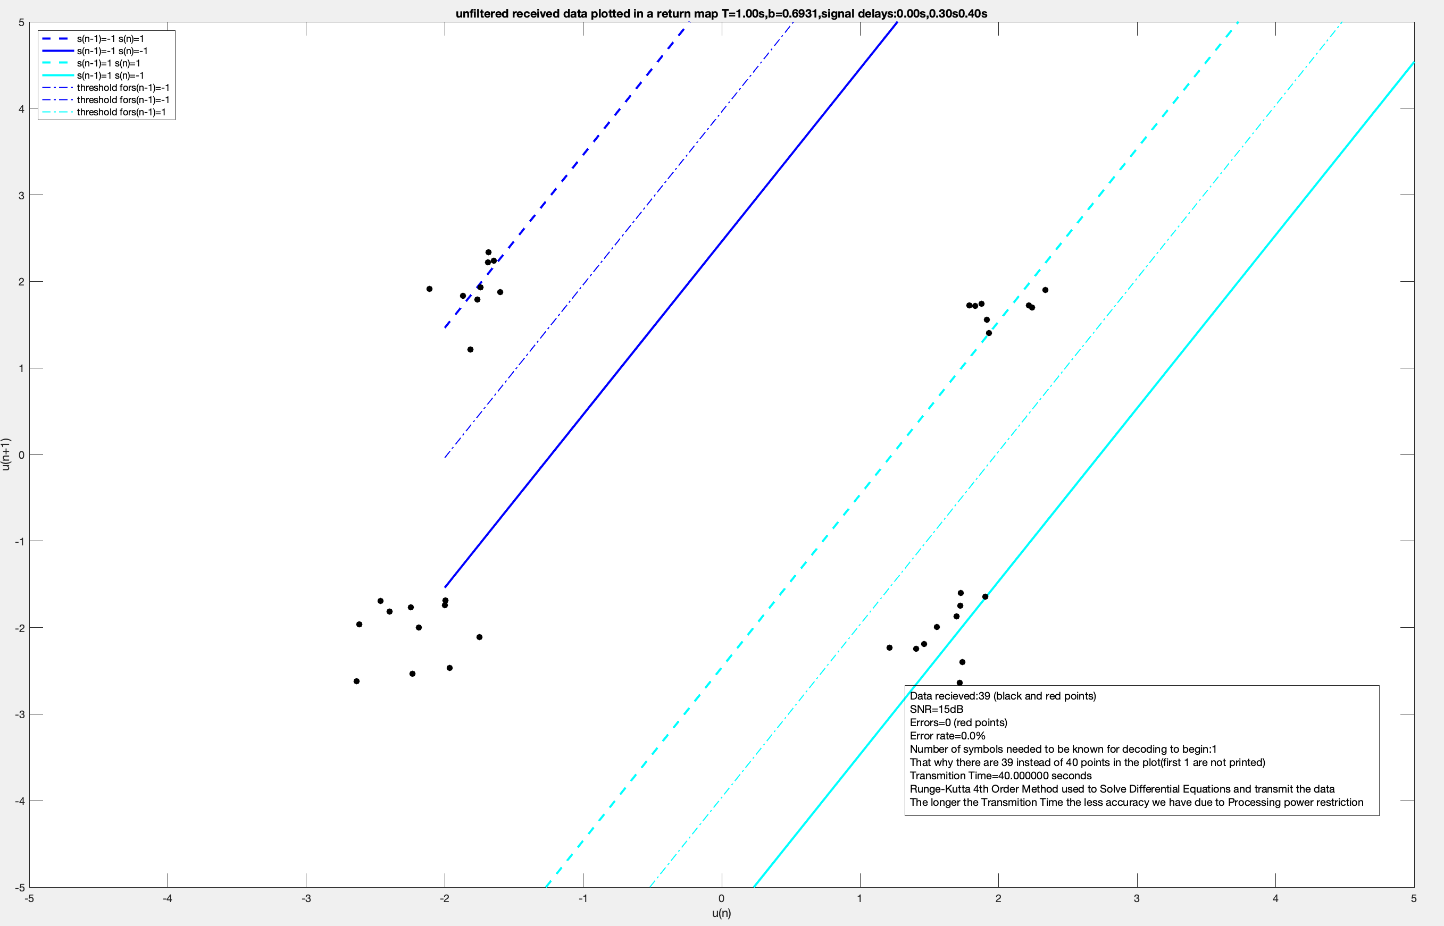
RANDOM CLUSTERS WITH LARGE DECODING SECTIONS(SCENARIO B)

Slide 21
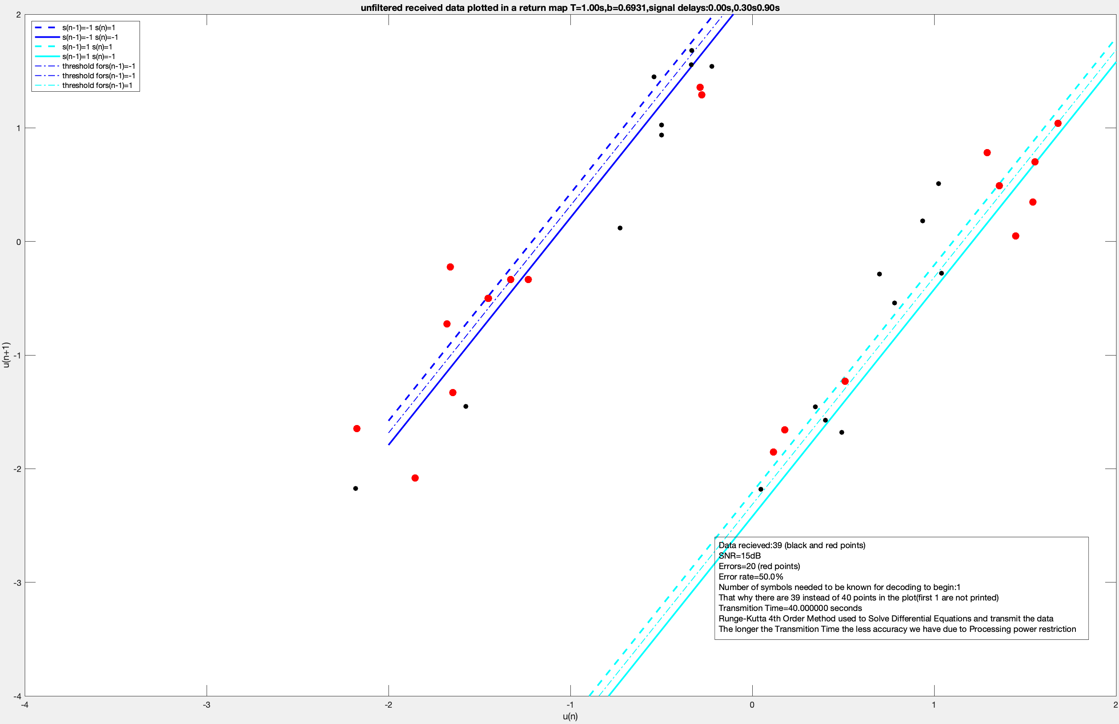
RANDOM CLUSTERS WITH SMALL DECODING SECTIONS(SCENARIO C)

Slide 22
CAN MUTUAL INFORMATION HELP WITH THE CONCLUSIONS?
From the $N_{R}$ equation and the previous figures it can be seen that the performance of a system affected by noise and multipath propagation is highly dependent on a relationship between the carrier frequency $f$ and the indirect signal delays $τ_{l}$.
The equation for Mutual information given by [3] will help us understand more about which $f$ and $τ_{l}$ combinations are better than others:
$$I(X;Y)=\underset{x}{∑}\underset{y}{∑}P(x,y)log\frac{P(x,y)}{P_{1}(x)P_{2}(y)}$$
I(X;Y) is the mutual information
x is the symbol transmitted
y is the symbol received
P(x,y) the probability that if symbol x was transmitted the symbol y was received,
$P_{1}(x)$ is the probability of the x symbol being transmitted(if the amount of 1s and 0s transmitted is the same the probability is 1/2)
$P_{2}(y)$ is the probability of the y symbol being received.Both x and y are random variables and can be either 1 or -1.
Where:

Slide 23
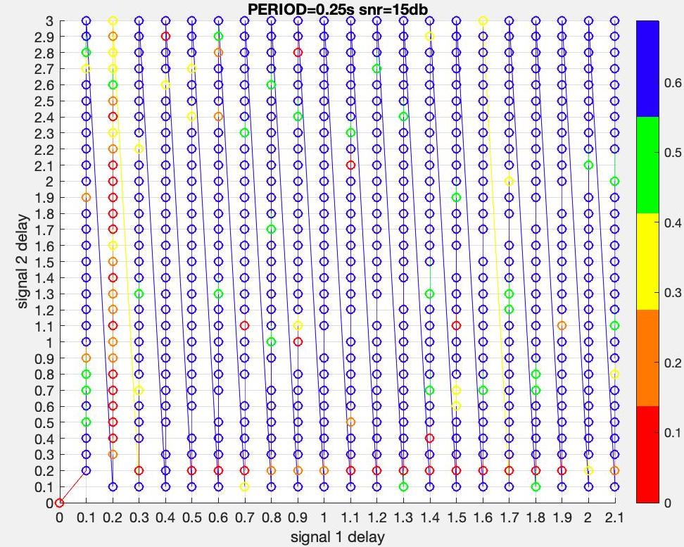
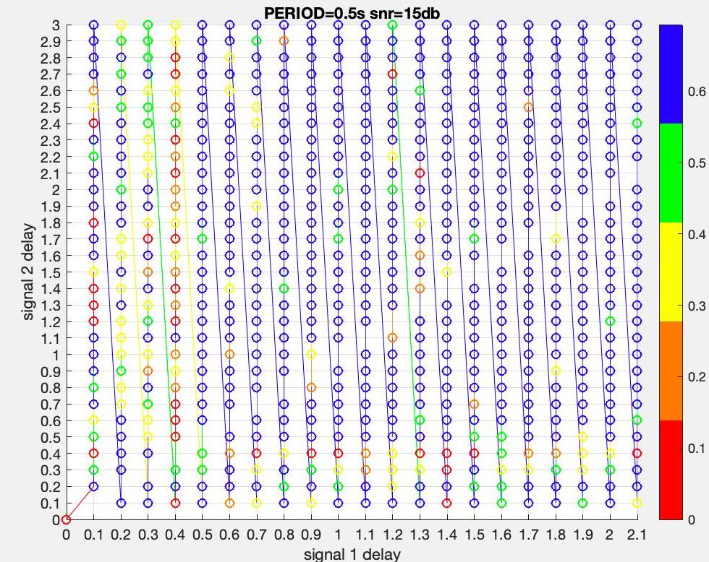
CAN MUTUAL INFORMATION HELP WITH THE CONCLUSIONS?

Slide 24
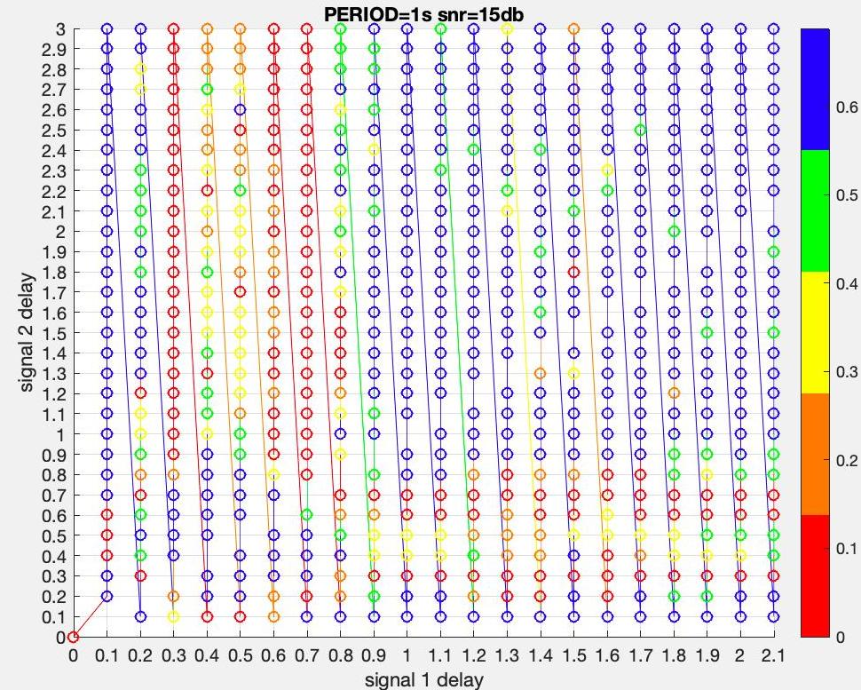
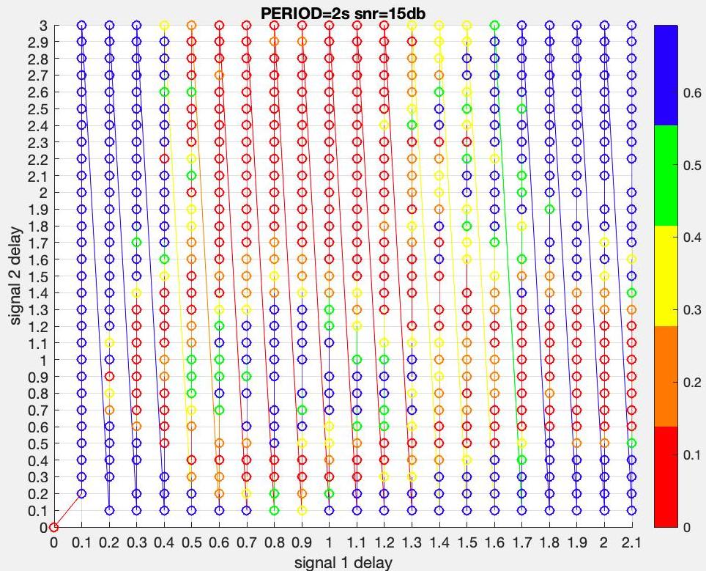
CAN MUTUAL INFORMATION HELP WITH THE CONCLUSIONS?

Slide 25
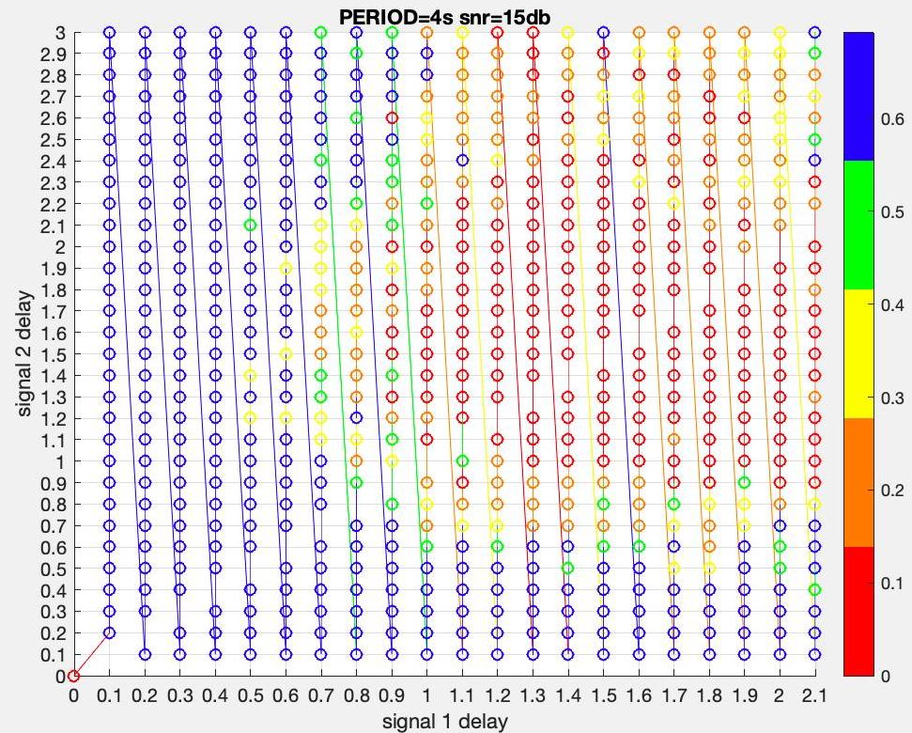
SETUP WHERE MULTIPATH HAS NO NEGATIVE IMPACT
As the period of the signal grows, the lower MI clusters shift towards bigger delays on the right, leaving behind an error free communication zone of smaller delays.
For example in this figure, the received signal with snr 15db and Period 4s achieves maximum Mutual information for all possible combination of delays for indirect signals within the range 0.1s-0.4s for signal 1, and 0.1s-3s for signal 2 (both indirect signals).

Slide 26
CAN AVERAGE MUTUAL INFORMATION TELL US
EVEN MORE?
Finally in order to get a clear idea about how the system performs under the influence of noise and multipath propagation for various frequencies we will focus on the average mutual information(AMI).The AMI for a specific carrier frequency is the sum of each individual MI of every signal delay combination multiplied by the carrier frequency.
$$AMI(f)=\overset{2.1}{\underset{d_{1}=0.1}{∑}}\overset{3}{\underset{d_{2}=0.2}{∑}}I_{d_{1},d_{2}}(X;Y)*f$$
Where:
$d_{1}$ and $d_{2}$ are the delays of indirect signals 1 and 2 respectively.
$f$ is the carrier frequency.
$I_{d_{1},d_{2}}$ is the mutual information calculated for delays $d_{1}$,$d_{2}$f or $d_{2}$>$d_{1}$.
*The delays used in the simulations were in the range of $0.1s≤d_{1}≤2.1s$ and $0.2s≤d_{2}≤3s.$

Slide 27
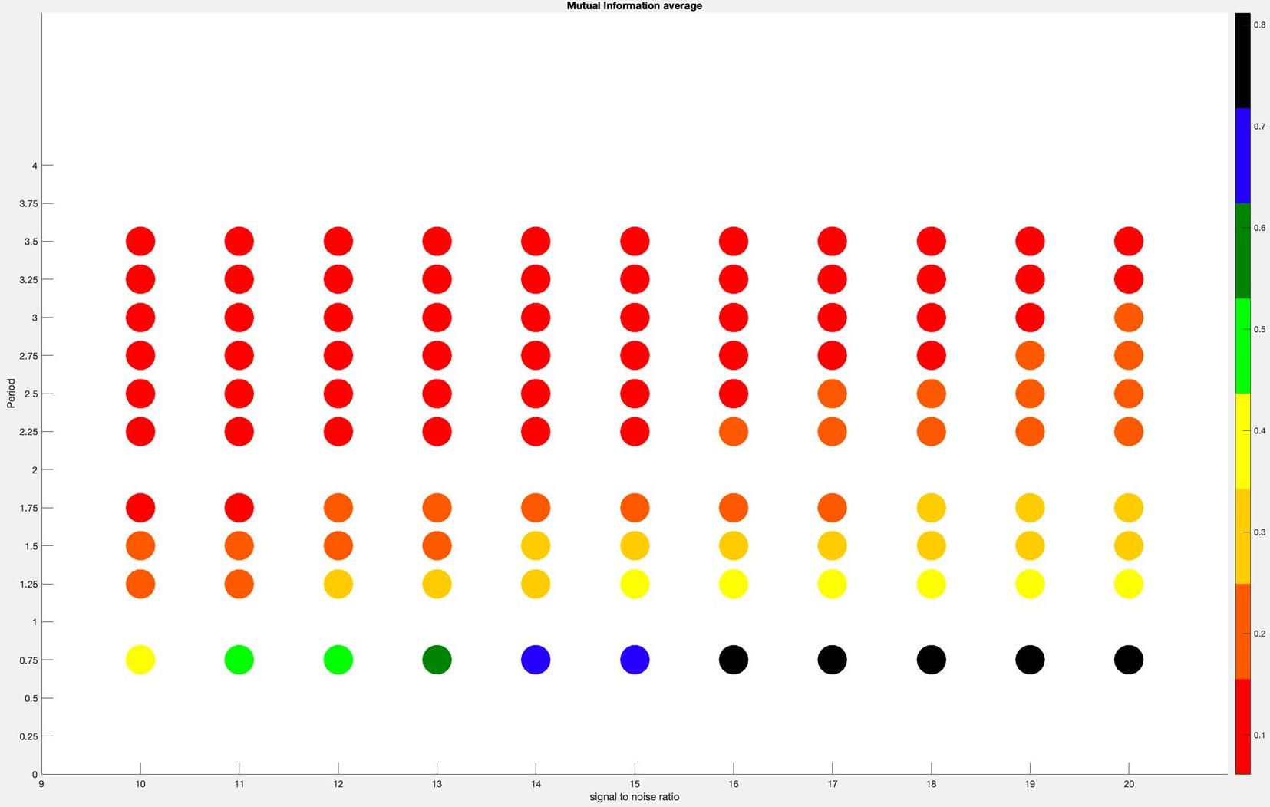
WHAT AVERAGE MUTUAL INFORMATION TELLS US(2)

Slide 28
FINAL THOUGHTS
The last figure (which is the result of a simulation that calculated the AMI for frequencies in the range from 0.25Hz to 0.4Hz for snr ranging from 10 to 20db) demonstrates a controversial effect chaos based communication offers: When operating under mutlipath and noise, higher frequencies offer higher AMI, and better performance .
With these findings a Multi-path sniffing application can be made: a method for observing the range of frequencies that do not contain harmful delayed signal reflections, in order to apply a suitable partial topology reconfiguration to the network, and eradicate most (if not all) possible errors that can be caused by Multi-path.When the frequency and the error free time delays(that cause multipath) are known, the distance the signals travel in the medium before they reach the receiver can be calculated .Therefore ommunication infrastructure can then be placed in more optimal positions based on the coordinates the application will provide.

Slide 29
REFERENCES
[1]N. Corron, J. Blakely, and M. Stahl, A matched filter for chaos, Chaos (Woodbury, N.Y.) 20, 023123 (2010).
[2] Baptista, M.S. Chaos for communication. Nonlinear Dyn 105, 1821–1841 (2021).
https://doi.org/10.1007/s11071-021-06644-4
3]C. E. Shannon, A mathematical theory of communication, The Bell System Technical Journal 27, 379 (1948).

