Slide 1
Title of the Presentation
Mona Almansoori^{1,}*, Ahmad Elshamy², and Ahmad Mustafa²
¹ Suez Canal University, Department of Mathematical, Faculty of Science, Computer Science unit, 43711 Suez, Ismailia, Egypt
² British University, Computer Science Department, 11837 Cairo, Egypt.
* Corresponding author: mnmalmansoori@gmail.com; Tel.: +971-505-686-660

Slide 2
Title:
Secure Z-MAC Protocol as a Proposed Solution for Improving Security in WSNs

Slide 3
Abstract:
Security is one of major issues in WSNs as poor security disrupts the entire network and can have a significant effect on data transmission. So, the focus of the current research is to develop a secure Z-MAC protocol along with the implementation of elliptic curve encryption and IHOP mechanism. Basic Z-MAC protocol and secure Z-MAC protocol were compared in terms of the stages and performance while they were introduced with blackhole, flooding, and DDOS attacks. It was found that secure Z-MAC protocol ensures high security and performance even when the network is introduced with variety of attacks. It was also observed that delay in packets was minimal when secure Z-MAC protocol was implemented in the network.
Keywords: Security in WSNs; security attacks; Z-MAC protocol; secure Z-MAC protocol

Slide 4
Introduction:
The Z-MAC protocol enables to have minimal contention, fast throughput, shorter latency, lower power consumption, and improved efficiency[1], because of weak data integrity and encryption methods, wireless sensor networks are readily hacked.
This research focused on increasing the security of WSNs by developing a more secure and safe Z-MAC protocol.
Objectives:
WSN require efficient secure data transmission using low processing power and maintaining data integrity which is partially provided by Z-MAC
Proposed a secure data transmission solution modifying the z-mac for secure data transmission using IHOP and Eliptic curve.
Encrypt packets using the Eliptic curve for efficient and lightweight properties
Prove that it can achieve a high throughput without being compromised
Rhee, I., Warrier, A., Aia, M., Min, J., & Sichitiu, M. L. Z-MAC: a hybrid MAC for wireless sensor networks. IEEE/ACM Transactions On Networking 2008, 16(3), 511-524. 10.1109/TNET.2007.900704

Slide 5
Literature Review:
Problem Statement
Numerous attacks, such as DDOS attacks, flooding attacks, and blackhole attacks, can arise in a WSN, compromising the network's security and efficiency.
To guard against such attacks in a WSN, there is a protocol known as the Z-MAC protocol that utilizes TDMA and CSMA mechanisms. This Z-MAC protocol has inherent limitations that compromise the network's security, including cost constraints related with slot assignment and clock synchronization, excessive energy consumption, synchronization issues, and concealed terminal issues [2].
Suggested Solution
To overcome the issue of security in the Z-MAC protocol, a secure Z-MAC protocol has been developed.
Secure Z-MAC protocol would occur in seven developed stages, such as neighbour discovery and slot assignment, local framing, transmission control, explicit contention notification, receiving schedule of Z-MAC, and local time synchronization, which are a part of IHOP mechanism.
2. Arshad, S., Al-Sadi, A., & Barnawi, A. (2013). Z-MAC: performance evaluation and enhancements. Procedia Computer Science, 21, 485-490.

Slide 6
Literature Review:
Types of Security Attacks in Networks.
Security networks are highly vulnerable to attacks, which allows the hackers to modify data, steal information, attack confidential of individuals. Because sensor networks are scattered, tracking and regulating the true state of the network's elements is a difficult task [3].
Common attacks in a WSN are eavesdropping, sinkhole, Denial of Service, flooding, and blackhole attack .
Significance of Security in Sensor Networks.
Managing security in sensor networks contributes to the authenticity, secrecy, integrity, privacy, and access to data packets.
When additional security elements are introduced into the network, the computations, communications, and administration overhead increases in tandem with the increased security effectiveness [4].
3. Kosachenko, T., Dudkin, D., Konev, A., & Sharamok, A. Threat Model for Trusted Sensory Information Collection and Processing Platform. In International Conference on Futuristic Trends in Networks and Computing Technologies, 2020, (pp. 296-304). Springer, Singapore. 10.1007/978-981-16-1483-5_27
4. Du, X., & Chen, H. H. Security in wireless sensor networks. IEEE Wireless Communications 2008, 15(4), 60-66. 10.1109/MWC.2008.4599222

Slide 7
Literature Review:
Elliptic curve Encryption
Elliptic Curve Encryption (ECE) is a kind of encryption method that may be used to encode and decode data and message authentication, developing digital signatures, and engage in process of exchanging keys[5].
The basic process for understanding how ECE works is discussed as follows:
A network's nodes decide on an elliptic curve and a fixed curve point F, which are not a secret in the network.
Node A selects a secret random integer Ak and it is a secret key and a curve point A_{P}= A_{k}F is calculated and it is considered as a public key.
Node B also engages in the similar process as done by Node A.
Node A randomly selects an integer B_{k} and it is considered as a secret key, which is not be shared publicly. After that, it calculates the curve point B_{P} = B_{k}F as its public key.
Once the secret key is generated, Node A wants to send a message to node B.
Node A can simply compute A_{k}B_{P} and use the final developed outcome as the secret key for encrypting a conventional symmetric block.
After this step, Node B can further calculate the similar value by evaluating BkAP, because B_{k}A_{P} = B_{k} · (A_{k}F) = A_{k} · (B_{k}F) = A_{k}B_{P}
5. Kang, B., Shao, D., & Wang, J. A fair electronic payment system for digital content using elliptic curve cryptography. J. of Algorithms & Comp. Tech. 2018, 12(1), 13-19. https://doi.org/10.1177/1748301817727123

Slide 8
Literature Review:
IHOP Mechanism for Key Generation
The IHOP mechanism has six stages:
Installation and setting up stage for nodes.
Association discovery stage, which further has two stages that are known:
Base station hello stage.
Cluster acknowledgement stage.
Report endorsement phase, in which t + 1 nodes cooperate to generate a report when they detect the existence of an event occurrence.
En-route filtering, involves each sending node to validate the message authentication code (MAC) produced by its subordinate associated and connected nodes before excluding it from the receiving report.
Following successful verification, the node creates and deploys a new MAC with the bilateral key exchanged with the upper connected node. Lastly, it sends the information to its next node throughout the route of the base station.
The base station verification stage. If the base station determines that the communication was properly authorized by the t + 1 nodes, it acknowledges

Slide 9
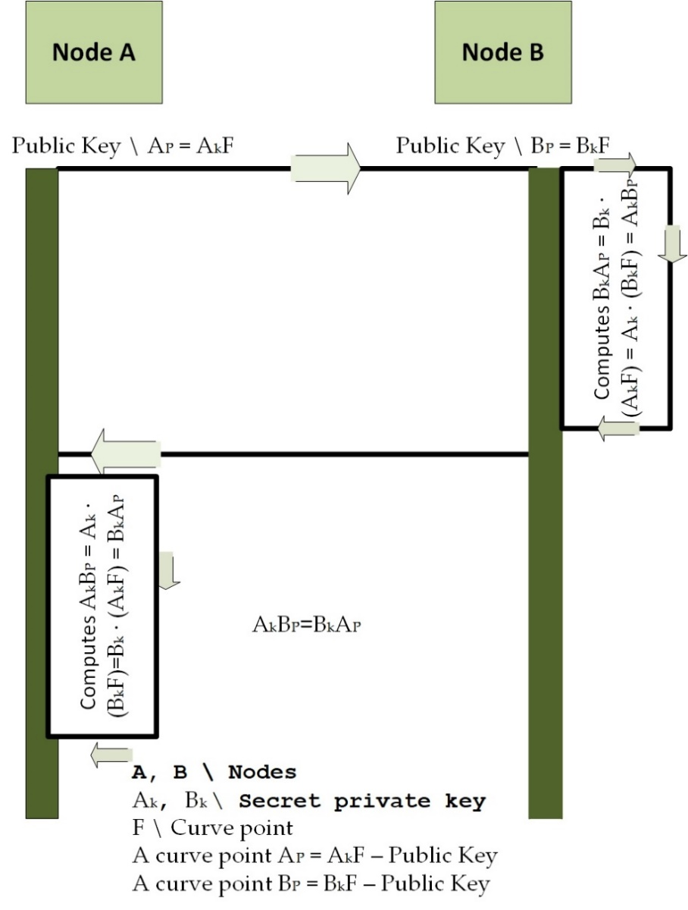
Elliptic Curve Encryption
Key Sharing using IHOP Mechanisms

Slide 10
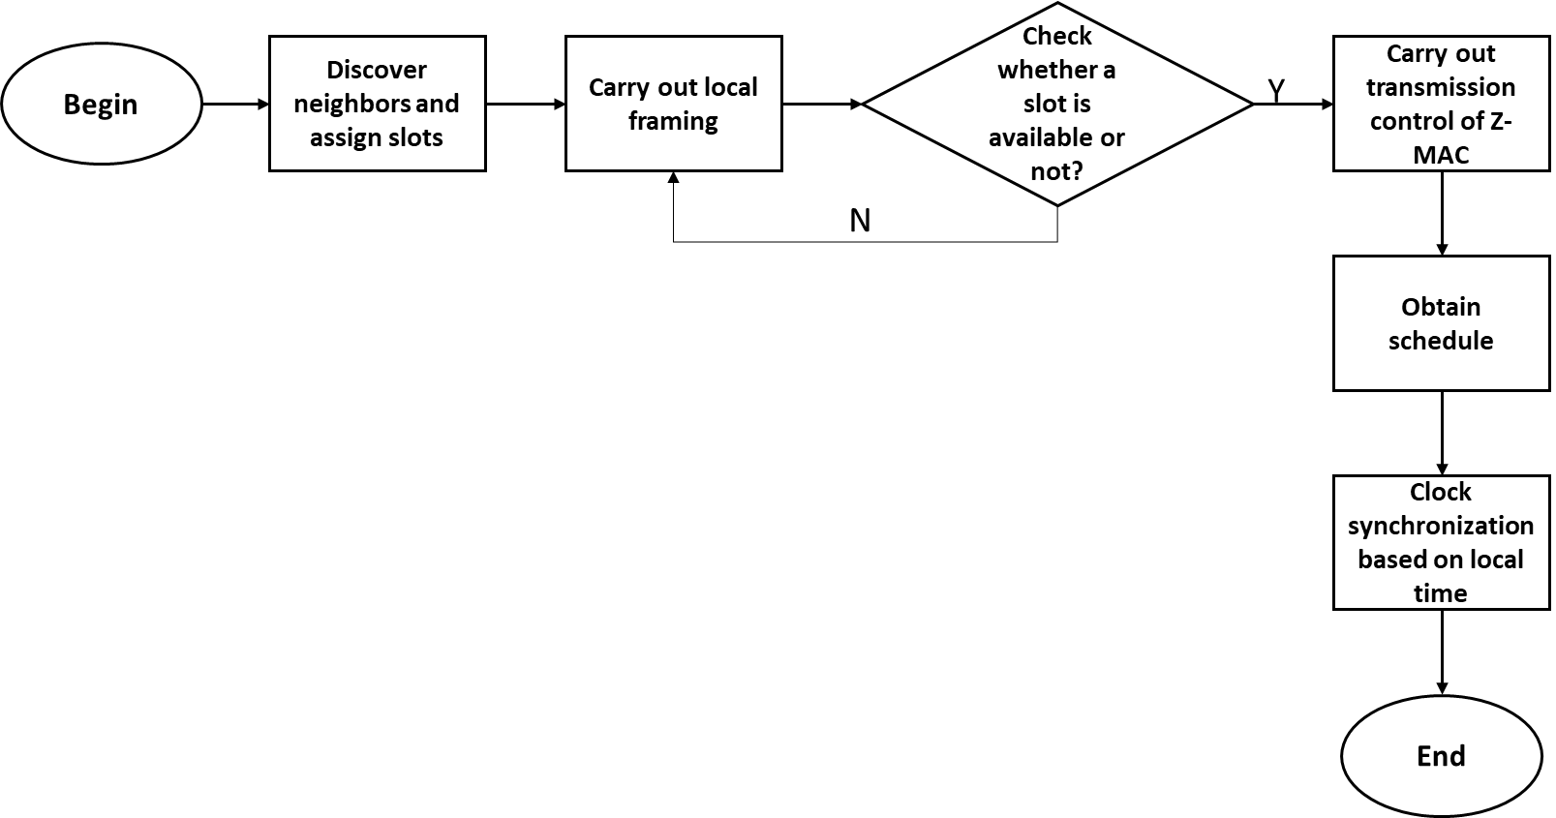
Z-MAC Protocol Operation
Neighbor Discovery and Slot Assignment
Local Framing
Transmission Control of Z-MAC
Explicit Contention Notification
Receiving Schedule of Z-MAC
Local Time Synchronization

Slide 11
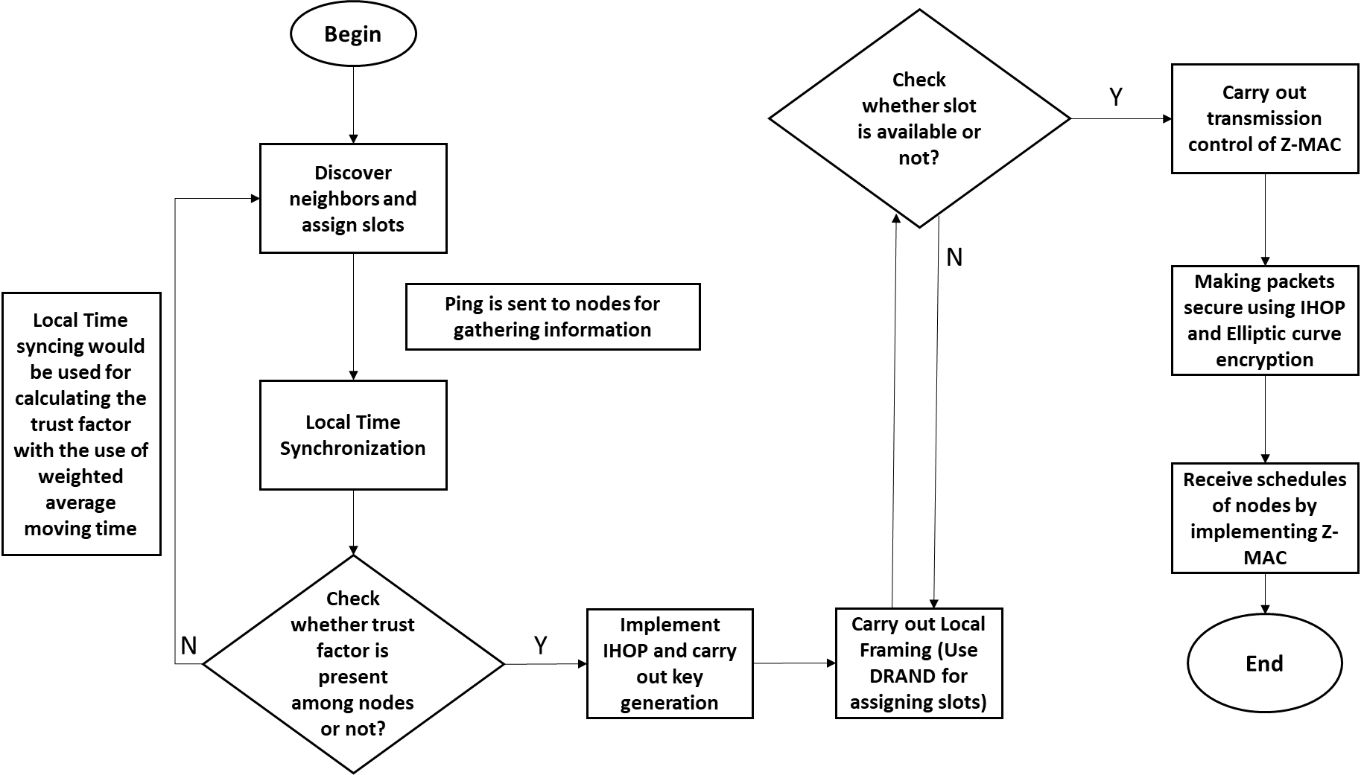
Secure Z-MAC Protocol Operation

Slide 12
Secure Z-MAC algorithm
Secure Z-MAC algorithm is presented as follows, which provides a step-by-step understanding of Secure Z-MAC:
Step 1: Begin
Step 2: Conduct neighbor discovery and slot assignment process
Step 3: Send a ping to collect details about the neighboring nodes and to perform local clock synchronization.
Step 4: Check if there is trust factor between the neighboring nodes
IF ‘Yes’ then Implement IHOP mechanism and generate keys
IF ‘No’ then repeat Step 2
Step 5: Implement the local framing stage
Step 6: Check if there is a slot available
IF ‘Yes’ then Carry out Transmission control of Z-MAC protocol
IF ‘No’ then repeat Step 5
Step 7: Carry out encryption of packets using IHOP mechanism, which is run by ECE
Step 8: Receiving schedule of Z-MAC protocol
Step 9: End

Slide 13
Expermintal setup and Scenarios
The simulations of the current research was done using NS2 simulator.
In all Expermintal implement the following:
The X-axis indicates the number of packets in bytes.
The Y-axis represents the transmission time in seconds.
A network nodes were increased in size by five, repeated until 35-40 nodes.
The attack vectors were successfully implemented into the nodes, flooding, DDOS, and Black-hole attack.
Scenarios as the following :
Measuring total transmission time using the Z-MAC scheme.
Measuring number of packets and transmission time during the attack vector introduction against the packets transmitted in Z-MAC scheme.
Measuring transmission time while implementing IHOP mechanism with Z-MAC protocol.

Slide 14
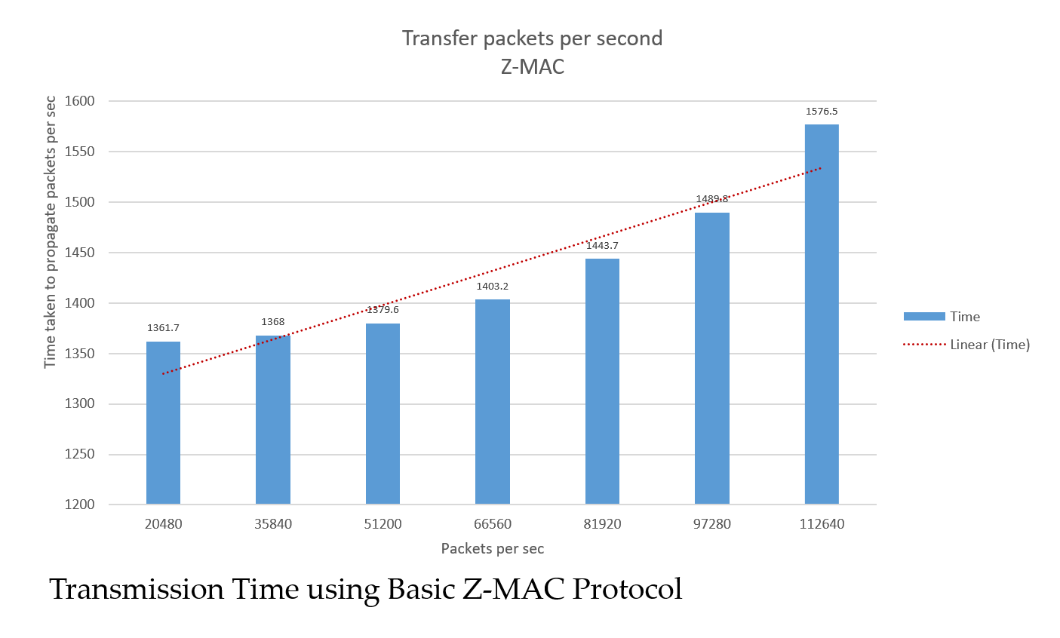
Experimental Results – Scenario 1
Total transmission time for nodes using the ZMAC scheme
Nodes | Packets/sec in bytes | Time in bits/s
5 | 20480 | 1361.78478
10 | 35840 | 1367.985821
15 | 51200 | 1379.645156
20 | 66560 | 1403.241674
25 | 81920 | 1443.686908
30 | 97280 | 1489.758152
35 | 112640 | 1576.497647

Slide 15
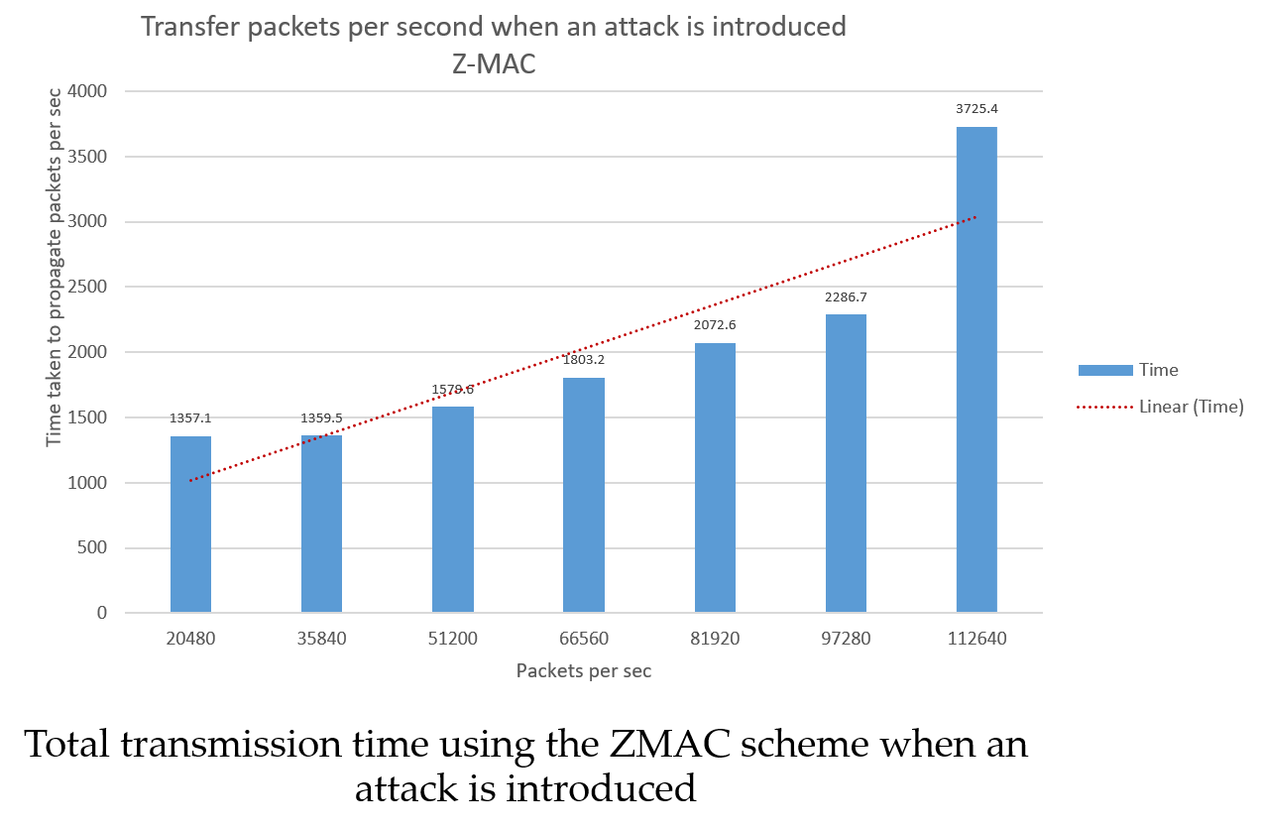
Experimental Results – Scenario 2
Total transmission time for nodes using the ZMAC scheme when an attack is introduced
Nodes | Packets/sec in bytes | Time in bits/s
5 | 20480 | 1357.1
10 | 35840 | 1359.5
15 | 51200 | 1579.645156
20 | 66560 | 1803.241674
25 | 81920 | 2072.686908
30 | 97280 | 2286.758152
35 | 112640 | 3725.497647

Slide 16
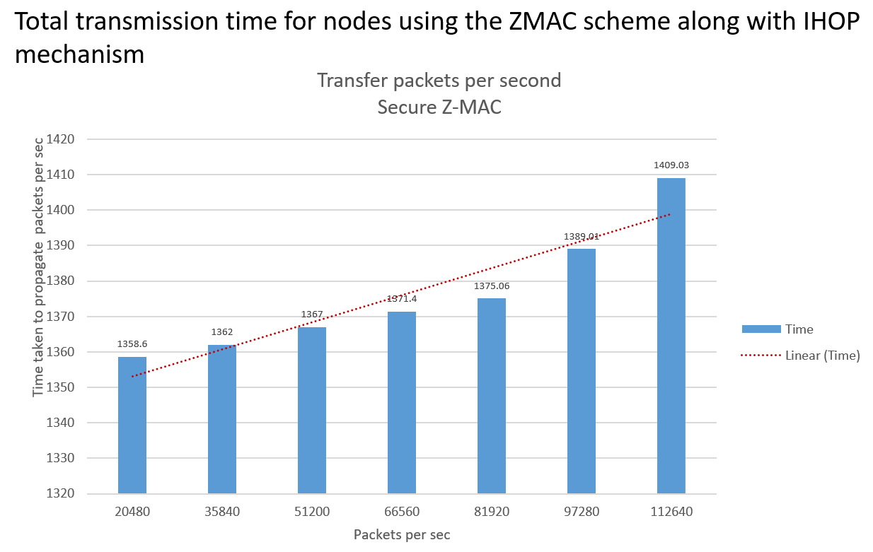
Results and Discussion – Scenario 3
Total transmission time for nodes using the Secure ZMAC scheme .
Nodes | Packets/sec in bytes | Time in bits/s
5 | 20480 | 1358.598129
10 | 35840 | 1361.77138
15 | 51200 | 1366.963776
20 | 66560 | 1371.648392
25 | 81920 | 1375.062767
30 | 97280 | 1389.011017
35 | 112640 | 1409.034265

Slide 17
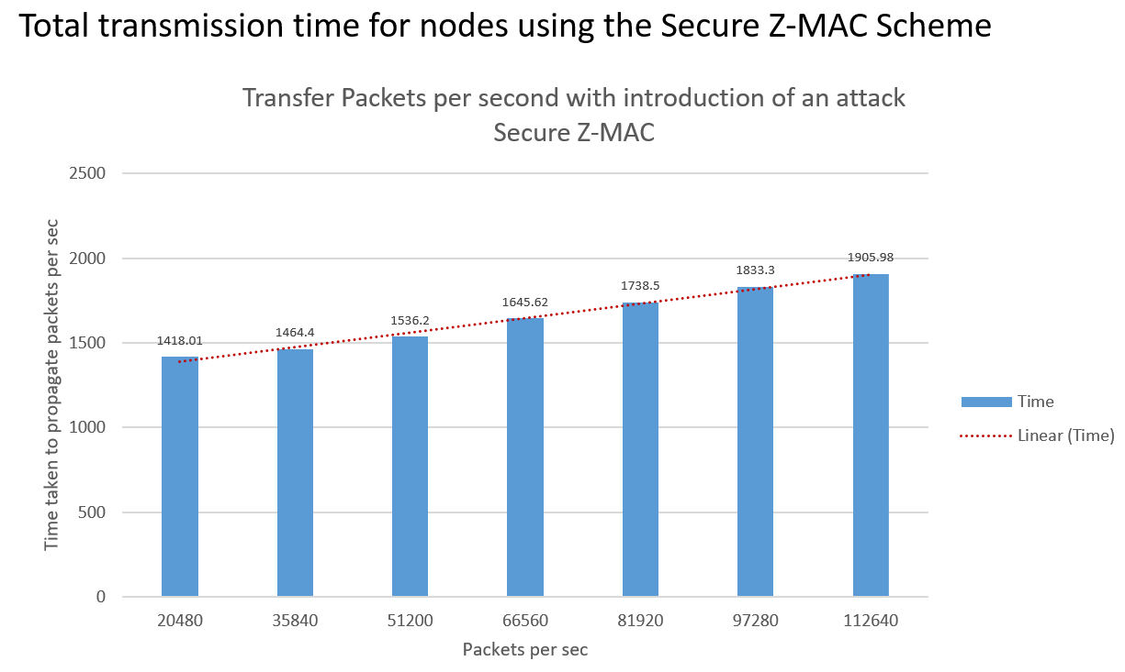
Results and Discussion
Total transmission time for nodes using the Secure Z-MAC Scheme
Nodes | Packets/sec in bytes | Time in bits/s
5 | 20480 | 1418.014112
10 | 35840 | 1464.402046
15 | 51200 | 1536.198699
20 | 66560 | 1645.619443
25 | 81920 | 1738.530628
30 | 97280 | 1833.294729
35 | 112640 | 1905.975264

Slide 18
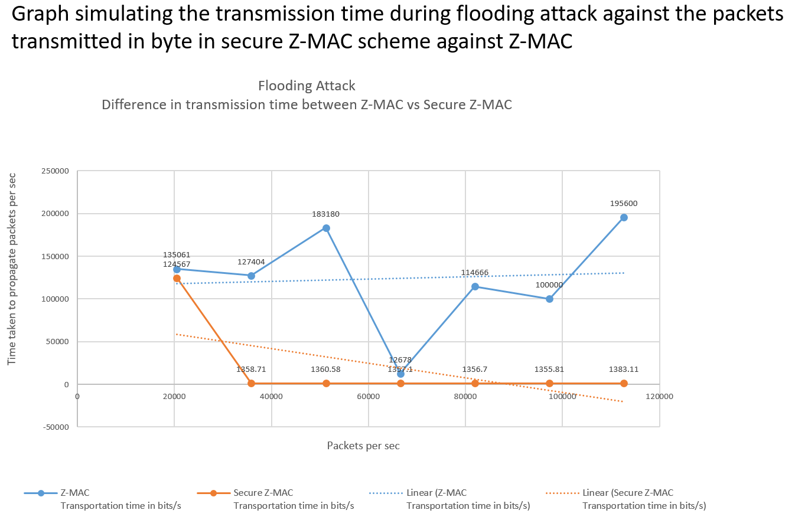
Results and Discussion
Total transmission time during flooding attack for nodes processed using the secure ZMAC scheme against Z-MAC
Nodes | Packets/sec in bytes | Z-MAC Transmission time in bits/s | Secure Z-MAC Transmission time in bits/s
5 | 20480 | 135061 | 124567
10 | 35840 | 127404 | 1358.71
15 | 51200 | 183180 | 1360.58
20 | 66560 | 12678 | 1357.1
25 | 81920 | 114666 | 1356.7
30 | 97280 | 100000 | 1355.81
35 | 112640 | 195600 | 1383.11

Slide 19
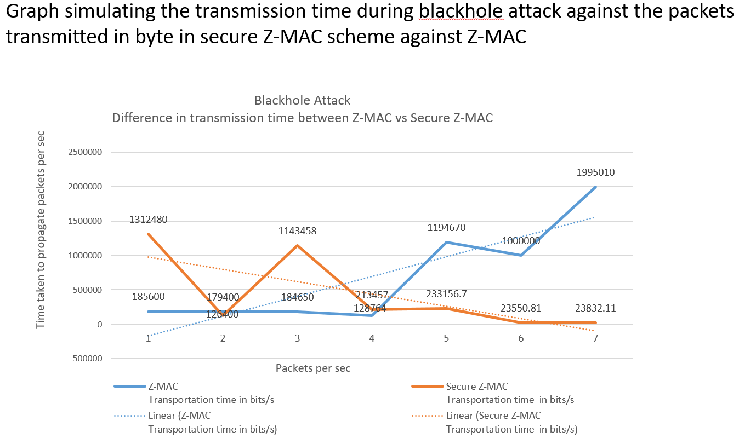
Results and Discussion
Total transmission time during blackhole attack for nodes processed using the secure ZMAC scheme against Z-MAC
Nodes | Packets/sec in bytes | Z-MAC Transmission time in bits/s | Secure Z-MAC Transmission time in bits/s
5 | 50480 | 185600 | 1312480
10 | 65840 | 179400 | 126400
15 | 81200 | 184650 | 1143458
20 | 560566 | 128764 | 213457
25 | 781920 | 1194670 | 233156.7
30 | 9007280 | 1000000 | 23550.81
35 | 1001264 | 1995010 | 23832.11

Slide 20
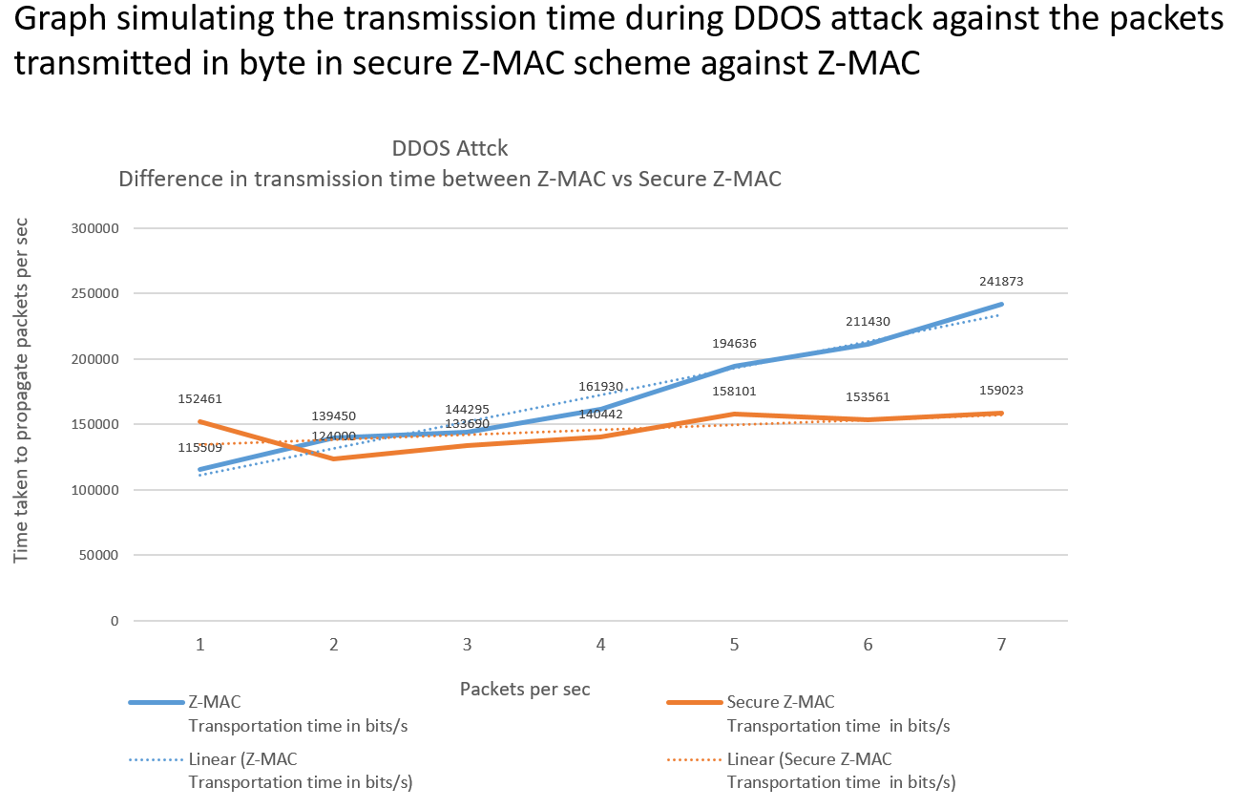
Results and Discussion
Total transmission time during DDOS attack for nodes processed using the secure ZMAC scheme against Z-MAC
Nodes | Packets/sec in bytes | Z-MAC Transmission time in bits/s | Secure Z-MAC Transmission time in bits/s
5 | 50480 | 115509 | 152461
10 | 65840 | 139450 | 124000
15 | 81200 | 144295 | 133690
20 | 560566 | 161930 | 140442
25 | 781920 | 194636 | 158101
30 | 9007280 | 211430 | 153561
35 | 1001264 | 241873 | 159023

Slide 21
Results and Discussion
A comparison of Z-MAC and secure Z-MAC protocol
Protocol | Neighbor discovery | Local time Framing(DRAND) | Transmission control(LCL,HCL) | Receiving schedule | Local time synchronization | IHOP | Elliptic curve(Encryption) | Key sharing(Public, Private) | XORING
Z-mac | X | X | X | X | X
Secure Z-MAC | X | X | X | X | X | X | X | X | X

Slide 22
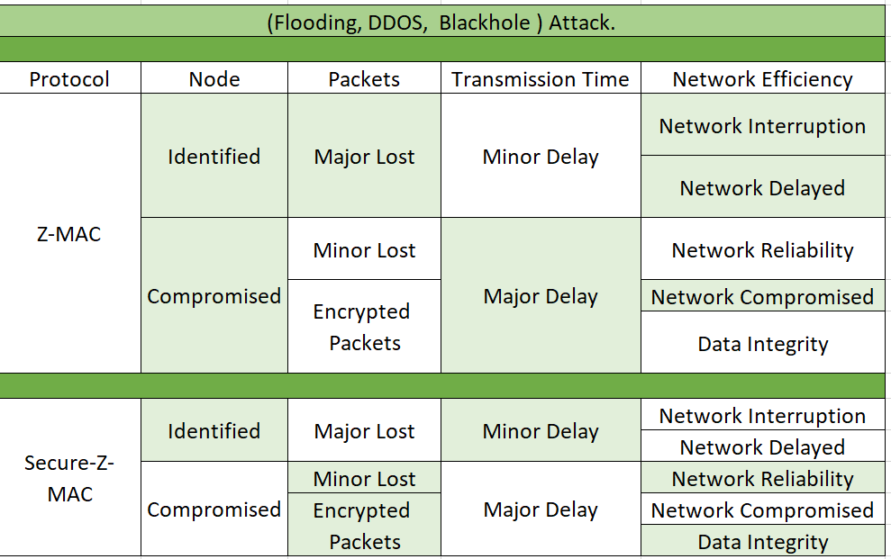
Results and Discussion
Performance Comparison of Z-MAC and Secure Z-MAC in terms of Flooding, DDOS, and Blackhole Attack.

Slide 23
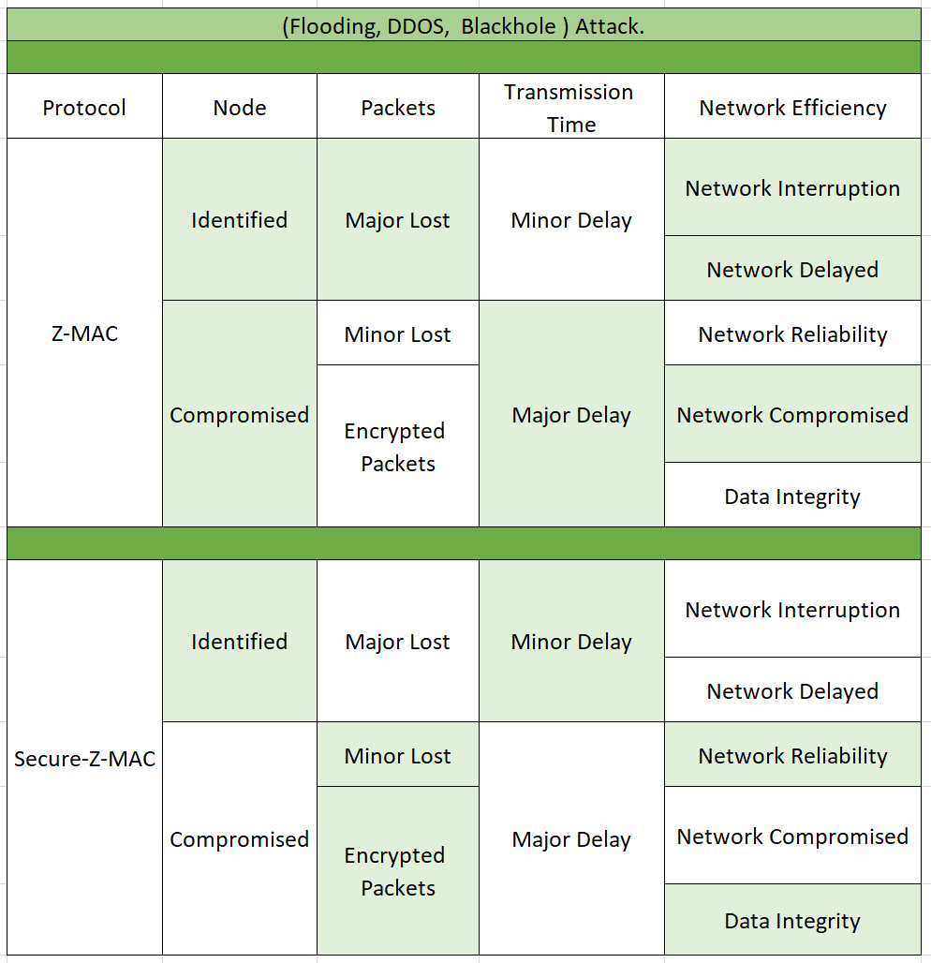

Slide 24
Results and Discussion
Secure Z-MAC protocol has a higher efficiency, security, and productivity compared to basic Z-MAC protocol. The primary goal of the study was to improve the security of the Z-MAC protocol by making it very safe when used in a wireless network. Additionally, although the network was subjected to a variety of assaults, including flooding, blackhole, and DDOS attacks, it was determined that the secure Z-MAC protocol is securing the network.
Conclusions
Secure Z-MAC protocol was found to be more efficient and secure compared to the basic Z-MAC protocol. Also, the implementation of IHOP mechanism and ECE helped in achieving a higher security for the protocol. For instance, one of the most significant uses of the Secure Z-MAC protocol is Vehicle Area Network, which would aid in boosting vehicular traffic on highways while also improving individual safety and reducing accidents.

Slide 25
Future Plan
The protocol will be evaluated in the future against a variety of network assaults, including the Sybil, message modification, wormhole, and attacks on the system's multiple levels.
The future plan calls for the development of hardware or software that implements the proposed secure Z-MAC protocol, enabling the safe transmission of essential communications. The hardware will be connected to the network's user devices through an application, ensuring secure network connection.

Slide 26
Acknowledgments
I would like to start by thanking the IECI 2021 organizers and board members for giving me the opportunity to participate in this event.
A special heartfelt thank you to supervisors Professors Dr. Medhat A. Rakha, Dr. Ahmed Alshamy , Dr. Ahmad Mostafa and Dr. Mohammed Fatehy Soliman .
I would also like to thank my father Nasser AlMansoori, my mother, my husband Khalid AlMansoori, and the rest of my family and friends for their constant support throughout my work. Also special thank you to my daughters and sons for their continuous support.

Slide 27
Thank you
Author Contributions: Mona Almansoori, Dr.Ahmad Elshamy, and Dr.Ahmad Mustafa, All authors have read and agreed to the published version of the manuscript.
Funding: This research received no external funding.
Conflicts of Interest: The authors declare no conflicts of interest.
Any Comments are welcome
mnmalmansoori@gmail.com

