Slide 1
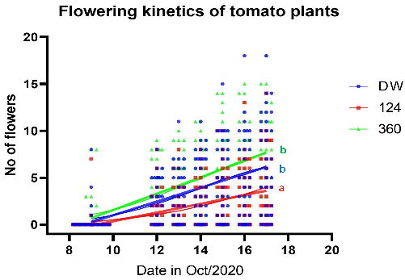
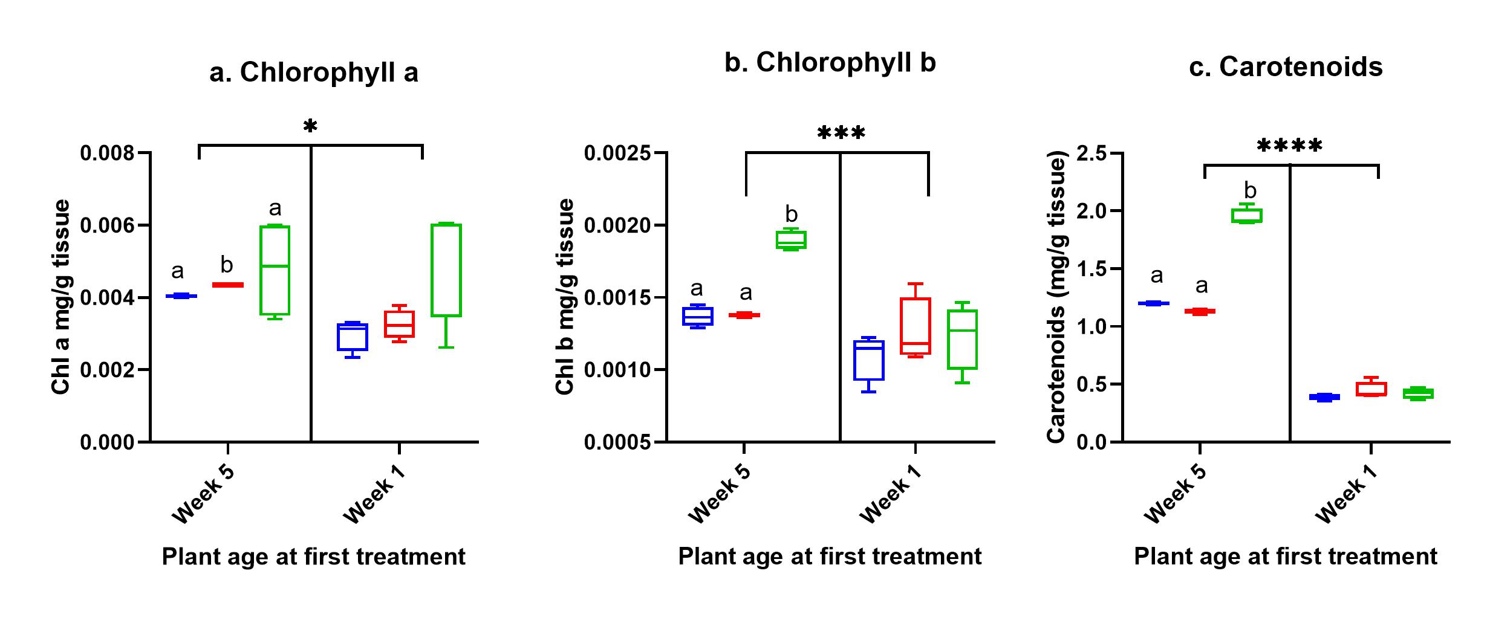
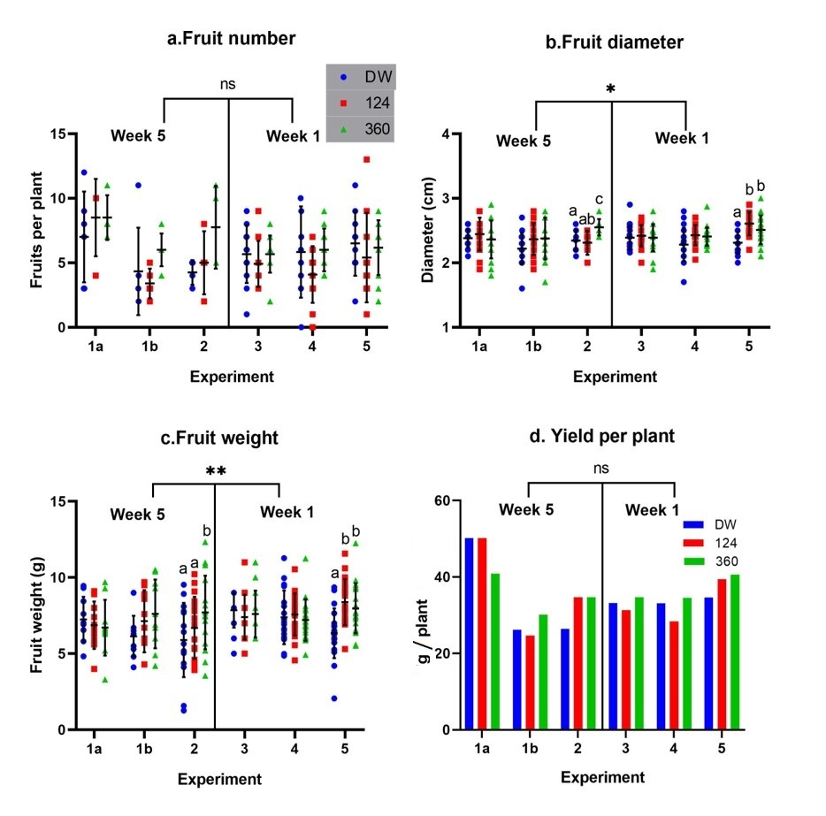
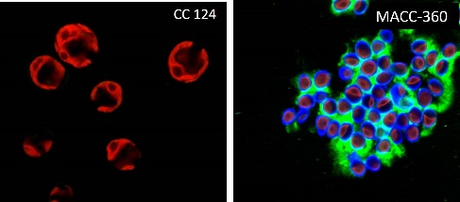
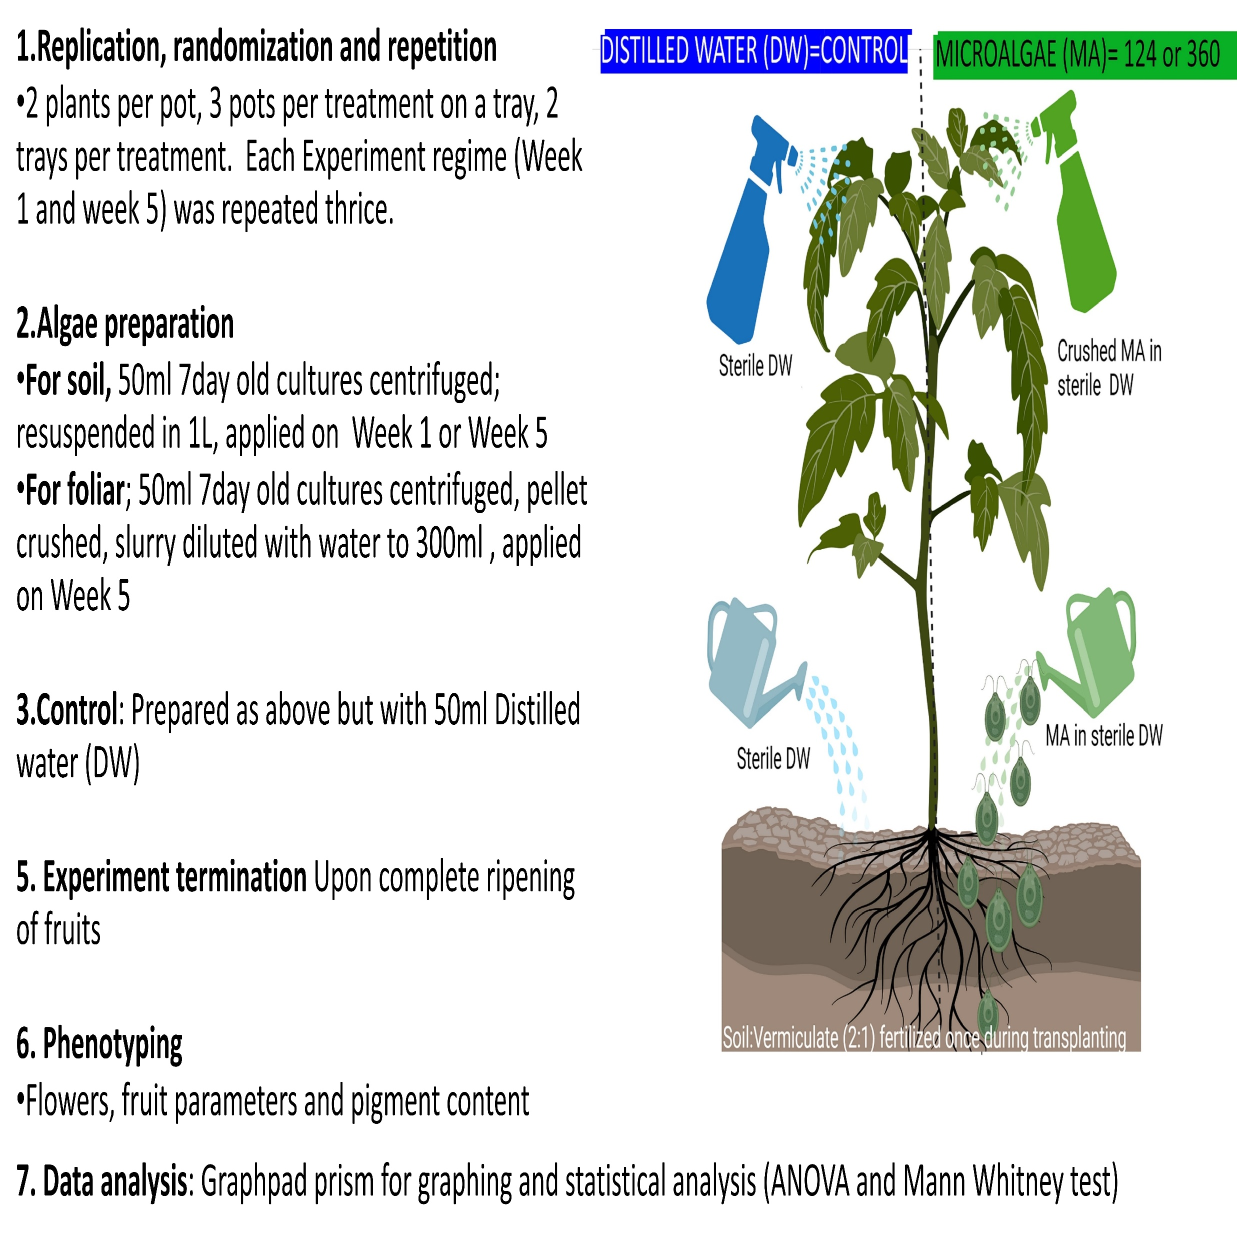
Biostimulant effect of Eukaryotic Microalgae on greenhouse grown Solanum lycopersicum.
Biological Research Centre
Gitau Margaret Mukami^{1, 2}; Gergely Maróti²
¹University of Szeged, Szeged, Hungary; ²Biological Research Centre, Szeged, Hungary
University of Szeged
Introduction
Results
Results
Conventional farming practices rely on chemical fertilizers to increase crop yields in order to meet global food demand. However, nutrients from applied fertilizers can end up accumulating in the environment, disrupting ecosystems and reducing biodiversity.
Organic fertilizers could be a solution to this problem. Unfortunately, large scale applications can be expensive. Microalgae (MA) are photosynthetic organisms, they require considerably less space to cultivate and generate huge biomass within a short time. These microorganisms produce a wide range of bioactive compounds which could promote crop quality and yield. They are eco-friendly and could be used directly in the farms without further processing (Coban et al. 2020).
The aim of our study was to investigate if small doses of MA from two genera (Chlamydomonas reinhardtii cc124 and Chlorella sp. MACC-360) could improve tomato quality and yields. Plants treated with Distilled Water (DW) served as the Control. Tomato represents an economic crop whose cultivation requires addition of many nutrients as it is a heavy-feeder.
Figure 3: Flowering kinetics
Figure 5: Pigment data
Alphabetical letters at the end of the best line of fit for every treatment signify significant differences; same letters show no significant difference, different letters show significant difference.
Pigment content: a) Chl a, b) Chl b and c)Carotenoids. Different letters on bars represent significant differences between groups within an experiment regime. Horizontal line on top of graphs show differences between week 5 and week 1 regime where asterisks (*) show significant difference at alpha p= 0.05 based on ANOVA analysis.
Materials & Methods
Figure 4: Fruit parameters
Conclusions
Figure 1: Microalgae strains
The applied Chlorella strain (MACC-360) promoted flowering while Chlamydomonas reinhardtii cc124 reduced/delayed flowering, consequently MACC-360 slightly increased yields while Chlamy cc124 reduced yields.
Both strains had significant effects on measured parameters especially on fruit diameter, weight and pigment content.
The strain-specific effects could be due to the strains’ different cellular composition and ability to produce extracellular components.
Time of MA application affected the outcome with application at week 5 proving to be more beneficial than week 1.
Our results on yields resonate with Coppens et al., (2016) while those of pigments and fruit size were as reported by Ali et al. 2016 and Coban et al. (2020).
Figure 2: Experimental design
Acknowledgement
This research was funded by the following international and domestic funds: NKFI-FK-123899 (GM), 2020-1.1.2-PIACI-KFI-2020-00020 and the Lendület-Programme (GM) of the Hungarian Academy of Sciences (LP2020-5/2020).
References
Çoban, G. A., Daşgan, H. Y., Akhoundnejad, Y., & Çimen, B. A. (2020). Use of microalgae (Chlorella vulgaris) to save mineral nutrients in soilless grown tomato. Acta Horticulturae.
Coppens, J., Grunert, O., Van Den Hende, S., Vanhoutte, I., Boon, N., Haesaert, G., & De Gelder, L. (2016). The use of microalgae as a high-value organic slow-release fertilizer results in tomatoes with increased carotenoid and sugar levels. Journal of applied phycology, 28(4), 2367-2377.
Ali, N., Farrell, A., Ramsubhag, A., & Jayaraman, J. (2016). The effect of Ascophyllum nodosum extract on the growth, yield and fruit quality of tomato grown under tropical conditions. Journal of applied phycology, 28(2), 1353-1362.
Fruit parameters: a) Fruit number, b) Fruit diameter, c)Fruit weight, d) Yield per plant. Different letters on bars represent significant differences between groups within an experiment. Horizontal line on top of graphs show differences between week 5 and week 1 regime where asterisks (*) show significant difference at p= 0.05 while ns means no significant differences based on ANOVA analysis.
Illustrative figure created with Biorender.com
Contact information : Gitau Margaret Mukami, Email address: gitau.margaret@brc.hu

