Slide 1
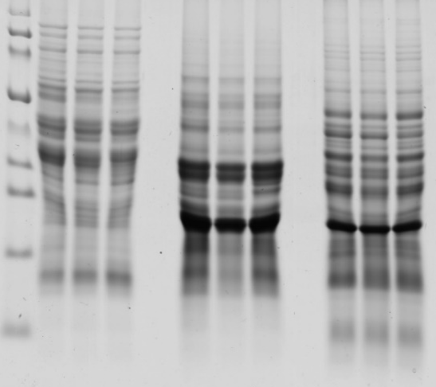
Detection of celiac active polypeptides in wheat, oat and buckwheat by immunochemical methods
Milan Chňapek, Dana Rajnincová, Želmíra Balážová, Katarína Ražná, Martin Vivodík, Janka Drábeková, Zuzana Hromadová, Lucia Mikolášová, Zdenka Gálová
Faculty of Biotechnology and Food Sciences, Slovak University of Agriculture in Nitra, Tr. Andreja Hlinku 2, 949 76 Nitra, Slovak Republic, e-mail: Zdenka.Galova@uniag.sk
The aim: To analyze the proteome of selected varieties of wheat, oats and buckwheat with emphasis on the detection of celiac active polypeptides that cause allergic reactions in hypersensitive people.
Material: Grains of wheat varieties (Triticum aestivum L.), grains of oat varieties (Avena sativa L.) and grains of buckwheat varieties (Fagopyrum esculentum Moench). Samples were obtained from the Gene Bank of Seed Species of the Slovak Republic NPPC VÚRV in Piešťany.
.
Methods:
Protein extraction was performed according to the Schägger methodology (2006).
Elisa method using the AgraQuant Gluten G12 test (Romer Labs).
Tris-tricine SDS-PAGE according to the methodology of Schägger (2006).
Western blot analysis was performed in an OmniBLOT Mini Blotting system.
Results:
The gluten content in the analyzed wheat varieties ranged from 23,899.63 mg.kg⁻¹ to 67,385.83 mg.kg⁻¹,
The content of celiac active polypeptides in the analyzed oat samples varied considerably in individual varieties.
All buckwheat samples meet the limit for the label "gluten-free„.
The strongest reaction of the polyclonal antibody with wheat proteins was with 25 kDa - 50 kDa, in oats with proteins of 20 kDa and also 40 kDa-55kDa.
No signal was detected in buckwheat.
Only buckwheat can be used to produce foods suitable for patients with celiac disease.
kDa
140
95
72
52
42
34
26
17
10
M 1 2 3 4 5 6 7 8 9
A
kDa
140
95
72
52
42
34
26
17
10
B
Acknowledgments: This publication was supported by the project VEGA No. 1/0291/21, KEGA No. 026SPU 4/2021, KEGA No. 027SPU-4/2021 and by the Operational program Integrated Infrastructure within the project Drive4SIFood 313011V336.
Figure 1. SDS-PAGE and Western blot of analyzed wheat, oat and buckwheat samples.
Explanations: A - SDS-PAGE, B - Western blot, M - molecular marker Spectra Multicolor Broad Range Protein Ladder, 1-3 wheat , 4-6 oats , 7-9 buckwheat
Conclusion: The ELISA method and the Western blot have been shown to be accurate and sufficiently sensitive analyzes by which it is possible not only to accurately detect but also to quantify the content of celiac agents in plant samples. Buckwheat met the standard for a gluten-free crop.

