Slide 1
Differential tolerance of cowpea cultivars to osmotic stress in germinative phase: a multivariate approach
Letícia Oliveira ^{1,}*, Maria Silva ¹, Alexandre Oliveira ¹, Aiala Amorim ², Carlos Dias ¹ and Rosilene Mesquita ¹
¹ Federal University of Ceara; leticia.kbo7@gmail.com; lilian.ufc@hotmail.com; aleufc@gmail.com; ctsdias@ufc.br; rosilenemesquita@ufc.br
² University of the International Integration of the Afro-Brazilian Lusophony; aialaamorim@unilab.edu.br
* Corresponding author: leticia.kbo7@gmail.com

Slide 2
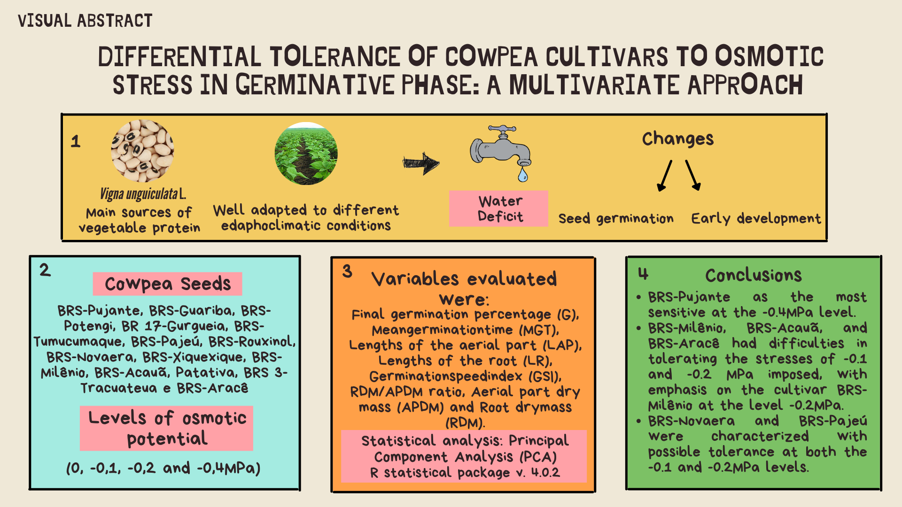

Slide 3
Abstract:
This study aimed to characterize the behavior of different cultivars of Vigna unguiculata L. Walp. to osmotic stress, from germination and vigor parameters. The experimental design used was completely randomized, in a 14x4 factorial arrangement, with fourteen cultivars and four levels of osmotic potential (0, -0.1, -0.2, and -0.4 MPa) of the germination solution. BRS-Novaera and BRS-Pajeú cultivars were characterized with possible tolerance at both the -0.1 and -0.2 MPa levels. The study pointed to the BRS-Pujante cultivar as the most sensitive to the -0.4 MPa level. The multivariate technique used allowed for a satisfactory characterization of the treatments adopted.
Keywords: Vigna unguiculata L. Walp; abiotic stress; germination; vigor; exploratory analysis.

Slide 4
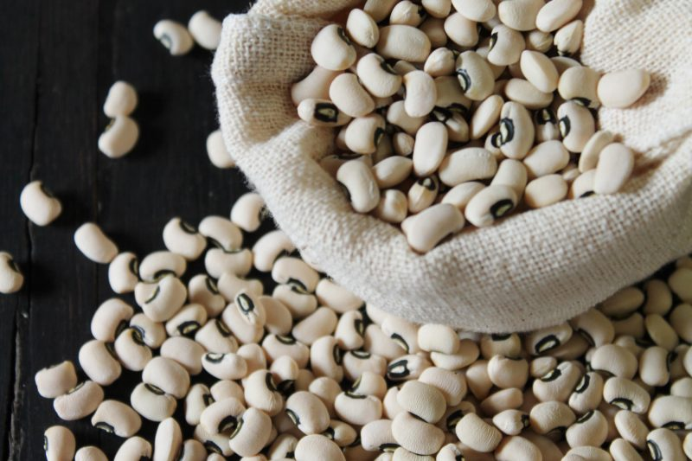
INTRODUTION
FEIJÃO-CAUPI (Vigna unguiculata L. Walp.)
Main sources of vegetable protein
Well adapted to different edaphoclimatic conditions
Water deficit
Seed germination
Changes
In Brazil
Early development
Regions
North and Northeast
Employment and income
(SILVA et al., 2010; VIJAYKUMAR et al., 2010; SILVA; NEVES, 2011; NASCIMENTO et al., 2011; FREITAS et al., 2017)

Slide 5
INTRODUTION
OSMOTIC STRESS
Water limitation
Speed of germination
Tends to compromise the initial establishment of the seedling stand
The starting factor for germination
Water
Involved in all other stages of germination metabolism
Shortage of water right after sowing can compromise the entire germination process
(MOŻDŻEŃ et al., 2015; OLIVEIRA; GOMES FILHO, 2010)

Slide 6
INTRODUTION
Studies with seeds
Germination
Vigor in low humidity conditions
Studies related to the tolerance of different cultivars of cowpea to abiotic stresses at these developmental stages are still scarce in the literature
Interpretation of certain studied phenomena
Simultaneous evaluation of several variables
Multivariate analysis
Carrying out studies to evaluate the performance of cultivars during germination and initial seedling growth.
(COLMAN et al., 2014; VICINI et al., 2018; MANLY; ALBERTO, 2019)

Slide 7
INTRODUTION
OBJECTIVE
- The objective of this work was to characterize, through multivariate data analysis, the behavior of different cowpea bean cultivars to osmotic stress, based on germination and vigor variables

Slide 8
MATERIAL AND METHODS
Place:
Seed Analysis Laboratory
(Federal University of Ceara)
BRS-Pujante, BRS-Guariba, BRS-Potengi, BR 17-Gurgueia, BRS-Tumucumaque, BRS-Pajeú, BRS-Rouxinol, BRS-Novaera, BRS-Xiquexique, BRS-Milênio, BRS-Acauã, Patativa, BRS 3-Tracuateua e BRS-Aracê
Plant material:
Cowpea seeds
Experimental design:
Completely randomized, in a 14 x 4 factorial arrangement, with four replications
(0, -0,1, -0,2 and -0,4MPa)
Levels of osmotic potential

Slide 9
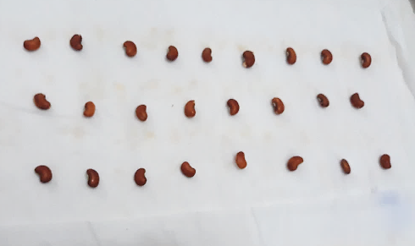
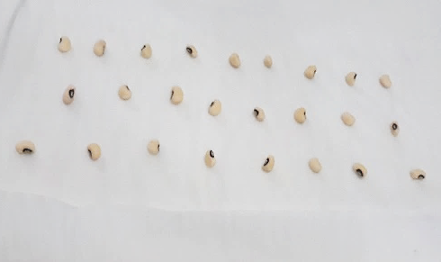
MATERIAL AND METHODS
Germination test
Seed selection
Uniform seeds with intact integument
Distilled water
Blotting paper
PEG 6000 solution
2.5 times the weight of the dry paper
2.5 times the weight of the dry paper
200 seeds → 4 replicates of 50 seeds
BOD → 25°C
(BRASIL, 2009)

Slide 10
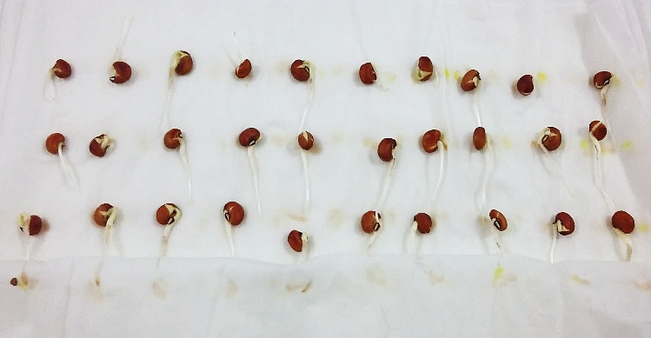
MATERIAL AND METHODS
Germination test
The count of germinated seeds
Daily
Nine days
- Germination criterion: the emission of a radicle with at least 2.0 mm (ROSA et al., 2005)
The germination variables evaluated...
Final germination percentage (G)
Germination speed index (GSI)
(LABORIAU, 1983)
(MAGUIRE, 1962)
Mean germination time (MGT)
(LABORIAU, 1983)

Slide 11
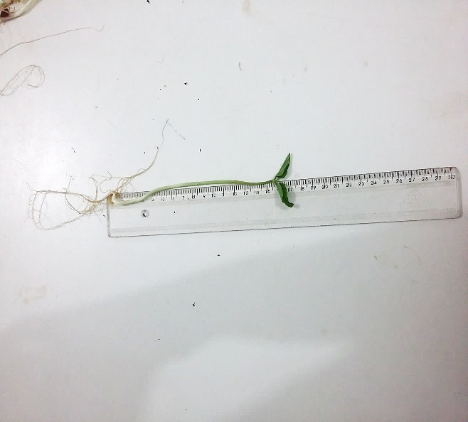
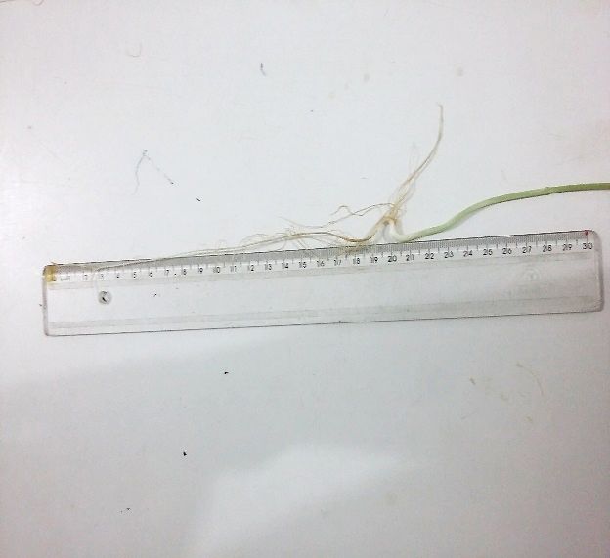
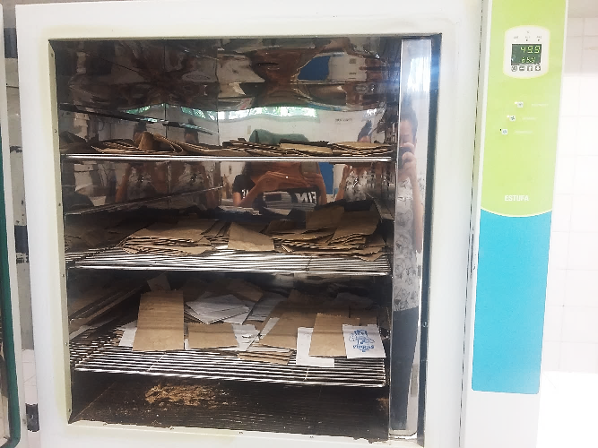
MATERIAL AND METHODS
Vigor evaluation
Experimented with the same conditions GT
4 repetitions of 20 seeds
(NAKAGAWA,1999)
Nine days after sowing:
Lengths of the aerial part (LAP)
Aerial part dry mass (APDM)
Lengths of the root (LR)
Oven 65°C
Root dry mass (RDM)
The average results were expressed in grams per seedling
RDM/APDM ratio

Slide 12
MATERIAL AND METHODS
Statistical analysis:
Principal Component Analysis (PCA)
Greater correlation between the original variables
Spearman's correlation coefficient
Shapiro-Wilk test
p-value < 0.05
The data set was standardized (μ = 0; σ² = 1)
Kaiser’s criterion
Number of main components
R statistical package v. 4.0.2

Slide 13
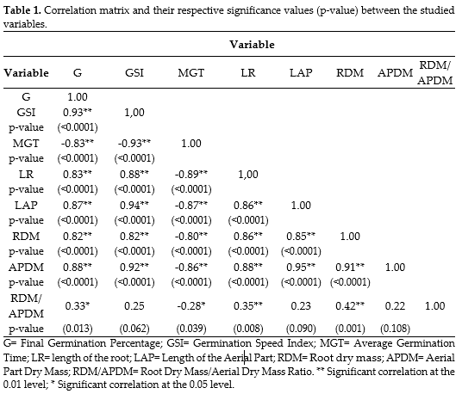
RESULTS AND DISCUSSION
Evidence of a correlation between the characteristics
The use of multivariate analysis techniques is adequate

Slide 14
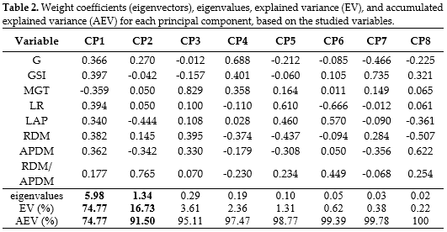
RESULTS AND DISCUSSION
Kaiser (1958)

Slide 15
RESULTS AND DISCUSSION
Germinal performance and root growth
CP1 = 0.366X₁ + 0.397X₂ – 0.359X₃ + 0.394X₄ + 0.340X₅ + 0.382X₆ + 0.362X₇ + 0.177X₈
Differences in seedling size
CP2 = 0.270X₁ – 0.042X₂ + 0.050X₃ + 0.050X₄ – 0.444X₅ + 0.145X₆ – 0.342X₇ + 0.765X₈

Slide 16
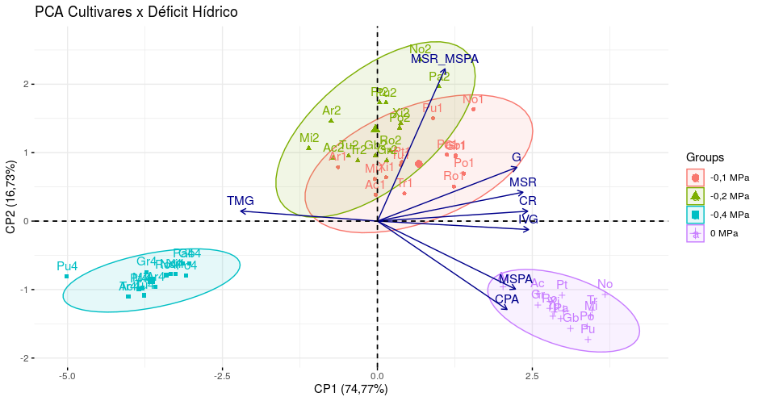
RESULTS AND DISCUSSION
PCA Cultivars x Water stress
RDM/APDM
RDM
MGT
LR
GSI
APDM
LAP
Figure 1. Biplot showing the relationship between variables and treatments for the first two main components (CP1 e CP2). Pu = BRS-Pujante; Gb = BRS-Guariba; Po = BRS-Potengi; Gr = BR 17-Gurgueia; Tu = BRS-Tumucumaque; Pa = BRS-Pajeú; Ro = BRS-Rouxinol; No = BRS-Novaera; Xi = BRS-Xiquexique; Mi = BRS-Milênio; Ac = BRS-Acauã; Pt = Patativa; Tr = BRS-Tracuateua; Ar = BRS-Aracê.

Slide 17
RESULTS AND DISCUSSION
Bewley; Black (1994) and Taiz et al. (2017)
Scalon et al. (2011)
Reductions in seedling LAP values can be explained by the decrease in seed metabolism since there is less water availability for the digestion of reserves and translocation of metabolized products.
The water deficit condition suggests a prioritization of root growth, an important feature in the escape from this type of stress, where it can favor water absorption precisely by increasing the surface of contact with the substrate.
Agostini et al. (2013)
These decreases in the GSI and increases in the MGT, due to the increase in the expressiveness of stress, are widely reported in the literature
Machado Neto et al. (2004)
When seeds are subjected to water deficiency by osmotic solutions, vigor is more affected than germination.
Bewley et al., 2013 and Pelegrini et al., 2013
Soares et al. (2015)
Answer shows adequate water availability.
Ferreira et al. (2017)

Slide 18
CONCLUSIONS
The Principal Component Analysis allowed the characterization of the treatments, pointing the cultivar BRS-Pujante as the most sensitive at the -0.4MPa level.
The technique showed that the cultivars BRS-Milênio, BRS-Acauã, and BRS-Aracê had difficulties in tolerating the stresses of -0.1 and -0.2 MPa imposed, with emphasis on the cultivar BRS-Milênio at the level -0.2MPa.
The cultivars BRS-Novaera and BRS-Pajeú were characterized with possible tolerance at both the -0.1 and -0.2MPa levels.

Slide 19
ACKNOWLEDGMENTS

