Slide 1
Physiological assessment of Rocha pear trees to agronomic enrichment with CaCl₂ and Ca(NO₃)₂
Cláudia Campos Pessoa^{1,2,}*, Inês Carmo Luís^{1,2}, Ana Coelho Marques^{1,2}, Ana Rita F. Coelho^{1,2}, Diana Daccak^{1,2}, José C. Ramalho^{2,3}, Maria José Silva^{2,3}, Ana Paula Rodrigues³, Paula Scotti Campos^{2,4}, Isabel P. Pais^{2,4}, José N. Semedo^{2,4}, Maria Manuela Silva^{2,5}, José Carlos Kullberg^{1,2}, Maria Graça Brito^{1,2}, Paulo Legoinha^{1,2}, Maria Fernanda Pessoa^{1,2}, Manuela Simões^{1,2}, Fernando H. Reboredo^{1,2} and Fernando C. Lidon^{1,2}
¹ Earth Sciences Department, Faculdade de Ciências e Tecnologia, Universidade Nova de Lisboa. Campus da Caparica, 2829-516 Caparica, Portugal;
² GeoBioTec Research Center, Faculdade de Ciências e Tecnologia, Universidade Nova de Lisboa. Campus da Caparica, 2829-516 Caparica, Portugal;
³ PlantStress & Biodiversity Lab, Centro de Estudos Florestais (CEF), Instituto Superior Agronomia (ISA), Universidade de Lisboa (ULisboa), Quinta do Marquês, Av. República, 2784-505 Oeiras, and Tapada da Ajuda, 1349-017 Lisboa, Portugal;
⁴ Instituto Nacional de Investigação Agrária e Veterinária, I.P. (INIAV), Avenida da República, Quinta do Marquês, 2780-157 Oeiras, Portugal;
⁵ ESEAG-COFAC, Avenida do Campo Grande 376, 1749-024 Lisboa, Portugal.
* Corresponding author: c.pessoa@campus.fct.unl.pt

Slide 2
Physiological assessment of Rocha pear trees to agronomic enrichment with CaCl₂ and Ca(NO₃)₂
Food sector challenges
Population increase
Quantity and quality
Biofortification workflow
2 sprays: CaCl₂ (0.4 to 1.6 kg.ha⁻¹) or Ca(NO₃)₂ (0.1 to 0.6 kg.ha⁻¹)
Analysis
NDVI (UAVs)
1 spray: CaCl₂ 4 kg.ha⁻¹
4 sprays: CaCl₂ 8 kg.ha⁻¹
Leaf gas parameters (portable open-system infrared gas analyzer)
Ca content in leaves and fruits (XRF analyzer)

Slide 3
Abstract: The exponential increase of the world`s population is a major concern for the food sector since quantity and quality of food products needs to be ensured for consumers. Thus, in an orchard of pears located in Portugal, a total of seven foliar sprays, using CaCl₂ and Ca(NO₃)₂ were performed. The first two sprays with three different concentrations each (CaCl₂ - 0.4, 0.8 and 1.6 kg.ha⁻¹; Ca(NO₃)₂ – 0.1, 0.3 and 0.6 kg.ha⁻¹), the third with CaCl₂ 4 kg.ha⁻¹ and the remaining four with CaCl₂ 8 kg.ha⁻¹. During the workflow, normalized difference vegetation index (NDVI) was attained with unmanned aerial vehicle (UAV) and later correlated with photoassimilates synthesis (assessed by a portable open-system infrared gas analyzer) and Ca content in leaves and fruits (assessed by X-Ray fluorescence analysis). Regarding NDVI values, the exclusive use of CaCl₂ presented slightly inferior values, however no major signs of disrupted vegetation were detected. For leaf gas exchange, only minor changes occurred (namely E and iWUE parameters), while calcium content in leaves during the workflow and fruits at harvest increased. In conclusion smart farming techniques can be correlated with in situs analysis to monitor Rocha pear trees and the concentrations used in this study increased Ca content in fruits without reaching toxicity levels.
Keywords: Calcium; Foliar sprays in pears; Leaf gas exchange; NDVI; X-Ray fluorescence analysis

Slide 4
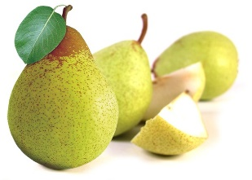
Introduction
Rocha pears are a variety of Pyrus communis largely produced in Portugal, and it contributes to the country`s fruit sector since up to 60% of the total production is exported (ANP, 2021).
When considering the exponential growth of the world’s population (FAO, 2021), agroindustry`s will face challenges related to the production of food, but also maintaining its quality to assure the nutritional needs of the human body (FAO, 2017).
In this regard, calcium (Ca) is a macronutrient performing both structural and signaling functions on the body, and its deficits are associated with pathologies such as osteopenia and osteoporosis, increasing the risk of fractures (EFSA, 2015).
Agronomic enrichment of plants with minerals, focuses on the use of soil or spray fertilizers in order to increase a certain mineral in its comestible parts (Singh et al., 2016).
This study thus aimed to apply agronomic enrichment practices to increase Ca content in pears and simultaneously monitor its effects on the orchard with UAVs and in situ analysis.
Ca²⁺

Slide 5
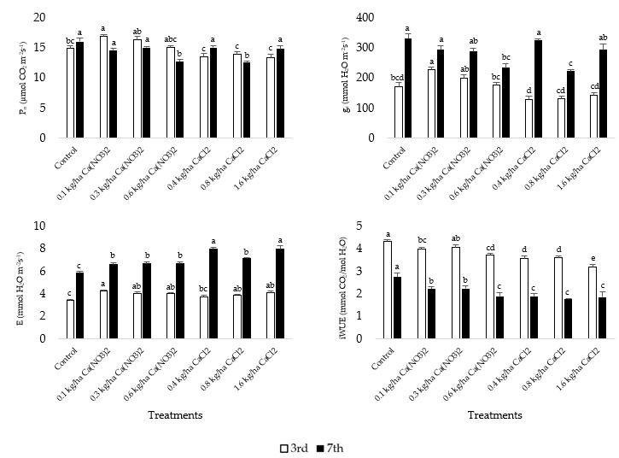
Results and Discussion
Treatments | Mean ± SD | Maximum | Minimum
Control | 0.94 ± 0.02 | 0.97 | 0.79
0.1 kg.ha⁻¹ Ca(NO₃)₂ | 0.94 ± 0.02 | 0.97 | 0.84
0.3 kg.ha⁻¹ Ca(NO₃)₂ | 0.94 ± 0.02 | 0.97 | 0.81
0.6 kg.ha⁻¹ Ca(NO₃)₂ | 0.94 ± 0.03 | 0.97 | 0.77
0.4 kg.ha⁻¹ CaCl₂ | 0.91 ± 0.06 | 0.96 | 0.63
0.8 kg.ha⁻¹ CaCl₂ | 0.88 ± 0.08 | 0.96 | 0.56
1.6 kg.ha⁻¹ CaCl₂ | 0.89 ± 0.09 | 0.96 | 0.53
Field mean value | 0.92 ± 0.05 | 0.91 | 0.70
All mean values attained in this study were higher than 0.85, being in accordance with the absence of toxicity signals indicating a healthy orchard.
The external application of Ca may have led to minor differences in leaf gas exchanges parameters, due to its role in stomatal closure, non-photochemical quenching and photosystems function (Hochmal et al., 2015; Wang et al., 2019), however, accumulation of Ca in fruits was not affected. Additionally, for the concentrations applied in this field trial, no toxicity signs such as leaf injuries occurred.
Regarding Ca, the absence of significantly higher levels of this mineral in leaves after sprays indicates a translocation to other plant tissues like fruits.
Conclusions
The implemented workflow increased Ca content in fruits at harvest and concentrations up to 8 kg.ha⁻¹ CaCl₂ did not have negative impacts on pear trees. Additionally, in situ and precision agriculture techniques can be used complementary to assess orchards health, during the different phases of production.

Slide 6
Acknowledgments
The authors thanks to José Henriques (HBio Lda.) for technical assistance. We also give thanks to the Research centers (GeoBioTec) UIDB/04035/2020 and (CEF) UIDB/00239/2020 for support facilities. This research was funded by PDR2020, grant number 101-030734. Funding from Fundação para a Ciência e Tecnologia (FCT) UI/BD/150718/2020 is also greatly acknowledged.

