Slide 1
Content of sterols in in vitro propagated Chamerion angustifolium (L.) Holub plants
Mariola Dreger^{1,}*, Agnieszka Gryszczyńska², and Milena Szalata¹
¹ Department of Biotechnology, Institute of Natural Fibres & Medicinal Plants National Research Institute, Wojska Polskiego 71b, 60-630 Poznań, Poland;
² Department of Pharmacology and Phytochemistry, Institute of Natural Fibres & Medicinal Plants National Research Institute, Kolejowa 2; 62-064 Plewiska, Poland
* Corresponding author: mariola.dreger@iwnirz.pl

Slide 2
Abstract:
Chamerion angustifolium (L.) Holub (syn. Epilobium angustifolium L., Onagraceae family) plants are utilized as a component of drugs, nutraceuticals and cosmetic products. The European Medicines Agency (EMA) approved E. angustifolium in traditional herbal medicinal products for treatment and alleviating symptoms related to Benign Prostatic Hyperplasia (BPH). Plants are a rich source of ellagitannins, flavonoids and phenolic acids, the herb also contains steroids, triterpenes and fatty acids. Campesterol, cholesterol, stigmasterol and β-sitosterol and its derivatives have been identified in plants. Phytosterols are synthesized and accumulated in plant in vitro cultures, in this way in vitro cultures could be an alternative source to produce phytosterols.
The aim of this study was to determine the content of campesterol, β-sitosterol and stigmasterol in Ch. angustifolium plants cultivated in vitro. The plants after five weeks of culture were subjected to the HPLC-DAD analysis. Additionally, the analysis of phytosterols in the plants regenerated under in vitro conditions and planted in field was performed.
Results of HPLC-DAD analysis have shown that stigmasterol was a dominant compound (382.60–577.77 mg/100 DW) in the plants grown in vitro. Among the tested genotypes, significant variation in the sterol content was found. In contrast to in vitro cultures, plants harvested from field synthesized mainly β-sitosterol (103.05 mg/100 g DW), whereas campesterol and stigmasterol were less abundant. Plants cultivated under in vitro conditions contained more sterols than plants grown in field.
Keywords: Epilobium angustifolium; HPLC-DAD; in vitro cultures; campesterol; β-sitosterol; stigmasterol

Slide 3
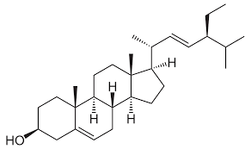
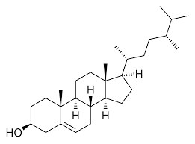
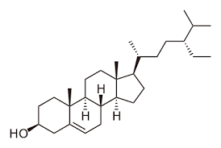
stigmasterol
campesterol
ß-sitosterol
Phytosterols are essential biomolecules for human health. These compounds have shown hypocholesterolemic, anti-inflammatory, antidiabetic and anticancer activities.
Phytosterols are added to the cosmetic products for their moisturizing and regenerating skin properties.
Since the phytosterol extraction methods are based on use of organic solvent that are harmful for human health and toxic for the environment, therefore another alternative source to produce phytosterols are needed.
Considering, the growing demand for a raw material rich in these compounds, a new alternative source such as in vitro cultures should be considered.

Slide 4
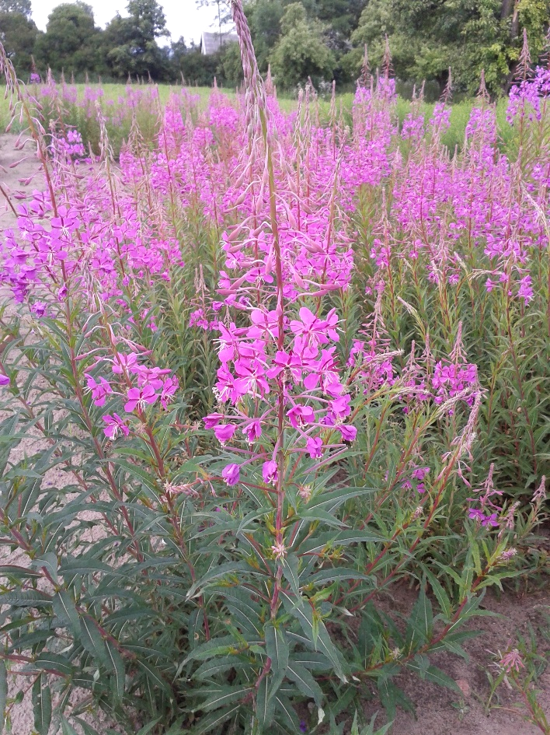
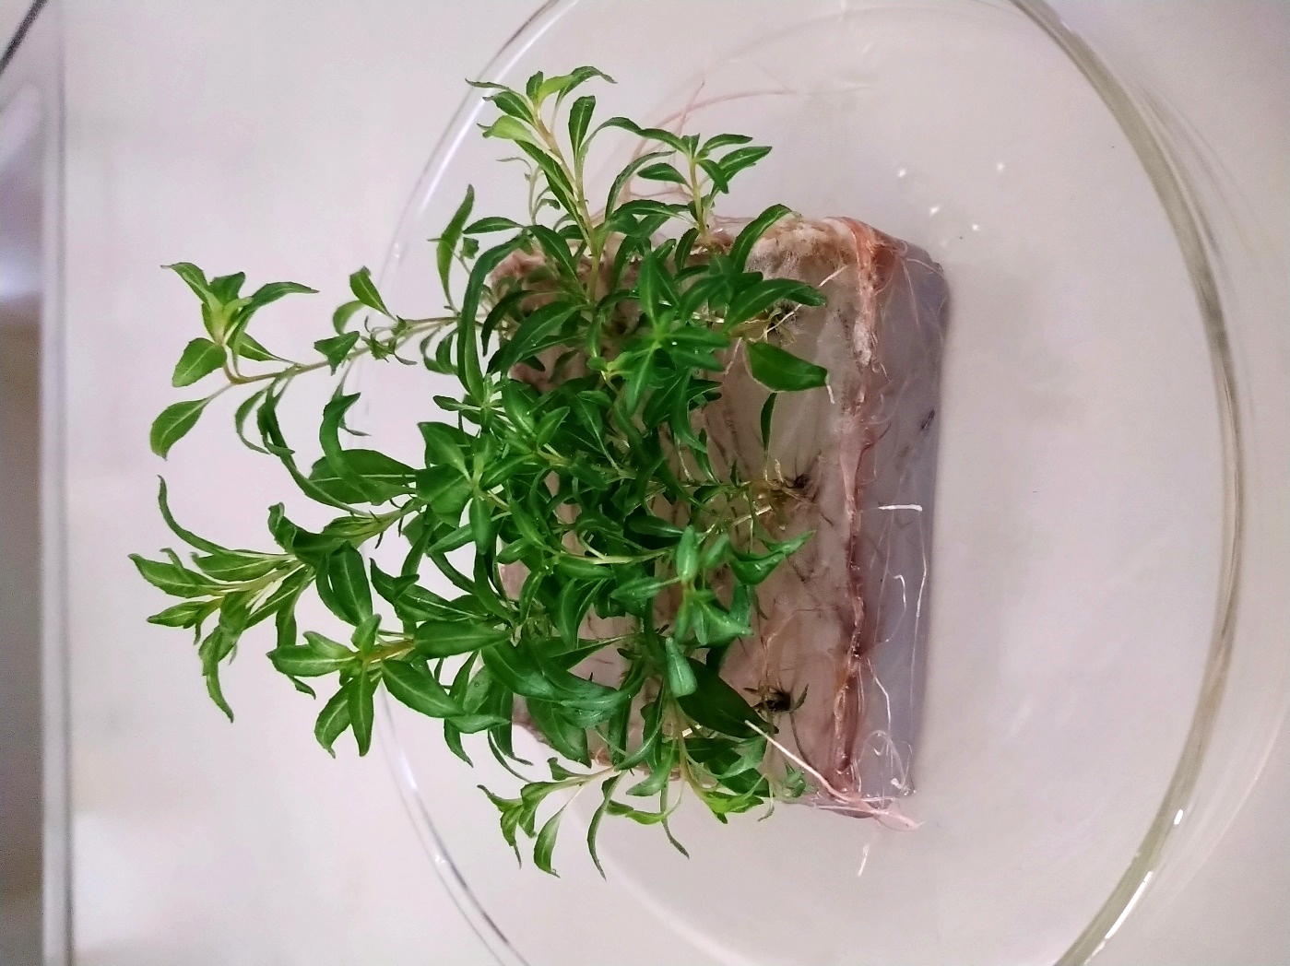
a
b
Figure 1. (a) Full blooming Ch. angustifolium plants grown in field (Plewiska, Poland); (b) In vitro rooted plants (5-weeks-old culture)

Slide 5
Results and Discussion
Table 1. Variation in sterols content (mg/100g of DW) in Ch. angustifolium genotypes derived from in vitro culture. Values are mean ± SD of two repetitions for chemical analysis. Mean values in column with the same letter are not significantly different at p = 0.05 (Tukey’s multiple range test)
Genotype | Content of sterols mg/100 g [±SD] |  |  | Sum of sterols mg/100g
 | Campesterol | Stigmasterol | β-sitosterol
N3 | 150.87±1.39^{d} | 448.08±27.07^{ad} | 131.83±5.29ª | 730.78
N5 | 200.94±3.27e | 501.83±8.55^{ab} | 141.64±1.11ª | 844.41
N6 | 228.41±9.07^{b} | 375.64±21.55^{c} | 222.49±9.03^{c} | 826.53
N11 | 255.88±7.88ª | 525.68±14.88^{be} | 105.30±0.61e | 886.85
PL37 | 119.63±5.53^{c} | 501.93±11.92^{ab} | 69.79±0.43^{d} | 691.35
PL38 | 323.86±10.00^{g} | 577.77±6.94e | 185.87±2.43^{b} | 1087.50
PL44 | 240.99±2.40^{ab} | 389.80±15.78^{cd} | 189.34±0.84^{b} | 820.13
PL45 | 255.00±8.62ª | 382.60±10.92^{c} | 211.88±2.07^{c} | 849.48
PL58 | 293.26±6.36^{f} | 481.06±4.15^{ab} | 146.55±6.74ª | 920.88
The mean value | 229.88±62.99 | 464.93±69.56 | 156.08±49.13 | 850.89
Results of HPLC-DAD analysis have shown that stigmasterol was a dominant compound among tested sterols.
The investigated genotypes differed in sterols content, particularly in β-sitosterol.
The highest content of campesterol was recorded for PL58 genotype
PL38 genotype was characterized by the highest level of stigmasterol
N6 line was characterized by high level of β-sitosterol.

Slide 6
Results and Discussion
Table 2. Content of campesterol, stigmasterol and β-sitosterol (mg/100g of DW) in the Ch. angustifolium plants cultivated in field. Values are mean ± SD of four repetitions for chemical analysis.
Plant material | Content mg/100 g [±SD] |  |  | Sum of sterols mg/100 g
 | Campesterol | Stigmasterol | β-sitosterol
Above-ground part of plants grown in field | 25.06±16.41 | 7.03±1.50 | 103.05±16.68 | 135.14
Plant harvested from field significantly differ in the composition and content of sterols
In contrast to in vitro cultures, the plants grown in soil synthesized mainly β-sitosterol (103.05 mg/100 g DW), whereas campesterol and stigmasterol were less abundant.
Plants cultivated in field contained less sterols than plants cultivated in vitro (135.14 vs 850.89 mg/100 g DW).

Slide 7
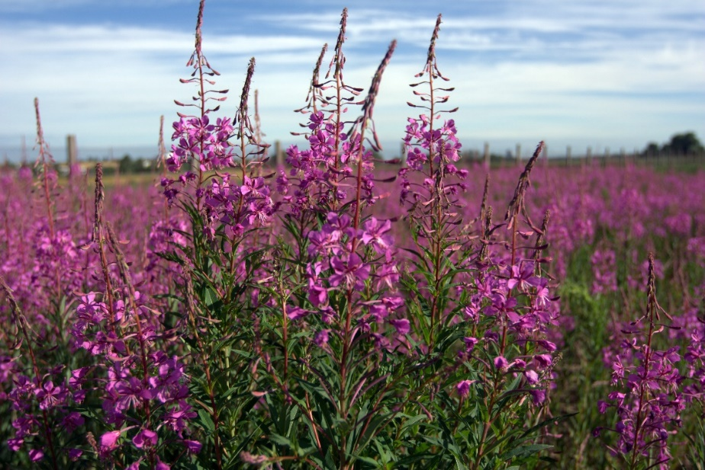
Conclusions
In vitro cultures of Ch. angustifolium are rich source of phytosterols
Genotype has a significant influence on the accumulation of phytosterols under in vitro conditions

Slide 8
Acknowledgments
This work was funded by the Polish National Centre of Research and Development (Grant No. PBS2/A8/23/2013)

