Slide 1
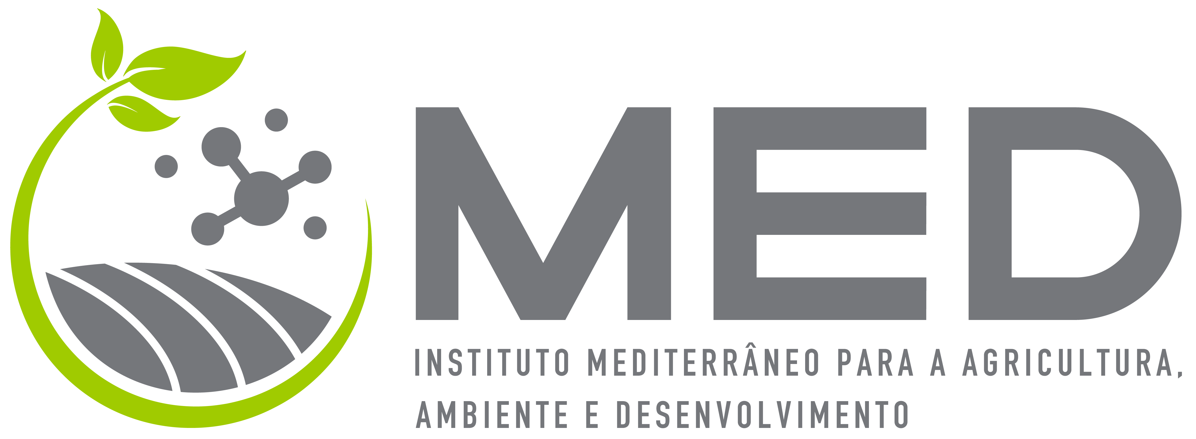
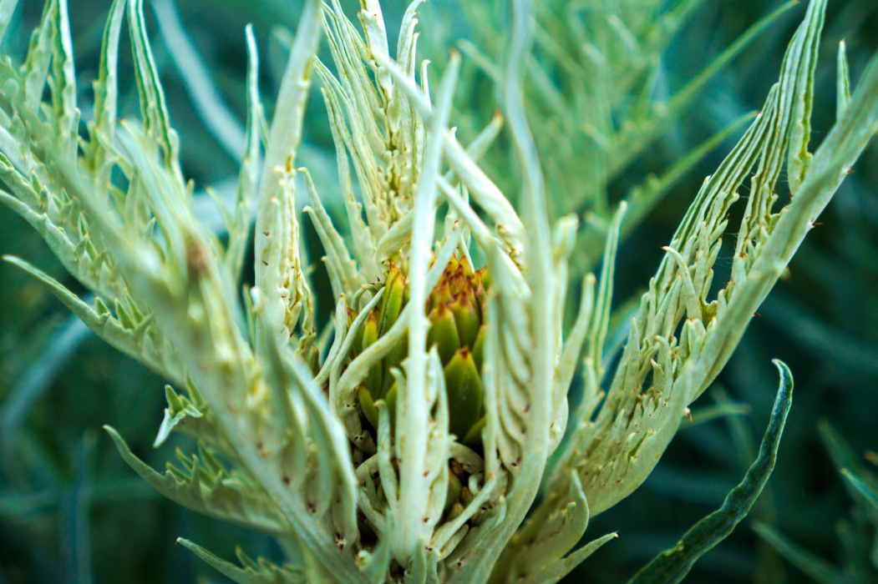
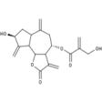
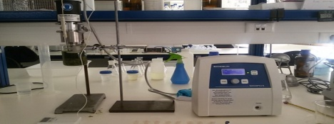
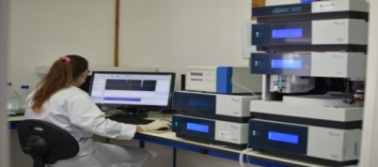
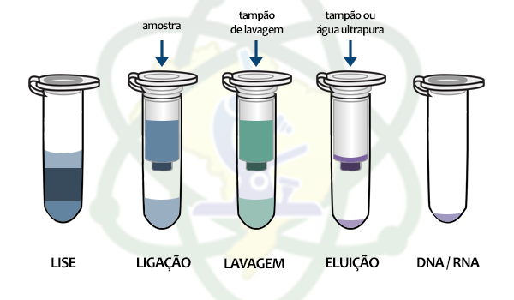
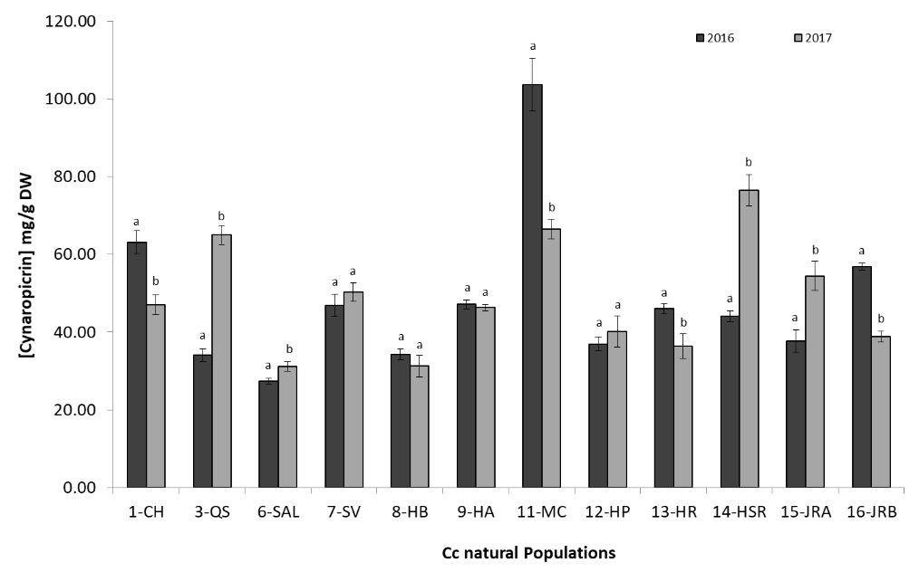
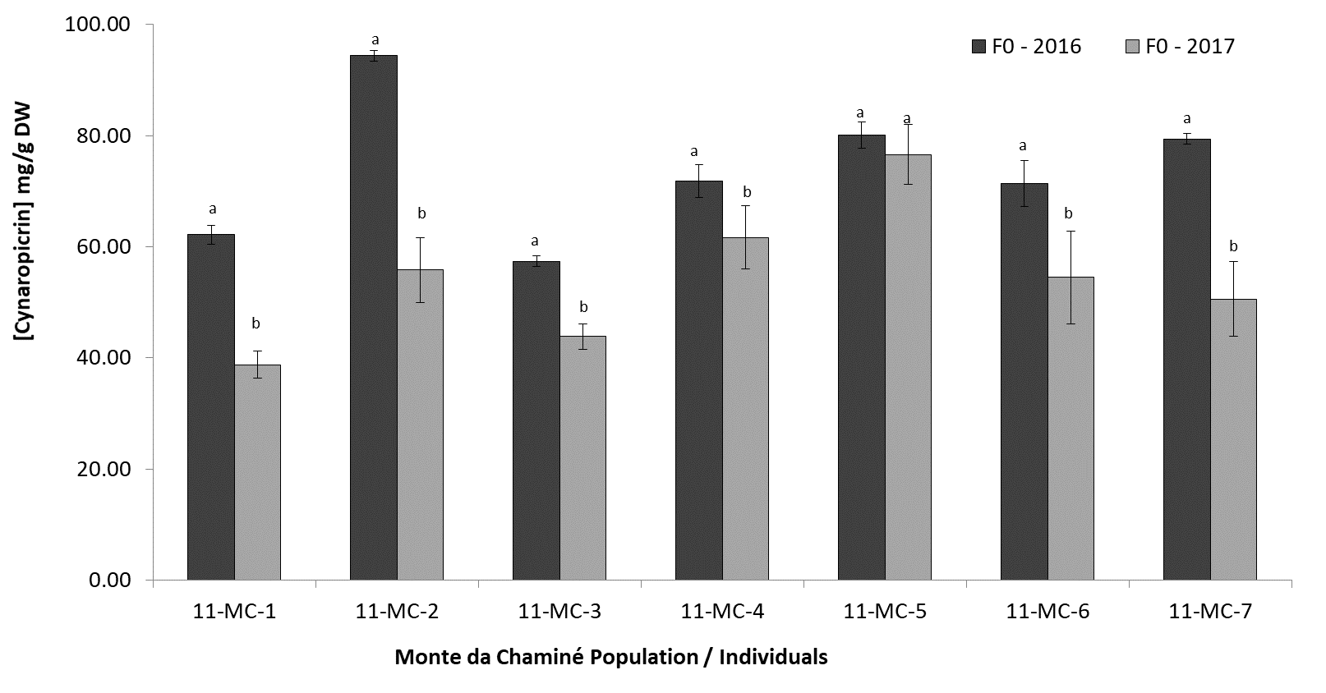
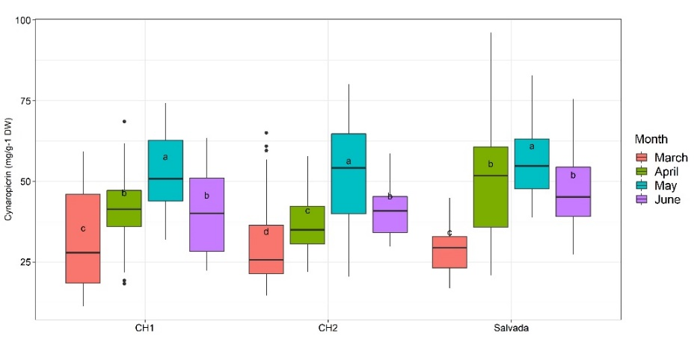
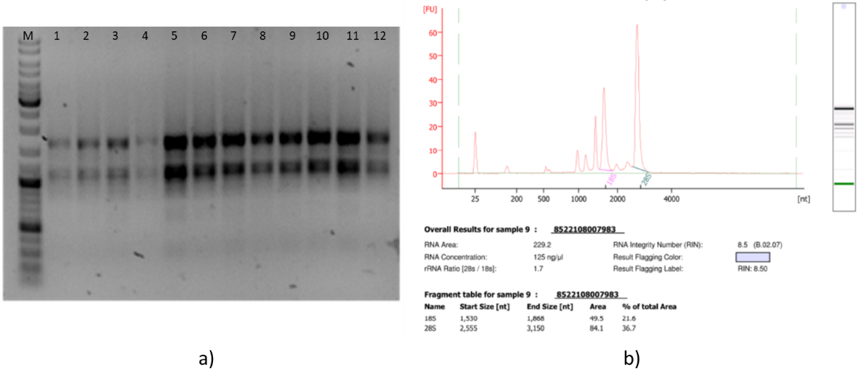
Chemical and genetic relationship of Cynara cardunculus L. (cardoon) in southern Portugal
Ana Paulino ^{1,2}*, Teresa Brás ^{1,3}, Daniela Rosa ^{1,3,4}, Rita C. Pires ¹, Jacqueline Santos ^{1,3}, Margarida Pereira ¹, Octávio S. Paulo ², Liliana Marum ^{1,3} and Mª Fátima Duarte ^{1,3}
¹ Alentejo Biotechnology Center for Agriculture and Agro-food (CEBAL)/ Instituto Politécnico de Beja (IPBeja), 7801-908 Beja, Portugal; teresa.bras@cebal.pt (T.B); daniela.rosa@cebal.pt (D.R); rita.pires@cebal.pt (R.C.P.); jacqueline.oliveira@cebal.pt (J.S); margarida.pereira@cebal.pt (M.P.); liliana.marum@cebal.pt (L.M); fatima.duarte@cebal.pt (M.F.D);
² Computational Biology and Population Genomics Group, Centre for Ecology, Evolution and Environmental Changes (cE3c), Faculdade de Ciências, Universidade de Lisboa, 1749-016, Lisboa, Portugal; ofpaulo@fc.ul.pt (O.S.P);
³ MED – Mediterranean Institute for Agriculture, Environment and Development, CEBAL, 7801-908, Beja, Portugal;
⁴ Allelopathy Group, Department of Organic Chemistry, INBIO Institute of Biomolecules, Campus de Excelencia Internacional Agroalimentario (ceiA3), University of Cádiz, 11510 Puerto Real, Cádiz, Spain.;
* Correspondence: ana.paulino@cebal.pt (A.P).
INTRODUCTION
Southern Portugal has a high natural variability of Cynara cardunculus L. (Cc) at a biochemical and morphological levels, conducting to the necessity of genetic diversity studies.
Cc represents a natural source of sesquiterpene lactones (SL), particularly cinaropicrin.
To improve the biotechnological cardoon impact, based on SL chemical profile, a transcriptomic analysis is ongoing to select the best genotypes for cynaropicrin production.
AIM: To obtain molecular markers, related to characteristics of interest, for future cardoon breeding programs
Materials and Methods
25 natural different-geographical locations selected within Alentejo region, south of Portugal (F0)
Genetic
characterized
Total DNA extracted
Fragment analysis
Cynara cardunculus Leaves
7 plants/population were selected (175 individuals)
Chemical
Cynaropicrin quantification
49 different plants (F1 generation) selected from experimental fields installed
High and low level of Cynaropicrin according to previous results
Extraction
HPLC analysis
Cynaropicrin quantification
Cynara cardunculus Leaves
High Cyn content
(>60 mg/g DW)
RNA Extraction
Transcriptome analysis
4 Time collection points
March, April, May and June 2020
Low Cyn content
(<40 mg/g DW)
kit RNAqueous-4PCR Total RNA Isolation
Run on 1% agarose gel of total RNA from different samples
Results
Cc chemical characterization regarding cynaropicrin contents
F0 generation
F1 generation
Figure 1. Graphical representation of the results from Cynaropicrin content (mg/g DW) of populations F0 (natural populations of Cc, represented by different letters and numbers: 1-CH; 3-QS; 6-SAL; 7-SV; 8-HB; 9-HA; 11-MC; 12-HP; 13-HR; 14-HSR; 15-JRA and 16-JRB) in two consecutive years (2016 and 2017). Columns with different letters (a, b) represent means significantly different only between populations in the two different years (one-factor ANOVA analysis, Duncan’s test, P<0.05 ).
Figure 2. Graphical representation of the results from Cynaropicrin content (mg/g DW) of the population F0 (natural population of Cc - Monte da Chaminé) in two consecutive years. Columns with different letters (a,b) represent means significantly different only between individuals in two different years (one-factor ANOVA analysis, Duncan’s test, P<0.05 ).
Figure 3. Graphical representation of the results from Cynaropicrin content (mg/g DW) of the population F1 in 4 consecutive months (march, April, May and June 2020). Box plot with different letters represent means significantly different between individuals in the different months sampled and in the different installed fields over the time (ANOVA analysis, Tukey’s test, P<0.05 ).
Demonstrate a great variability of chemical profiles within populations and demonstrates a great variability within the same populations, in different years;
Cynaropicrin content is different from individual to individual within the same population;
Cynaropicrin contents were variable within two consecutive years (F0 2016 vs F0 2017).
Different chemical profiles were identified, Cynara cardunculus leaves ethanolic extracts presented a remarkable range between 12.7 (low Cyn content) and 80.7 (high Cyn content) mg/g DW of cynaropicrin.
RNA Extraction
The lipophilic extracts of Cc leaves (generation F0) showed a remarkable variation between 27 and 103 mg/g DW of Cyn;
The results obtained in the different plants over the 4 months collection (F1 generation) show a great variability in terms of cynaropicrin content, concerning the genotype and collection period;
Different chemical profiles were identified, Cynara cardunculus leaves ethanolic extracts presented a remarkable range between 12.7 and 80.7 mg/g DW of cynaropicrin;
Total RNA amount of 1µg and RIN higher than 8 were confirmed by highly accurate and precise electrophoresis;
The next step will be the transcriptome analysis.
Conclusions and Ongoing work
Figure 4. a) Agarose gel electrophoresis (2%) of total RNA from different Cc leaves samples; b) Elec-tropherograms (Agilent technologies) of total RNA from cardoon leaves.
Total RNA was extracted from biological samples with high and low level of cynaropicrin content;
Total RNA amount of 1µg and RIN (RNA Integrity Number) higher than 8 were confirmed by highly accurate and precise electrophoresis.
ACKNOWLEDGMENTS:
This work is supported by Program Alentejo 2020, through the European Fund for Regional Development (FEDER) under the scope of MedCynaraBioTec – Selection of Cynara cardunculus genotypes for new biotechnological applications: the value chain improvement of cardoon, a well-adapted Mediterranean crop (ALT20-03-0145-FEDER-039495). Authors also acknowledge FCT for Contrato – Programa to L. Marum (CEECINST/00131/2018), PhD grant to A. Paulino (SFRH/BD/145383/2019) and D. Rosa (SFRH/BD/143845/2019), and Project UIDB/05183/2020 to Mediterranean Institute for Agriculture, Environment and Development (MED).

