Slide 1



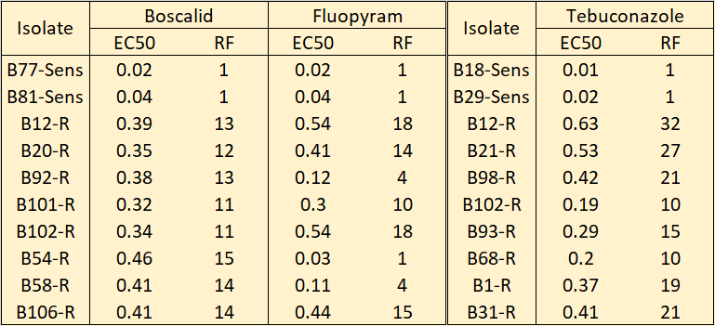
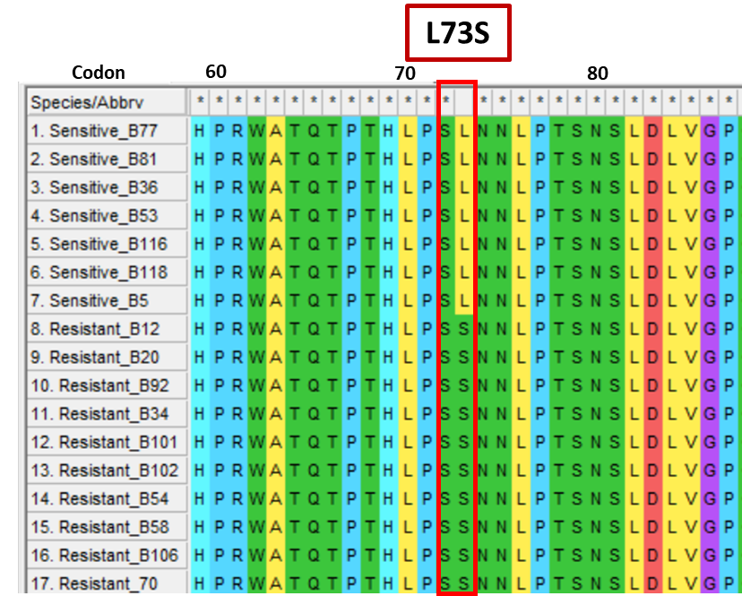
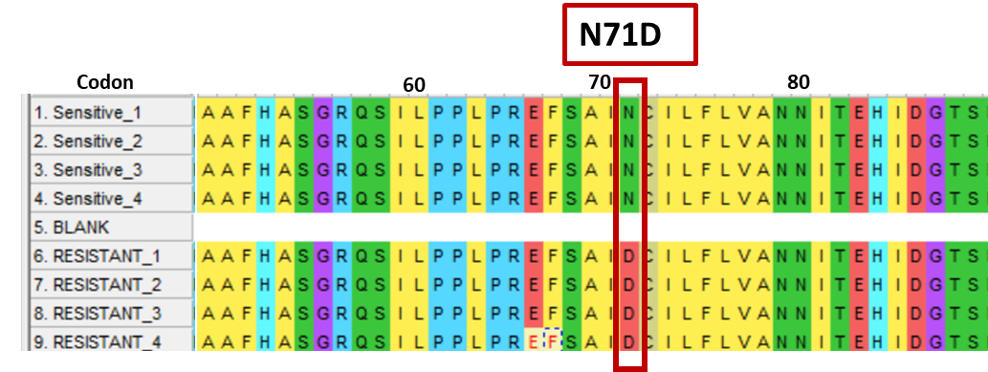
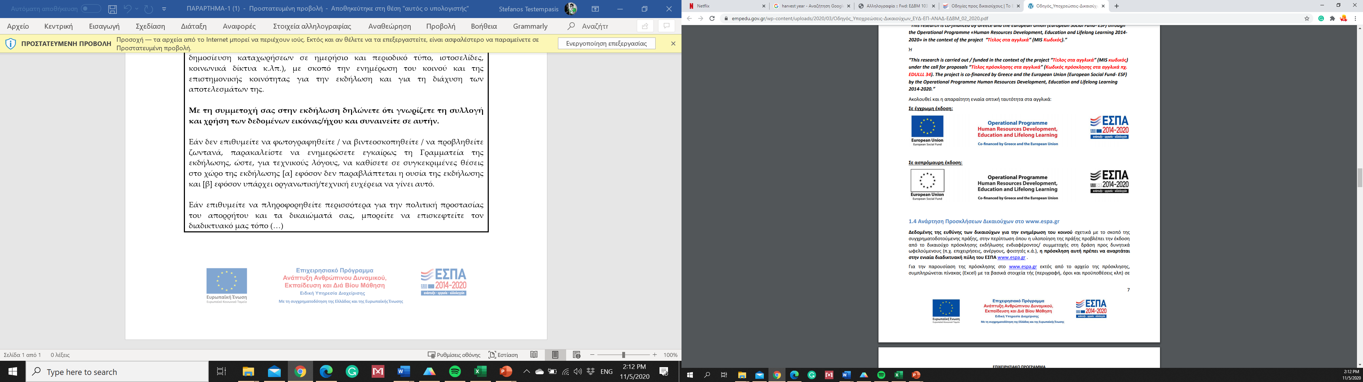
The 2nd International Electronic Conference on Plant Science
1-15 December 2021
“Assessment of sensitivity to boscalid, fluopyram and tebuconazole in Monilinia fructicola isolates obtained from peach orchards in Greece”
S. Testempasis¹, V. Tsintila¹, G. Karaoglanidis¹
¹ Faculty of Agriculture, Forestry and Natural Environment, Laboratory of Plant Pathology, Aristotle Universitity of Thessaloniki. POB 269, 54124, Thessaloniki, Greece.
testempa@agro.auth.gr.
Aim:
The determination of the sensitivity profile of M. fructicola isolates obtained from peach orchards in Greece to the SDHI fungicides boscalid and fluopyram and the DMI fungicide tebuconazole.
Table 1. EC₅₀ and resistant factor (RF) values of sensitive, and resistant M. fructicola isolates to SDHI fungicides boscalid and fluopyram, and DMI fungicide tebuconazole
Introduction:
Brown rot is one of the most important diseases of stone fruit worldwide. In most European countries, the main agents of Brown rot were considered to be Monilinia laxa and M. fructigena. However, during the last decade M. fructicola has been found in high frequencies in most countries around the Mediterranean basin, including Greece. Taking into account that M. fructicola is considered to be of higher risk for fungicide resistance development compared to M. laxa or M. fructigena, this study was initiated aiming to determine the fungicide sensitivity profile of isolates originating from peach orchards in Greece
Figure 1. Frequency of Sensitive (■), DMI-Restistant; DMI-R (■) and SDHI-Resistant; SDHI-R (■) isolates collected from diseased peach fruit from Greek orchards
Materials & Methods:
M. fructicola isolates (n= 230) were collected from symptomatic peach-fruit during the harvest season from several orchards in the region of Macedonia (northern Greece).
To determine the resistance profile of the fungal isolates to SDHI fungicides, conidial suspension (40 μl) of each isolate was spread on Minimal medium (MM) amended with 0.1, 0.5, 1, 2, 5 and 10 μg ml⁻¹ boscalid or the fluopyram. After 24 h of incubation at 25 °C in dark, conidia were examined microscopically and the length of germination tube was measured.
DMI sensitivity assay was performed based on the inhibition of mycelial growth on Potato Dextrose Agar plates amended with 0.001, 0.003, 0.01, 0.03, 0.1, 0.3, 1 and 3 μg ml⁻¹ tebuconazole and inoculated with mycelial plug (5 mm) obtained from 72 h old cultures . After 3 days of incubation at 25 °C in dark, the diameter of mycelia growth was measured.
The EC₅₀ value (effective concentration that reduces the germ tube or the mycelial growth by 50%) of each isolate was calculated by regressing the relative inhibition of growth against the Log10 fungicide concentration using with GraphPad Prism version 9.2.0 (GraphPad Software, San Diego, California USA).
SDHI’s subunits B, C, and D were amplified to all resistant isolates to elucidate the molecular mechanisms of resistance in these isolates.
(A)
SdhC
(B)
Key Results:
Among all tested isolates, 53.9% (n=124) were characterized as sensitive to all fungicides.
The highest frequency of resistant isolate (29.6%) was observed at the DMI fungicide tebuconazole, while the percentage of SDHI’s-resistant isolates was 16.5%.
Amplicon sequencing of SDHI’s subunits B, C and D revealed changes in amino acids sequences of SdhC and SdhD subunits.
Point mutations in SdhC subunit led to an amino acid substitution at codon 73 (Leucine→Serine)
Point mutations in SdhD subunit led to an amino acid substitution at codon 71 (Asparagine→Aspartic acid)
SdhD
Figure 3. Alignment of deduced amin acids sequences of (A) SdhC, and (B) SdhD subunits of sensitive and SDHI-resistant isolates of M. fructicola isolates. Residues involved in resistance to SDHI’s in both subunits are circulated with red color.
This research has been co-financed by the European Union and Greek national funds through the Operational Program Competitiveness, Entrepreneurship and Innovation, under the call RESEARCH–CREATE–INNOVATE (project code: T1EDK- 04591).

Slide 3
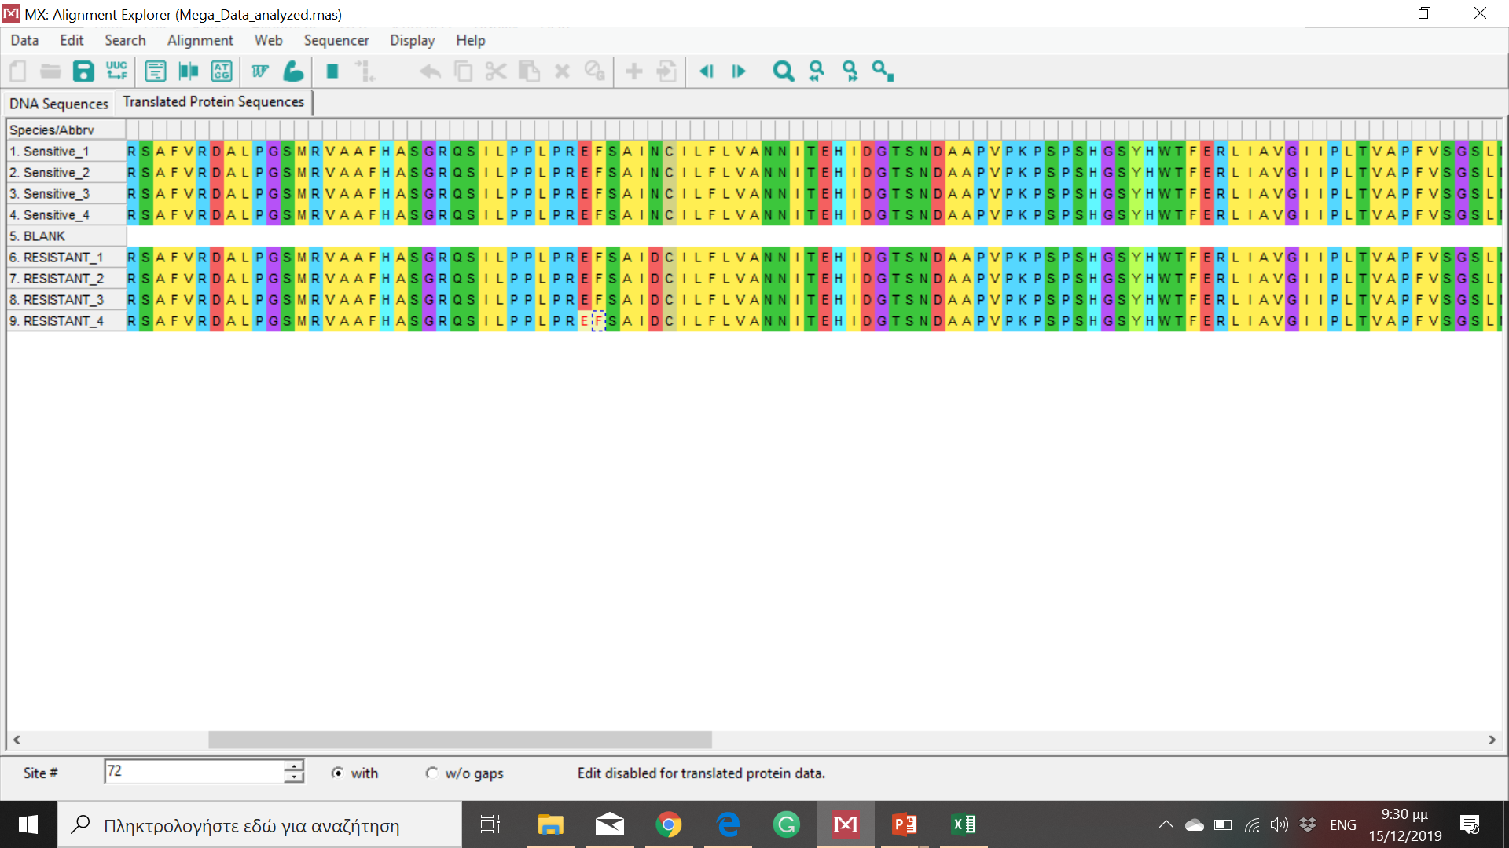
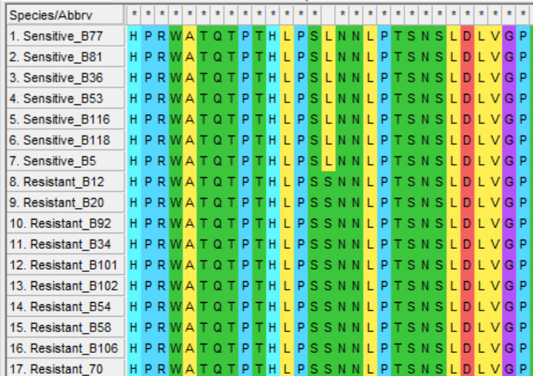
N71D
Codon
60
70
80
L73S
Codon
60
70
80

