Slide 1
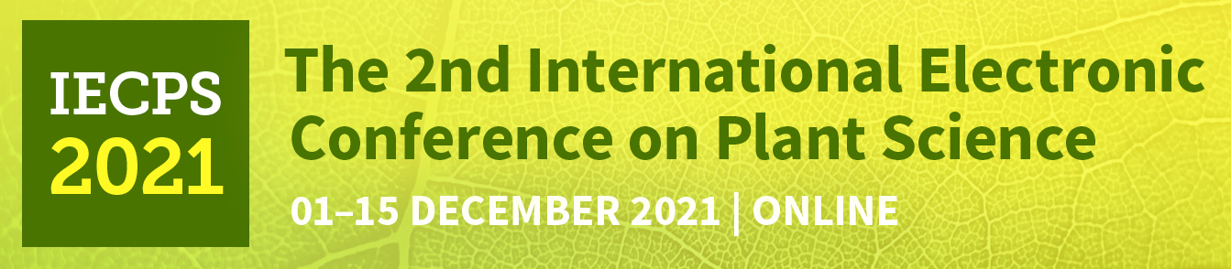

Different strategies to tolerate salinity involving water relations
Alberto Martinez-Alonso ^{1,}*, Micaela Carvajal ¹ and Gloria Barzana ¹
¹Aquaporins Group, Centro de Edafología y Biología Aplicada del Segura, CEBAS-CSIC, Campus Universitario de Espinardo-25, E-30100, Murcia, Spain.
*Corresponding autor: amalonso@cebas.csic.es

Slide 2
Abstract and keywords
Abstract: Salinity is one of the main limiting factors in agriculture, which can affect plants growth and development, as a result of a disruption of homeostasis. Therefore, the understanding of the mechanism of the plants for tolerate salinity stress is essential in order to develop new techniques that may improve tolerance for optimizing crop yields. In this paper, we compare the response of Cucumber (Cucumis sativus L.) and tomato (Solanum lycopersicum L.), grown by hydroponic culture, to a moderate salinity of NaCl 60 mM. For that, root hydraulic conductance, relative water content of leaves (RWC), stomatal conductance, fresh weight and dry weight ratio, and Na concentration in shoot and root were measured. The results showed a significant decrease of root hydraulic conductance in both species treated with NaCl, revealing a higher resistance to water passage from root to shoot, probably influenced by the increase of Na content after the treatment. In addition, stomatal conductance in cucumber was reduced, accompanied by a decrease of fresh/dry weight ratio in the root. Conversely, neither of those parameters changed in tomato. These experiments confirm the evidence that cucumber and tomato follow different strategies in the adaptation to salinity, being tomato more resistant probably due to the role of membrane water transporters. Despite that, more specific studies would be needed in order to support this conclusion.
Keywords: salinity resistance; water relations; water transport; aquaporins; cucumber; tomato.

Slide 3
Introduction

Slide 4
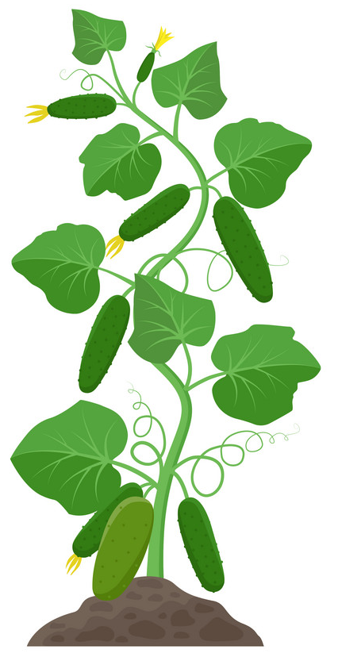
Introduction
Salinity
Osmotic Stress
Inhibition of growth and development.
Metabolism alteration.
Water deficit

Slide 5
Introduction
Salinity resistance strategies
Salt avoidance
Salt exclusion
Osmotic adjustment
Accumulation of organic solutes.
Control ions transport pathways.
Membrane transporters: maintain water flow.

Slide 6
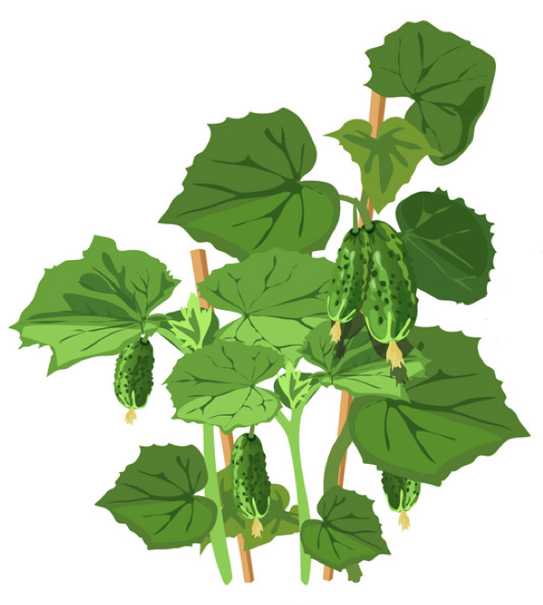
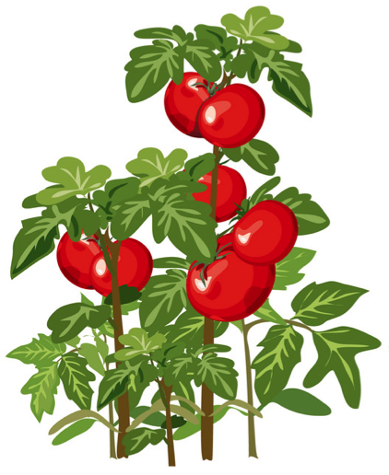
Introduction
Cucumber
Tomato
Salt sensitive
Salt tolerant

Slide 7
Introduction
Objectives
The objective of this study is to determine the effects of salinity in the water relations in cucumber and tomato and to determine the possible mechanisms involved in the stress tolerance caused by salinity in these plants.

Slide 8
Materials and methods

Slide 9
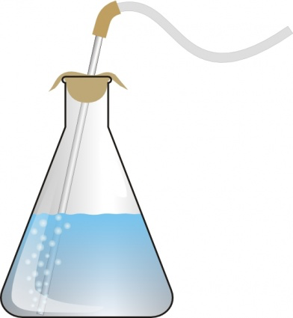
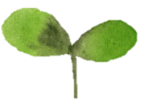
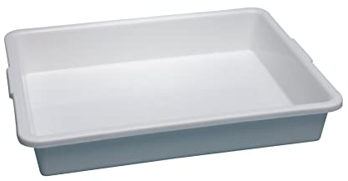
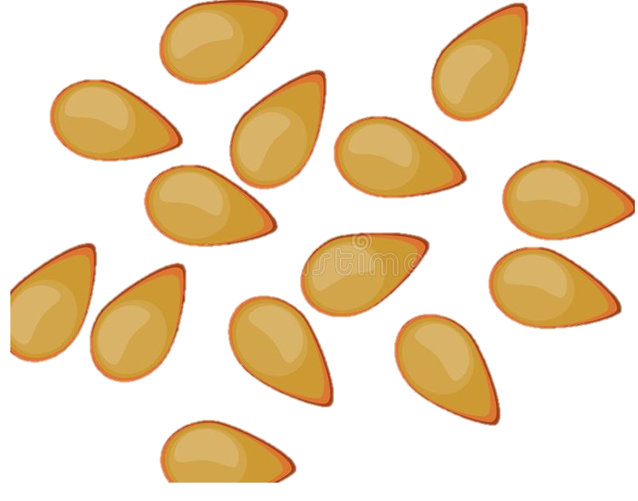
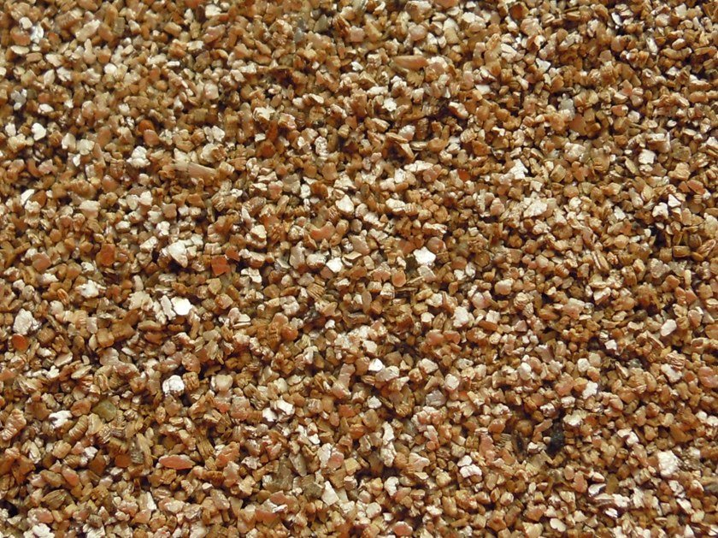
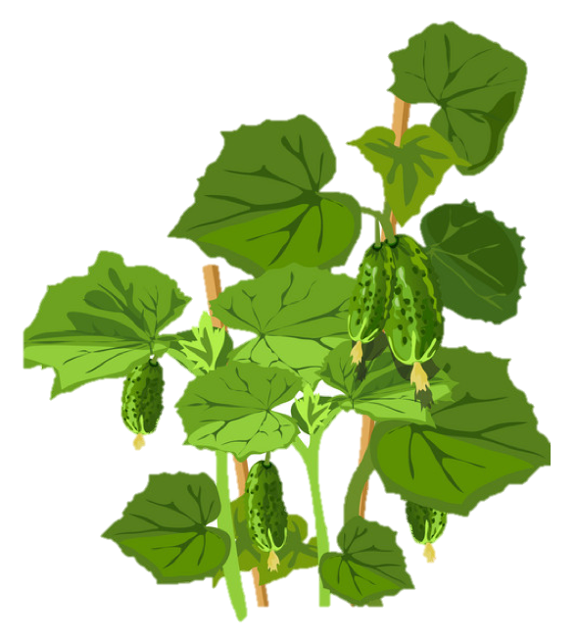
Materials and methods
Plant materials and growth conditions
Germination in vermiculite
28 °C chamber
Darkness
seeds
pre-hydration
24 hours
2 weeks after
Hoagland’s solution
Control
NaCl
Every week replaced
Growth time: 12 days
Control
NaCl
Hydroponic culture

Slide 10
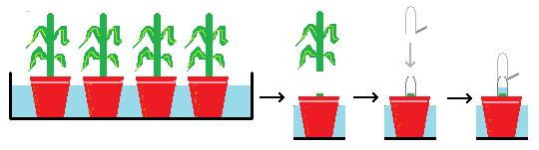
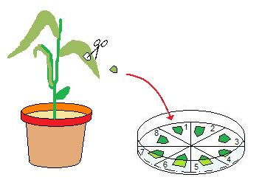
Materials and methods
Root hydraulic conductance (L₀)
Relative water content (RWC)
1 cm² leaf fragment
Fresh weight
Turgor weight
Dry weight
Root exudate
Stomatal conductance
Fresh weight (FW) /
dry weight (DW) ratio
TPS-2 Portable Photosynthesis System
Shoot
Root
2nd, 3rd and 4th fully expanded leaves
Ions concentration
Shoot
Root
Inductively coupled plasma (ICP) analysis

Slide 11
Results and discussion

Slide 12
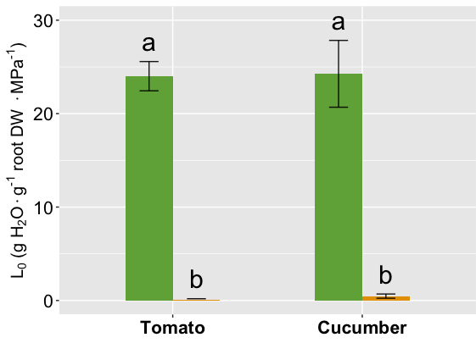
Results and discussion
Root hydraulic conductance (L₀)
Lower in plants subjected to salinity.
Same pattern in both species.

Slide 13
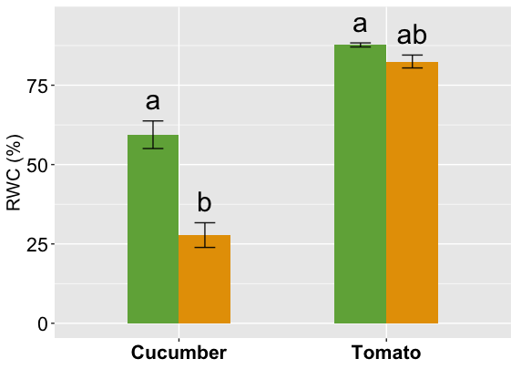
Results and discussion
Relative water content (RWC)
50 % lower in cucumber.
No changes in tomato.

Slide 14
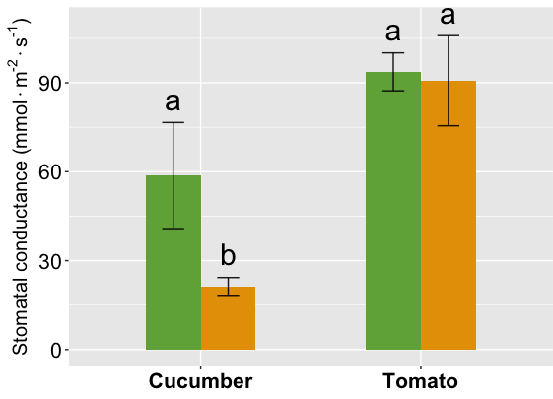
Results and discussion
Stomatal conductance
Cucumber: significative drop with salinity.
No changes in tomato

Slide 15
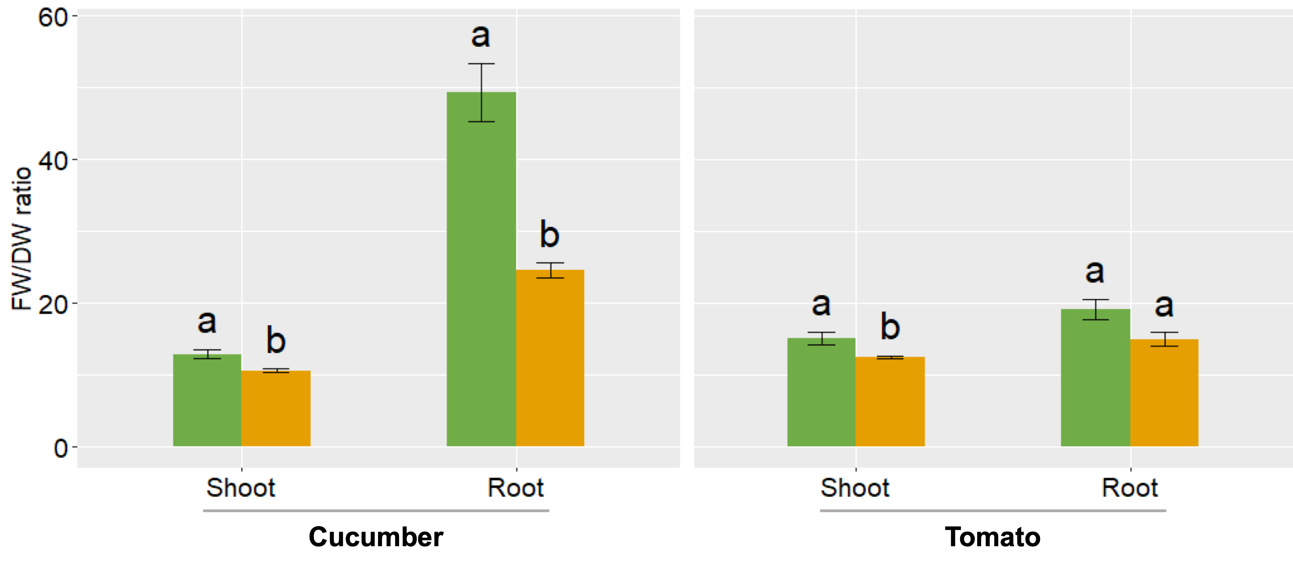
Results and discussion
FW/DW ratio
Cucumber: FW/DW ratio decreased in both organs with NaCl.
Tomato: decreased only in shoots under salinity.

Slide 16
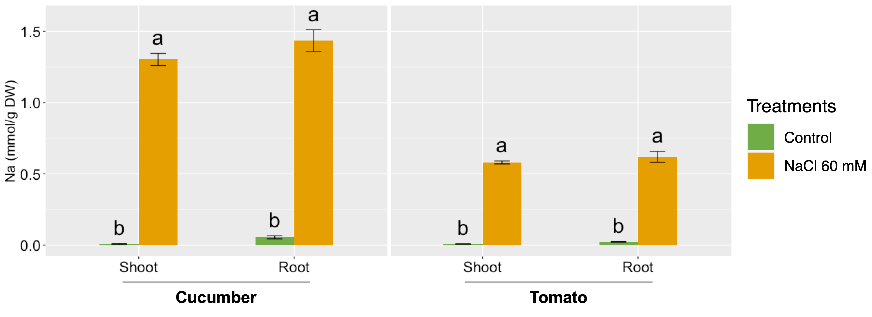
Results and discussion
Sodium (Na) concentration
Na concentration was considerably higher after salinity treatment in both species.
Na concentration in tomato was nearly 50% lower than in cucumber plants under salinity stress.

Slide 17
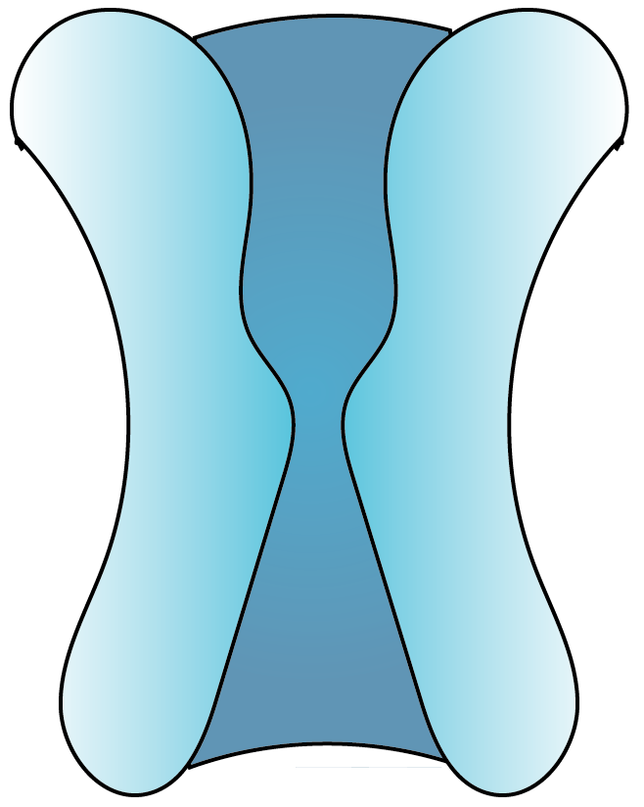
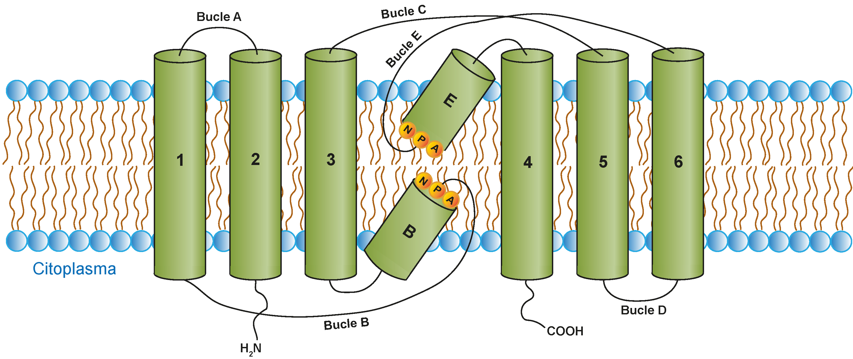
Results and discussion
Membrane water transporters could have a significant influence on salinity adaptation.
Aquaporins (AQPs)
Transmembrane proteins.
Water selective transport and other solutes.
Some AQPs can transport some ions to the vacuole.

Slide 18
Conclusions

Slide 19
Conclusions
In light of all these results, the main conclusions of this study are:
The maintenance of the water balance in the plant has a considerable influence on the adaptation to salinity stress.
Tomato is able to resist salinity better than cucumber, as most of the water relations in the plant have not been altered.
Membrane water transporters, like aquaporins, could have a key role in relieving the harmful effects of salinity in the plant, although more in-depth studies will be needed in order to confirm this fact.

Slide 20



Acknowledgments
Funding

