Slide 1
Title of the Presentation
Milena Szalata ^{1,}*, Mariola Dreger ¹, Małgorzata Górska-Paukszta ¹, Marcin Ożarowski ¹ and Karolina Wielgus ²
¹ Department of Biotechnology, Institute of Natural Fibres and Medicinal Plants National Research Institute, Wojska Polskiego 71B, 60-630 Poznań, Poland;
² Department of Pediatric Gastroenterology and Metabolic Diseases, Poznan University of Medical Sciences, Szpitalna Street 27/33, 60-572 Poznań, Poland.
* Corresponding author: milena.szalata@iwnirz.pl

Slide 2
Abstract:
The aim of the study was comparison of CBD extraction methods from Cannabis sativa. For extraction with ethanol (40%, 60% and 80%) were selected fresh panicles of monoecious hemp variety Beniko (2.55% CBD and 0.06% THC) allowed to cultivation in Europe. After harvesting, the panicles were frozen in liquid nitrogen and stored in a freezer (-20°C). For extraction, dynamic maceration was used during which the plant material was shaken in the dark (100 rpm, 72h) and ultrasound assisted extraction (45 Hz, 0.5 h). The conducted research showed the highest content of CBD (361.3 µg/ml) during extraction with 80% ethanol combined with ultrasound. On the other hand, dynamic extraction with 60% ethanol allowed to obtain 352.7 µg/ml of CBD. The obtained results indicate that the most efficient method of extraction is ultrasound assisted extraction, however, dynamic maceration with shaking may be an alternative method.
Keywords: Cannabis sativa; fibre hemp; ethanol extract; CBD; THC

Slide 3
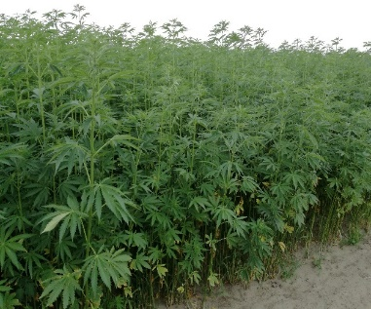
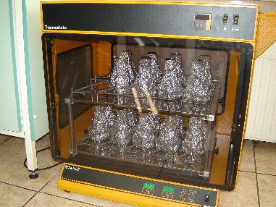
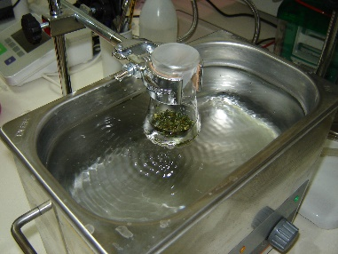
Materials and Methods
The monoecious hemp variety Beniko belongs to fibre-type Cannabis sativa allowed for cultivation in Poland and the European Union. The Beniko variety was grown on the fields of the Institute of Natural Fibres & Medicinal Plants in Experimental Station in Petkowo, Poland in 2018. The plants were collected at the beginning of seed maturation and frozen in liquid nitrogen, then the material was stored in refrigerator (-20°C).
Cannabinoids composition was analyzed using HPLC chromatography.
Dynamic maceration: 20 ml of ethanol solution (40%, 60% and 80%) was added to 2 g of plant material triturated in liquid nitrogen. Then dynamic maceration was applied during which the plant material was shaken in the dark (100 rpm, 72h).
Ultrasound assisted extraction: 10 ml of ethanol solution (40%, 60% and 80%) was added to 2 g of material triturated in liquid nitrogen and an ultrasonic bath was used for ultrasonically assisted extraction (45 Hz, 0.5 h).
Extractions were carried out at room temperature and the obtained extracts were filtered through mill gauze.

Slide 4
Results and Discussion
Analysis showed the highest content of CBD (361.3 µg/ml) during extraction with 80% ethanol combined with ultrasound. On the other hand, dynamic extraction with 60% ethanol allowed to obtain 352.7 µg/ml of CBD. In the case of ultrasound assisted extraction was observed significantly lower content of CBD at the level 303.4 µg/ml for extraction with 40% and 301.4 µg/ml for 60% ethanol in comparison with the higher content of CBD (361.3 µg/ml) obtained during extraction with 80% ethanol. Differently, dynamic maceration with 40% ethanol showed significantly low content of CBD on the level 252.6 µg/ml and application of 60% ethanol increased CBD content to 352.7 µg/ml which was significantly high, whereas extraction with 80% ethanol showed 331.9 µg/ml of CBD.
Extraction method | Ethanol (%) | Total CBD (µg/ml) | Total THC (µg/ml)
Dynamic maceration (100 rpm, 72h) | 40 | 252.6^{b} | 10.0^{b}
 | 60 | 352.7ª | 16.8^{ab}
 | 80 | 331.9^{ab} | 17.7ª
Ultrasound assisted extraction (45 Hz, 0.5 h) | 40 | 303.4^{ab} | 11.4^{ab}
 | 60 | 301.6^{ab} | 12.2^{ab}
 | 80 | 361.3ª | 15.6^{ab}

Slide 5
Results and Discussion
Extraction with dynamic maceration revealed significant differences in level of THC, and in 40% ethanol was observed the lowest content THC (10.0 µg/ml) and in 80% ethanol the highest content of THC (17.7 µg/ml). Ultrasound assisted extraction showed not important changes in the level of THC from 11.4 µg/ml in 40% ethanol to 15.6 µg/ml in 80% ethanol respectively. The obtained results indicate that the most efficient method of extraction is ultrasound assisted extraction, however, dynamic maceration with shaking may be an alternative method. The use of ultrasound supports the extraction by faster mass transfer and uniform mixing, which accelerates the extraction of compounds, what was showed at the extraction with 80% ethanol. A similar effect at a lower ethanol concentration (60%) was observed when dynamic maceration was used. The research has shown that hemp variety Beniko is a potentially good source of non-psychoactive CBD. Dynamic maceration and ultrasound assisted extraction are efficient methods of obtaining cannabinoids from plant material derived from Beniko hemp. Optimizing the extraction process of bioactive compounds from fibrous hemp with the use of ultrasound assisted extraction or dynamic maceration will allow the process to be carried out in a more effective way. In addition, application of ethanol extraction is one of the most effective extraction methods for hemp processing and receiving cannabinoids.

Slide 6
Conclusions
The conducted research showed the highest content of CBD (361.3 µg/ml) during extraction with 80% ethanol combined with ultrasound. On the other hand, dynamic extraction with 60% ethanol allowed to obtain 352.7 µg/ml of CBD. The obtained results indicate that the most efficient method of extraction is ultrasound assisted extraction, however, dynamic maceration with shaking may be an alternative method. These methods can be used to obtain high-quality extracts containing bioactive compounds for pharmaceutical purposes and food production.

Slide 7
Acknowledgments
Funding: This research was funded by Polish Ministry of Agriculture and Rural Development, resolution of the Council of Ministers no: 171/2017.

