Slide 1
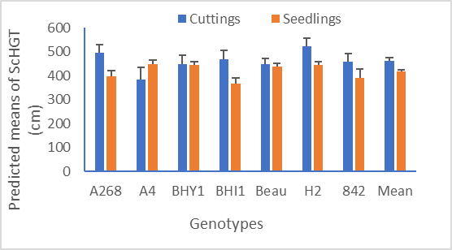
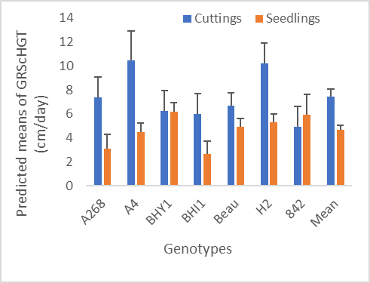
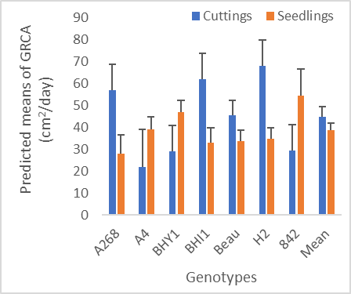
Evaluating seven macadamia seedling and cutting rootstocks for their effect on scion growth
P. D. Poudel^{1*}, M. Cowan¹, B.L. Topp¹, M. Alam¹,
¹Queensland Alliance for Agriculture and Food Innovation, University of Queensland, Maroochy Research Facility, 47 Mayers Rd, Nambour QLD 4560
Introduction
Large tree size is one of the key obstacles of building an efficient orchard system in macadamia (Macadamia integrifolia, M. tetraphylla, and hybrids). Rootstocks in tree crops are known to control vigour and play an important role in scion growth.
Commercial macadamias in Australia are mostly propagated through grafted seedlings while cutting (clonal) rootstocks are rarely used. Study on rootstock propagation methods and its effect on scion growth in macadamia is limited.
This preliminary study therefore aimed to identify the variation in seedlings and cutting rootstocks for scion growth traits and growth rates.
Methodology
Figure 1.Effect of rootstock propagation types and genotypes on variability in ScHGT (2021). Error bars show the standard errors (SE) of each mean. Mean bars in x-axis shows the average value across the genotypes.
7 rootstock genotypes propagated as seedlings and cuttings were selected from an existing trial planted in 2017 at Maroochy Research Facility, Nambour. A common scion ‘HAES 741’ was grafted onto all rootstocks.
Phenotyping from 2017-2021 was done each year for: Scion height (ScHGT) and Canopy Area (CA). Growth rates (GR) were calculated for both parameters.
Growth parameters were analysed using a REML mixed model in Genstat-21. Phenotypic correlations between grafted scion and ungrafted rootstock traits were estimated
Results
(a) (b)
Figure 2. Effect of rootstock propagation types and genotypes on variability in a) GR of ScHGT and b) GR of CA (2017-2021). Error bars show SE of each mean. Mean bars in x-axis shows the average value across the genotypes.
Scions grafted on cutting rootstocks had greater scion height than seedlings for most genotypes except ‘A4’ in 2021 (Fig 1) while not being significantly different in 2018, 2019 and 2020.
No significant variation between rootstock genotypes and types (seedlings and cuttings) was observed for Canopy Area (Table 1).
GRs (2017-2021) were significantly higher for cuttings than seedlings for most of the genotypes (Fig 2 and 3). GR in 2018-2019, 2019-2020 and 2020-2021 were not significant.
A significant Genotype x Type interaction for GRCA was identified (Table 1). ‘A268’, ‘BHI1’, ‘Beau’ and ‘H2’ cuttings had higher GRCA than their respective seedlings. Inversely, seedlings of ‘BHY1’, ‘A4’ and ‘842’ had higher GRCA than cuttings.
A strong positive phenotypic correlation (r = 0.8, p<0.001) was identified between grafted and ungrafted rootstock genotypes for CA. Rootstock height of ungrafted genotypes was positively and moderately correlated with scion height of grafted genotypes (r = 0.36, p<0.001).
Table 1. F probabilities from REML mixed model analysis of growth traits and growth rates of seedlings and cutting rootstock effects.
Conclusions
Components | Growth Traits (2021) |  | Growth Rates (2017-2021)
Components | ScHGT | CA | ScHGT | CA
Genotype | 0.365 | 0.353 | 0.337 | 0.957
Type (Seedling Vs Cutting) | 0.025 | 0.196 | <0.001 | 0.036
Genotype X Type | 0.15 | 0.342 | 0.214 | 0.015
Cutting rootstocks of most of the genotypes in this study produced trees with higher scion height and canopy area than the seedlings. This result contrasts with several other studies in macadamia and other tree crops.
Rootstock effect on scion growth may not become apparent until later stages of maturity.
Rootstock vigour is closely related with scion vigour and selection of rootstock can be made accordingly, however investigating a more diverse range of germplasm is required in future studies.
Acknowledgements
This research has been funded by the University of Queensland (UQ) and Hort Innovation (HI) Australia.
p.dhakalpoudel@uq.edu.au

