Slide 1
Title of the Presentation
André Caeiro^{1,}*, Filipa Ventura², Sandra Correia², and Jorge Canhoto²
¹ Center for Functional Ecology, Department of Life Sciences, University of Coimbra, 3000-456 Coimbra, 4 Portugal
² Full Affiliation, Address. Department of Life Sciences, University of Coimbra, 3000-456 Coimbra, Portugal
* Corresponding author: afcaeiro91@gmail.com

Slide 2
Abstract: Tamarillo (Solanum betaceum Cav.) is a Solanaceae tree cultivated for its edible fruits. Under specific stimuli, indirect somatic embryogenesis originates distinct calli: embryogenic (EC) and non-embryogenic (NEC). Both types proliferate, but only EC originates somatic embryos. The presence of secondary metabolites is known to influence induction and embryogenic competence. The objective of this work is to study of some of these compounds on SE.
Leaf segments from in vitro clones were cultivated on solid Murashige and Skoog medium supplemented with sucrose (26 mM) and picloram (20 µM). Phenolic acid influence was tested using caffeic acid (896 and 448µM), flavonoid were assayed with rutin (197.5 and 98.75µM). Anthranilic acid, an amidobenzoic acid, was also tested (1164.8 and 582.4µM). Additionally, previously induced EC and NEC lines were grown in liquid medium with the highest concentrations of each compound.
Results showed highest induction rates (>90%) in the control and when rutin and caffeic acid were tedted, whereas lower concentrations inhibit dedifferentiation. In contrast, the compounds seem to inhibit growth of established calli without affecting protein, phenolic acids and flavonoid levels, measured by spectrophotometric methods. Anthranilic acid completely inhibited both induction and calli growth.
The results seem to present a correlation of some secondary metabolites with dedifferentiation and a tendency to inhibit growth of established calli, probably related to metabolic effects. Further studies are underway to further characterize the dose-response relation of these compounds and molecular mechanism underlying this phenotypic effect.
Keywords: Calli; embryogenic competence; flavonoids; phenolic acids.

Slide 3
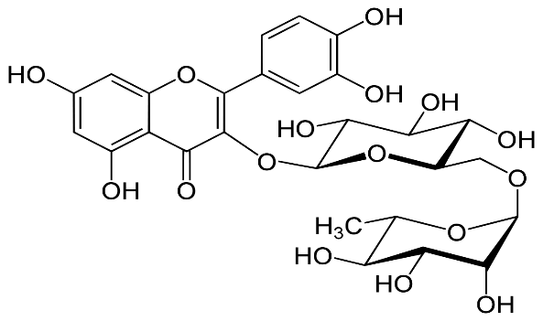
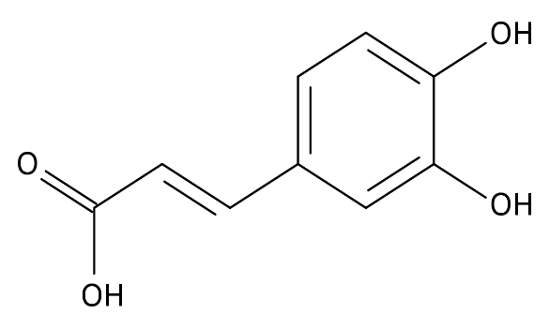
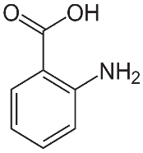
Changes of secondary metabolites during Tamarillo somatic embryogenesis
Callus multiplication
Embryogenic Callus (EC)
Non embryogenic Callus (NEC)
SE induction
Control
Rutin (A)
Caffeic acid (B)
Anthranilic acid (C)
A
B
A
B
C
C
Growth rates;
Phenolic acid and flavonoid quantification
Dedifferentiation rates
A and B influence deddiferentiation in dose-response
Callus multiplication is hampered by both compouns
C inhibits both phases

Slide 4
Introduction
Tamarillo (Solanum betaceum Cav.) is a Solanaceae tree indigenous to South America
It is grown globally for its fruits
There are several propagation and cloning techniques for this plant
Somatic embryogenesis (SE) is one of these methodologies
SE is complex phenomena influenced by several factors
One of this factors is the influence of certain secondary metabolites

Slide 5
Objectives
To study the influence of secondary metabolites in two SE phases:
Induction phase (measurement of dedifferentiation rates);
Multiplication of EC and NEC.
Compounds used
Flavonoid
Phenolic acid;
Amino benzoic acid
Rutin (quercetin-3-O-rutinoside
Caffeic acid
Anthranilic acid

Slide 6
Results
Anthranilic acid inhibits deddiferentiation;
Higher concentration of rutin and caffeic acid tend to lower dedifferentiation
Lower concentrations are indistinguible from control

Slide 7
Results
Anthranilic acid inhibits growth completely;
Caffeic acid inhibits growth for both types of callus
Rutin inhibits NEC growth completely and EC severely

Slide 8
Results
Phenolic and flavonoids intracellular concentrations seems to be independent from the extracellular medium content
Some of the lower results (antranilic acid) are possibly due to the low concentration of cells (growth severely affected)

Slide 9
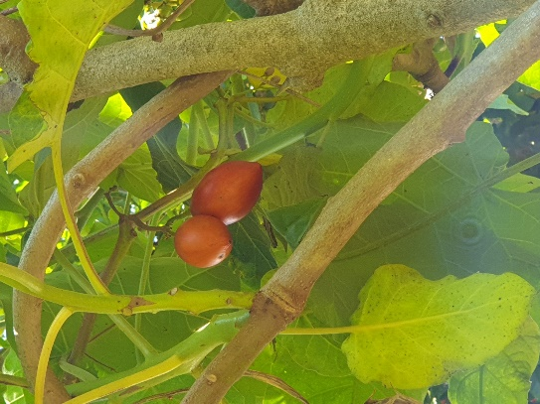
Conclusions
Influence of flavonoids and phenolic acid in dedifferentiation appears to be dependent on dose
All compounds tested seem to inhibit callus multiplication
Different compound should be tested in future assays
Quantification methods in the future should be more sensitive

