Slide 1
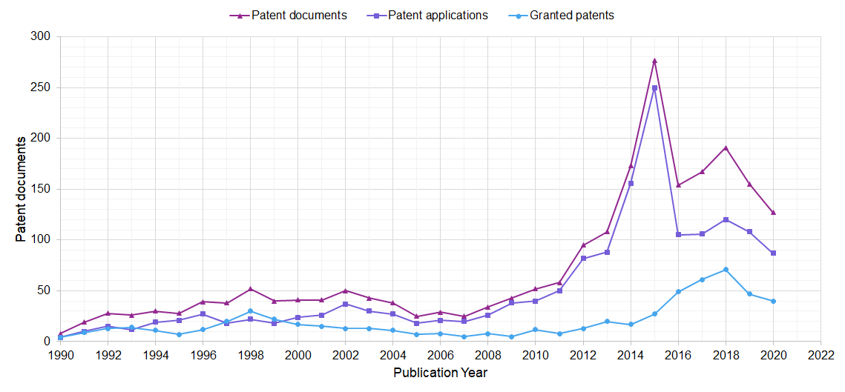
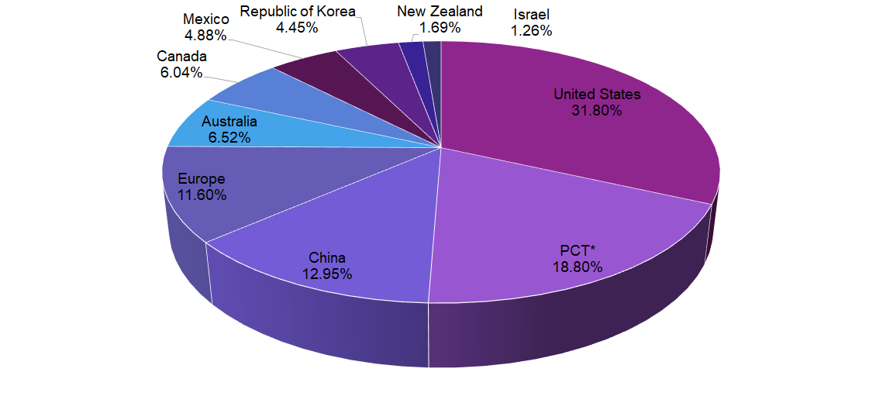
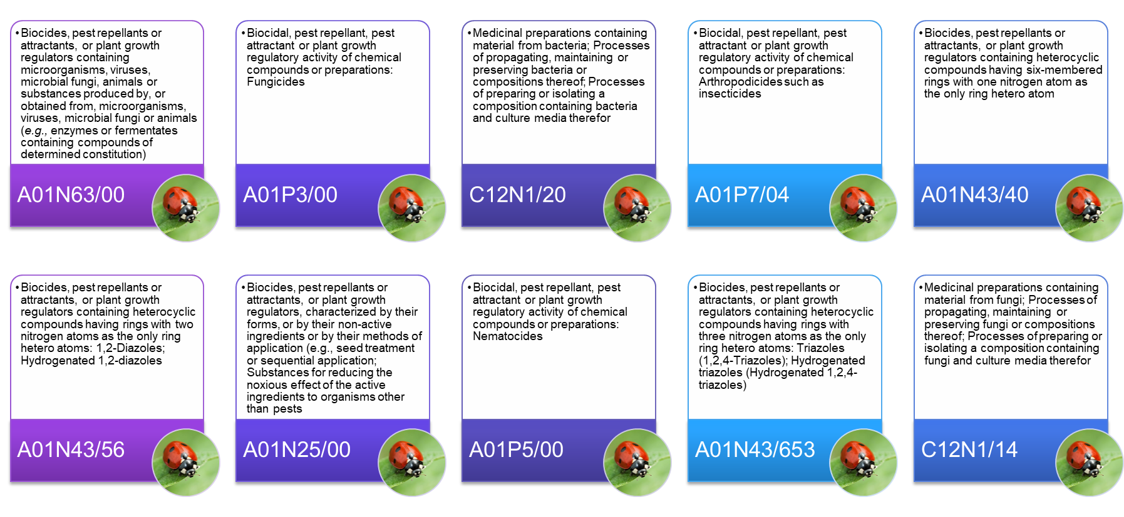
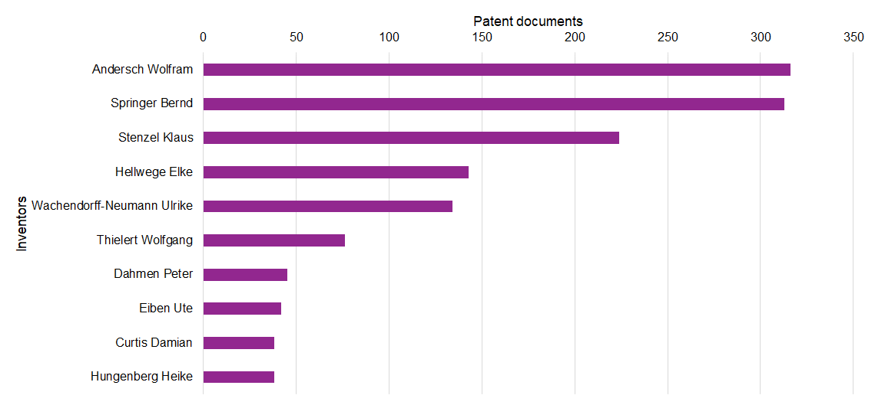
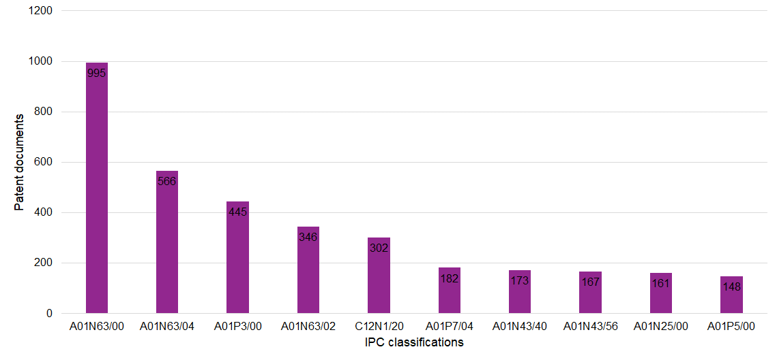
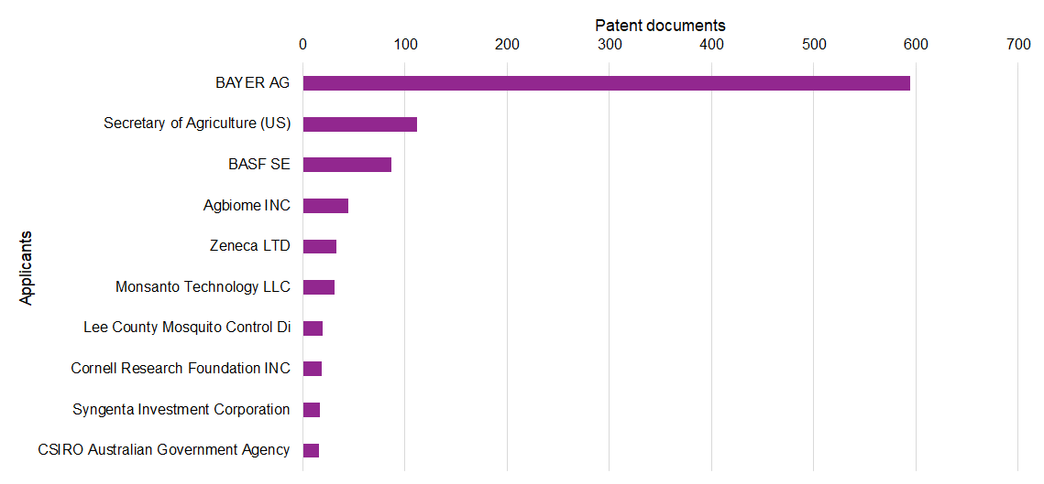
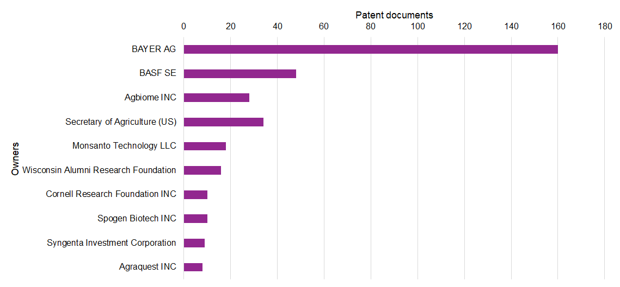
Formulation of biocontrol agents: A patent landscape analysis
Ahmed Fatimi ^{1,2 *}
¹ Department of Chemistry, Polydisciplinary Faculty, Sultan Moulay Slimane University, P.O.BOX 592 Mghila, Beni-Mellal 23000, Morocco
² ERSIC, Polydisciplinary Faculty, Sultan Moulay Slimane University, P.O.BOX 592 Mghila, Beni-Mellal 23000, Morocco
(*) a.fatimi@usms.ma
INTRODUCTION
A good formulation of biocontrol strain needs to be manufactured in a form that is easy to apply on crops. Whether to manufacture the strain in different galenic forms (e.g., liquid, suspension, solid, emulsion, etc.) is an important choice to make, as it affects shelf life and application method on crops. Different formulations of biocontrol agents from living organisms have been reported using several experimental conditions in laboratory scale: emulsifiable concentrate, suspension concentrate, wettable powder, oil miscible flowable, dustable powder, granule, etc.
This work, in the form of a patent analysis, which is a family of techniques for studying the information present within and attached to patents, describes the state by introducing what has been patented concerning biocontrol agents regarding preparation methods/processes, formulations, and applications. Furthermore, this work gives a competitive analysis of the past, present, and future trends in biological control and leads to various recommendations that could help one to plan and innovate research strategy.
AIM & METHODS
The aim of this study is to determine publication years, jurisdictions, patent classifications, inventors, applicants and owners.
The supported field codes used in this study was based on the Patentscope search service of the World Intellectual Property Organization (WIPO).
Different keywords and related terms were used and patents were searched according to title, abstract and claims.
The search was then filtered to include only documents with the application date until 2020.
RESULTS
CONCLUSIONS
This analysis of the patentability concerned only the innovation and improvement of biocontrol agents until 2020. We provided a detailed analysis of the patentability of formulations and the preparation process of biocontrol agents. During our research, we found 2260 patent documents (1643 patent applications and 617 granted patents). The United States was ranked first with 658 patent documents and 2015 was the year with the maximum number of patent documents (277). All filled patents and the most inventions intended for: (i) Medicinal preparations containing material or substances produced by, or obtained from, microorganisms, viruses, microbial fungi or animals; (ii) Processes of propagating, maintaining, or preserving microorganisms, viruses, microbial fungi or compositions thereof; (iii) Processes of preparing or isolating a composition containing microorganisms, viruses, microbial fungi, and culture media therefor.

