Slide 1
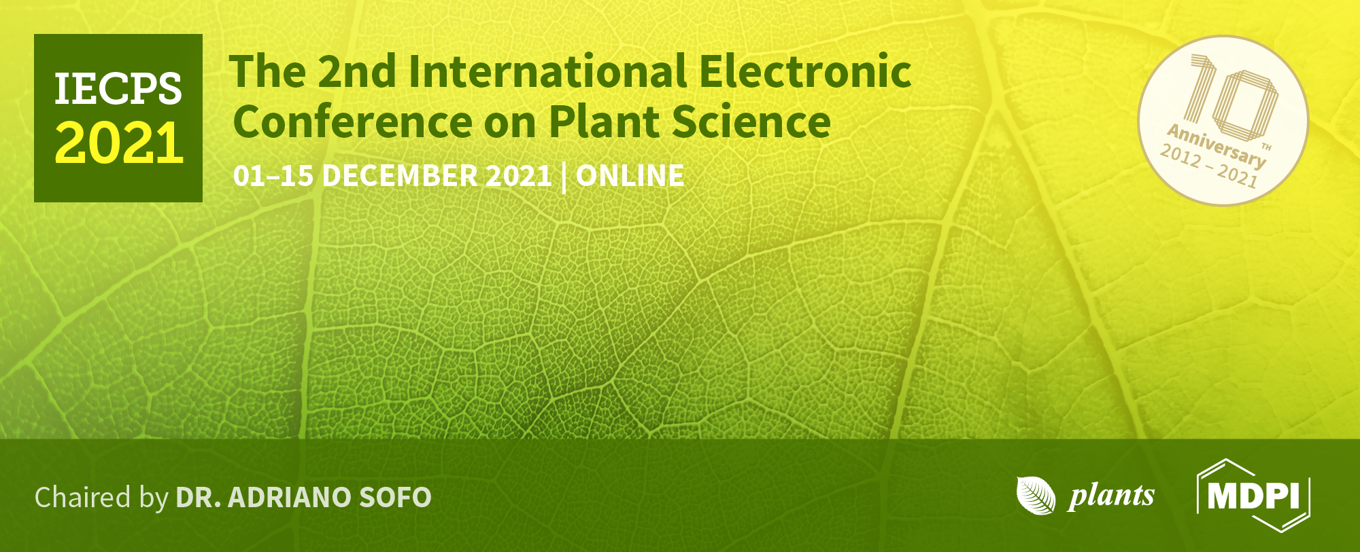

Title of the Presentation
Saurabh Saxena^{1,}*
¹Department of Biochemistry, School of interdisciplinary and Applied Sciences, Central University of Haryana, Jant-Pali, Mahendergarh, Haryana-123031, India
* Corresponding author: saurabhcs@cuh.ac.in

Slide 2

Elucidating the role of Inositol monophosphatases gene family in abiotic stress management
Abstract:
Myo-inositol is considered as an important osmoprotectant, which is directly involved in abiotic stress management in plants. We have biochemically and functionally characterized the Inositol Monophosphatase (CaIMP) and IMP like proteins (CaIMPL1 and CaIMPL2) from chickpea (Cicer arietinum). Biochemical study revealed that CaIMP encodes a lithium-sensitive phosphatase enzyme with broad substrate specificity. Our work also signifies the role of CaIMPL2 in Histidine pathway as it was able to catalyze the dephosphorylation of Histidinol 1-P, however IMPL1 was mostly involved in the hydrolysis of D-Ins 3-P and D Gal 1-P. Given the relation between IMP, IMPL1 and IMPL2, the difference in substrate specificity among these highly homologous enzymes suggests that the genes encoding these enzymes have diverged evolutionarily.
Keywords: Cicer arietinum; Inositol Monophosphatase; IMP like proteins; Broad substrate specificity; Abiotic stress

Slide 3
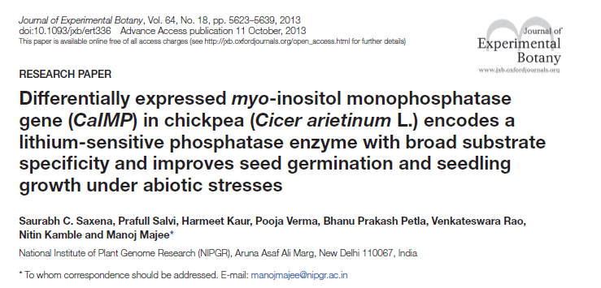
BACKGROUND

Slide 4
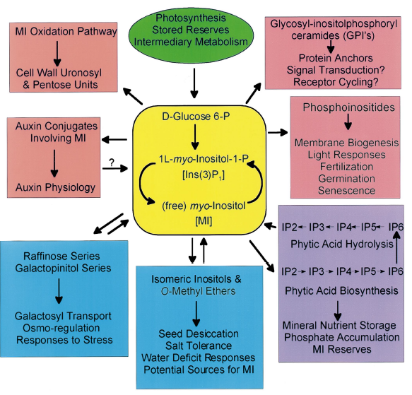
Inositol
Myo-Inositol plays a central role in growth and development.
This is especially true in plant biology where molecular entities containing or utilizing MI are involved in structure and function.

Slide 5
Inositol monophosphatase like Proteins (IMPL)
To date, three putative IMP encoding sequences have been identified in the Arabidopsis genome; VTC4, Myo-inositol monophosphatase-like1 and 2 (IMPL1& IMPL2)
vtc4 null mutants showed only a 30% reduction in myo-inositol content, suggesting genetic redundancy in the capacity to generate myo-inositol (Torabinejad et al., 2009)
IMPL1 and IMPL2 were shown to have in-vitro IMP activity (Torabinejad et al., 2009)
It has been shown that IMPL2 protein (At4g39120) was also able to catalyze the dephosphorylation of histidinol-P to histidinol (Petersen et al., 2010)
we need to explore the functions of IMPL genes in plant metabolism and its regulation under various abiotic stresses and growth & development

Slide 6
Objectives
Isolation and cloning of IMPL genes and their corresponding cDNA from chickpea
2. Expression pattern of CaIMPL genes under different environmental stresses, hormones and in different tissue /organ
3. Bacterial over expression, purification and biochemical characterization of CaIMPL1 and CaIMPL2 gene(s) product and their comparison

Slide 7
Methodology
Isolation and molecular cloning of CaIMPL1 and CaIMPL2 cDNA
Isolation of Total RNA
cDNA synthesis
Amplification using gene specific primers
Cloning into pJET blunt vector
Insert confirmation using restriction digestion
Sequencing

Slide 8
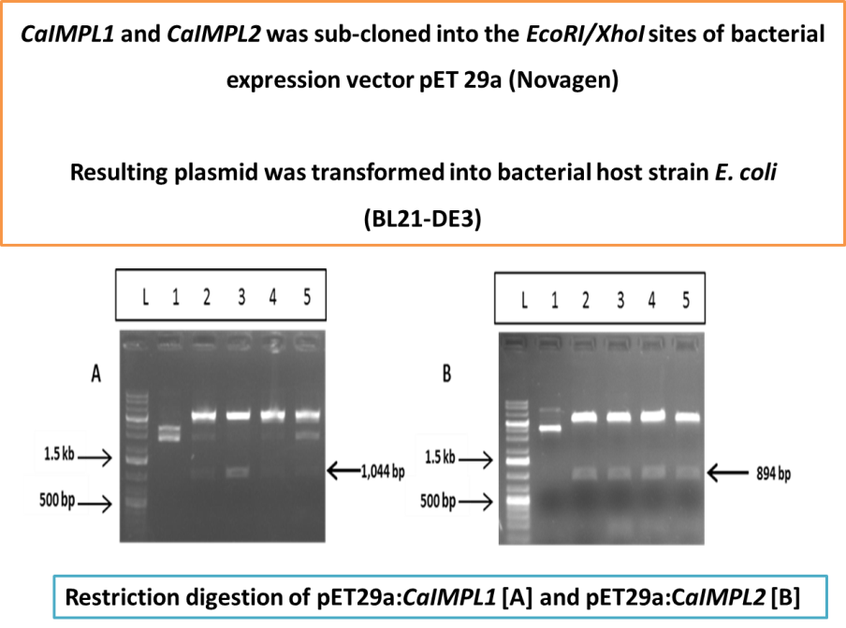
Methodology
Bacterial overexpression of CaIMPL1 and CaIMPL2
Expression culture, Cells harvesting
And Cell lysis
CaIMPL1
CaIMPL2
EcoRI
XhoI
CaIMPL-His.tag
pET29a
SDS-PAGE Gel Run
For checking the protein expression in
the Soluble and pellet fractions
Kan^{r}
Protein Purification
using nickel charged affinity columns
Biochemical characterizations
pH optimun, temp. optimum, substrate
Optimum, co-factor optimum etc.

Slide 9
Methodology
Recombinant CaIMPL1 & CaIMPL2 Protein Purification
Solubilization
Pellet is solubilized in 8M Urea Buffer
Dialysis
(Protein dialyzed to remove Urea)
_{6M Urea Buffer}
_{4M Urea Buffer}
_{3M Urea Buffer}
_{2M Urea Buffer}
_{1M Urea Buffer}
_{0M Urea Buffer}
Column Purification
Dialyzed Sample loaded on to the Column Matrix (nickel charged affinity columns)
and purified fractions collected

Slide 10
Methodology
Expression pattern of CaIMPL genes
Chickpea seedlings were subjected to various abiotic stress and hormone treatments
RNA was extracted
cDNA synthesis
qRT-PCR

Slide 11
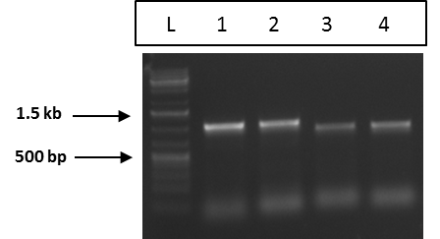
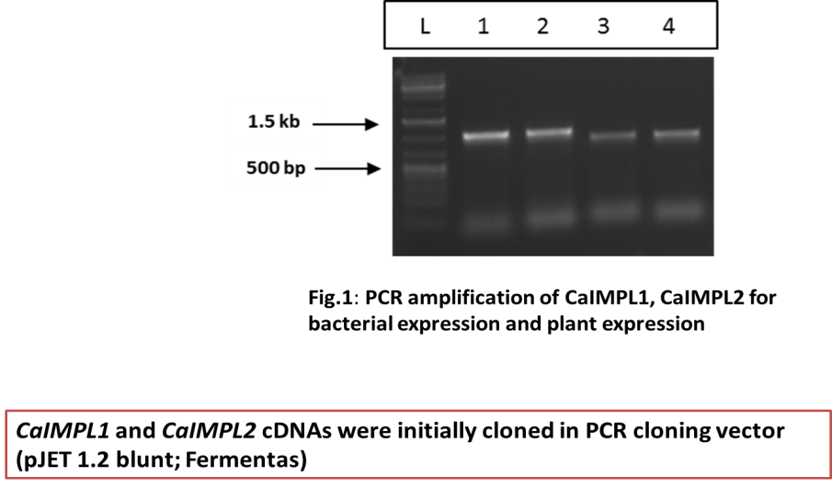
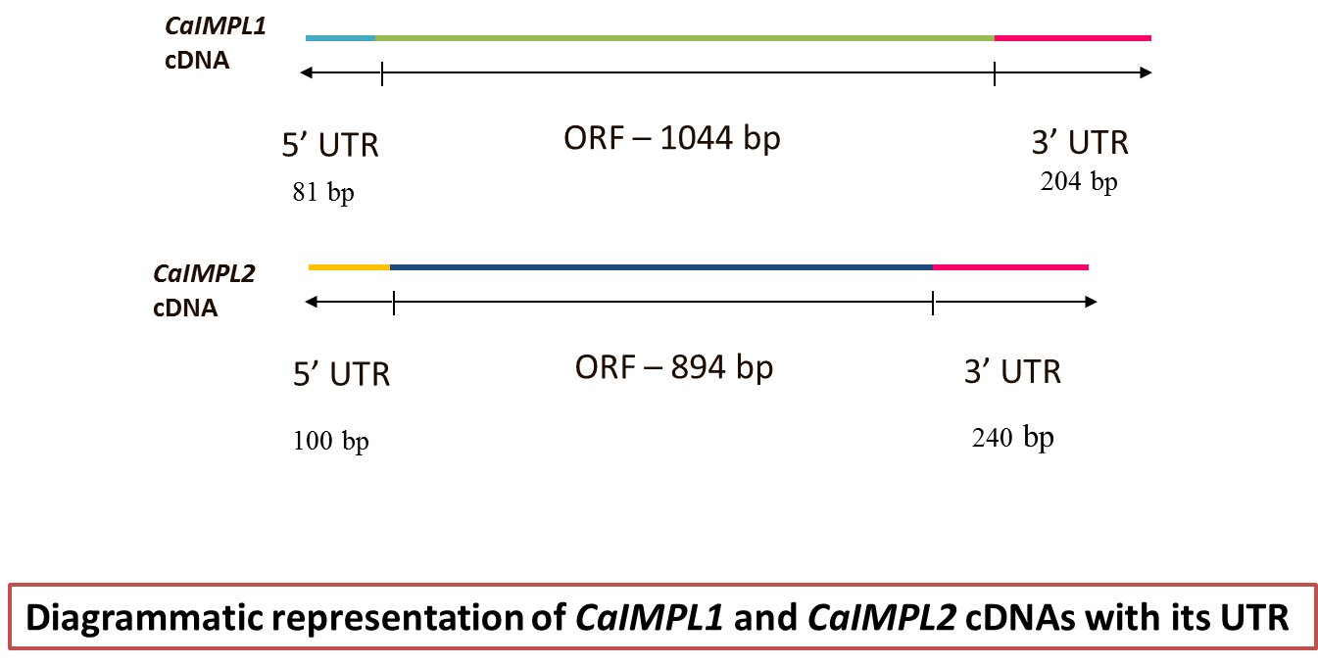
Results and Discussion
Amplification and Cloning of CaIMPL1 and CaIMPL2
RNA Isolation
CaIMPL1
(1044 bp)
CaIMPL2
(894 bp)
cDNA Preparation
Fig.1: PCR amplification of CaIMPL1 & CaIMPL2
Amplification
Fig. 2: Diagrammatic representation of CaIMPL1 and CaIMPL2 cDNA with UTR

Slide 12
Results and Discussion
Sequence Analysis of CaIMPL1 and CaIMPL2
Fig. 3: Polypeptide sequence of CaIMPL1 and CaIMPL2 showing characteristic motifs.
The polypeptide sequence of CaIMPL1 possesses three characteristic signature motifs (Motif ‘A’ – PIDGT, Motif ‘B’- WDXAAG, and Motif ‘C’-GEES) of the lithium-sensitive phosphatase super family enzymes including IMP, inositol polyphosphate 1-phosphatase, and fructose 1,6-bisphosphatase, though CaIMPL2 was lacking the ‘Motif B’, but possesses other two motifs viz. ‘Motif A’ and ‘Motif C’.
Continue…..

Slide 13
Results and Discussion
Parameters | CaIMPL1 | CaIMPL2
Genome sequence length | 2791bp | 2781bp
CDS length | 1044bp | 894
No. of exons | 10 | 9
No. of introns | 9 | 8
Chromosome location | 2 | 3

Slide 14
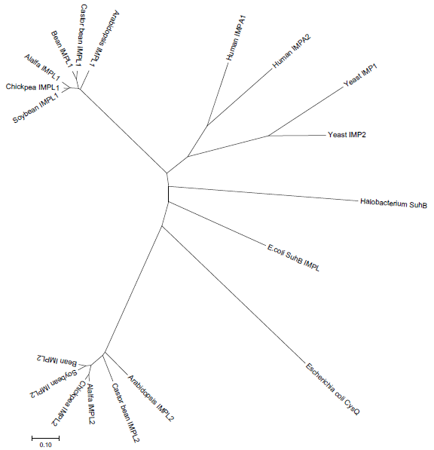
Results and Discussion
Phylogenetic Tree
Fig. 4: Radial format phylogenetic tree describing the evolutionary relationship between prokaryotic IMPL, yeast IMPL, Human IMPL proteins and Fabaceae family IMPL1 and IMPL2 proteins.

Slide 15
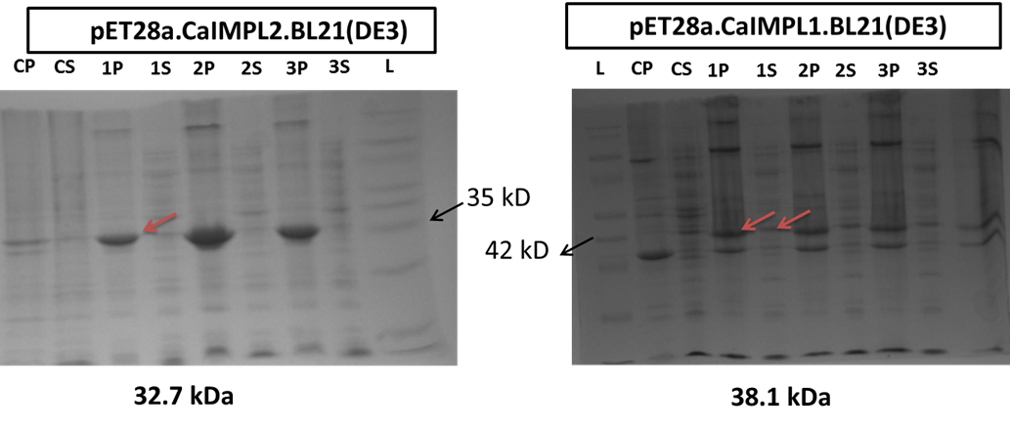
Results and Discussion
Cell lysis (DE3 cells overexpressing pET28a:CaIMPL1,L2) by sonication and analysis on SDS PAGE
Fig.5: 12% SDS PAGE analysis of CaIMPL1 and CaIMPL2 over-expressed protein in E. coli BL21 (DE3). [Control, pET23d empty vector transformed induced cells; CaIMP, CaIMP transformed induced cells; M, molecular weight marker; P, pellet fractions; S, soluble fractions.]

Slide 16
Results and Discussion
CaIMPL1 and CaIMPL2 Protein Purification
Fig. 6: Purified fractions of CaIMPL1 and CaIMPL2 proteins on 12% SDS PAGE

Slide 17
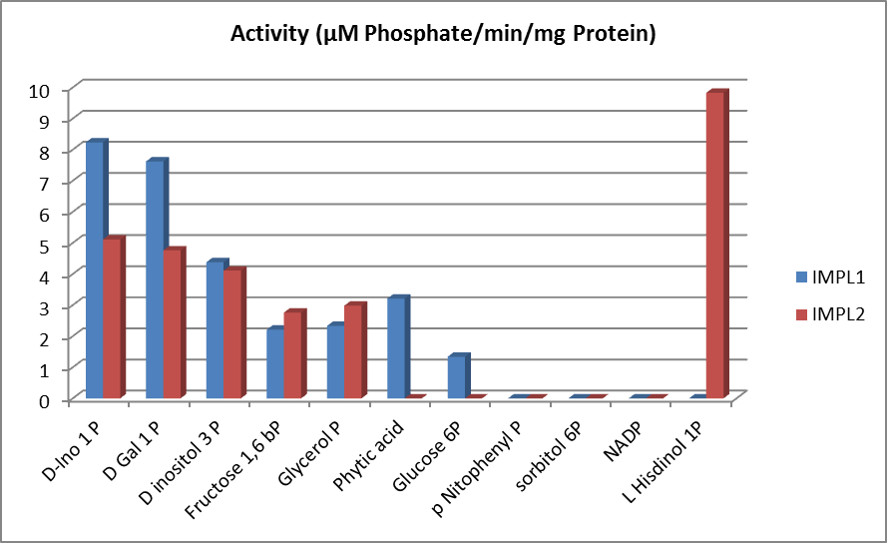
Results and Discussion
Phosphatase Activity of purified CaIMPL1 & CaIMPL2 protein with different substrates
IMP activity was assayed by colorimetric estimation of released inorganic phosphate after enzymatic hydrolysis of L-myo inositol 1 phosphate (and other phosphates) with Malachite Green
Fig. 7: Activity of CaIMPL1 and CaIMPL2 with different substrates

Slide 18
Results and Discussion
Biochemical characterization of recombinant CaIMP, CaIMPL1 and CaIMPL2
Table A. Kinetic Parameters of IMPL1 and IMPL2 Recombinant Proteins.
 | Enzyme (Substrate) | Km (μM) | Vmax (μmol min^{–1} mg^{–1}) | MgCl2 (mM) | Optimum Temperature | Optimum pH
1 | CaIMPL2 (Histidinol 1-P) | 29 | 3.8 | 3 | 37°C | 8
2 | CaIMPL1 (D-Ins 1-P) | 24 | 4.1 | 3 | 37°C | 8
3 | CaIMPL1 (D-Gal 1-P) | 18 | 4.9 | 3 | 37°C | 8
4 | CaIMP (D-Ins 1-P) | 25 | 4.4 | 3 | 37°C | 8
5 | CaIMP (D-Gal 1-P) | 16 | 5.3 | 3 | 37°C | 8

Slide 19
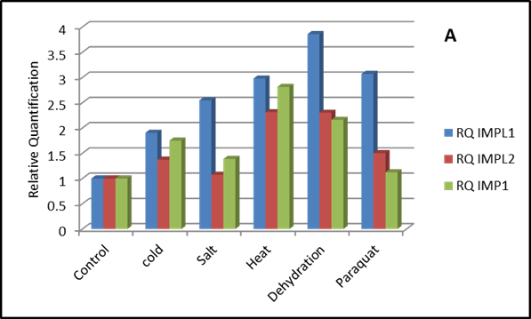
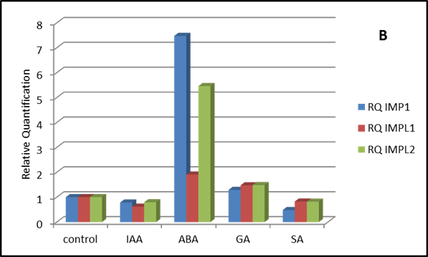
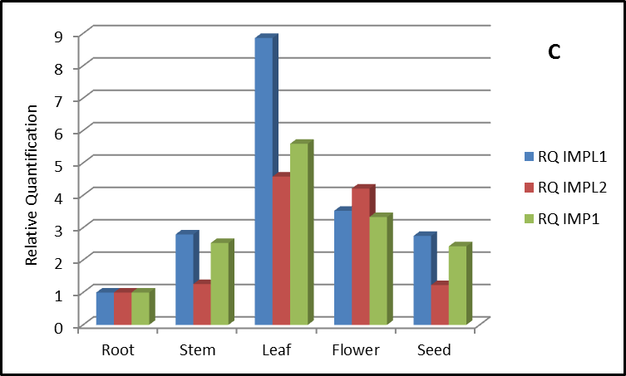
Results and Discussion
Quantitative RT PCR analysis of CaIMP, CaIMPL1 and CaIMPL2
Fig. 8: Quantitative RT PCR analysis of CaIMP, CaIMPL1, and CaIMPL2 (A) under different abiotic stresses, (B) in the presence of exogenous hormones, and (C) in different organs

Slide 20
Conclusions
The research of present project emphases on the characterization of IMPL1 and IMPL2, and their functional roles in plant growth and development along with stress tolerance.
Biochemical characterization of IMPL and kinetic comparisons of the Cicer arietinum recombinant IMPL1 and IMPL2 enzymes were done with various inositol phosphate substrates.
Our data supports that IMPL2 gene encodes an active histidinol 1-phosphate phosphatase enzyme in contrast to the IMPL1 enzyme which has the ability to hydrolyze D-Ins 3-P substrate and both CaIMPL1 & CaIMPL2 like CaIMP showed broad substate specificity.
IMPL1 and IMPL2 genes whose function is not completely yet known were found to be expressed under various abiotic stress conditions.
Few stress responsive domains were found in amino acid sequence of CaIMPL1 and CaIMPL2

Slide 21
Acknowledgments
This work was supported by the Science and Engineering Research Board (SERB), Government of India under the scheme of “Start Up Research Grant (Young Scientist) - Elucidating the Functional and Regulatory Aspects of inositol Monophosphatase like Proteins (IMPL1 and IMPL2) from drought tolerant legume Chickpea (Cicer arietinum)”
(Grant no: YSS/2014/001012/LS).

