Slide 1
Technology for the production of somatic seeds useful for the storage of valuable genotypes of Salvia officinalis
Aleksandra Deja
¹ Institute of Natural Fibres & Medicinal Plants National Research Institute, Biotechnology Department Wojska Polskiego str. 71b, 60-630 Poznan, Poland
* Corresponding author: aleksandra.deja@iwnirz.p

Slide 2
Abstract:
Developing a method to store valuable genotypes is very important for Salvia officinalis, which is an insect-pollinated plant and flowers in the second year of cultivation from seed. Moreover, somatic seeds can ensure the storage of plant line with a guarantee of genetic homogeneity and propagation of variable genotypes such as transgenic plants. In this context, research into the improvement of biotechnological methods for the production of high-quality somatic seeds is highly important.
Current research has attempted to produce and convert somatic seeds that would enable the long- or medium-term preservation of valuable sage genotypes. The creation of artificial seeds consisted in placing explants capable to regenerating into plants in a protective casing. The apical and axillary buds were collected from the multi-shoot cultures, encapsulated with 1.2% sodium alginate solution, and then dripped into the 200 mM CaCl₂ solution. After production, somatic seeds were placed on MS medium containing 0.3 mg L-1 of BAP to convert them. The method of obtaining somatic seeds used in this study allowed to obtain a high level of conversion of seeds into plants using apical buds (85%), and slightly lower in the case of axillary buds (62.5%).
The obtained results concerning the formation and conversion of somatic seeds allowed to obtain a high level of plant viability, which may prove the usefulness of the method of storing valuable Salvia officinalis genotypes.
Keywords: somatic seeds, Salvia officinalis, in vitro cultures

Slide 3
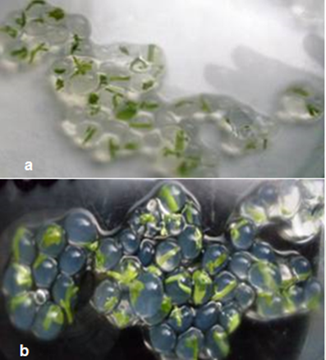
Results
The method of obtaining somatic seeds used in this study allowed to obtain somatic seeds using both the apical and axillary buds (Figure 1).
During the cultivation on MS medium containing 0.3 mg L-1 BAP a high level of conversion of seeds into plants using apical buds (85%) was observed (Table 1). The slightly lower percentage of regenerated plants was obtained for axillary buds (62.5%).
Table 1. In vitro cultures of somatic seed of sage
Somatic seed | Explant
 | W | B | L.S.D_{0,05}
 | Mean values (%)
Green | 77.5ª | 75.0ª | 17.51
Brown - green | 22.5ª | 25.0ª | 17.51
Brown | 0.0 | 0.0 | -
Growing | 85.0ª | 62.5^{b} | 12.18
Non vitality | 15.0^{b} | 37.5ª | 12.18
Necrosed | 0.0 | 0.0 | -
Vittificated | 30.0ª | 32.5ª | 13.71
Contaminated | 0.0 | 0.0 | -
Figure 1. Somatic seeds of S. officinalis: (a) using apical buds; (b) using axillary buds

Slide 4
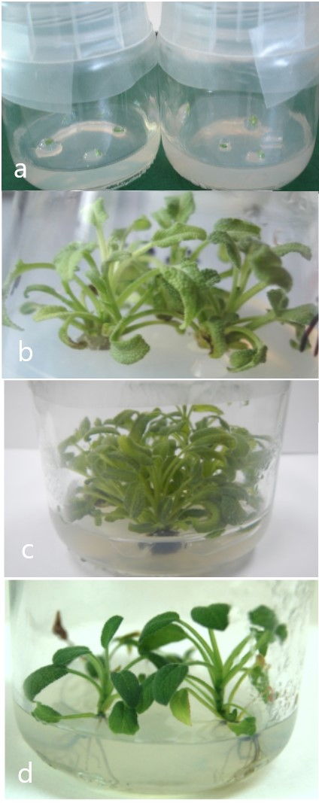
The statistical significance of seed viability in the ANOVA analysis of variance was at the level of p <0.01 (Table 2). Therefore, it can be assumed that the usefulness of the developed method applies to both initial explants.
Table 2. ANOVA analysis of in vitro cultures of somatic seeds
Source of variation | D.F. | Somatic seed
 |  | Green | Brown -green | Brown | Growing | Non vitality | Vittificated
Observation | 1 | 9025.0 *** | 9025.0 *** | 0.0 | 11025.0 *** | 11025.0 *** | 15625.0 ***
Explant | 1 | 25.0 | 25.0 | 0.0 | 2025.0 ** | 2025.0 ** | 25.0
Residual | 12 | 258.3 | 258.3 | 0.0 | 125.0 | 125.0 | 158.3
** p<0.01; *** p<0.001
For complete regeneration of plants, shoots were rooted in ½ MS medium containing 0.3 mg L-1 IAA. The results indicate that 4 explants out of 5 developed roots (4.067 ± 0.3914). Regenerated sage plants were characterized by proper growth and development at each stage of culture (Figure 2).
Figure 2. In vitro culture of S. officinalis: (a) somatic seeds placed on MS medium containing 0.3 mg L-1 BAP ; (b) shoots regenerated from somatic seeds; (c) multi-shoot cultures; (d) regenerated plants on ½ MS medium containing 0.3 mg L-1 IAA.

Slide 5
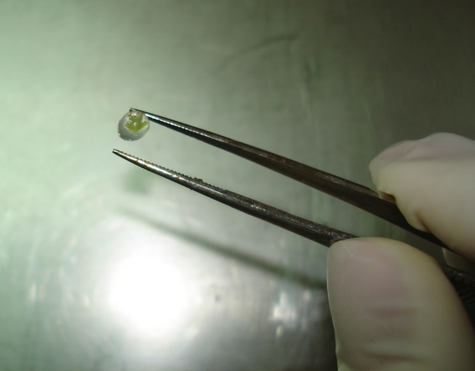
Discussion and Conclusions
The results have shown that somatic seeds of Salvia officinalis were capable of conversion and regeneration. The developed a protocol was effective and enabled the complete regeneration of plants from apical and axillary buds. The use of this type of explants for the production of artificial seeds is increasingly an alternative to the use of somatic embryos. The high conversion and regeneration efficiency of somatic seeds will enable study on the application of the technique of long-term storage genotypes of sage.
In addition, somatic seeds can provide for the delivery and propagation of variable genotypes such as transgenic plants with high genetic instability. In this context, the method obtained in own work could be develop and optimized in the future for the storage of valuable sage genotypes after genetic transformation.

Slide 6
Acknowledgments
The presented work was financially supported by The Ministry of Science and Higher Education in Poland, Technological Initiative I
Grant number MNiSzW IT-1 – 13910: „Obtaining of salvia (Salvia oficinalis) with anti carries properties”.

