Slide 1


Title of the Presentation
Problems with first-order infotheoretic measures on short sequences
Nithin Nagaraj^{1,}*
¹Consciousness Studies Programme, National Institute of Advanced Studies (NIAS), Bengaluru, India
* Corresponding author: nithin@nias.res.in
© Nithin Nagaraj
Notes:
Hello and welcome to the 1st International Electronic Conf. on Information. My name is Nithin Nagaraj and I am from the Consciousness Studies Programme, NIAS, Bengaluru. India. The title of my paper is “”. So, let us begin.

Slide 2

Abstract: Shannon entropy (H) and Mutual Information (MI) are practically estimated using first-order statistics as it is easier and convenient. However, the estimated first-order H and MI values could be grossly incorrect as we shall demonstrate with 3 carefully designed short linearly independent sequences X1, X2 and X3. These are carefully constructed to take values from the set {0, +1, -1} such that the time stamps of zeroes exactly coincide. Being linearly independent, the pairwise correlation coefficients are zeros. X2 and X3 are cyclic permutations of each other and X1 is independent of both X2 and X3. The estimated pair-wise first-order MI values turn out to be the same for all the pairs, thus showing its inability to capture the additional mutual dependence between X2 and X3. After puncturing the zero-values from all the sequences (along with the time stamps) the first-order MIs turn out to be zeros for all pairs - wrongly implying that the sequences are independent, whereas X2 and X3 continue to be cyclic permutations of each other (and hence completely dependent). Compression-complexity measures such as the Effort-To-Compress complexity measure can correctly capture the non-linear dependencies in this case. First-order estimation of H and MI is thus fraught with danger in practical applications, especially on short data lengths and in such situations, it is preferable to employ compression-complexity measures.
Keywords: Shannon entropy; Mutual Information; first order; compression-complexity; Effort-To-Compress; short sequences
Notes:
The abstract of the paper is given here. We shall demonstrate the drawbacks of using Shannon Entropy and MI using first order statistics on short time series.

Slide 3
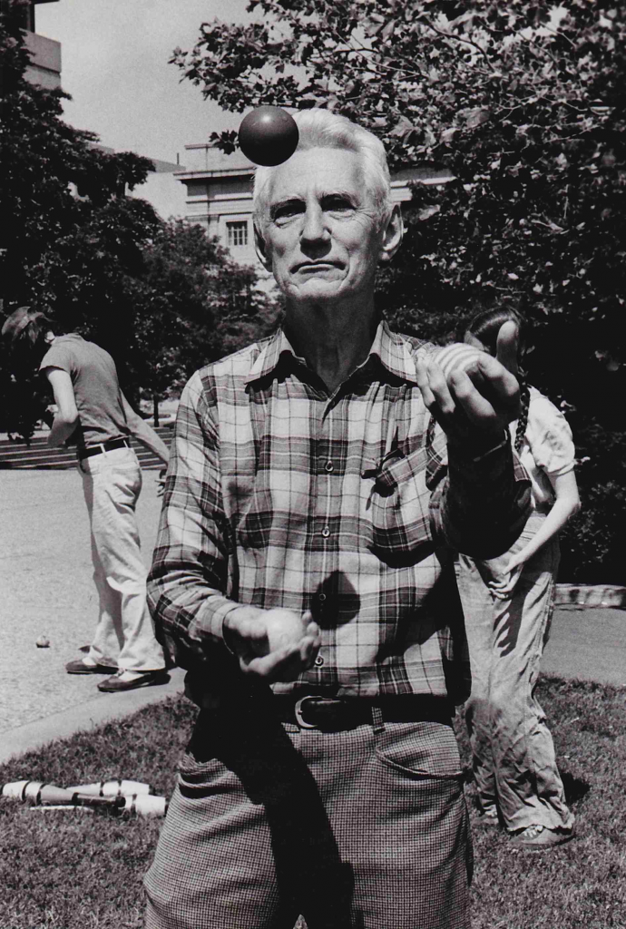
Claude E Shannon
(1916-2001)
The Father of Information Theory
Notes:
(CREDIT: EECS MICHIGAN POSTER)
It all began with claude Shannon the father of information theory who ushered us into the information age.

Slide 4
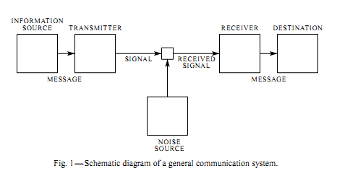
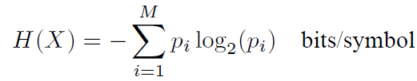

Shannon’s 1948 Masterpiece*
Entropy
Channel Capacity
*Claude E Shannon, A Mathematical Theory of Communication, Bell Sys. Tech. Journal, Vol. 27, pp. 379-423, 1948.
Notes:
forma

Slide 5
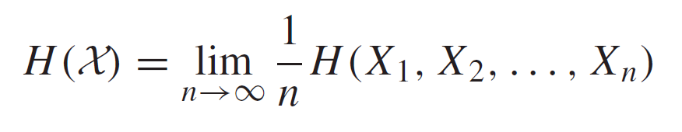
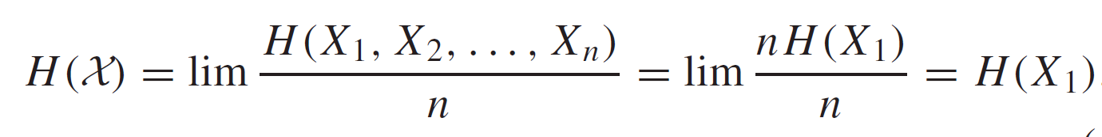

Entropy of a stochastic process*
For a sequence of n discrete random variables, entropy (if the limit exists):
If these are independent and identically distributed (i.i.d), then:
In most practical scenarios, i.i.d is assumed and hence first-order statistics is used to estimate the entropy of a time series.
*Cover, T. M. (1999). Elements of information theory. John Wiley & Sons.
Notes:
We are familiar with the definition of Shannon entropy for a random variable given in the previous slide. In this slide, Entropy is defined for a sequence of n random variables as the limit n tending to infinity 1/n times the joint entropy of X1 to Xn. In most practical scenarios, especially for short sequences, these n variables are assumed to be i.i.d. i.e. Independent and identically distributed. In which case, the entropy reduces to H(X1) which can be computed using first order statistics.

Slide 6
Three Short Time Series X1, X2 and X3:
take values from the set {-1,0,1}
Dependent
(share zeros)
Length = 24 samples
Notes:
However, the assumption of IID can be problematic in practical scenarios. Here is an example of 3 short time series – X1, X2 and X3 of length 24 samples. These take values from the set {-1,0,1} and are highly dependent since they all share the location of zeros.

Slide 7
Three Short Time Series X1, X2 and X3:
take values from the set {-1,0,1}
Dependent
(share zeros)
Highly
dependent
Length = 24 samples
Notes:
Furthermore, X2 and X3 are constructed to be highly dependent. The two halves of X2 and X3 are exactly the same but in different order as indicated in this figure.

Slide 8
Linear correlation, Mutual Information (MI) and Mutual Effort-To-Compress (METC*)
Pair | ρ (Correlation Coefficient) | MI First-order (bits) | METC
(X1, X2) | 0 | 0.9183 | 0.2609
(X1,X3) | 0 | 0.9183 | 0.2609
(X2,X3) | 0 | 0.9183 | 0.5652
*Nagaraj, N., Balasubramanian, K., & Dey, S. (2013). A new complexity measure for time series analysis and classification. The European Physical Journal Special Topics, 222(3), 847-860.
Notes:
We compute the pairwise values of linear correlation coefficient, mutual information and mutual effort-to-compress complexity measures for the pairs (X1,X2), (X1,X3) and (X2,X3). Notice that the values of correlation coefficients are zeros for all the pairs indicating that they are linearly uncorrelated. The MI, computed using first-order statistics (with the assumption of iid) is the same for all the pairs. This betrays the fact that (X2,X3) have a higher degree of dependence than the other pairs. Only the measure Mutual ETC is able to capture this increased dependence between (X2,X3). A description of ETC is omitted here but can be found in the reference given here and also at the end of the presentation in the appendix.

Slide 9
Zeros removed
Length = 16 samples
Notes:
We now puncture all the three time series at the locations where they are zeros to create versions of them with just 16 samples.

Slide 10
Zeros removed
Independent
Highly
dependent
Length = 16 samples
Notes:
Now, with the zeros removed, X1 is completely independent of X2 and X3. However, X2 and X3 continue to be highly dependent just as before. Let us see if the measures are able to capture these dependencies.

Slide 11
Linear correlation, Mutual Information (MI) and Mutual Effort-To-Compress (METC*) on the new time series with zeros removed
Pair | ρ (Correlation Coefficient) | MI First-order (bits) | METC
(X1, X2) | 0 | 0 | 0
(X1,X3) | 0 | 0 | 0
(X2,X3) | 0 | 0 | 0.2
Notes:
The linear correlation coefficients are zeros for all the pairs and so are the first order MI estimates. This implies that MI estimated using the iid assumption (i.e. using first-order statistics) is unable to capture the fact that X2 and X3 are highly dependent on each other. On the other hand, METC is zero for the pairs (X1,X2) and (X1,X3) but not for the pair (X2,X3). Thus, METC alone correctly captures the fact that X2 and X3 are not independent. It is important to note that METC does not make any assumptions on the data for its computation.

Slide 12
Discussion & Conclusion
Assumption of i.i.d is problematic
For short sequences, first-order statistics is typically used, but as it was demonstrated, this may lead to erroneous conclusions
Effort-To-Compress, a compression-complexity measure, is able to capture the nonlinear dependence between the time series better than MI without making any further assumptions on the data
This has implications in causal analysis as well*
*Nithin Nagaraj. "Problems with information theoretic approaches to causal learning." arXiv preprint arXiv:2110.12497v1 [cs.IT] (2021).
Notes:
In this paper, we have demonstrated that the assumption of i.i.d is indeed problematic. Especially for short sequences,

Slide 13
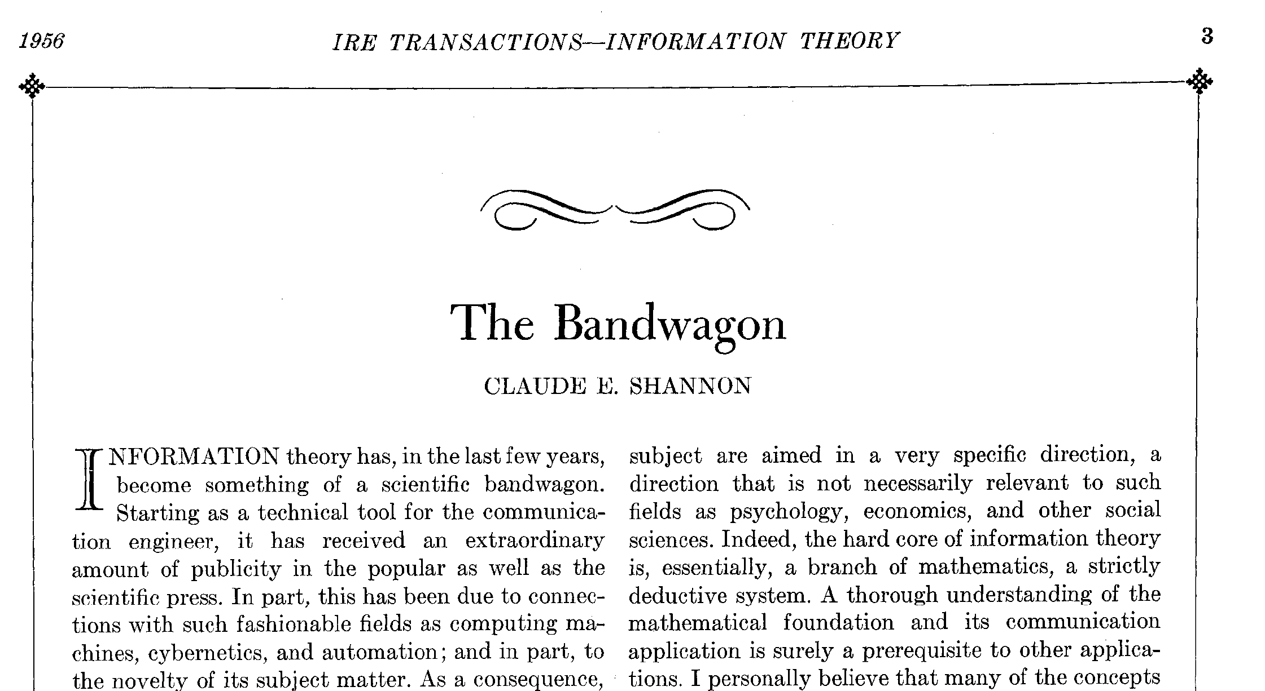
Ref: Shannon, C. E. (1956). The bandwagon. IRE transactions on Information Theory, 2(1), 3.
A warning from Shannon!
Notes:
Let me conclude with a warning from none other than Shannon himself. He wrote this paper titled “The Bandwagon” in 1956, 8 years after his masterpiece paper where he invented Information Theory. Seeing the extraordinary amount of publicity Information Theory received in both popular as well as the scientific press, Shannon sounded the following warning.

Slide 14
Shannon’s words of caution:
“...it has perhaps been ballooned to an importance beyond its actual accomplishments.‘’
“...it carries at the same time an element of danger‘’
“...it is certainly no panacea for the communication engineer or, a fortiori, for anyone else.‘’
“It will be all too easy for our somewhat artificial prosperity to collapse overnight when it is realized that the use of a few exciting words like information, entropy, redundancy, do not solve all our problems.‘’
So have we been forewarned!

Slide 15
For further reading:
Nithin Nagaraj. "Problems with information theoretic approaches to causal learning." arXiv preprint arXiv:2110.12497v1 [cs.IT] (2021).
Notes:
arXiv:2110.12497v1 [cs.IT]

Slide 16


Acknowledgments
The financial support of Tata Trusts is gratefully acknowledged.
Many thanks to Prof. Sangeetha Menon, Consciousness Studies Programme, NIAS for all the support.
Notes:
I would like to thank Tata Trusts for the financial support received.

Slide 17

Please email nithin@nias.res.in with any questions, suggestions, and feedback.
Thank you for your patient listening
© Nithin Nagaraj
Notes:
Please email me with any questions, suggestins and feedback.

Slide 18
Appendix
Working of ETC
Notes:
arXiv:2110.12497v1 [cs.IT]

Slide 19
Effort-to-Compress (ETC)*
It measures the effort required to compress an input sequence using a lossless data compression algorithm, Non-sequential recursive pair substitution.
Example: Consider the Input ‘11011010’ with length L = 8.
‘11’ occurs most frequently. Replace it with ‘2’
‘11011010’ => ‘202010’
Now, ’20’ occurs most frequently. Replace it with ‘3’
‘202010’ => ‘3310’
Similarly, ‘3310’ => ‘410’ => ‘50’ => ‘6’. STOP!
ETC is defined as number of steps needed to convert input sequence to a constant sequence. For this example, $n$ = 5.
ETC_{normalized} = $n/(L−1$) = 5/(8 $−$1) = 5/7 = 0.7142.
0 $$ETC_{normalized} = $ 1$
*Nagaraj, Nithin, Karthi Balasubramanian, and Sutirth Dey. "A new complexity measure for time series analysis and classification." The European Physical Journal Special Topics 222.3 (2013): 847-860.

