Slide 1
On the Effectiveness of Query Variation
in Technology-Assisted Review Systems
Giorgio Maria Di Nunzio^{1,2}
1 Department of Information Engineering, University of Padova, Italy
2 Department of Mathematics, University of Padova, Italy
Intelligent Interactive Information Access Hub

Slide 2
Abstract
High-recall Information Retrieval systems tackle challenging tasks that require the finding of (nearly) all the relevant pieces of information in a collection. Systematic review systems and electronic discovery (eDiscovery) systems are examples of that kind where the search for relevant information with limited resources, such as time and money, is necessary.
In this field, Technology-Assisted Review (TAR) systems use a type of human-in-the-loop approach where, starting from an initial request of the user, ranking algorithms are continuously trained according to the relevance feedback from the user until a substantial number of the relevant documents are identified. This approach, named Continuous Active Learning (CAL), is more effective and more efficient than traditional practices which typically consist of a mix of keyword search and manual review of the search results.
In this work, we aim to study the effectiveness of query variation approaches that work in parallel with the explicit relevance feedback of the users during a search session. In particular, we want to predict when to stop the search for relevant documents in terms of the cost/benefits of the amount of missing information compared to the effort of continuing to search. We evaluate the approaches on standard Information Retrieval test collections provided by the Conference and Labs Evaluation Forum (CLEF) and the Text Retrieval Conference (TREC).
Keywords: Information Retrieval, Continuous Active Learning, Technology-Assisted Review

Slide 3
Problem
High-recall Information Retrieval systems tackle challenging tasks that require the finding of (nearly) all the relevant pieces of information in a collection.
Systematic review systems and electronic discovery (eDiscovery) systems are examples of that kind where the search for relevant information with limited resources, such as time and money, is necessary.

Slide 4
Problem
High-recall Information Retrieval systems tackle challenging tasks that require the finding of (nearly) all the relevant pieces of information in a collection.
Systematic review systems and electronic discovery (eDiscovery) systems are examples of that kind where the search for relevant information with limited resources, such as time and money, is necessary.

Slide 5
Problem
A few “good” documents

Slide 6
Problem
All the good documents with some “bad” ones

Slide 7
Problem
Back Pain
What Kind of Pain?
Injury? Strained Muscle?

Slide 8
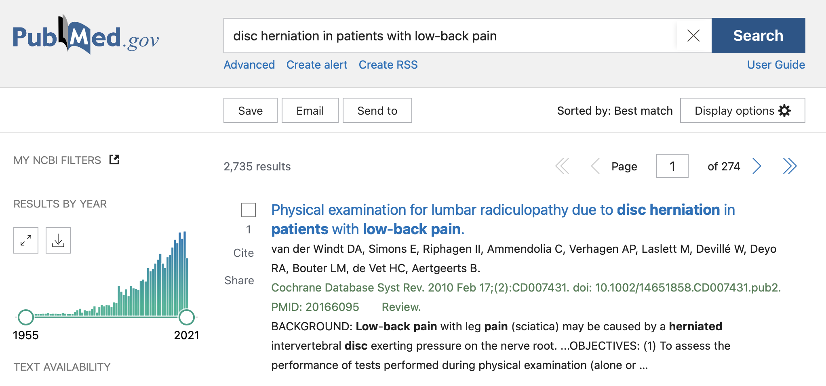
Problem
2,735 results

Slide 9
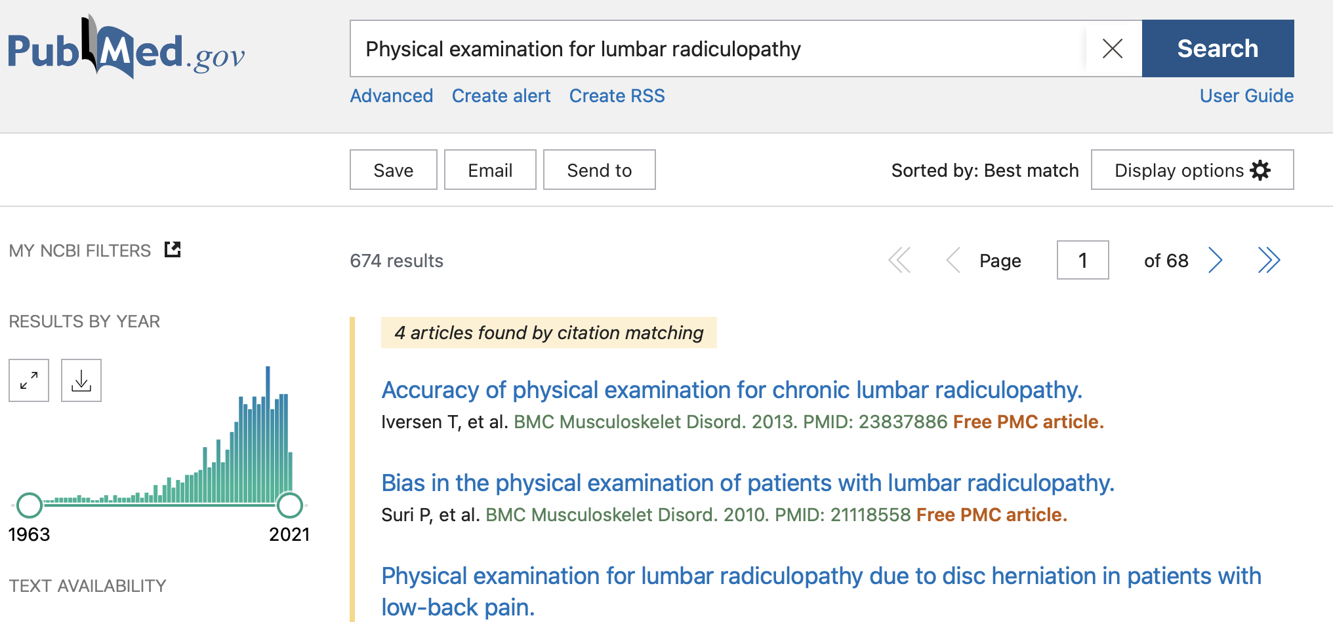
Problem
674 results

Slide 10
Objective
Build an effective system given limited resources
Resources can be
limited time (+ infinite money)
limited money (+ infinite time)
limited time and limited money

Slide 11
Approach
Formulate
Rank
Sample
Assess

Slide 12
Approach
Formulate
Rank
Sample
Assess
Reformulate
Rank
Sample
Assess
Reformulate
Rank
Sample
Assess

Slide 13
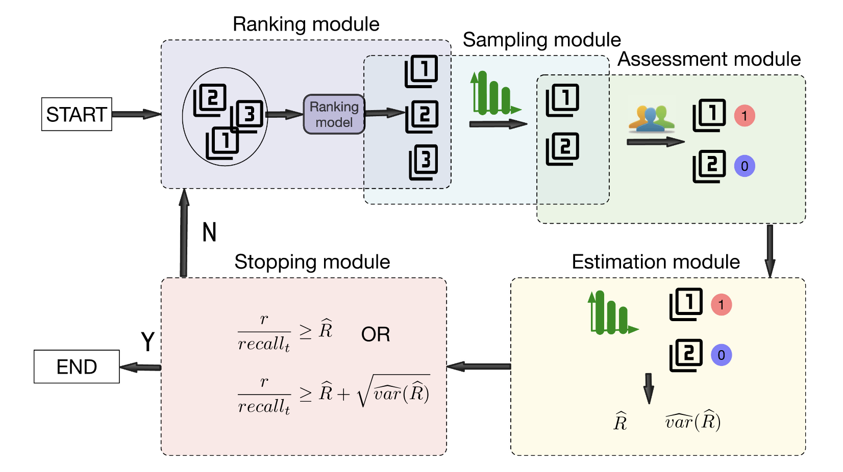
Approach
Li, D., Kanoulas, E. TOIS 2021
When to Stop Reviewing in Technology-Assisted Reviews:
Sampling from an Adaptive Distribution to Estimate Residual Relevant Documents

Slide 14
Approach
Umemoto, K., Yamamoto, T., Tanak,. K. SIGIR 2016
ScentBar: A Query Suggestion Interface Visualizing the Amount of Missed Relevant Information for Intrinsically Diverse Search

Slide 15
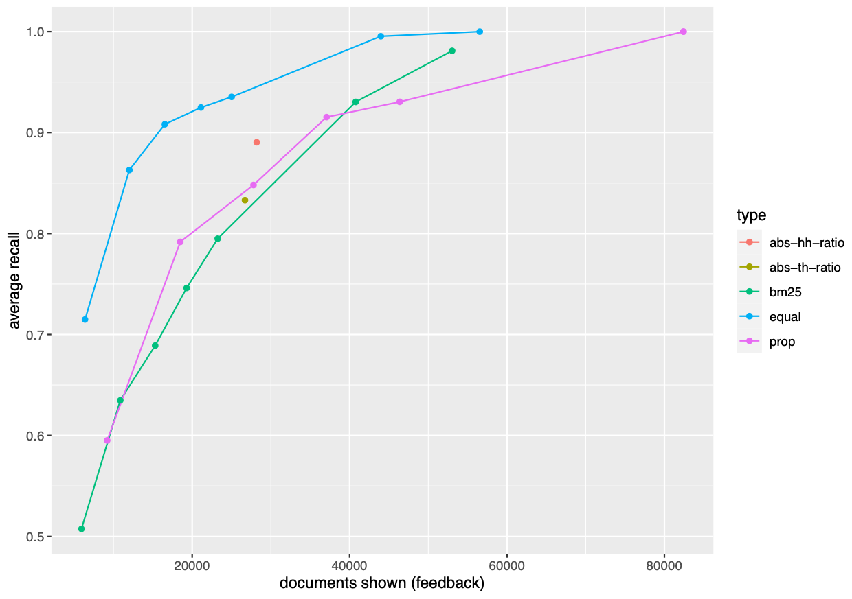
Results and Discussion
Di Nunzio, G. M. ECIR 2018
A Study of an Automatic Stopping Strategy for
Technologically Assisted Medical Reviews

Slide 16
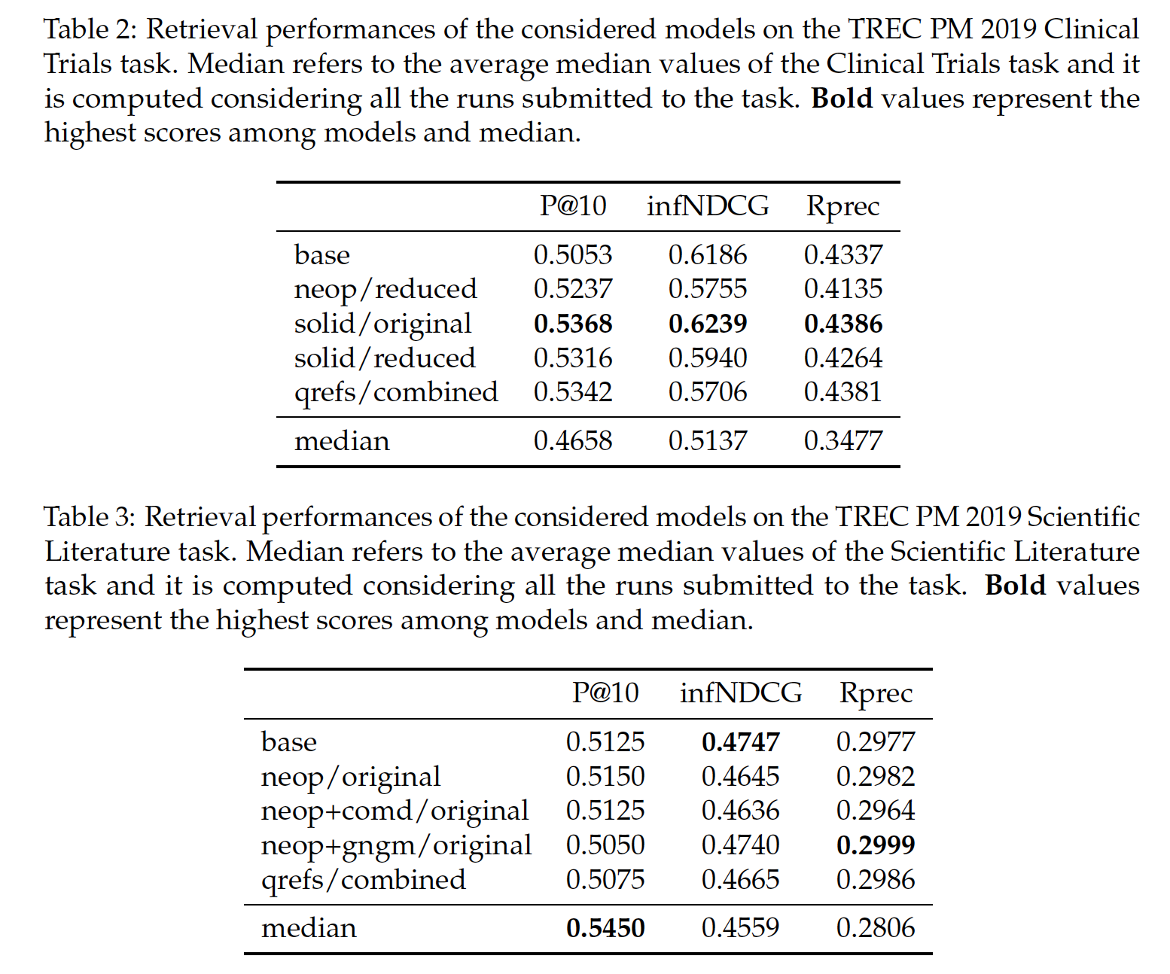
Results and Discussion
Marchesin, S., Di Nunzio, G. M., Agosti, M. MDPI Information 2021
Simple but Effective Knowledge-Based Query Reformulations for Precision Medicine Retrieval

Slide 17
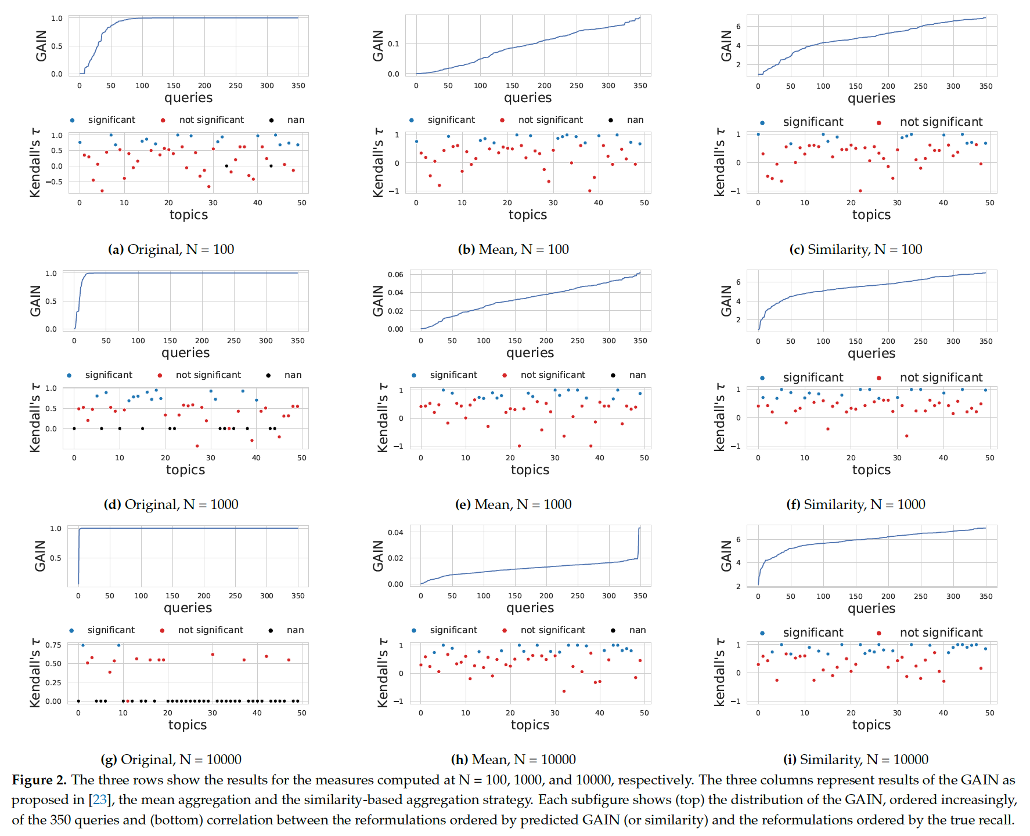
Results and Discussion
Di Nunzio, G.M., Faggioli, G., MDPI Applied Sciences 2021
A Study of a Gain Based Approach for
Query Aspects in Recall Oriented Tasks

Slide 18
Conclusions
Save time (and money) with heuristic approaches that use active learning to train a technology assisted review system
Improve performance by manually or automatically reformulate queries
Predict the performance of each reformulation to improve recall in advance

Slide 19
Supplementary Materials
Links:
https://sciprofiles.com/publication/view/74d8a0631b46dda1559c4ed5f7aac497
https://sciprofiles.com/publication/view/92301d84516fc2501befa85d45d6e483
https://sciprofiles.com/publication/view/dbd4aead65333f0314e5bf1080b1c199
https://sciprofiles.com/publication/view/9d43297a96633f03f749caa6d7ba8ae7
Follow me/us!
@airamoigroig
@iiia_unipd

