Slide 1
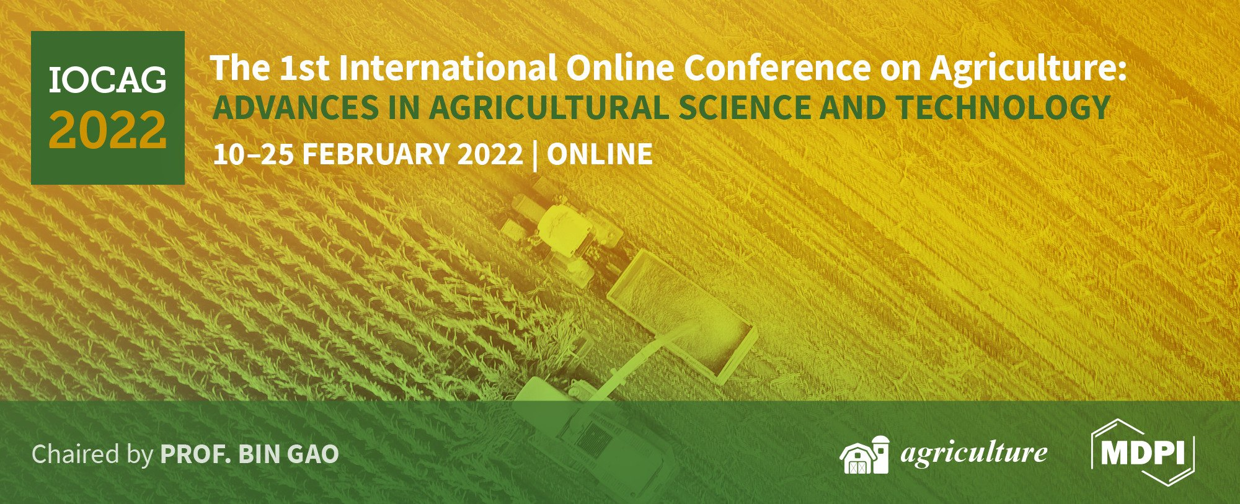





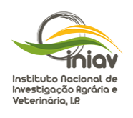

Monitorization through NDVI of a rice (Oryza sativa L.) culture production in Ribatejo region
Ana Coelho Marques^{1,2}*, Inês Carmo Luís^{1,2}, Ana Rita F. Coelho^{1,2}, Cláudia Campos Pessoa^{1,2}, Diana Daccak^{1,2}, Manuela Simões^{1,2}, Ana Sofia Almeida^{2,3}, Paula Scotti Campos^{2,4}, José C. Ramalho^{2,5}, José Manuel N. Semedo^{2,4}, José Carlos Kullberg^{1,2}, Maria Graça Brito^{1,2}, Maria F. Pessoa^{1,2}, Fernando H. Reboredo^{1,2}, Paula Marques⁶, Maria Manuela Silva^{2,7}, Paulo Legoinha^{1,2}, Karliana Oliveira², Isabel P. Pais^{2,4} and Fernando C. Lidon^{1,2}
¹ Earth Sciences Department, Faculdade de Ciências e Tecnologia, Universidade Nova de Lisboa, Campus da Caparica, 2829-516 Caparica, Portugal
² GeoBioTec Research Center, Faculdade de Ciências e Tecnologia, Universidade Nova de Lisboa, Campus da Caparica, 2829-516 Caparica, Portugal
³ Instituto Nacional de Investigação Agrária e Veterinária, I.P. (INIAV), Avenida da República, Quinta do Marquês, 2780-157 Oeiras, Portugal
⁴ Instituto Nacional de Investigação Agrária e Veterinária, I.P. (INIAV), Estrada de Gil Vaz 6, 7351-901 Elvas, Portugal
⁵ PlantStress & Biodiversity Lab., Centro de Estudos Florestais (CEF), Instituto Superior Agronomia (ISA), Universidade de Lisboa (ULisboa), Quinta do Marquês, Av. República, 2784-505, Oeiras and Tapada da Ajuda, 1349-017 Lisboa, Portugal
⁶ Centro Operativo e Tecnológico do Arroz (COTARROZ), 2120-014 Salvaterra de Magos, Portugal
⁷ Escola Superior de Educação Almeida Garrett (ESEAG-COFAC), Avenida do Campo Grande 376, 1749-024 Lisboa, Portugal
* Corresponding author: amc.marques@campus.fct.unl.pt

Slide 2
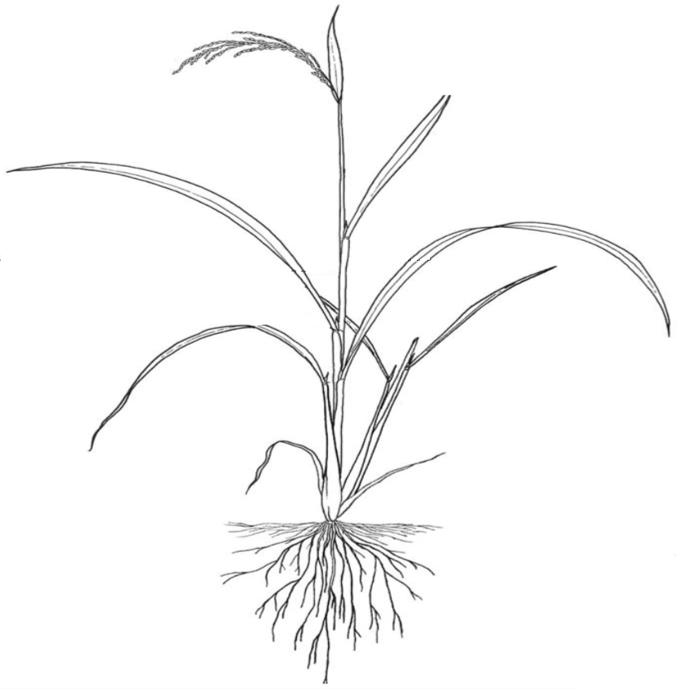

Monitorization through NDVI of a rice (Oryza sativa L.) culture production in Ribatejo region
Plants
Orthophotomap
Normalized vegetation index (NDVI)
Leaf gas exchange parameters
Soil
Humidity
Organic matter
pH
Electrical conductivity
Colorimetric parameters
Oryza sativa L.

Slide 3
Abstract: Remote sensed data has already an important role in crop management. In fact, NDVI (normalized difference vegetation index) has been use for staple crop management and monitorization since 80’s, namely in rice, wheat and maize. Accordingly, this study aimed to monitor, through precision agriculture, the development of a highly produced and consumed rice genotype in Portugal (Ariete variety), submitted to a selenium biofortification workflow. Rice biofortification was promoted during the production cycle, and assessed after two foliar applications with selenium (sprayed with 50 and 100 g Se.ha⁻¹ of sodium selenite). In this context, NDVI showed a high and identical value between control and biofortified plants, which indicated that the culture dis-played a higher vigor and was in a healthy state of development despite foliar applications. Analyzes were further carried out for monitor the mobilization of photoassimilates, showing that plants did not demonstrate any negative impact on net photosynthesis and there was even a slight rise in the treatments. Additionally, to characterize the soil of the paddy rice field, some parameters were also analyzed, namely, organic matter, humidity, pH and electrical conductivity, being found that the parameters ranged between from 1.085 - 1.575 %, 12.05 - 17.45 %, 5.70 – 6.20, respectively while the average conductivity was 223.4 µS cm⁻¹. Concerning to soil color, and considering the parameters L, a* and b* of the CIELab scale, significantly higher values in samples without humidity and without humidity and organic matter were found. In spite of the differences found, it is concluded that biofortification process did not affect any physiological parameters (net photosynthesis – Pn, stomatal conductance to water vapor - gs, transpiration rates - E and instantaneous water use efficiency - iWUE) in rice plants.
Keywords: NDVI; Precision Agriculture; Rice; Selenium biofortification

Slide 4
Introduction
In Portugal, rice (Oryza sativa L.) production is more significant in areas located near the estuaries of the rivers Tejo, Sado, and Mondego, where the edaphoclimatic factors are more suitable [1,2]. Considering the unique and favorable conditions for rice cultivation in Portugal and the concern for growing and sustainable production, smart farming technologies emerge as a tool to support this whole process. Normalized vegetation indices (NDVI) are relatively simple algorithms determined by high correlations with the biophysical characteristics of plants [2].
These data allow assessing crop vigor and growth dynamics or plant cover. Remote sensing in agriculture allows to estimate yields, evaluate the nutritional and hydric state of plants [3], detect pests and diseases [4] as well as delimit areas associated with higher weed emergence density so that it is possible to perform differentiated treatments. In addition, these platforms allow the monitoring of large areas such as paddy rice fields. Selenium (Se) is an essential element in the human diet but the presence in plants is scarce [5] and biofortification is considered one of the most outstanding example of agronomic intervention [6].
Studies pointed on Se rice biofortification have indicated that selenite is more effective than selenate [7]. Studies show that the assessment of leaf gas exchange parameters combined with remote sensing data provides important inputs in biofortification processes [8].

Slide 5
Introduction
In fact, the bioavailability of Se in soil is directly related to its content in plants [9]. Plant micronutrient availability decreases as soil pH approaches 8 [10]. As such, plants adapt intolerance to alkaline or acid soil conditions, however, they would rather near neutral pH. It is near this pH that the activity of microorganisms is greatest [10]. The soils in Portugal generally have a low organic matter content [11], with a tendency for its progressive decrease, as a result of climatic conditions favorable to its decomposition [12].
Accordingly, considering the increasing importance of precision technologies, this work aimed to implement and monitor agronomic biofortification (by foliar pulverization of sodium selenite) while evaluating the plant vigor and photosynthetic metabolism.

Slide 6
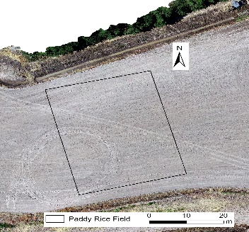
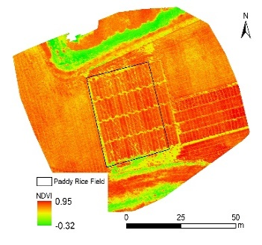
Results
In paddy rice field the application of sodium selenite did not show a negative impact on the level of plant vigor (Figure 1a). In the normalized vegetation index values, there were no significant differences (Figure 1b) regarding control.
Treatments (g Se.ha⁻¹) | NDVI
Control | 0.799a ± 0.060
50 | 0.803a ± 0.050
100 | 0.802a ± 0.055
(a)
(b)
Figure 1. Orthophotomap and normalized vegetation index (NDVI) obtained from images of UAV’s (n = 12) of Oryza sativa (Ariete variety) after the 2nd application of 50 and 100 g Se.ha⁻¹ sodium selenite (a). Mean values of NDVI ± standard deviation (b). Information collected at 12 September 2018. Letter a indicate the absence of significant differences among treatments (P ≤ 0.05).

Slide 7
Results
The plants did not show a negative impact on Pn after pulverization with Na2SeO3, regardless of the dose (50 or 100g Se.ha⁻¹), however shows a marginal increase in Pn (Tabela 1). The sprayed plants showed higher gs and E, particularly with increasing dose, regarding to the control. As a consequence of the increase in gs and E, iWUE values decreased from 4.15 to 2.44 CO₂ mol⁻¹ H₂O.
Table 1. Leaf gas exchange parameters – net photosynthesis (Pn), stomatal conductance to water vapor (gs), transpiration (E) rates and instantaneous water use efficiency (iWUE=Pn/E) in leaves of Oryza sativa, variety Ariete. Average values ± standard errors (n = 4-6). Letters a, b and c indicate significant differences between treatments (P ≤ 0.05).

Slide 8
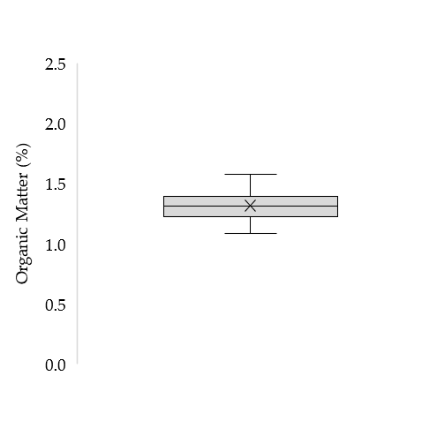
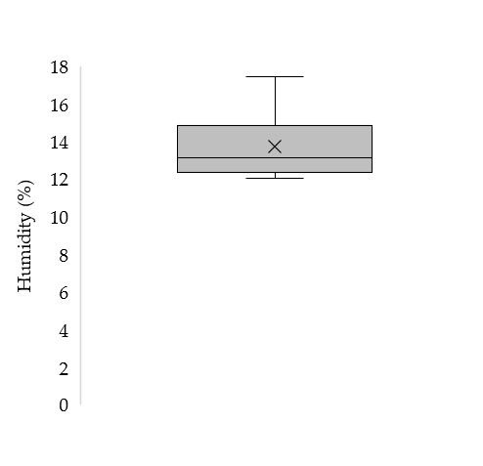
Results
In the paddy rice field some soil chemical properties were analyzed (Figure 2). Regarding, the organic matter content, the values obtained ranged from 1.085-1.575% (Figure 2a). The minimum humidity value registered was 12.05% while the maximum value was 17.45% (Figure 2b). The pH ranged from 5.7 to 6.2, while the average electrical conductivity was 223.4 µS cm⁻¹ (varied from 144.6 to 428.0 µS cm⁻¹).
(a)
(b)
Figure 2. Average soil parameters ± standard deviation (n = 16) of organic matter (a) and humidity (b) of the paddy rice field.
The analysis of the colorimetric parameters showed significant differences on the CIELab scale (L, a* and b*) (Table 2). Regarding the a* and b* parameters, both samples revealed red and yellow colors, respectively. The data obtained in the samples without humidity and organic matter are significantly highest compared in the samples without humidity.
Table 2. Colorimeter parameters of the paddy rice field soil without humidity (A) and without humidity and organic matter (B) ± standard deviation (n = 4). Letters a and b indicate significant differences among treatments (P ≤ 0.05).

Slide 9
Discussion
In this study, the NDVI values of the selenium treated plants showed no significant changes compared to the control (Figure 1). NDVI values can range from -1 to 1, and thus higher values indicate healthy crop plants [20]. Since all treatments showed values of approximately 0.8 (including the control) this suggests that the application of sodium selenite did not negatively impact crop vigor. In this case, selenite pulverization enters the plant through the cuticle or via stomata [21].
Based on this, it was necessary to complement leaf gas exchange parameters data. In this analysis, the plants showed no negative impact on Pn and a slight increase, compared to the control (Table 1). Additionally, the increase in the dose of selenium applied increased the values of gs and E, regarding the control. Comparing the NDVI data with leaf gas ex-change parameters, it is possible to verify that selenium stimulates net photosynthesis [22].
Considering that soil conditions have direct implications on the cultivation of rice plants, soil analyses showed that the paddy rice field was to be suitable for crops management at the pH and conductivity level. According to the literature, soils with a pH around neutral are suitable for rice production [23]. Our findings fall within this pH range (5.70 - 6.20). The electrical conductivity obtained was less than 600 µS cm-1, which is in accordance with the recommended value for the conductivity of soils where crops are to be grown [11]. The electrical conductivity depends, among other properties, on soil humidity [24]. The rate of decomposition of organic matter is a result of high temperature and precipitation which promotes the release of nutrients to the soil [10].
Using the CIELab system a connection between soil color and organic matter content (pigment substances) is established numerically. [26]. Furthermore, organic matter showed (Figure 2) an impact in the colorimeter parameters on the CIELab scale (L, a* and b*) (Table 2). The b* value tends towards yellow, a lighter color, which allows the conclusion that the soil has less humus [25]. The organic carbon content affects the parameters L *, a *, and b* of the soils [25]. This approach may justify the significant changes in the samples after burning (without humidity and organic matter).

Slide 10
Conclusions
Foliar application of the 50 and 100 g Se.ha⁻¹ of sodium selenite in Ariete variety did not affect the NDVI values of the plants, which was verified in the absence of any negative impact.
The vigor of rice plants showed high values, compared to the control. Net photosynthesis showed a slight rise in the treatments however plants did not demonstrate any negative impact.
Regarding to soil characterization, organic matter, humidity, pH and electrical conductivity were considered.
The colorimetric in-dices revealed significant differences when comparing soil samples without humidity with samples without humidity and organic matter.
Despite the differences found, it is concluded that biofortification process did not affect any physiological parameters studied in the rice plants.

Slide 11


Acknowledgments
Authors thanks to Paula Marques, Cátia Silva (COTArroz) and Orivárzea (Orizicultores do Ribatejo, S.A.) for technical assistance.
We also thanks to the Research centers (GeoBioTec) UIDB/04035/2020 and (CEF) UIDB/00239/2020 for support facilities.

