Slide 1
Food supply chain traceability: A multiple case study from Alto Tietê Region, Brazil
Lucas Era ¹, Sivanilza Machado ^{2,}*, and Luiz Kawamoto Jr. ²
¹Postgraduate in Logistics and Operation, Federal Institute of São Paulo; lucashideoera@hotmail.com
² Management and Business Department, Federal Institute of São Paulo; teruo@ifsp.edu.br
* Corresponding author: sivanilzamachado@ifsp.edu.br

Slide 2
Abstract: The traceability is one way to food supply chain transparency. However, when the food is produced by family farmers, considering in communities with low levels of education and lack of TI infrastructure, traceability becomes a major challenge. This article verified the adequacy of the family farmer to the traceability of the food production chain, through the application of a multiple case study in Alto Tietê region, Brazil. The results showed that most farmers have incomplete elementary education (55%), work practically alone in production and they are unable to carry out traceability due to the lack of pesticide registration, which makes implementation unfeasible even if the community has IT infrastructure
Keywords: food safety; production control; process quality; supply chain transparency.
This paper aims to investigate the adequacy of the family farmer to the traceability process to guarantee the food supply chain transparency from farm to fork.

Slide 3
Materials and Methods
All family farmers should answered about social economics and productions process aspect, as well as food supply chain traceability and the governments requirements.
The data was collected in March 2021 following the design of interview
Maped the family farms in region
Selecting family farms by convenience
Research Objective presentation
Applying the semi-structured questionnaire (closed and open questions)
Informed Consent Statement obtained

Slide 4
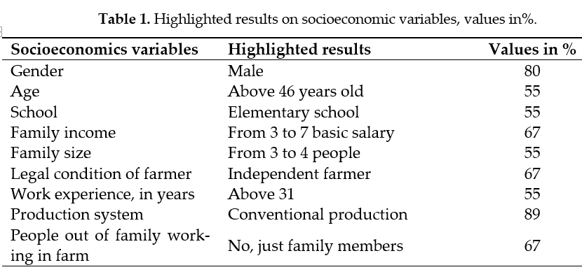
Results and Discussion

Slide 5
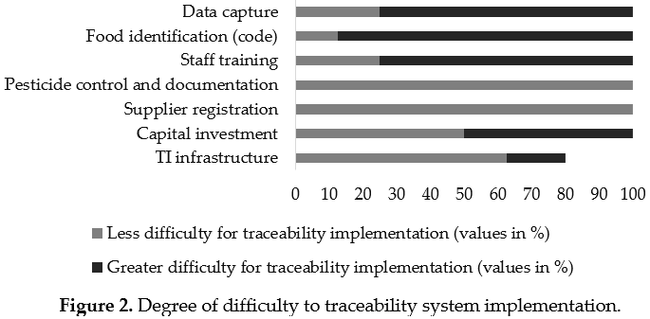
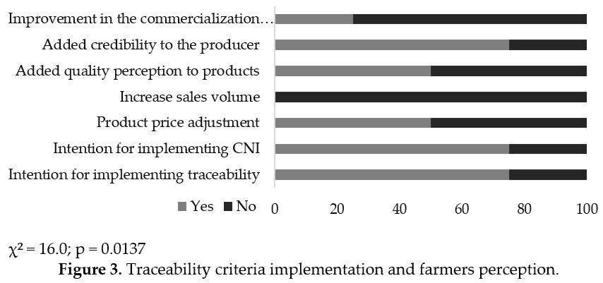
Results and Discussion
Just one farmer applied the traceability, but in 1% of all production area, so the 99% of production is not traced.

Slide 6
Conclusions
1) lack of pesticide registration to use in agricultural production;
2) current commercialization design that allow lots product merge and this is inconsistent with traceability premise;
3) lack of government support and training people; and
4) high investment by family farmer and no payback expectative, in other words, the costs is not transfer to the market.

Slide 7
References
[1] Patidar, A.; Sharma, M.; Agrawal, R. Prioritizing Drivers to Creating Traceability in the Food Supply Chain. Procedia CIRP, 2021, 98, 690–695.
[2] Ferreira, V. B.; Silva, T. T. C. da; Garcia, S. R. M. C.; Srur, A. U. O. S. Estimation of Organophosphate Pesticide Ingestion through Intake of Fruits and Vegetables. Cad. Saúde Coletiva, 2018, 26 (2), 216–221.
[3] Anvisa, A. N. de V. S. Instrução Normativa Conjunta Nº 2, de 7 de fevereiro de 2018
[4] Anvisa, A. N. de V. S. Instrução Normativa Conjunta Nº 1, de 15 de Abril de 2019. 2019.
[5] IBGE - Instituto Brasileiro de Geografia e Estatística. Censo Agro 2017 https://censos.ibge.gov.br/agro/2017/resultados-censo-agro-2017.html.
[6] Paes, R. da S.; Zappes, C. A. Agricultura Familiar No Norte Do Estado Do Rio de Janeiro: Identificação de Manejo Tradicional. Soc. Nat., 2016, 28 (3), 385–395.
[7] IBGE - Instituto Brasileiro de Geografia e Estatística. Censo Agropecuário Mogi das Cruzes https://cidades.ibge.gov.br/brasil/sp/mogi-das-cruzes/panorama.
[8] Astill, J.; Dara, R. A.; Campbell, M.; Farber, J. M.; Fraser, E. D. G.; Sharif, S.; Yada, R. Y. Transparency in Food Supply Chains: A Review of Enabling Technology Solutions. Trends Food Sci. Technol., 2019, 91, 240–247.
[9] Aung, M. M.; Chang, Y. S. Traceability in a Food Supply Chain: Safety and Quality Perspectives. Food Control, 2014, 39 (1), 172–184.
[10] Fávero, L. P.; Belfiore, P. Manual de Análise de Dados, 1ª.; LTC: Rio de Janeiro, 2021.
[11] Savian, M. Sucessão Geracional: Garantindo-Se Renda Continuaremos a Ter Agricultura Familiar? Rev. Espaço Acadêmico, 2014, 14 (159), 97–106.
[12] Fonseca, W. L.; Fonseca, W. J. L.; Oliveira, A. A.; Vogado, G. M. S.; Sousa, G. G. T.; Sousa, T. O.; Sousa Júnior, S. C.; Luz, C. S. M. Causas e Consequências Do Êxodo Rural No Nordeste Brasileiro. Nucleus, 2015, 12 (1), 233–240.
[13] Kageyama, A.; Hoffmann, R.; Kageyama, A.; Hoffmann, R. Determinantes Da Renda e Condições de Vida Das Famílias Agrícolas No Brasil. Economia, 2000, 1 (2), 147–183.
[14] Silva, G. J. Metodologia Para Inovação Tecnológica Através de Sistema Colaborativo de Inclusão Digital e Certificação Na Agricultura Familiar, Universidade Estadual Paulista, Faculdade de Ciências Agronômicas de Botucatu – UNESP, 2009.
[15] de Almeida, A. C.; dos Santos, C. A.; Menezes, I. R.; Teixeira, L. M.; Costa, J. P. R.; de Souza, R. M. Perfil Sanitário de Unidades Agrícolas Familiares Produtoras de Leite Cru e Adequação à Legislação Vigente. Ciência Anim. Bras., 2016, 17 (3), 303–315.
[16] Carvalho, F. A. de. Inclusão Digital: A Influência Do Ensino de Informática Como Contribuição à Gestão Rural, FUNDAÇÃO UNIVERSIDADE FEDERAL DE RONDÔNIA, 2013.3

Slide 8
Acknowledgments
Family farmers
Contact:
Lucas Era
E-mail: lucashideoera@hotmail.com
Contact of Supervisor:
Sivanilza Machado
E-mail: sivanilzamachado@ifsp.edu.br

