Slide 1
Antioxidant Capacity with Physical Property Variations of Morinda citrifolia L. Juice in Traditional Fermentation
Eng. (Mrs.) Malsha H. Samarasiri Eng. Thushitha A. Chandrasiri,
Eng. Diunuge B. Wijesinghe Prof. (Mrs.) Sanja P. Gunawardena
Department of Chemical & Process Engineering | Department of Computer Science & Engineering
University of Moratuwa, Sri Lanka

Slide 2
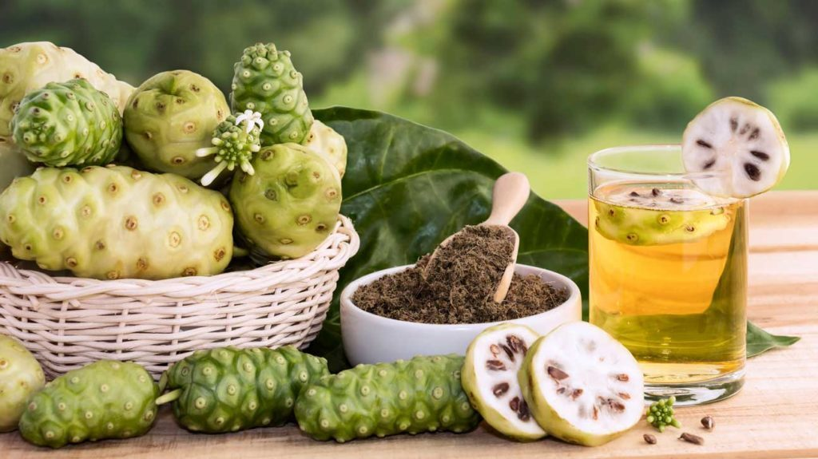
Outline of Presentation
Background
Research problem
Objectives
Methodology
Results
Conclusions
References

Slide 3
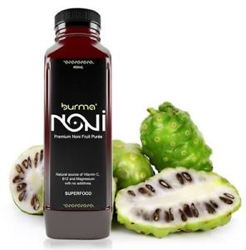
Noni (Morinda citrifolia L.) Fruit
Unripe fruit – hard & bright green
Noni juice
Ripe fruit – translucent & white/yellowish
One of underutilized fruits

Slide 4
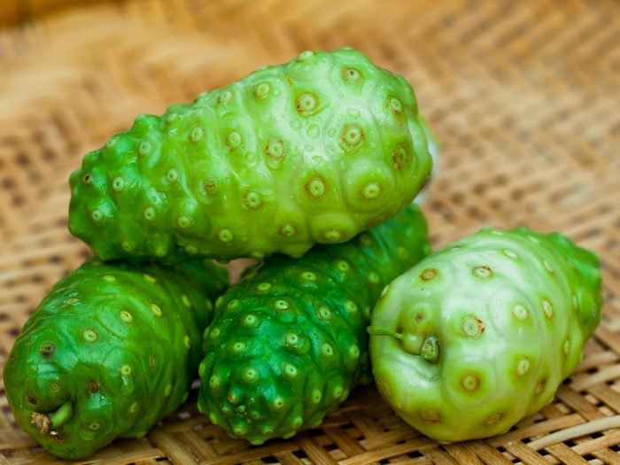
Introduction
Amazing therapeutic & nutritional value.
Contains phytochemicals to prevent/cure diseases.
Studying variation of physical parameters during traditional fermentation of noni juice (pH & temperature of juice, temperature & humidity of fermenter & juice level).
Identifying correlations between these physical properties with antioxidant capacity of noni juice.

Slide 5
Research Problem
Popular method for noni juice production - traditional fermentation (Usually 2 months).
How physical parameters vary with this time in fermentation of noni juice?
Antioxidant capacity of noni juice varies with the fermentation conditions. How is it correlated with the above physical properties?
Fermenter temperature
Juice temperature
pH of noni juice
Humidity of fermenter
Level of juice formed

Slide 6
Objectives
Determine whether there are significant variations of physical parameters with fermentation time.
Determine whether there are any significant correlations between physical parameters and antioxidant capacity of noni juice.

Slide 7
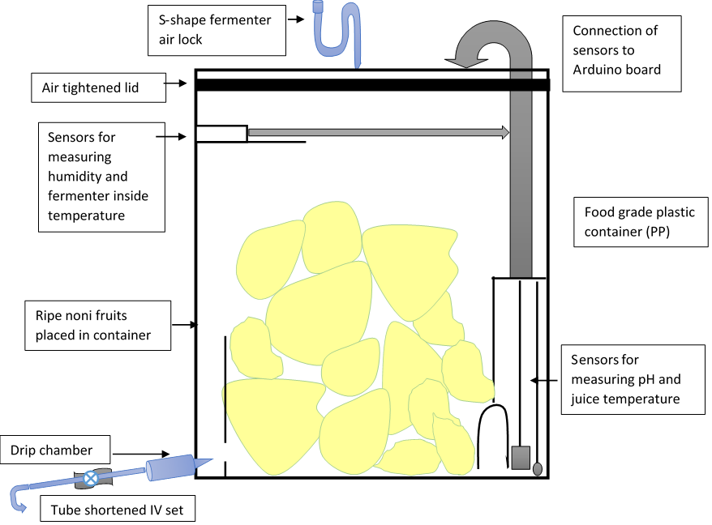
Methodology
Schematic Diagram of the Fermenter

Slide 8
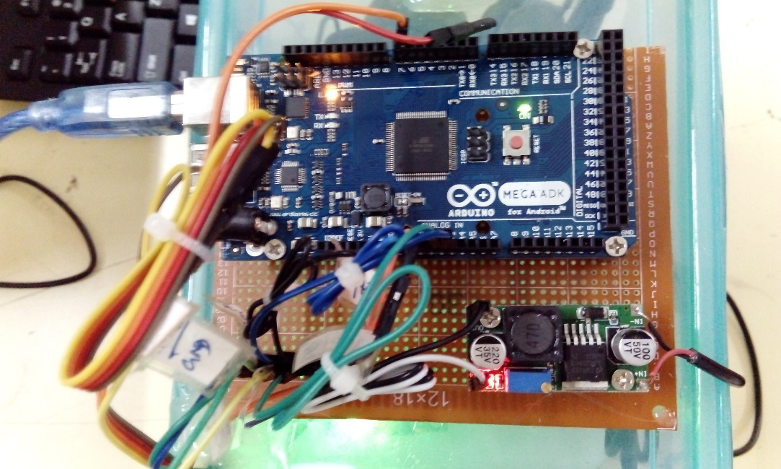
Fermenter Setup
After installing & starting execution of the coded program.
Arduino MEGA 2560 microcontroller board connected with sensors & attached to the top surface of the fermenter.

Slide 9
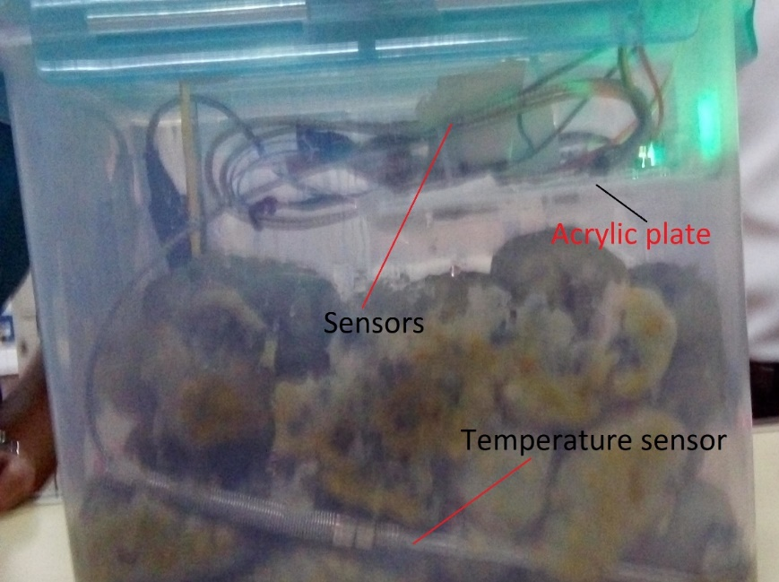
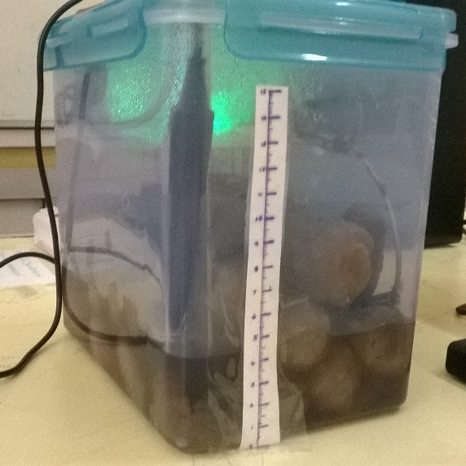
Determining variations of physical properties during traditional fermentation of noni juice is important.

Slide 10
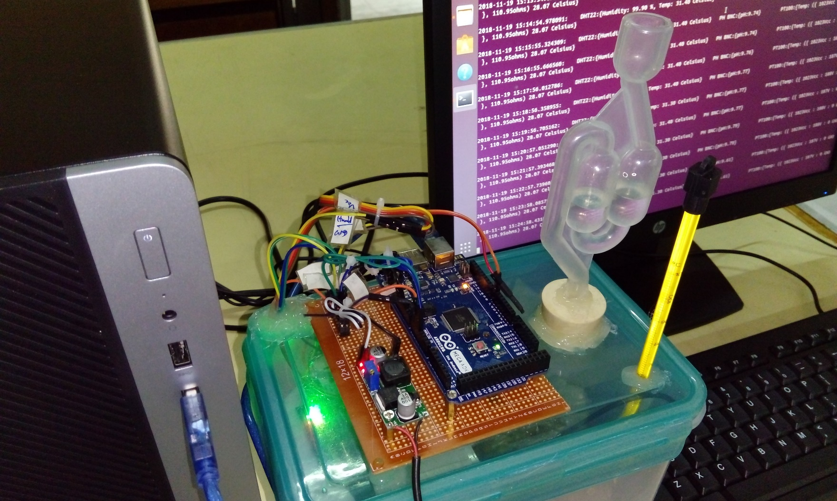
Top View of the Fermenter

Slide 11
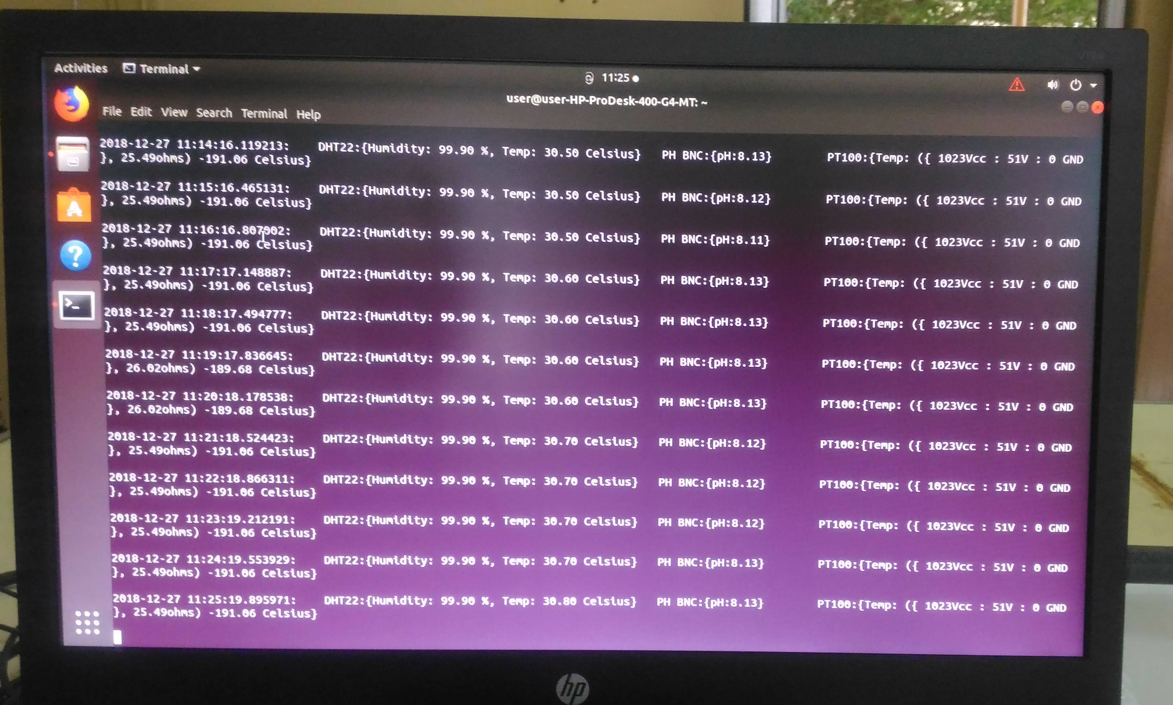
After installing & starting execution of the coded program.

Slide 12
Sensors Used to Measure the Physical Properties
Temperature of the fermenting juice :
PT100 RTD with Thermometer Sensor
pH of the fermenting juice :
Liquid PH Detect Sensor Module + PH Electrode Probe BN Arduino
Temperature & humidity in the fermenter:
DHT22/AM2302 Digital Temperature and Humidity Sensor
Level of formed noni juice : Reading manually

Slide 13
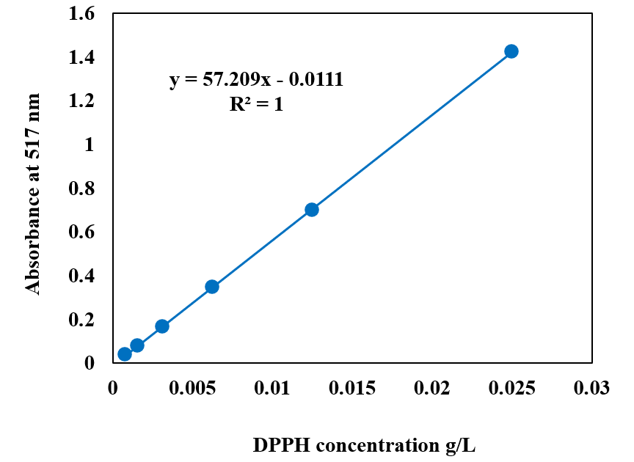
Variation of Antioxidant Capacity of Noni Juice
Measuring antioxidant capacity (AC) of noni juice every week for 2 months.
Determining AC by scavenging of DPPH free radicals as explained by Brand-Williams.
Determination of remaining DPPH concentrations in noni juice by using an experimentally derived standard curve of DPPH concentration vs absorbance

Slide 14
Correlation of Physical Properties and Antioxidant Capacity of Noni Juice
Average data of these physical properties of noni juice were then analysed for their correlations with antioxidant capacity of noni juice.
Correlation was determined by calculating Distance Correlation Coefficients for the obtained data.
Distance Correlation or Distance Covariance is a measure of dependence between two paired random vectors of arbitrary, not necessarily equal, dimension.

Slide 15
Mathematical Equations Used for Correlation Calculation
1
2
3
4
5
6
7
8

Slide 16
Calculation of Distance Correlation Coefficients
Distance correlations of each physical property with antioxidant capacity were calculated as follows.
Calculating n by n distance matrices (a_{j, k}) and (b_{j, k}) containing all pairwise distances by 1 & 2.
a_{j, k} matrices - for each physical property & b_{j, k} matrix - for antioxidant capacity
Computing all doubly centered distances by 3 & 4 for computed distance matrices.
Calculating squared sample distance covariance by 5.
Calculating corresponding squared sample variances by 6 & 7.
Computing distance correlation (R_{n}(X,Y)) of two random vectors by dividing their distance covariance by the product of their distance standard deviations by 8.

Slide 17
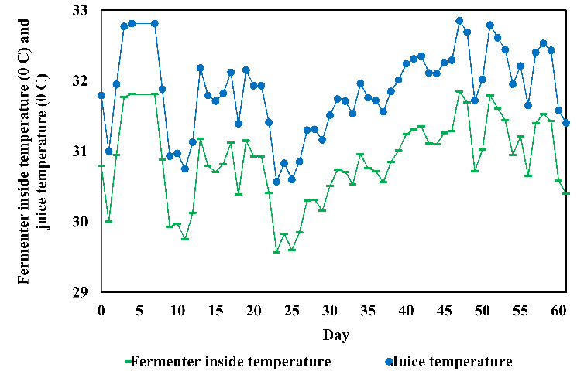
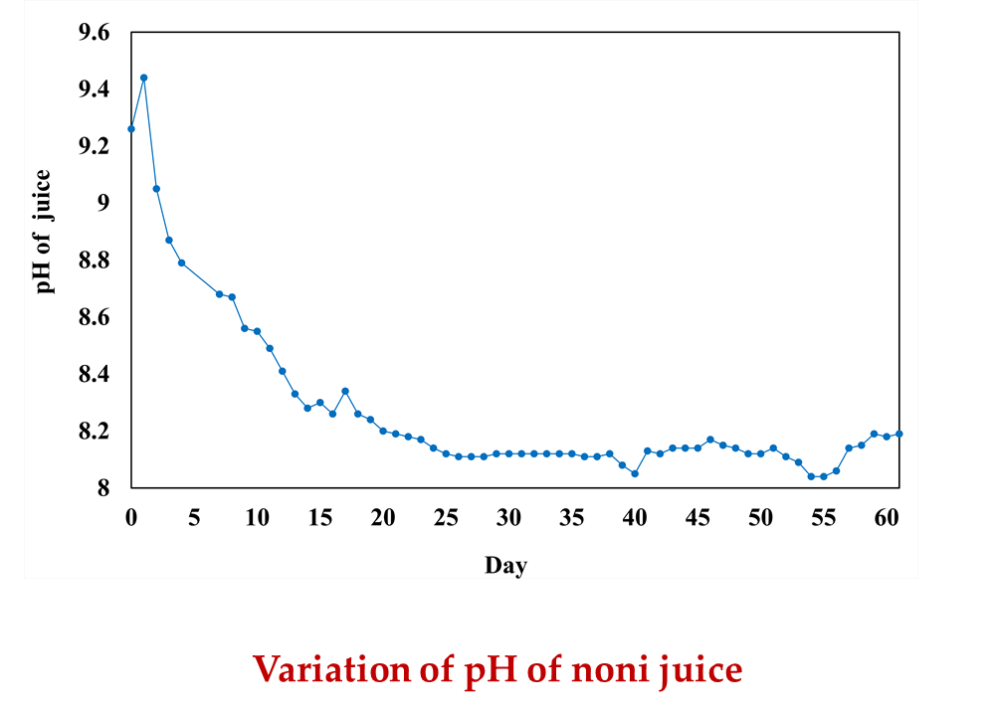
Results
Variations of physical properties during traditional fermentation of noni juice
Variations of juice temperature & fermenter inside temperature

Slide 18
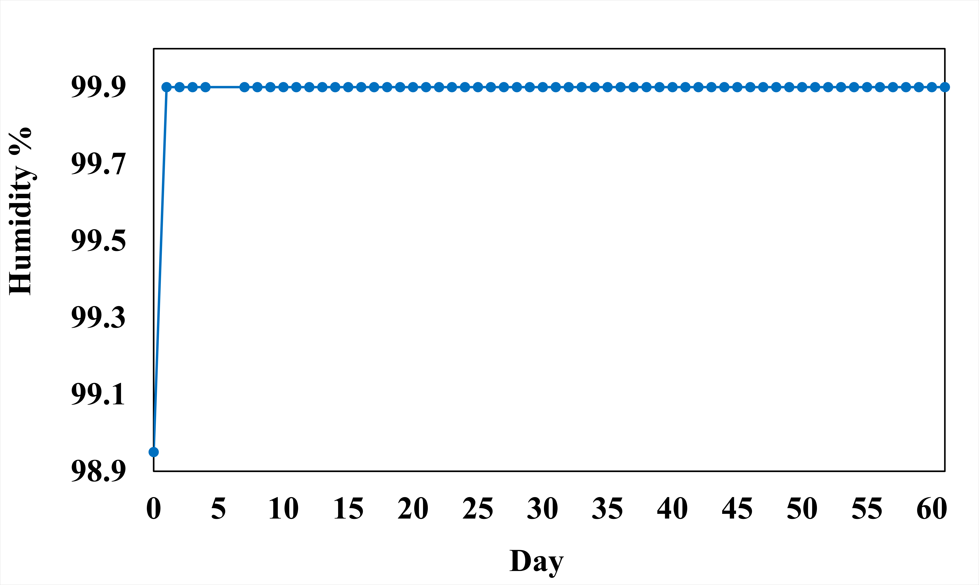
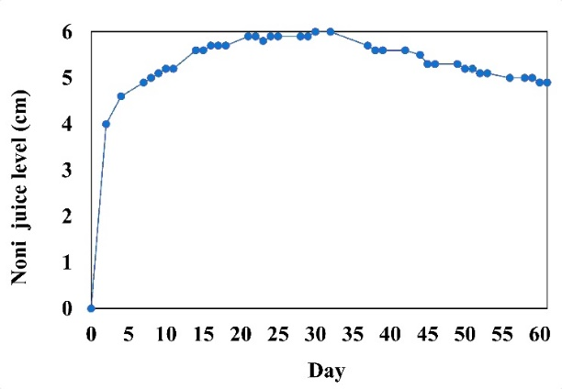
Variations of physical properties during traditional fermentation of noni juice
Variations of humidity within fermenter
Variations of noni juice level

Slide 19
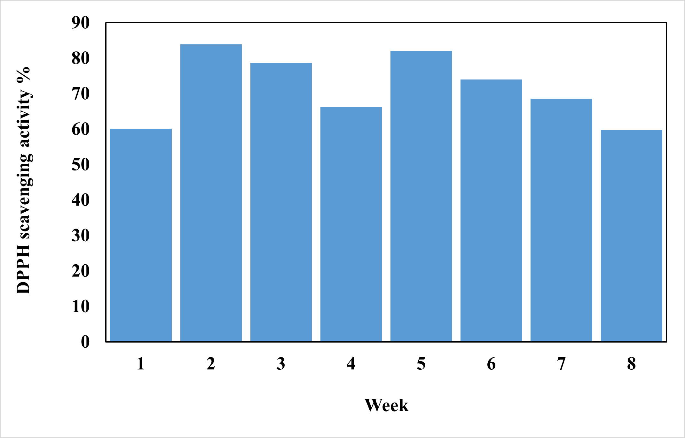
Variation of antioxidant capacity of noni juice during traditional fermentation

Slide 20
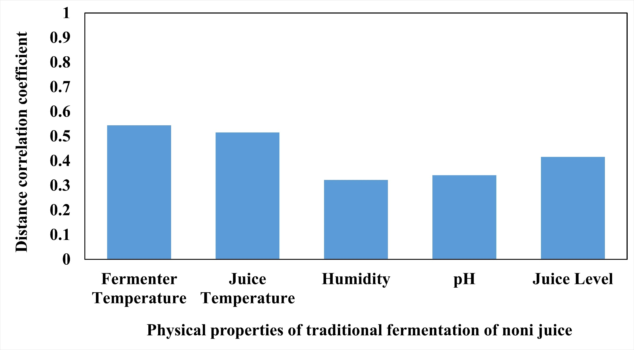
Distance correlation coefficients of physical properties of traditional fermentation of noni juice with its antioxidant capacity.
To have strong correlations, below properties should have large values of distance correlation coefficients which are close to 1.

Slide 21
Conclusions
Strong correlations did not exist in each physical parameter with the antioxidant capacity of noni juice.
Patterns of variations of physical properties during traditional fermentation of noni juice were different from the variation of antioxidant capacity which was maximum at 2nd week of traditional fermentation.

Slide 22
References
Meilawati, L.; Ernawati, T.; Dewi, R.; Megawati, M. and Sukirno, S. Study of Total Phenolic, Total Flavonoid, Scopoletin Contents and Antioxidant Activity of Extract of Ripened Noni Juice. Jurnal Kimia Terapan Indonesia 2021, 23, 55-62.
Krishnaiah, D.; Bono, A.; Sarbatly, R.; Anisuzzaman, S. Antioxidant activity and total phenolic content of an isolated Morinda citrifolia L. methanolic extract from Poly-ethersulphone (PES) membrane separator. J. King Saud Univ. Eng. Sci. 2015, 27, 63-67.
Yang, J.; Paulino, R.; Janke-Stedronsky, S.; Abawi, F. Free-radical-scavenging activity and total phenols of noni (Morinda citrifolia L.) juice and powder in processing and storage. Food Chem. 2007, 102, 302-308.
Yang, J.; Gadi, R.; Paulino, R.; Thomson, T. Total phenolics, ascorbic acid, and antioxidant capacity of noni (Morinda citrifolia L.) juice and powder as affected by illumination during storage. Food Chem. 2010, 122, 627-632.
Sirilun, S.; Sivamaruthi, B. S.; Kesika, P.; Makhamrueang, N.; Chaiyasut, K.; Peerajan, S.; and Chaiyasut, C. Development and evaluation of Mustard green pickled liquid as starter for Morinda citrifolia Linn. Fermentation. Int. Food Res. J. 2017, 24, 2170–2176.
Sina, H.; Dramane, G.; Tchekounou, P.; Assogba, M.; Chabi-Sika, K.; Boya, B.; Socohou, A.; Adjanohoun, A. and Baba-Moussa, L. Phytochemical composition and in vitro biological activities of Morinda citrifolia fruit juice. Saudi J. Biol. Sci. 2021, 28, 1331-1335.
Brand-Williams, W.; Cuvelier, M.; Berset, C. Use of a free radical method to evaluate antioxidant activity. LWT - Food Sci Technol 1995, 28, 25-30.
Samarasiri, M.; Chandrasiri, T.; Wijesinghe, D.; Gunawardena, S. Antioxidant Capacity and Total Phenolic Content Variations
Székely, G.; Rizzo, M.; Bakirov, N. Measuring and testing dependence by correlation of distances. Ann. Stat. 2007, 35.
Konsue, N.; Yimthiang, S.; & Kwanhian, W. Effect of fermentation conditions of noni (Morinda citrifolia L.) juice on glutathione content and lipid oxidation in vero cells. Int. Food Res. J. 2018, 25, 1534–1540.

Slide 23
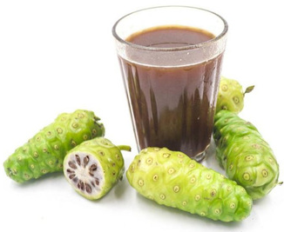
Thank You !

