Slide 1
Grassland reseeding-improving grassland productivity and reducing soil surface phosphorus accumulations
Emma Hayes¹, Suzanne Higgins², Josie Geris³ and Donal Mullan¹
¹ Queen’s University Belfast, UK
² Agri-Food and Bioscience Institute
³ University of Aberdeen, UK

Slide 2
Research Context
Issues exist with current approaches used for water quality improvement
These fail to address ongoing accumulation of nutrients and the approaches used for reducing in-field soil nutrient accumulations have issues for practical farming implementation
Long-term phosphorus (P) accumulations within agricultural soils are concerning for water quality improvement
Achieving the EU WFD is difficult due to point and diffuse soil P sources
Wide sub-field scale P variability exists

Slide 3
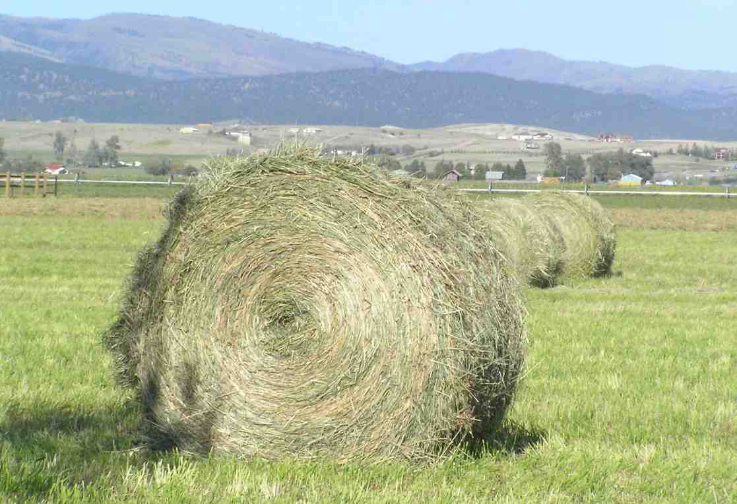
Reducing Soil Nutrient Accumulations
Research shows wide timeframes for soil P decline rates of 3-20 years, it may be several decades before any impacts are seen on water quality status ¹¯³
Increased silage cuts and zero-P applications are the quickest methods currently used, but such cuts of elevated nutrient content must be sold off to farms of deficient soil nutrient status
Complexities arise for zero-P applications as farms must remove waste slurries and manures from the farmyard and the actions of livestock grazing can introduce nutrient returns via excretion

Slide 4
Conventional approaches have issues for practical farm implementation, but to improve water quality a rapid solution to reduce nutrient accumulations is needed

Slide 5
Grassland Reseeding and Tillage
Previous research has shown the potential for reseeding and tillage inversion as a means to reduce soil P accumulations ⁴¯⁶
Tillage has an immediate effect with the vertical stratification of soil P ⁵
Few studies have looked at changes in sub-field scale soil nutrient content before and after reseeding to explore the effects of reseeding and tillage to reduce soil nutrient accumulations

Slide 6
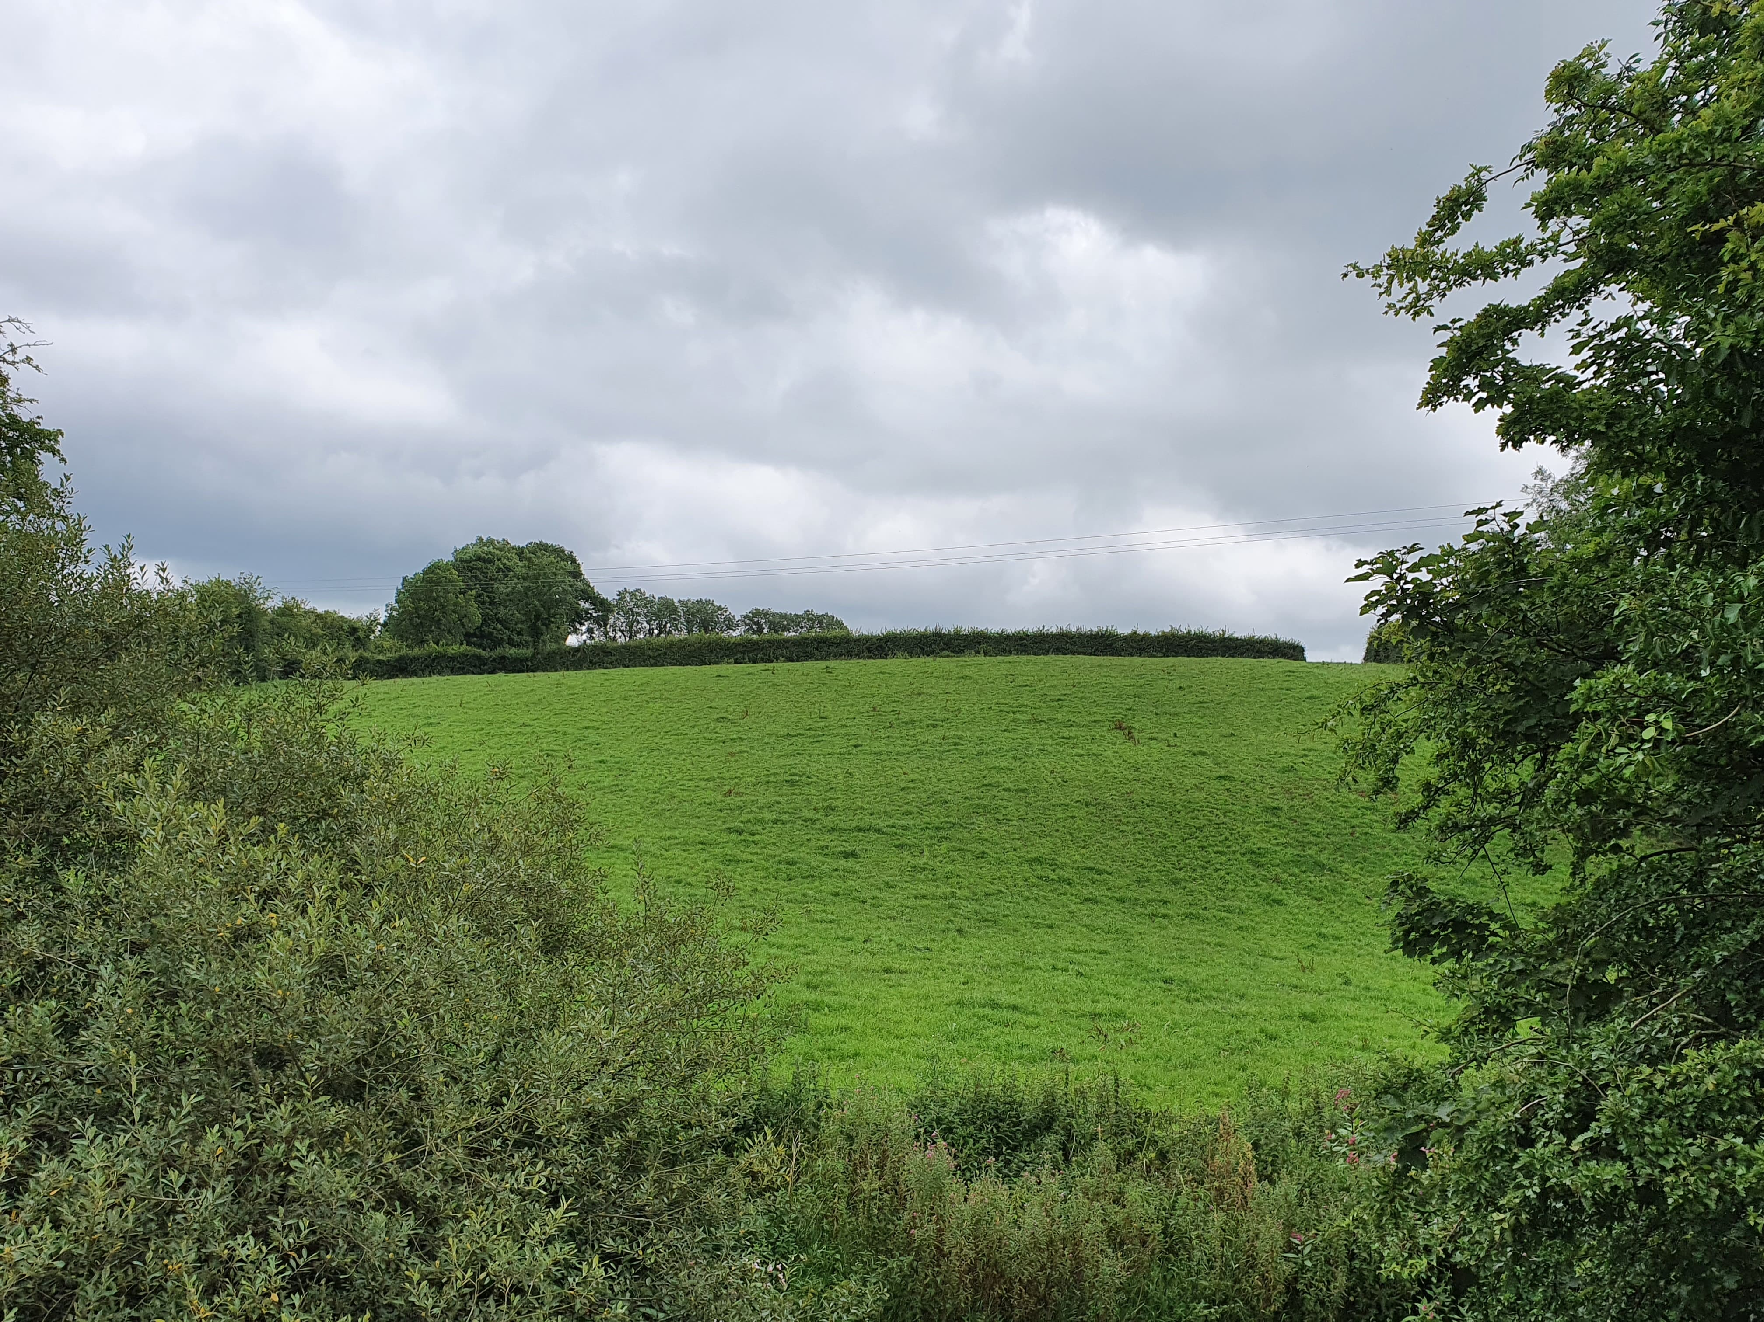
Research Area
Research Methods
Blackwater catchment-90% land use as agricultural ⁷
Focus on a site used for wider unpublished research on sub-field scale variability in soil P content
Site underwent reseeding and tillage in spring-summer 2020 period
Usage of 35 m gridded soil sampling and GIS-based interpolation of ordinary kriging to visualise nutrient content ⁸
Soil sampling to a depth of 7.5 cm before reseeding (January 2020) and after reseeding (February 2021)
Soil nutrients of phosphorus (P), potassium (K), magnesium (Mg), and sulphur (S) analysed
Site in August 2020 following reseeding

Slide 7
Effects of Reseeding and Tillage on Soil Nutrient Content
Comparisons between soil nutrient content (mgl¯¹) in Table 1 before and after reseeding showed largely decreases in soil nutrient content
Sample Point ID | Soil P Content | Soil K Content | Soil Mg Content | Soil S Content
4301 | 36.67% decrease | 2.86% decrease | 0.85% increase | 8.88% increase
4302 | 30.00% decrease | 7.69% decrease | 6.60% decrease | 4.87% decrease
4303 | 11.90% decrease | 32.30% decrease | 17.29% decrease | 9.10% decrease
4304 | 52.00% decrease | 37.50% decrease | 14.19% decrease | 18.88% decrease
4305 | 5.08% increase | 4.55% increase | 6.89% decrease | 0.78% decrease
4306 | 47.66% decrease | 24.14% decrease | 14.78% increase | 25.65% decrease
Table 1. Calculated percentage change in soil nutrient content (mgl¯¹) from 2020 to 2021 per gridded sample point for Site 3 sub-field C.

Slide 8
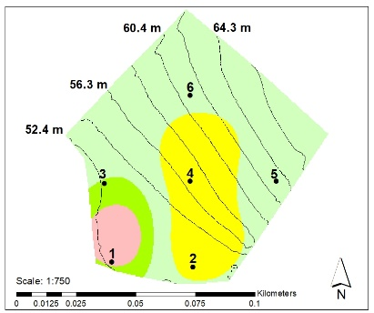
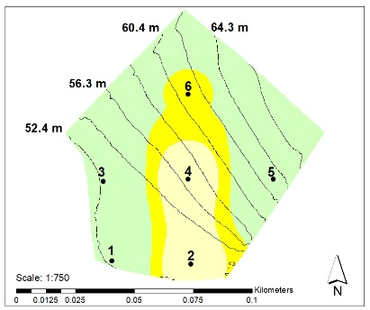
Effects of Reseeding and Tillage on Soil Nutrient Content
Visualising reductions in soil nutrient accumulations is particularly evident for interpolated soil P
Figure 1a shows soil P content before reseeding with an Index 3 P hotspot present at the edge of sub-field C. Figure 1b shows that this hotspot has been removed following reseeding and tillage with increasing P deficiency evident at this site
(a)
(b)
Figure 1. Interpolated nutrient content for Site 3 sub-field C with (a) soil P content in 2020; (b) soil P content in 2021

Slide 9
Conclusions
Achieving the EU WFD requires changes to management of diffuse and point P sources
Given the long time-scales associated with traditional methods to reduce nutrient accumulations, the immediate effects of grassland reseeding and tillage is an innovative way to reduce soil surface nutrient accumulations
Future research must assess the associated risks of using reseeding as a tool for water quality improvement in terms of potential losses associated with soil erosion and runoff generation

Slide 10
Thank you all for listening
@EmmaHayes1998
ehayes07@qub.ac.uk

Slide 11
References
1. Schulte, R. P. O. et al. (2010) ‘Modelling soil phosphorus decline: Expectations of Water Framework Directive policies’, Environmental Science & Policy. Elsevier, 13(6), pp. 472–484. doi: 10.1016/J.ENVSCI.2010.06.002.
2. Bailey, J. S. (2015) ‘Assessing the effectiveness of manure export plus intensive silage cropping for lowering the Olsen-P status of P-enriched grassland’, Soil Use and Management. John Wiley & Sons, Ltd, 31(4), pp. 438–439. doi: 10.1111/SUM.12226.
3. Wall, D. P. et al. (2013) ‘Forecasting the decline of excess soil phosphorus in agricultural catchments’, Soil Use and Management. John Wiley & Sons, Ltd, 29(SUPPL.1), pp. 147–154. doi: 10.1111/J.1475-2743.2012.00413.X.
4. Baker, D. B. et al. (2017) ‘Vertical Stratification of Soil Phosphorus as a Concern for Dissolved Phosphorus Runoff in the Lake Erie Basin’, Journal of Environmental Quality. John Wiley & Sons, Ltd, 46(6), pp. 1287–1295. doi: 10.2134/JEQ2016.09.0337.
5. Sharpley, A. N. (2003) ‘Soil Mixing to Decrease Surface Stratification of Phosphorus in Manured Soils’, Journal of Environment Quality. Wiley, 32(4), p. 1375. doi: 10.2134/jeq2003.1375.
6. Watkins, M. et al. (2012) ‘Nitrogen and phosphorus changes in soil and soil water after cultivation’, Applied and Environmental Soil Science, 2012. doi: 10.1155/2012/157068.
7. Bastola, S., Murphy, C. and Sweeney, J. (2011) ‘The role of hydrological modelling uncertainties in climate change impact assessments of Irish river catchments’, Advances in Water Resources. Elsevier, 34(5), pp. 562–576. doi: 10.1016/j.advwatres.2011.01.008.
8. Shi, Z. et al. (2002) ‘Temporal changes in the spatial distributions of some soil properties on a temperate grassland site’, Soil Use and Management. John Wiley & Sons, Ltd, 18(4), pp. 353–362. doi: 10.1111/J.1475-2743.2002.TB00252.X.

