Slide 1
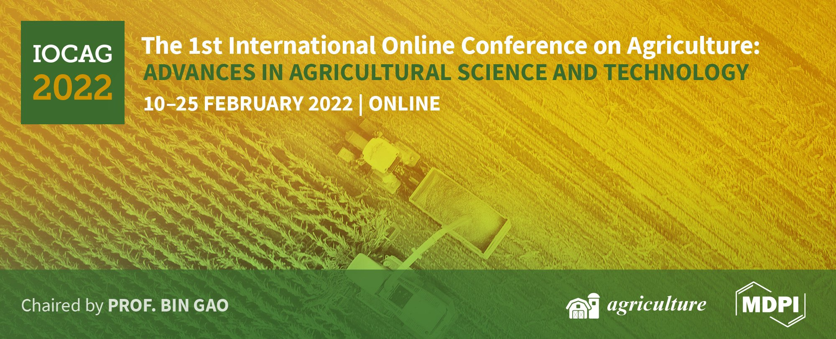
Comparison of soils of two fields for potato production located in the same region of Portugal
Ana Rita F. Coelho^{1,2}*, Diana Daccak^{1,2}, Ana Coelho Marques^{1,2}, Inês Carmo Luís^{1,2}, Cláudia Campos Pessoa^{1,2}, Maria Manuela Silva^{2,3}, Manuela Simões^{1,2}, Fernando H. Reboredo^{1,2}, Maria F. Pessoa^{1,2}, Paulo Legoinha^{1,2}, José C. Ramalho^{2,4}, Paula Scotti Campos^{2,5}, Isabel P. Pais^{2,5}, José N. Semedo^{2,5} and Fernando C. Lidon^{1,2}
¹ Earth Sciences Department, Faculdade de Ciências e Tecnologia, Universidade Nova de Lisboa, Caparica, Portugal;
² GeoBioTec Research Center, Faculdade de Ciências e Tecnologia, Universidade Nova de Lisboa, Caparica, Portugal;
³ Escola Superior de Educação Almeida Garrett, Lisboa, Portugal;
⁴ PlantStress & Biodiversity Lab, Centro de Estudos Florestais, Instituto Superior Agronomia, Universidade de Lisboa, Oeiras, Portugal;
⁵ INIAV, Instituto Nacional de Investigação Agrária e Veterinária, Oeiras, Portugal;
* Correspondence: arf.coelho@campus.fct.unl.pt;

Slide 2
Comparison of soils of two fields for potato production located in the same region of Portugal
Correlation between mineral elements
Field A
Soil
pH
Potato Production
Field B
Organic matter content
Electrical conductivity

Slide 3
Abstract: Soil is considered a highly complex ecosystem, providing food, and maintaining crop and animal productivities. Soil variability can affect plant production. Accordingly, this study aimed to com-pare soils chemical characteristics from two different locations in the same region of Western of Portugal (Lourinhã), intended for potato production. Soil was collected and analyzed for soil chemical properties (pH, electric conductivity, organic matter, and mineral element content). Through principal components analysis (PCA) was possible to identify that the interrelations among the mineral elements are explained in the projections of components 1 and 2 for both fields. Regarding Field A, Ca, K, Fe, P, S, Mg, As, Pb, and Zn are more correlated with each other than the other mineral element (Cd). In the other hand, in Field B, all the mineral elements correlate differently compared to Field A (except Cd) and showed that K, As, Mg, Ca, Zn, Fe, and Pb are the most correlated with each other. Also, Fe and S are more correlated in Field A, however in Field B, Fe and Zn are the ones that are more correlated with each other. Additionally, although both soils have the same pH (slightly basic soil - ideal for agriculture), they showed a significantly different content of organic matter and conductivity, where Field B presented higher contents of both parameters. The obtained data is discussed, being concluded that the soils, despite being geographically close, have different relationships between elements and different content of organic matter and electrical conductivity, which may lead to differences in potato production.
Keywords: Agricultural soils; Principal component analysis; soil analyzes; soil characterization.

Slide 4
Introduction
In plants, soil is the primary source for their production, being recognize that soil physical condition can affect crop production (Benjamin et al., 2003). Soil is considered not only a highly complex ecosystem but also a valuable resource, providing food and maintaining crop and animal productivities. Additionally, in soil, nutrient contents are a fertility indicator (Yang et al., 2020) and its variability can affect plant production, namely in potato (Khan et al., 2020). Potato is the 3rd most important - non-grain - food crop worldwide (CIP, 2021), playing a huge part in the human diet and supplying different minerals required in human body (Subramanian et al., 2011). However, considering that in potato plants mineral elements uptake occurs (primary) through soil solution, if soils where crops are cultivated have low fertility, can contribute to low mineral content, due to poor uptake and translocation of some mineral elements to the edible parts (Subramanian et al., 2011). Potato production is dependent of certain nutrients from soil to the plant, namely, N, P, K, Ca, Mg, S, Fe, and Zn (Vander, 1981).
In this context, this study aimed to compare soils chemical characteristics (pH, electrical conductivity, organic matter, and mineral element content relationship) from two different locations in the same region of Portugal (Lourinhã), intended for potato production.

Slide 5
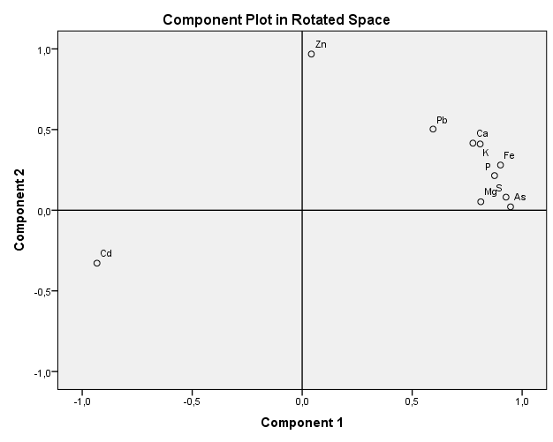
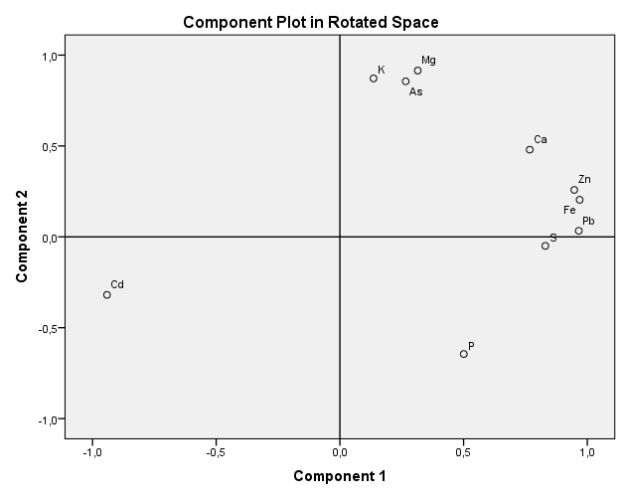
Results and Discussion
Figure 1. Projection of the factorial plane created by F1 (71.4 % variance) and F2 (11.2 % variance) axes of the macro and micro elements of soil samples (n = 9) of Field A. (Observation: Eigenvalues are greater than 1 only in F1 and F2).
Figure 2. Projection of the factorial plane created by F1 (60.7 % variance) and F2 (25.0 % variance) axes of the macro and micro elements of soil samples (n = 9) of Field B. (Observation: Eigenvalues are greater than 1 only in F1 and F2).
Regarding macro and micro elements of soil samples of both fields (Fig. 1 and 2), through principal component analysis (PCA) was possible to identify that for both fields, the interrelations among mineral elements are explained in the projections of components 1 and 2 (F1 and F2).
This different correlation between minerals of soil in the same region is probably due to soil nutrient content variability (Khan et al., 2020) that can occur presumably due to the sensitive impact that topography has in the movement of soil material (Hattar et al., 2010).

Slide 6
Results and Discussion
Figure 3A,B. Organic matter content (%)(A) and soil electrical conductivity (µS cm⁻¹) (B) of soil of both fields (Field A and Field B).
In both field, pH was the same, average of 7.4 (pH of 7.4 ± 0.03 for Field A and 7.4 ± 0.05 for Field B). However, regarding organic matter and electrical conductivity of the soil (Fig. 3), there were significant differences between the two fields. In fact, Field B showed higher values in both parameters compared to Field A.
Considering the pH of both soils (7.4), being slightly alkaline, is within the ideal range for agriculture (6.5 – 7.5) [19]. In fact, despite potatoes being tolerant regarding pH, this range is optimal for nutrient availability to plants (Muthoni, 2016).
In addition, is also important to say that Field B has a higher chance of soil salinization because the accumulation of salt (in irrigated agricultural soils) can lead to loss of stand, reducing plant growth and yield (Corwin and Lesch, 2005). Yet can be used to potato production, being important to choose salt-tolerant varieties (Jaarsma and De Boer, 2018).

Slide 7
Conclusions
Through the comparison of soils of two fields intended for potato production in the same region of Portugal, was possible to verify that, despite being geographically close, they showed different relationships between mineral elements, organic matter content, and soil electrical conductivity. Additionally, despite Field A showing lower organic matter content and the different correlations between minerals elements compared to Field B, due to the lower electrical conductivity it presents a field with greater potential for potato production. Yet, it needs to be fertilized with organic matter. Regarding Field B, also can be used for potato production, however, needs to be chosen a variety or varieties with greater tolerance to salts, considering the high electrical conductivity presented in the soil. In conclusion, both fields may present differences in potato production due to the differences verified in this study. Also, if the correction of organic matter is not carried out in Field A, apparently Field B (despite greater organic matter) due to its greater electrical conductivity, can lead to a greater loss of productivity.

Slide 8
Acknowledgments
The authors thanks to Eng. Nuno Cajão (Cooperativa de Apoio e Serviços do Concelho da Lourinhã- LOURICOOP) for technical assistance in the agricultural parcel as well as to project PDR2020-101-030719—for the financial support. We also thanks to the Research centers (GeoBioTec) UIDB/04035/2020, and (CEF) UIDB/00239/2020.
Funding from Fundação para a Ciência e Tecnologia (FCT) UI/BD/150806/2020 is also greatly acknowledged.

