Slide 1
Comparison between varieties of rice (Oryza sativa L.) produced in Portugal – mineral and quality analysis
Ana Coelho Marques^{1,2}*, Ana Rita F. Coelho^{1,2}, Cláudia Campos Pessoa^{1,2}, Diana Daccak^{1,2}, Inês Carmo Luís^{1,2}, Ana Sofia Almeida^{2,4}, Paula Scotti Campos^{2,3}, Manuela Simões^{1,2}, Maria F. Pessoa^{1,2}, Fernando H. Reboredo^{1,2}, José C. Ramalho^{2,5}, Maria Manuela Silva^{2,7}, Paula Marques⁶, Paulo Legoinha^{1,2}, Isabel Pais^{2,3}, Karliana Oliveira² and Fernando C. Lidon^{1,2}
¹ Earth Sciences Department, Faculdade de Ciências e Tecnologia, Universidade Nova de Lisboa, Campus da Caparica, 2829-516 Caparica, Portugal
² GeoBioTec Research Center, Faculdade de Ciências e Tecnologia, Universidade Nova de Lisboa, Campus da Caparica, 2829-516 Caparica, Portugal
³ Instituto Nacional de Investigação Agrária e Veterinária, I.P. (INIAV), Avenida da República, Quinta do Marquês, 2780-157 Oeiras, Portugal
⁴ Instituto Nacional de Investigação Agrária e Veterinária, I.P. (INIAV), Estrada de Gil Vaz 6, 7351-901 Elvas, Portugal
⁵ PlantStress & Biodiversity Lab., Centro de Estudos Florestais (CEF), Instituto Superior Agronomia (ISA), Universidade de Lisboa (ULisboa), Quinta do Marquês, Av. República, 2784-505, Oeiras and Tapada da Ajuda, 1349-017 Lisboa, Portugal
⁶ Centro Operativo e Tecnológico do Arroz (COTARROZ), 2120-014 Salvaterra de Magos, Portugal
⁷ Escola Superior de Educação Almeida Garrett (ESEAG-COFAC), Avenida do Campo Grande 376, 1749-024 Lisboa, Portugal
* Corresponding author: amc.marques@campus.fct.unl.pt

Slide 2
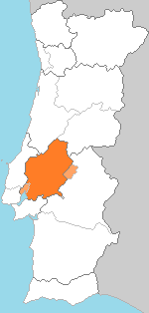
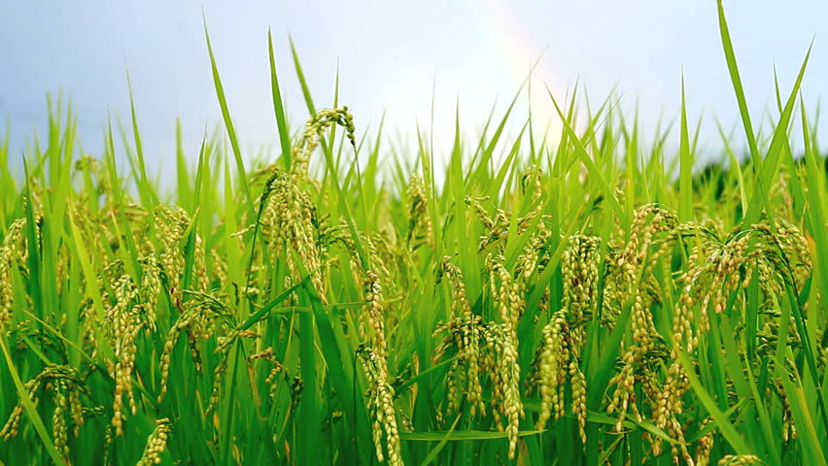
Comparison between varieties of rice (Oryza sativa L.) produced in Portugal – mineral and quality analysis
Ariete Variety
Grains and Flour
Quantification of Macro and Microelements
Ash Content
Density
Colorimetric parameters
Ceres Variety
Oryza sativa L.

Slide 3
Abstract: Rice (Oryza sativa L.) is considered one of the most consumed cereals worldwide. In fact, for most countries is considered a staple food crop. In this context, in Portugal, Ariete and Ceres are well known as varieties that produce grains with a high quality, yet little is known about their nutrient’s accumulation. In this context, this study aimed to characterize and compare both varieties produced in the central region of Portugal (Ribatejo). Whole and white rice grains, as well as the respective flours, were analyzed in order to quantify the mineral content of macro and micro-elements (Mo, Ca, K, P and S). Molybdenum (Mo)content varied significantly between 4.7 - 11.2 mg.kg⁻¹ in the whole flour of Ceres and Ariete, respectively, while P content was only detected in the flour of the Ariete variety. Regarding both varieties, concerning to the other elements there were no significant differences in their content. Moreover, total ash content in the refined flour showed significant differences in both varieties. Quality parameters, such as density of the grains and colorimetric indexes (L, a* and b*), in brown and white grain, were also considered, being found that density values varied between 1301 – 1651 kg/m³ (in the Ariete variety) and 1492 - 1573 kg/m³ (in the Ceres variety). It was concluded that, in spite of the differences found in both varieties, minerals contents combined with the quality parameters showed common characteristics required for an high industrial and gastronomic potential.
Keywords: Ariete variety; Ceres variety; Mineral contents; Quality analysis

Slide 4
Introduction
Considered a staple food for nearly two-thirds of the world’s population, rice (Oryza sativa L.) is referenced as the second most cultivated and consumed cereal crop in the world [1]. European countries produce 4.5 million tons of paddy rice, which translates into a self-sufficiency rate of about 65%. Although the Portuguese are the main consumers in Europe, (15 kg per capita per year), Portugal contributes 6% (190000 tons of paddy rice) to European production [1-3].
In Portugal, rice is mainly produced in Lisboa and Vale do Tejo region (47%) – Ribatejo [4]. Commercially known as Carolino rice, it is botanically classified as ssp. japonica. Being well adapted to Portuguese environmental conditions, this type of rice is widely used in traditional gastronomy. [3]. Moreover, it is self-sufficient in the consumption of Carolino rice, however, it only covers approximately 75% of the national need [3]. Thus, it is the most widely produced type of rice in the different regions of Portugal. The Ariete variety (Carolino rice type) stands out as the most widely grown in Portugal (21% of the total varieties grown) [5].
It is a variety of italian origin of the long A type (Carolino) being cultivated in Portu-guese soils for about 30 years. It is a reference variety in Carolinos, with high industrial yield, appreciated by farmers and industrialists for its quality and regularity of pro-duction [5]. The Ceres variety emerged from the need for modern and national varieties of rice to make this area differentiating.

Slide 5
Introduction
It is a Portuguese variety of Carolino rice, long type A, which results from crossbreeding performed under the National Program for Genetic Improvement of Rice and the partnership with many other entities for more than 10 years [6]. Characteristics such as good phytosanitary behavior, completely glassy grain, and excellent gastronomic quality, make this variety stand out [7]. In this context, in Portugal, Ariete and Ceres are well known as varieties that produce grains of high quality, yet little is known about their nutrient accumulation.
Considering the importance of the rice varieties, Ariete and Ceres, produced in the central region of Portugal (Ribatejo), this work aimed to characterize these varieties while evaluating the mineral content and quality of the grains.

Slide 6
Results
In the brown flours of the different varieties, there were significant differences and the Mo content ranged from 4.69 - 11.2 mg.kg⁻¹ (Table 1). Comparing the refined flours of the different varieties, P contents were only detected in the Ariete variety. In this variety, Mo, K, and P content were significantly lower in the refined flour while in the Ceres variety only Mo content was not affected by industrial processing.
Table 1. Average values (mg.kg⁻¹) ± standard deviation (n = 4) of Mo, Ca, K, P and S in the whole (WF) and refined flours (RF) of Oryza sativa L., varieties Ariete (AR) and Ceres (C) at harvesting. Different letters indicate significant differences between varieties in the same flour (letters a and b) and between different flours in the same variety (letters A and B), (P ≤ 0.05).

Slide 7
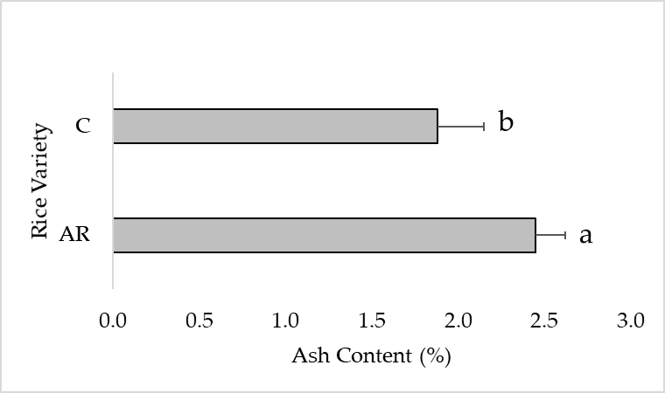
Results
Considering ash contents (Figure 1), the Ariete variety showed slightly values (2.45%) compared to the Ceres variety (1.88%).
Figure 1. Average values (%) ± standard deviation (n = 4) of ash content in the refined flours of Oryza sativa L., varieties Ariete and Ceres at harvesting. Letters a and b indicate significant differences among varieties (P ≤ 0.05).

Slide 8
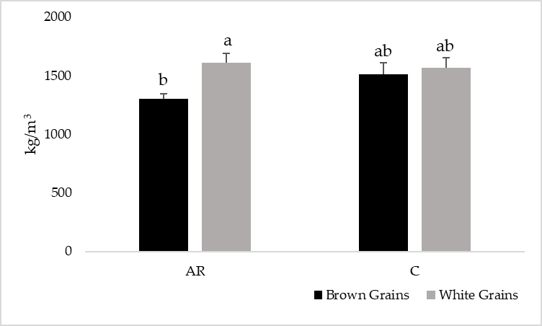
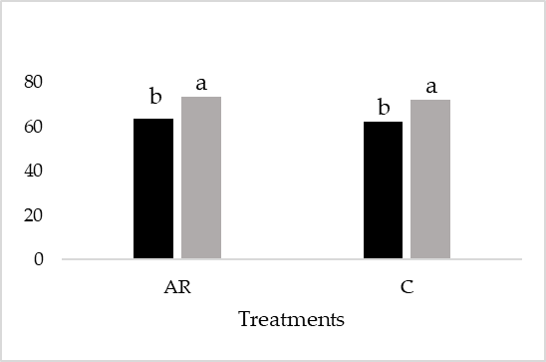
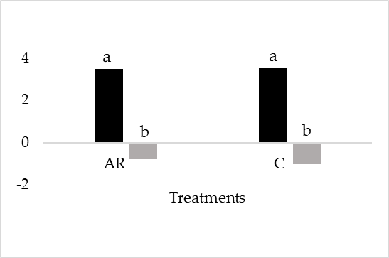
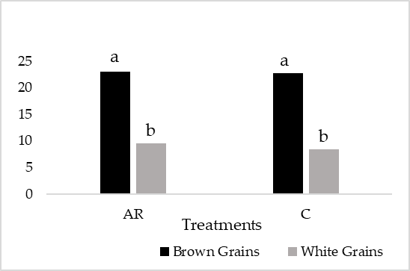
Results
Regarding density, values ranged between 1301 – 1651 kg/m³ in the Ariete variety (Figure 1). In Ceres variety, the minimum value registered was 1492 kg/m3 and the maximum showed 1573 kg/m³ (Figure 2). Significant differences were comparing brown with white grains in the Ariete variety while in the Ceres variety these differences were not so evident. In the Ariete variety, the density of the white grains was significantly higher than the brown grains.
Figure 2. Average (kg/m³) ± standard deviation (n = 4) of density of brown and white rice grains of Oryza sativa L. varieties Ariete (AR) and Ceres (C) at harvesting. Letters a and b indicate significant differences among grains on each variety (P ≤ 0.05).
In each variety, L, a*, and b* values show significant differences can be observed it is extensive to brown and white rice grains (Figure 3). The L of the samples was high (greater than 50%) in both varieties. Regarding the a* parameter, the colors red and green were evidenced in brown and white rice grains, respectively. The yellow color, corresponding to the b* parameter, was evident in both treatments.
(I)
(II)
(III)
Figure 3. Average of colorimetric parameters ± standard deviation (n = 4) of brown and white rice grains of Oryza sativa L., varieties Ariete (AR) and Ceres (C) at harvesting. Letters I, II and III represent L*, a* and b* parameters, respectively. Letter a and b indicate significant differences among grains on each variety (P ≤ 0.05).

Slide 9
Discussion
In Portugal, rice is historically considered a very important crop that is widely consumed [1]. Portugal has its characteristics that allow for the cultivation of Carolino rice with unique features [6]. Based on increasing agricultural production, maintaining soil health, and environmental sustainability, strategies have been developed to the creation of Portuguese varieties capable of meeting the needs of the farmer/industry, produce differentiated rice, of great quality, that the consumer values, but that is still accessible at a competitive price [6, 13], such as the Ceres variety.
To sustain plant growth, P is remobilized/retranslocated and as such is considered highly mobile within plants [18]. In the Ariete variety, and after processing, the content remained detectable in the refined flour, suggesting greater mobility in this variety. However, studies pointed that P is not very mobile in plants, which may justify the absence of values in the refined flour of the Ceres variety [19].
Studies have used the CIELab scale to quantify amylose in rice grains [23]. According to other studies, the amylose content in cooked rice affects the brightness (L) of the samples [6, 21]. In both varieties, brown and white grains showed significant differences in the colorimetric parameters (L, a*, and b*) (Figure 3). The L parameter increased in the white rice grain which is in accordance with studies where the same trend is seen when the endosperm and bran are removed [24].

Slide 10
Conclusions
This study, conducted in one of the regions that produce most rice nationally (Ribatejo, Portugal) was used rice (Oryza sativa L.) Carolino type of Ariete and Ceres varieties, of Italian and Portuguese origin, respectively.
After analyzing macro and microelements (Mo, Ca, K, P, and S) in the brown and refined flours it was concluded that there are significant differences, namely in Mo content varied significantly between 4.7 - 11.2 mg.kg⁻¹ in the whole flour of Ceres and Ariete, respectively, while P content was only detected in the flour of the Ariete variety.
The ash content value in the refined flour of the Ariete variety showed a tendency for higher values in the Ceres variety, implying significant differences. Quality parameters, such as density varied between 1301 – 1651 kg/m³ (in the Ariete variety) and 1492 - 1573 kg/m³ (in the Ceres variety).
Additionally, colorimetric indexes (L, a* and b*), in brown and white grain, showed significant differences. It was concluded that, despite of the differences found in both varieties, minerals contents combined with the quality parameters showed common characteristics required for a high industrial and gastronomic potential

Slide 11
Acknowledgments
Authors thanks to Paula Marques, Cátia Silva (COTArroz) and Orivárzea (Orizicultores do Ribatejo, S.A.) for technical assistance.
We also thanks to the Research centers (GeoBioTec) UIDB/04035/2020 and (CEF) UIDB/00239/2020 for support facilities.

