Slide 1
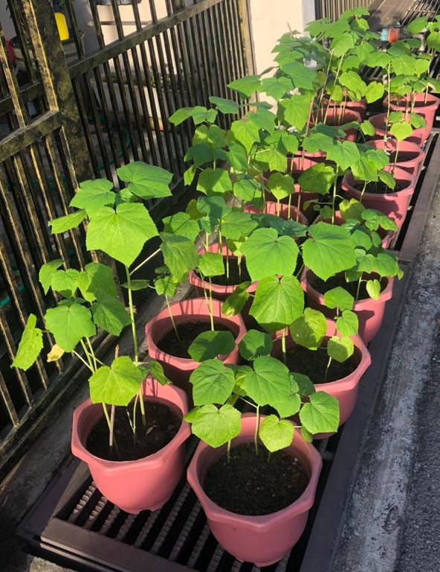
Unravelling Synergistic Effects of Palm Bunch Ash and Glutathione on Plant Growth
Participant: Koh Yi Sze
University: Monash University Malaysia
Faculty: School of Engineering
Supervisors: Dr Patrick Tang, Dr Goh Bey Hing

Slide 2
Introduction: Palm bunch ash (PBA)
Empty Fruit Bunch (EFB)
Palm Bunch Ash (PBA)
Fresh Fruit Bunch (FFB)
Palm oil cultivated from mesocarps of the oil palm fruits
22% of FFB, major waste
Mostly incinerated to be disposed
> pH 7 & rich in potassium
Reduces soil acidity and acts as a potash fertiliser [1]
2
Notes:
[1] H.C., O. (2016). Potential of Palm Bunch Ash Application on the Growth and Yield of Okra (Abelmoschus esculentus (L.). Global Journal of Biology, Agriculture & Health Sciences, 5(1), 8. doi:10.9734/IJPSS/2013/2039.
Clearly, PBA can be a great alternative to commercial fertilisers as it is organic and sustainable.

Slide 3
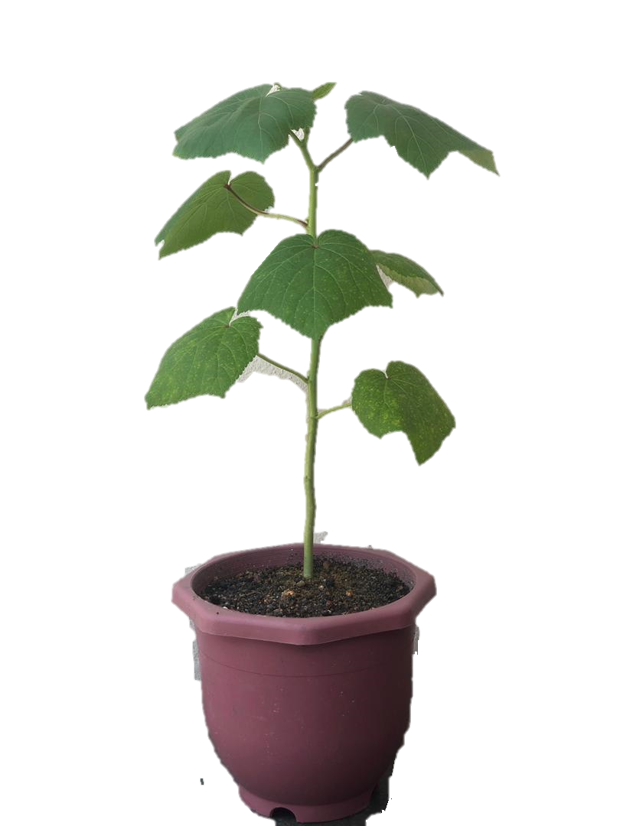
Introduction: Glutathione (GSH)
GSH is a tripeptide, found abundantly in most plant tissue
Mitigate oxidative stress and damage to plants
Foliar spray
Roles: Antioxidant, regulates enzymatic & photosynthetic activities
Exogenous applied GSH
Improved growth and yield of various plants [2]
Induced by abiotic stresses; Inhibited by extreme stresses.
Seed soaking
3
Notes:
[2] Hasanuzzaman, M., Nahar, K., Anee, T. I., & Fujita, M. (2017). Glutathione in plants: biosynthesis and physiological role in environmental stress tolerance. Physiology and Molecular Biology of Plants, 23(2), 249-268. doi:10.1007/s12298-017-0422-2

Slide 4
Problem Statement
Plants are susceptible to environmental stresses.
Individual application of PBA and GSH improve growth of plants.
However, there is yet to be a research on the effects of the combined application of PBA and GSH on plant growth
Objective
To assess the effects of PBA, GSH and their combined application on okra plant growth through:
Examination of growth parameters like plant height, stem girth, number of leaves per plant and leaf area.
4

Slide 5
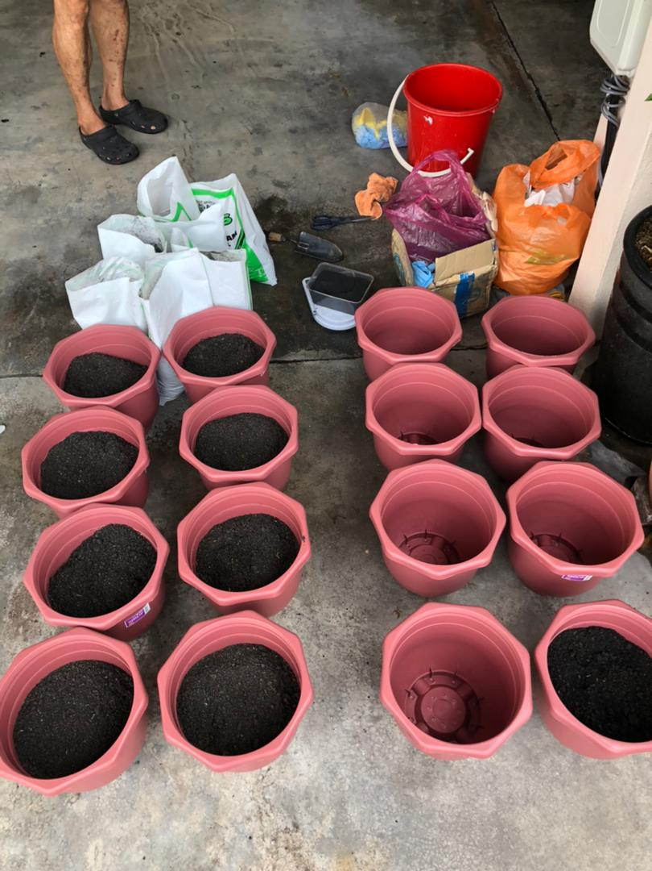
Experimental Design
4 groups , 4 replicate pots & 6 seeds each:
Control group
Water-soaked & planted in black soil (3 kg) only
PBA group
Water-soaked & planted in PBA-soil (200 g: 3 kg) mix
GSH group
GSH-soaked (100 mg/L) & planted in black soil (3 kg) only
PBA-GSH (Combination) group
GSH-soaked (100 mg/L) & planted in PBA-soil (200 g: 3 kg) mix

Slide 6
Experimental Procedures
1) Seed Soaking
- 60 seeds in GSH
- 60 seeds in water
2) PBA: Soil Mixing
- 200g PBA: 3 kg black soil for 8 pots
3) Planting
- 6 seeds in each pot accordingly
- Watered daily
4) pH & NPK Soil Test
- Soil samples added with reagents
- Compared against colour charts
6

Slide 7
Results & Discussion
Soil Test, Plant Height, Stem Girth, Number of Leaves per Plant, Leaf Area
7

Slide 8
Soil Test
For NPK level: 0 = depleted, 1 = deficient, 2 = adequate, 3 = sufficient, and 4 = surplus.
Soil Sample | Day 0 |  |  | Day 42
 | Black soil | PBA | PBA-soil mix | Control group (Black soil) | PBA group (PBA-soil mix) | GSH group (Black soil) | PBA-GSH group (PBA-soil mix)
pH | 6.5 | > 7.5 | 7 | 6.5 | 7 | 6.5 | 7
Nitrogen, N | N2 | N0 | N2 | N2 | N2 | N2 | N2
Phosphorus, P | P3 | P3 | P3 | P3 | P3 | P3 | P3
Potassium, K | K2 | K4 | K4 | K2 | K4 | K2 | K4
No change in properties; pH: 6.5 – black soil, 7 – PBA-soil mix.
Nitrogen level adequate; Phosphorus level sufficient in all soils
Potassium level surplus for PBA-soil mix
8

Slide 9
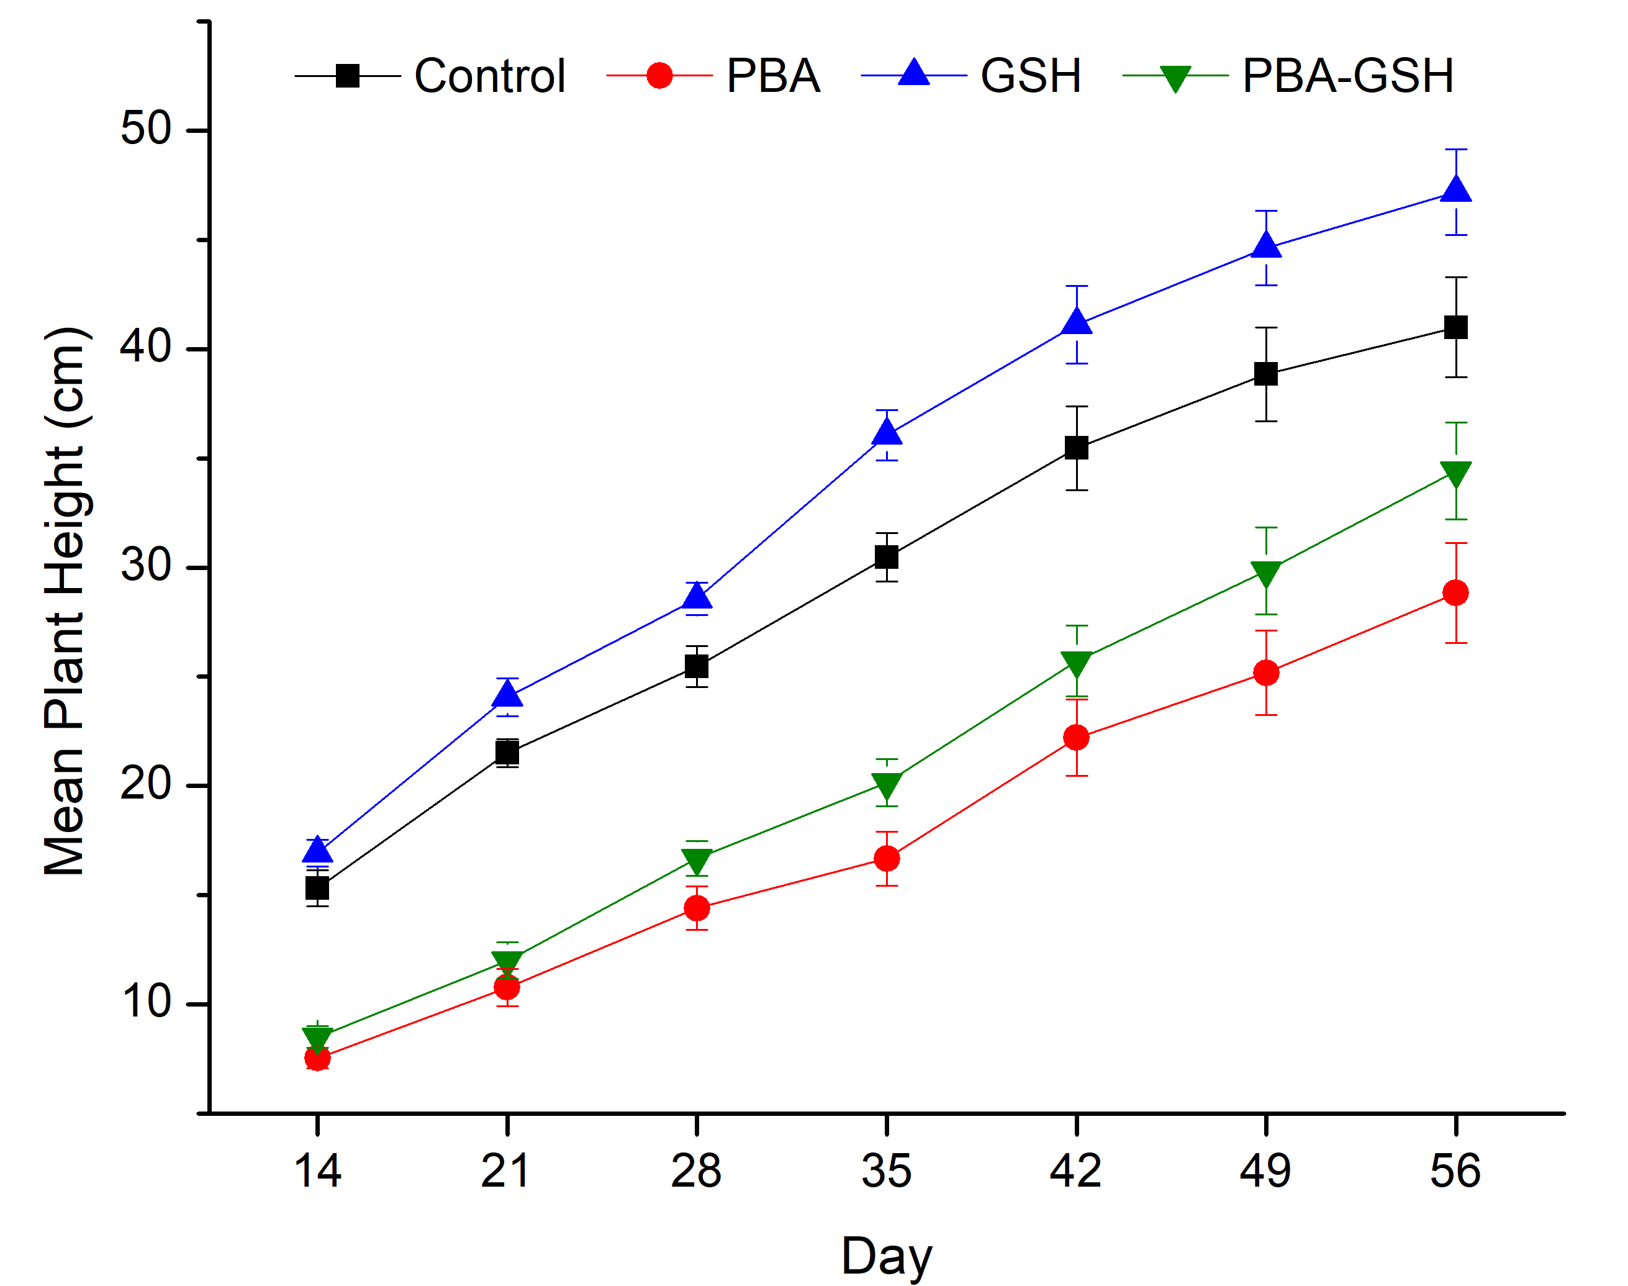
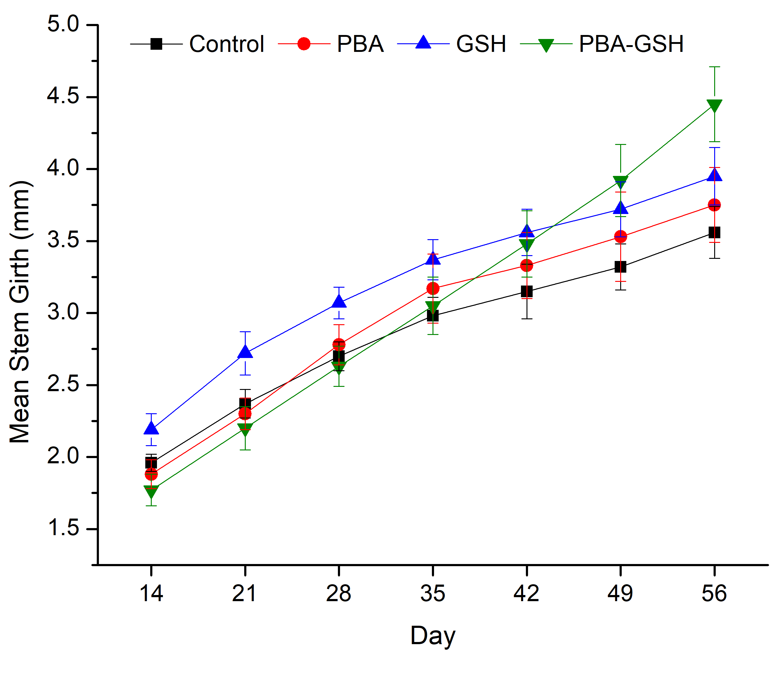
Plant Height
Stem Girth
GSH > Control > PBA-GSH (combination) > PBA
Combination recorded the thickest stem girth
Surplus in K: ↓ N-metabolising enzymes [3].
Synergistic effect observed,
GSH: ↑ photosynthetic activities
PBA: Accumulation of K is lower in stems [3].
9
Notes:
[3] Xu, X., Du, X., Wang, F., Sha, J., Chen, Q., Tian, G., Jiang, Y. (2020). Effects of Potassium Levels on Plant Growth, Accumulation and Distribution of Carbon, and Nitrate Metabolism in Apple Dwarf Rootstock Seedlings. Frontiers in Plant Science, 11. doi:10.3389/fpls.2020.00904
Plant Height
- Consistent trend: GSH > Control > PBA-GSH (combination) > PBA
- GSH: Increase enzymatic activities, increase in cell development of the shoots [2].
- PBA: Surplus of potassium (K4) reduces N-metabolising enzymatic activity, decreasing N uptake [4].
PBA-GSH: Outweighed effect of GSH, led to shorter plant height
Stem Girth
- Earlier stages: GSH > Control > PBA > PBA-GSH (combination)
- Day 35 onwards, PBA and combination surpassed control group
- Day 49 onwards, combination recorded the thickest stem girth
- Synergistic effect observed,
- GSH: Increased enzymatic activities [5].
- PBA: No adverse effects as accumulation of K is lower in stems [4].

Slide 10
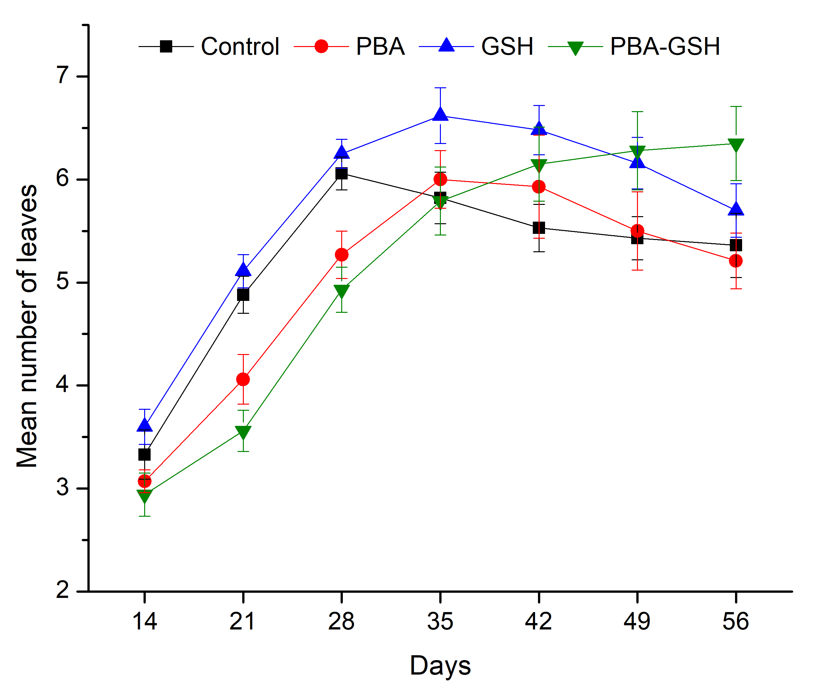
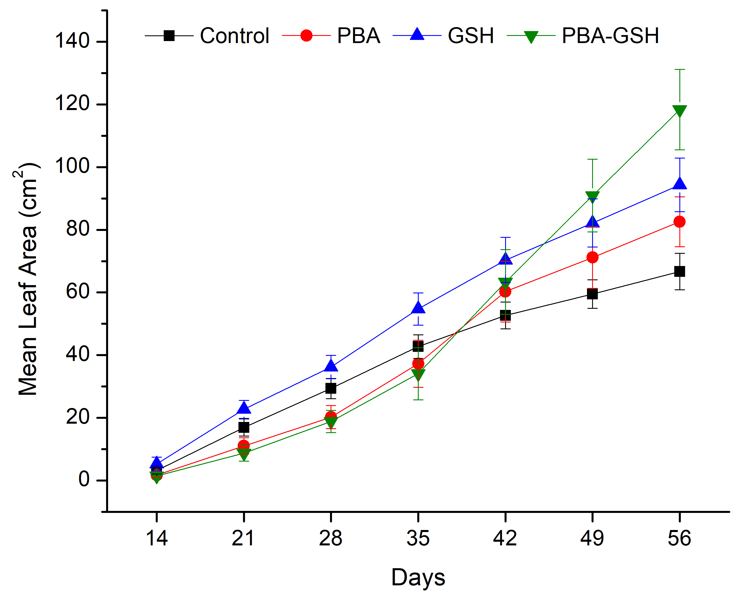
No. of leaves
Leaf surface area
Synergistic effects observed,
GSH: ↑ photosynthetic pigments [4].
PBA: Fulfilled ↑ demand of K, ↑ rate of photosynthesis [5].
Overall trend: Slight decrease
10
Notes:
[4] Vittoria Locato, Sara Cimini, & Gara, L. D. (2017). Glutathione as a Key Player in Plant Abiotic Stress Responses and Tolerance. In Glutathione in Plant Growth, Development (pp. 127-145). Unit of Food Science and Human Nutrition, Department of Medicine, Campus Bio-Medico, University of Rome, via Alvaro del Portillo 21, 00128 Rome, Italy: Springer International Publishing AG.
[5] Nazli, F., Bushra, Iqbal, M., Bibi, F., Zafar-ul-Hye, D. M., Kashif, M. R., & Ahmad, M. (2018). Modeling the potassium requirements of potato crop for yield and quality optimization. Asian Journal of Agriculture and Biology, 6, 169-180.
No of leaf
- Earlier stages: GSH > Control > PBA > PBA-GSH (combination)
- Day 35, control group decreased due to chlorosis and wilting
- Day 49-56, combination recorded the most number of leaves per plant
- Overall trend for other groups showed slight decrease after day 42 (next two slides)
Leaf area
- Earlier stages: GSH > Control > PBA > PBA-GSH (combination)
- Day 42, PBA and combination group surpassed control group.
- Day 49 onwards, combination group recorded biggest leaf area
- Synergistic effects observed,
- GSH: Increased photosynthetic pigments [5].
- PBA: Fulfilled increasing demand of K caused by the increased rate of photosynthesis [9].

Slide 11
Visual Assessment
Control: White Spots, Chlorosis, Wilting
GSH: Bigger leaves with a few yellow leaves
PBA: Curling & shrunken leaves, White flies and eggs
PBA-GSH: Bigger leaves with darker green
Powdery mildew: Fungus that favours high humidity [6].
Vectors of okra enation leaf curl disease (OECD) [7];
Increased photosynthetic pigments and improved resistance to diseases; Indicates presence of more chlorophyll [5];
11
Notes:
[5] Nazli, F., Bushra, Iqbal, M., Bibi, F., Zafar-ul-Hye, D. M., Kashif, M. R., & Ahmad, M. (2018). Modeling the potassium requirements of potato crop for yield and quality optimization. Asian Journal of Agriculture and Biology, 6, 169-180.
[6] Tripathi, K. K., Warrier, R., O.P. Govilla, & Ahuja, V. (2011). Biology of Abelmoschus esculentus L. (Okra). India.
[7] Mishra, G. P., Singh, B., Seth, T., Singh, A. K., Halder, J., Krishnan, N., Singh, P. M. (2017). Biotechnological Advancements and Begomovirus Management in Okra (Abelmoschus esculentus L.): Status and Perspectives. Frontiers in Plant Science, 8(360). doi:10.3389/fpls.2017.00360

Slide 12
Conclusion
Synergistic effects of combination PBA-GSH group were evident in later stages:
PBA fulfilled the increasing nutrient demand
GSH enhanced enzymatic and photosynthetic activities
PBA-GSH (Combination) group
Flowering buds
Greatest number & area of leaves
Thickest stem girth
BEST
Future Works:
Lab analysis of 1) Black soil and PBA composition; 2) Enzymatic and photosynthetic activities of plants
Encapsulation work to produce controlled release for PBA and GSH
12

Slide 13
Thank You
13

Slide 14
Acknowledgement
I would like to express my highest gratitude to:
Dr Patrick Tang Siah Ying, Dr Goh Bey Hing, Wong See Kiat
Chemical Engineering Department of Monash University Malaysia
Family and friends
14

Slide 15
References
[1] H.C., O. (2016). Potential of Palm Bunch Ash Application on the Growth and Yield of Okra (Abelmoschus esculentus (L.). Global Journal of Biology, Agriculture & Health Sciences, 5(1), 8. doi:10.9734/IJPSS/2013/2039.
[2] Hasanuzzaman, M., Nahar, K., Anee, T. I., & Fujita, M. (2017). Glutathione in plants: biosynthesis and physiological role in environmental stress tolerance. Physiology and Molecular Biology of Plants, 23(2), 249-268. doi:10.1007/s12298-017-0422-2
[3] Xu, X., Du, X., Wang, F., Sha, J., Chen, Q., Tian, G., Jiang, Y. (2020). Effects of Potassium Levels on Plant Growth, Accumulation and Distribution of Carbon, and Nitrate Metabolism in Apple Dwarf Rootstock Seedlings. Frontiers in Plant Science, 11. doi:10.3389/fpls.2020.00904
[4] Vittoria Locato, Sara Cimini, & Gara, L. D. (2017). Glutathione as a Key Player in Plant Abiotic Stress Responses and Tolerance. In Glutathione in Plant Growth, Development (pp. 127-145). Unit of Food Science and Human Nutrition, Department of Medicine, Campus Bio-Medico, University of Rome, via Alvaro del Portillo 21, 00128 Rome, Italy: Springer International Publishing AG.
[5] Nazli, F., Bushra, Iqbal, M., Bibi, F., Zafar-ul-Hye, D. M., Kashif, M. R., & Ahmad, M. (2018). Modeling the potassium requirements of potato crop for yield and quality optimization. Asian Journal of Agriculture and Biology, 6, 169-180.
[6] Tripathi, K. K., Warrier, R., O.P. Govilla, & Ahuja, V. (2011). Biology of Abelmoschus esculentus L. (Okra). India.
[7] Mishra, G. P., Singh, B., Seth, T., Singh, A. K., Halder, J., Krishnan, N., Singh, P. M. (2017). Biotechnological Advancements and Begomovirus Management in Okra (Abelmoschus esculentus L.): Status and Perspectives. Frontiers in Plant Science, 8(360). doi:10.3389/fpls.2017.00360
15

