Slide 1
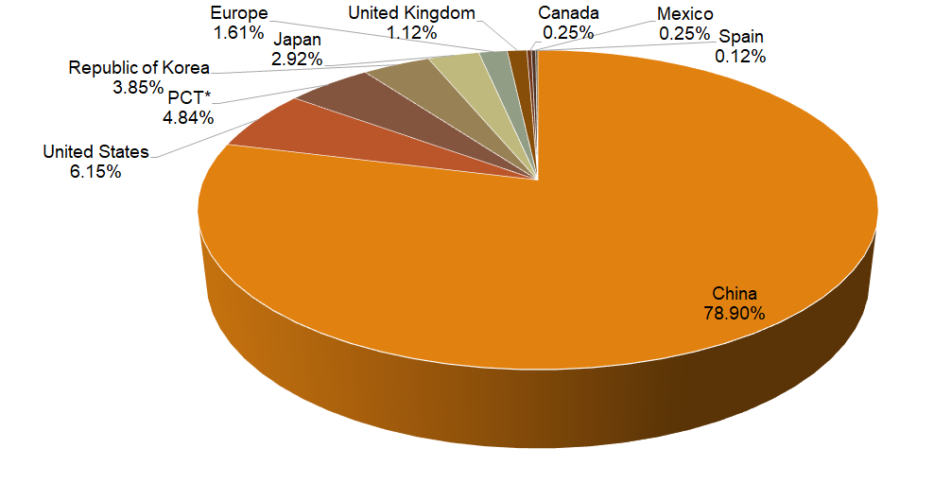
Patent landscape analysis of seaweed-based biofertilizers
Ahmed Fatimi ^{1,2 *}
¹ ERSIC, Polydisciplinary Faculty, Sultan Moulay Slimane University, P.O.BOX 592 Mghila, Beni-Mellal 23000, Morocco
² Department of Chemistry, Polydisciplinary Faculty, Sultan Moulay Slimane University, P.O.BOX 592 Mghila, Beni-Mellal 23000, Morocco
(*) a.fatimi@usms.ma
INTRODUCTION
Seaweed-based biofertilizers for agriculture are developing rapidly through the innovation and improvement of used raw materials, formulations, methods, and processes. This is also evident from the increase in the number of patent applications filed each year in this area of seaweed-based biofertilizer research and development. Therefore, this work in the form of patent analysis encapsulates information which could be used as a reference by researchers in the fields of agriculture and plants, as well as those interested especially in biofertilizers. The state has been reviewed by introducing what has been patented concerning seaweed-based biofertilizers.
Furthermore, an analysis of the patentability of seaweed-based biofertilizers, their preparation methods, and their formulations, will be provided by determining patent classifications and jurisdictions.
RESOURCES AND METHODS
The supported field codes used in this study were based on the Patentscope search service of the World Intellectual Property Organization, the Lens Patent Data Set, and the Espacenet of the European Patent Office.
Different keywords and related terms were used, and patents were searched according to title, abstract, and claims.
The search was then filtered to include only documents with an application date until 2020.
RESULTS
IPC Code | Classification | Patents documents
C05G3/00 | Mixtures of one or more fertilizers with additives not having a specifically fertilizing activity. | 842
C05G3/80 | Soil conditioners. | 474
C05F17/00 | Preparation of fertilizers characterized by biological or biochemical treatment steps (e.g., composting or fermentation). | 248
C05G3/60 | Biocides or preservatives (e.g., disinfectants, pesticides or herbicides Pest repellants or attractants). | 172
C05G1/00 | Mixtures of fertilizers covered individually by different subclasses of class. | 164
C05F11/00 | Other organic fertilizers. | 120
A01C21/00 | Methods of fertilizing fertilizers soil-conditioning or soil-stabilizing materials. | 110
C05G3/90 | Mixtures of one or more fertilizers with additives not having a specifically fertilizing activity for affecting the nitrification of ammonium compounds or urea in the soil. | 65
C05F11/08 | Organic fertilizers containing added bacterial cultures, mycelia or the like. | 58
C05F15/00 | Mixtures of fertilizers covered by more than one of main groups fertilizers from mixtures of starting materials, all the starting materials being covered by this subclass but not by the same main group. | 53
*International patents administered by the World Intellectual Property Organization through the Patent Cooperation Treaty (PCT)
CONCLUSIONS
This analysis concerned the period until 2020.
China was ranked first with 1271 patent documents.
Based on the patent classifications, all filled patents concerned soil conditioners and preparation of fertilizers characterized by biological or biochemical treatment steps, as well as organic fertilizers containing added bacterial cultures.
In addition, this study demonstrated that the inventions included in the patents concern formulation, methods for production, and the process for preparing, as well as devices and apparatus for manufacturing biofertilizers based on the three major classes of seaweed (Chlorophyta, Rhodophyceae, and Phaeophyceae).
The knowledge clusters and expert driving factors of this patent analysis indicate that the research and development are based on the preparation of fertilizers characterized by biological or biochemical treatment steps, as well as mixtures of one or more fertilizers that are concentrated in most patents..
REFERENCES
Fatimi A. “Seaweed-based biofertilizers: Patent analysis”. Recent Patents on Biotechnology. 2021 (Accepted)
Salehi B. et al. “Current Trends on Seaweeds: Looking at Chemical Composition, Phytopharmacology, and Cosmetic Applications”. Molecules. 2019;24:4182
Blunden G. “Agricultural uses of seaweeds and seaweed extracts”. Seaweed resources in Europe: uses and potential. Chicester: Wiley; 1991. p. 65-81
World Intellectual Property Organization. Patentscope. Available online: https://patentscope.wipo.int (accessed on September 21st, 2021)
Cambia Institute. The Lens Patent Data Set. Available online: https://www.lens.org, Version 8.0.14 (accessed on September 21st, 2021)
World Intellectual Property Organization. IPC Publication. Available online: https://www.wipo.int/classifications/ipc/ipcpub, IPCPUB v8.5 (accessed on September 2st, 2021)

