Slide 1
Urban soil enzyme activity restoration with Burger dirt
Chooi Lin Phooi; Elisa Azura Azman; Roslan Ismail
Faculty of Agriculture, Universiti Putra Malaysia

Slide 2
Outline
Introduction
Methods and materials
Results and discussions
Conclusion

Slide 3
Soil enzyme activity
Indicator of soil quality (Vázquez et al. 2020)
Stable protein with catalyst function
Source
plant root residue
animal and microbes excretion
Vital in the nutrient cycle

Slide 4
Urbanization and soil enzyme
Sensitive to pollutant
Prone to food insecurity
Low microbial and enzyme activity in acid and anthropogenic soil

Slide 5
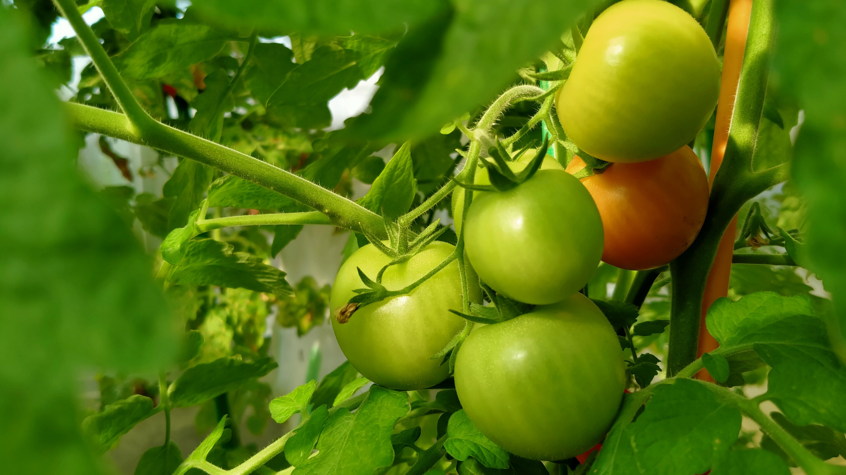
Food waste issues
Waste about 30-35% of total food production annually (UNSD 2020)
Food for next meal by composting
Accept animal based organic material composting method

Slide 6
Burger dirt
Highly versatile method
Anaerobic
Low emission of greenhouse gasses

Slide 7
Objective
To determine the effect of soil enzyme activity change with assorted Burger dirt ratio and restoration period

Slide 8
Experimental design
Completely random design

Slide 9
Treatments
Soil restoration periods (2, 4, 6, and 8 weeks)
Ratio of soil to Burger dirt (1:1 and 1:2)

Slide 10
Burger dirt preparation

Slide 11
Fermented for 2 weeks

Slide 12
Substrate
After 2 weeks
Leachate

Slide 13
$\frac{1}{3}$ Urban soil
$\frac{2}{3}$ 1:1 (Burger dirt : urban soil)
Restoration for 2, 4, 6, and 8 weeks

Slide 14
Soil physiochemical
Soil texture (Teh and Talib 2006)
Soil pH
1:2.5 soil to water extract (Xu et al. 2020)
Soil moisture content
gravimetrically (Xu et al. 2020)

Slide 15
Soil enzyme activity
Catalase activity
back-titrating residual H₂O₂ with KMnO₄ (Guan 1986)
Urease activity
spectrophotometrically (Guan 1986)

Slide 16
Statistical analysis
Two-way analysis of variance (ANOVA)
R statistic software
DMRT (p<0.05)

Slide 17
Results and discussions

Slide 18
Figure Correlation of urease activity (urease), pH, soil moisture content (smc) and catalase activity (CAT).

Slide 19
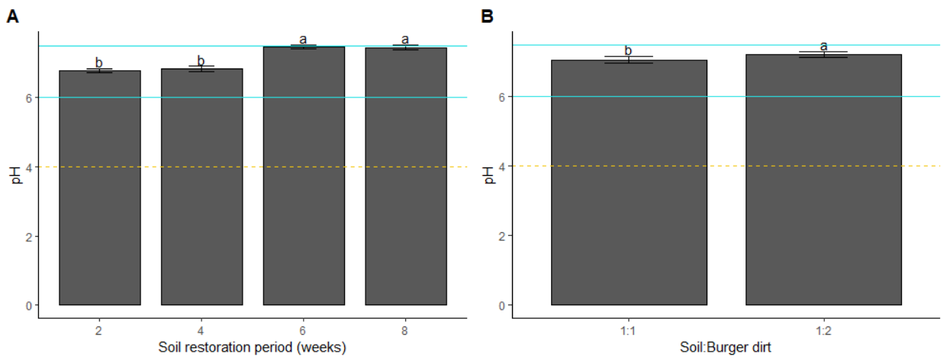
Soil pH increased with time and amount of Burger dirt
pH rose with the aerobic soil restoration (Smårs 2002)
Drought condition increased the soil pH over time (Msimbira and Smith 2020)
Figure Effect of (A) soil restoration period and (B) soil: Burger dirt ratio on pH. Means ± standard error with different letters is significantly different at P<0.05 using DMRT.
* “ – ”: recommended pH range (Whiting et al. 2015); “ - - - ”: pre-treated soil pH

Slide 20
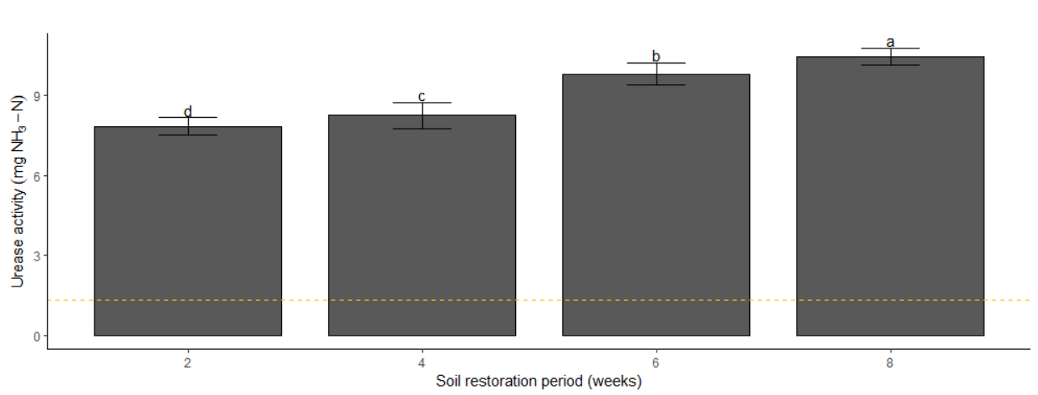
Urease activity increased with restoration period
Low ammonium is released in soil as the soil moisture content decreases and pH increases (Strock 2008)
Urease activity high in dry season (Fan et al. 2020)
Figure Interaction effect of soil restoration period (weeks) on soil urease activity (mg NH₃-N). Means ± standard error with different letters is significantly different at P<0.05 using DMRT.
“ - - - ”: pre-treated soil urease activity

Slide 21
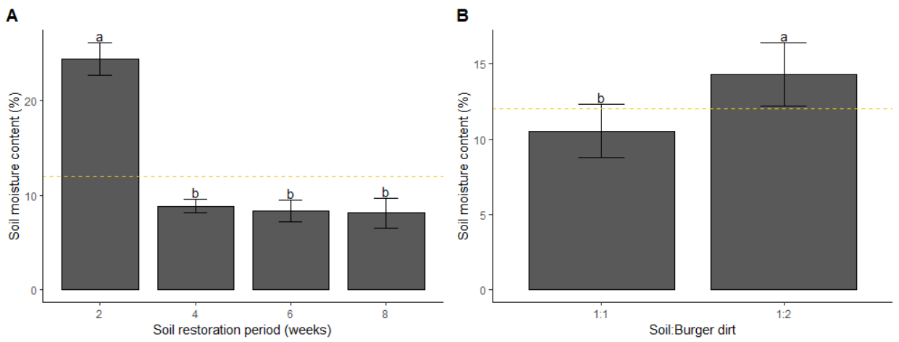
Soil moisture content
Low moisture content = low actual transpiration rate (Denmead and Shaw 1962)
Catalase activity increased with soil moisture content (Gömöryová et al. 2006, Borowik and Wyszkowska 2016)
20 % of soil moisture content showed higher enzyme activity (Borowik and Wyszkowska 2016)
Figure Effect of (A) soil restoration period and (B) soil:Burger dirt ratio on soil moisture content. Means ± standard error with different letters is significantly different at P<0.05 using DMRT.
* “ - - - ”: pre-treated soil moisture content (%)

Slide 22
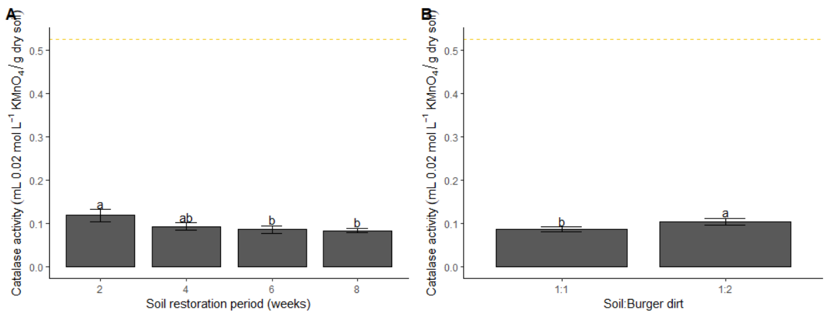
Catalase activity declined with time but increased with amount of Burger dirt
Soil catalase increased under well aerated soil (Brzezińska et al. 2005)
Soil catalase activity was significantly low in dry season compared to rainy season (Fan et al. 2020)
Figure Effect of (A) ratio of soil to Burger dirt (1:1 and 1:2) and (B) soil restoration period (weeks) on soil catalase activity (mL 0.02 mol L⁻¹ KMnO₄ per g soil). Means ± standard error with different letters is significantly different at P<0.05 using DMRT.
* “ - - - ”: pre-treated soil catalase activity

Slide 23
Conclusion
Burger dirt shows an ameliorative effect as it was able to increase the soil pH
700 times urease activity improvement
Soil moisture content and catalase activity decreased simultaneously
2 weeks of soil restoration period with 1:2 soil to Burger dirt ratio is recommended

Slide 24
Thank you

