Slide 1
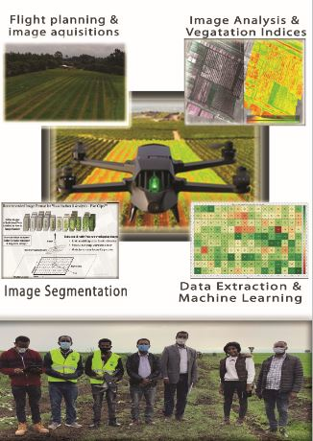
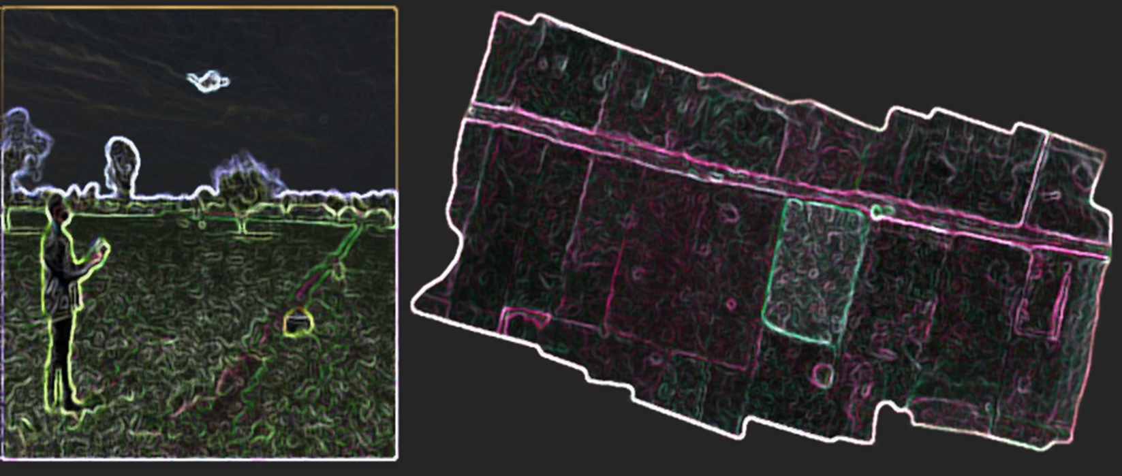
Title: Crop Field Classification using blending of Unmanned Aerial Vehicle (UAV) and Sentinel 2A satellite data: the case of Oda Dhawata Kebele Cluster farmland, Oromia Region, Ethiopia
By
Melkamu Demelash
June/2021

Slide 2
Introduction
In recent years, Remote sensing technology has a major role in dynamic data extraction of crop information and crop distribution mapping (Zhang Jiankang et al, 2012a). and based on interaction of electromagnetic radiation with surface features
It assesses the amount of sunshine reflected from surface features like soil, water and vegetation. The application of remote sensing in agriculture has been applied since 1950s (Colewell, 1956).
The image provided by satellite is low/medium-spatial and temporal resolutions as compared to UAV image is simply too insignificant result comparatively.

Slide 3
Cont.……..
Now a days, UAV-based approach gains popularity not just for its high spatial and temporal resolution; however for its ability to get spectral band spatial data at the same time (Licheng Zhao, 2019).
At low, medium and high resolution, UAV will play a great role and might generate additional feasible crop distribution information that could be significant to the development and application of crop monitoring technology.
Mapping of crop type using satellite image is challenging task due to complexities within cluster farmland field, and having similar spectral properties of different crop type.

Slide 4
Cont.…..
Recently sentinel satellite data launched with high resolution (10, 20 and 60), 13 spectral bands, and fast revisit time.
UAV-technology is good choice for crop type mapping since its running comprises four spectral bands.
Crop classification makes it possible to obtain the spatial distribution and planting area information of crops. A multiple crop mapping helps to show the dynamics of agricultural fields and may serve as the basis of crop structure
UAV has image composition with high resolution, simple operation and quick data acquisition.

Slide 5
Cont..…
UAV are changing the game in application of remote sensing and innovative digital technology in the agricultural sector by making :-
data capture more affordable and timely accessible for applications for crop type identification and mapping, understanding the plant health monitoring.
The need to know about farm plot/field plays a major role in piloting and implementing drone-based services
Use of UAV in precision agriculture is increasing day by day (Bansod, et.al, 2017).
UAV in agriculture are becoming important systems to collect data ,sustain and improve agricultural productions, efficiency and productivity of the agricultural practices

Slide 6
Statement problem
So far, there has been lack of a feasible and affordable data acquisition means at farm level for agricultural sector for decision making, agricultural practices and technology scaling.
To properly and accurately map the agricultural landscape crops in the area, it is necessary to use the satellite technology.
Agricultural fields are highly complex for mapping crop types that is a problem to accurately detect and discriminate between crop type and also classification mapping
UAV is the best approach for such mixed crop complexity and classification mapping

Slide 7
Objectives
General Objective
To evaluate the potential of blending Unmanned Aerial Vehicle (UAV) images and Sentinel 2A imageries for crop field classification from Ethiopia.
Specific objectives
Evaluating the UAV data for crop classification and mapping
Mapping of farmland using Sentinel 2A satellite image
To understand the potential of blending of UAV and Sentinel 2A images for Crop classification.

Slide 8
Significance of the study
Ethiopian Agricultural practices is complex and also fragmented land , many farmers grow multiple crops with similar plant cycles and inter-cropping is a common practice .
Satellite images cannot adequately capture in such complex agricultural landscapes and farming systems of Ethiopia ,so:-
medium resolution data of sentinel 2A downloaded
High resolution data of UAV captured
Ground truth data
The fusion approach proceeded to improve the lower resolution and then classify crop types

Slide 9
Data and methodology
Study area
The study area is located in Arsi zone, which is called Oda Dhawata Kebele, known for Agricultural land with 80 1’57.05” N and 39 10’39” E and area covering of 7.55ha
The average temperature ranges 10-25 0c and the altitude over all Arsi zone ranges from from 500 to 3000 mean sea level.
The major crops in the study area are wheat, Faba bean, barley, sorghum and teff. However, barley is the most dominant in the higher altitude of the zone wide, whereas wheat is the major crop in the middle altitude areas (chilot yirga et al., 1989).

Slide 10
Cont.….

Slide 11
Materials
UAV- Parrot Blues Grass
Emerging drone technology have the great potential to develop how to monitoring crops and mapping crop type.
Parrot blue grass is equipped with multispectral sensors, sequoia capture spectrally accurate high-resolution (fine grain) imagery in visible and near infrared part of electromagnetic spectrum, providing supplement to satellite and aircraft image.
Sequoia has 16mp RGB camera and internal memory of capacity of 64GB.

Slide 12
Cont.……
The parrot sequoia collects data of features in four spectral band in different wavelengths
Band name | Wavelengths(nm)
Green | 550
Red | 660
Red edge | 735
Near infrared | 790

Slide 13
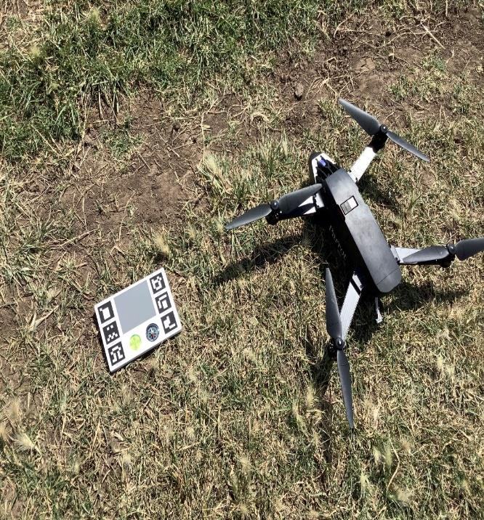
Calibrating Sequoia
Before using sequoia the calibration is needed.
The two sensors (multispectral and sunshine sensor) should be properly connected to the drone.
It is recommended that calibration of these sensors is possible at the same time, also calibrate each separately but sunshine sensor must be connected the Multispectral sensor to be calibrated.

Slide 14
Checklists of parrot blue grass before flight
On the field
Make sure you have 10 m of diameter of free space for takeoff and landing
Check that the flight area has no obstacles
Make sure the Sequoia lenses are clean
Connect the battery
Connect your smartphone or tablet to the sky controller
Turn on the drone
Make sure the GPS is detected on Free flight Pro or Pix4DCapture
Calibrate the drone and sequoia
Make sure the SD card of the Sequoia is empty
Make sure the front camera of the drone is clean

Slide 15
UAV Data acquisition and Orthomosaic generation
In this study, 1862 separate images acquired, at an altitude flight of 40m within -flight mission time to cover an area of the field. Before starting the flight mission, the design of the flight path covering the area of interest was performed by the pilot of the drone.
The flight controlled both manually and automatically in the study for crop mapping. The approach was applied 80%automatically when capturing images and 20% manually when landing.

Slide 16
UAV Data acquisition and Orthomosaic generation
Multispectral drone sensors are used to measure the surface reflectance by using two bands of wavelengths (e.g., the Red band and Near-infrared band) which is used as a base for calculating vegetation Index like NDVI or to form surface over classifications.

Slide 17
Cont.…

Slide 18
Cont.…
Both Multispectral image and RGB image have been acquired in October 16/2020 and downloaded via server 192.168.42.2 of the drone in each flight mission in the field.

Slide 19
Orthomosaic generation process
All the images need to be and stitched together to get a single image for further analysis.
The orthomosaic have been done using pix4Dfield that it combines all the individuals and overlapped images.
Pix4Dfield approach applied to process the drone images and then produce orthomosaic
It allows the structure reconstruction of scene from a number of images with corresponding points, and used to generate orthophoto.
Another significant of pix4Dfield is feature detection and matching

Slide 20
Cont.……..

Slide 21
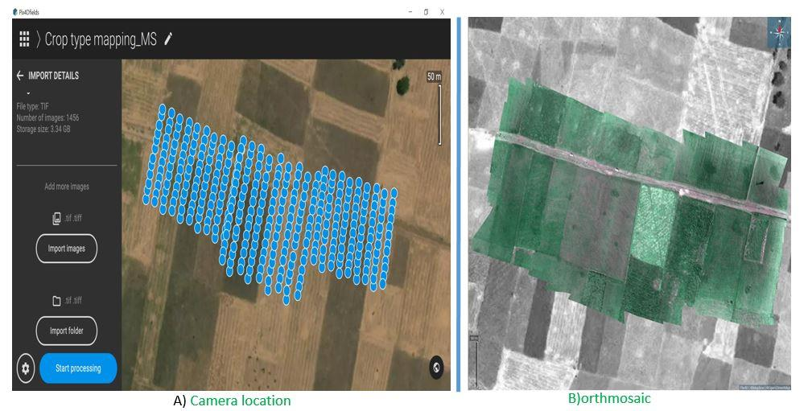
Cont.……..
The final product of Pix4Dfield is orthomosaic , digital surface model (DSM), different vegetation indices can be generated

Slide 22
Sentinel 2A
The sentinel 2A image has 13 spectral bands in total, in which four bands (Blue, green, red and near infrared) have spatial resolution of 10m.
Using Drone capturing data under cloud is possible and fine but not for satellite (Sentinel 2A) product. Thus, the only free cloud coverage image on 20 October 2020 was downloaded and preprocessed.

Slide 23
Cont..…
wavelengths b/n UAV &S2A
Sensor | Blue | Green | red | Red edge | NIR
parrot | - | 550 | 660 | 735 | 790
S2A(10m) | 492.4 | 559.8 | 664.6 | - | 864.7

Slide 24
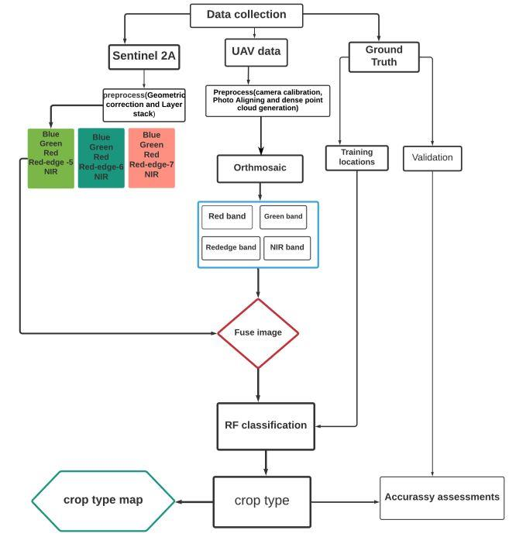
Methodology

Slide 25
Cont.….
Image fusion using Gram Schmidt Approach
Image fusion is the combination of spectral characteristics of a low-resolution image and spatial feature of higher resolution image to produce the spatially enhanced image.
Gram-Schmidt pan sharpening is to pan sharpen multispectral data using high spatial resolution data.
During fusion the high spatial resolution represents the information content of the images much more in detail and provides synthetic image close to reality when enhancing the resolution
The purpose is to improve the medium resolution(S2A) data which was 10m

Slide 26
Results and Discussion
From multispectral Analysis of UAV raw data
Number of overlapping images computed
Orthomosaic and sparse DSM before densification
Key points and Tie point positions
Internal camera parameters

Slide 27
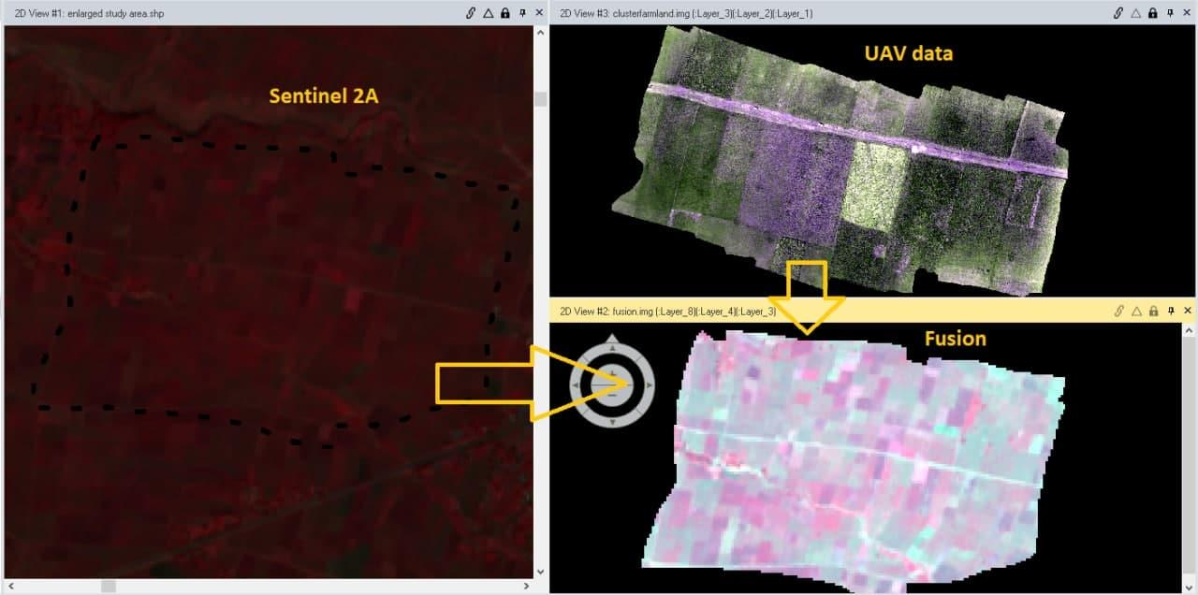
The Fusion approach

Slide 28
Random Forest classification Approach for fusion
With training data points, there is a possibility to generate to extract pixel values. At each sample locations, pixel values are extracted from raster data set.
These sample pixels are used to train and fit a statistical predictive model that it provides practices various statistical techniques to determine in the training data that it distinguishes between classes

Slide 29
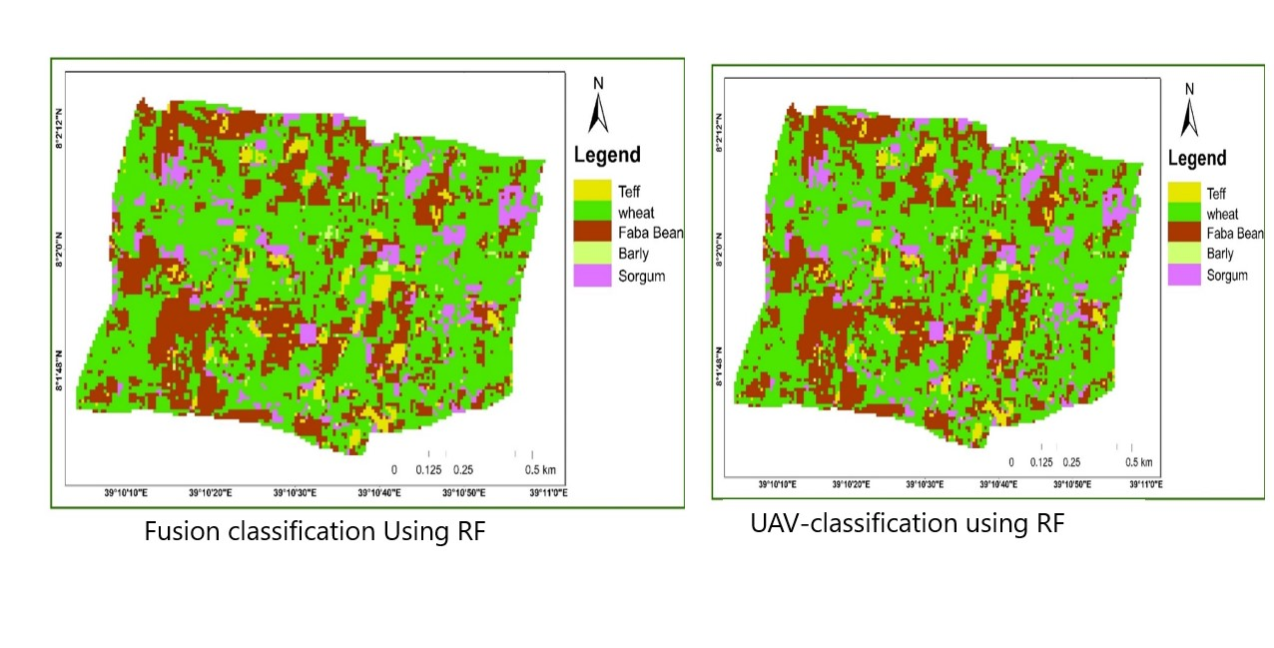
Overall accuracy=94%
Overall accuracy=84%

Slide 30
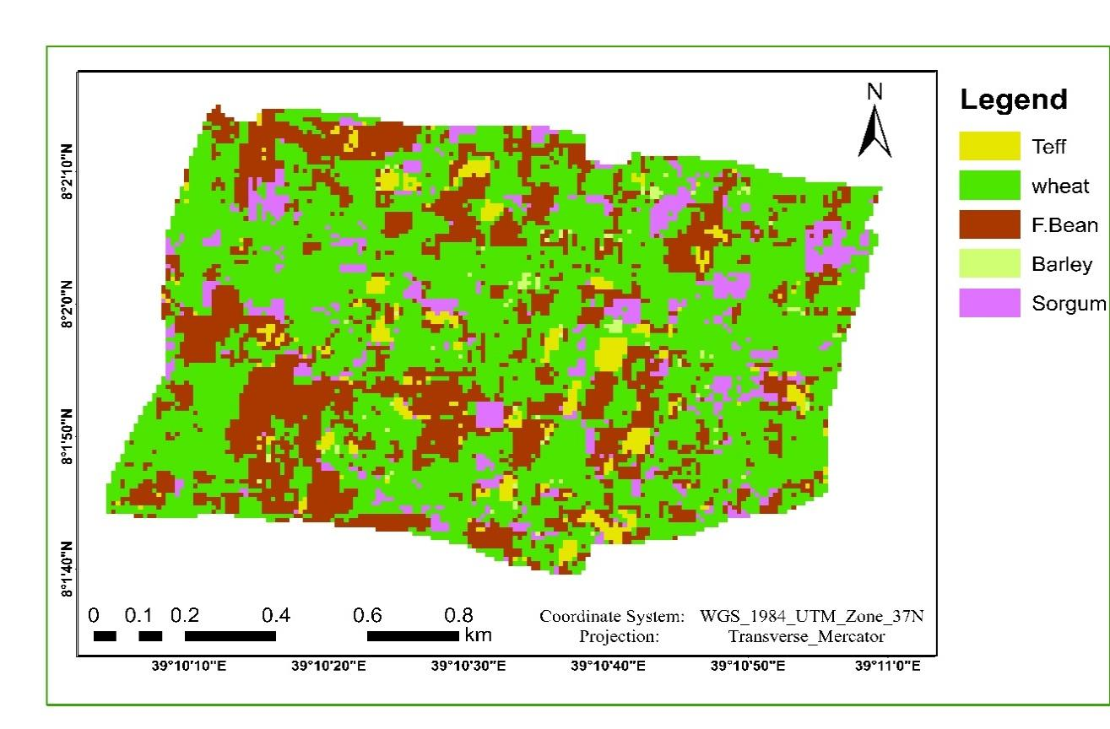
Maximum likelihood classification Approach
The study conducted to compare RF approach within the traditional algorithm which is Maximum likelihood classification.
Since maximum likelihood has been for a long time and easily implemented.

Slide 31
Accuracy Assessments
Accuracy assessment is a quantification of estimation with aid of remotely sensed data set to classification conditions:-
it is useful for evaluation of classification approach.
It is also important to determination the error that might involves.
Approach | Overall accuracy(%)
Random Forest | 94
Maximum Likelihood | 90
UAV accuracy assessment=84%

Slide 32
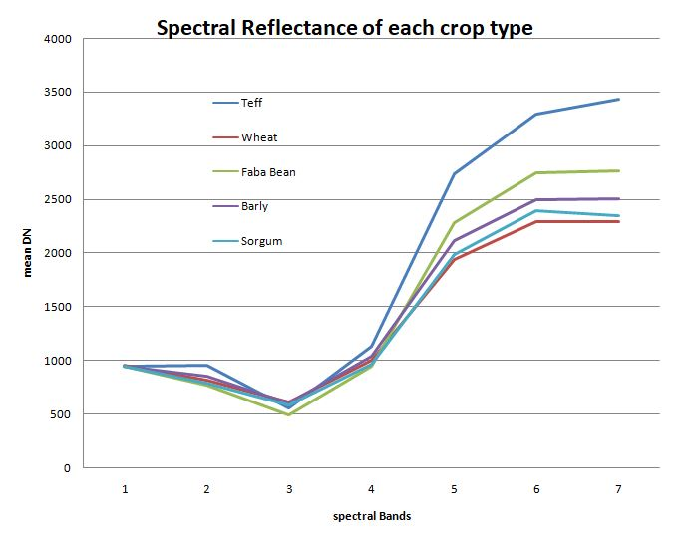
Spectral reflectance of crop types
The spectral response of each band is calculated by considering the average response of all pixel values in each crop type in the study area.
The spectral reflectance curves are created the average value of surface reflectance of spectral bands.
The spectral response of each crops is more distinguishable after band four to last bands range

Slide 33
Cont.….
The crop type classification was pixel based digital number (DN) values of reflectance curve of each type evaluated after fusion.

Slide 34
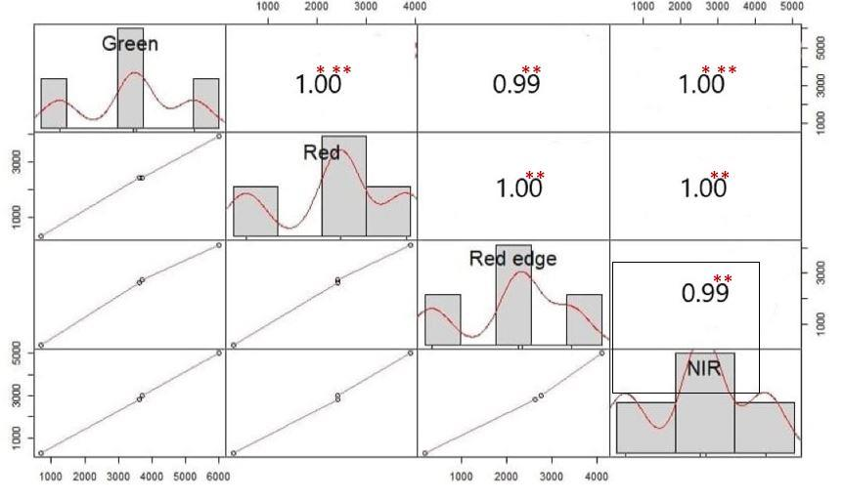
Band comparison b/n UAV and S2A
NIR(Near-infrared) and or Band4 wave length is useful in vegetation and also in Crop identification soil/crop and land/water contrast.

Slide 35
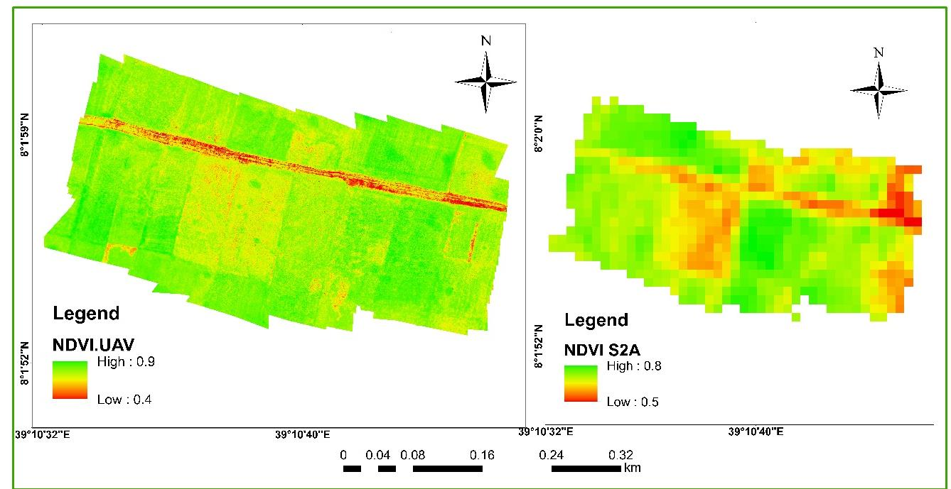
NDVI calculations for UAV &S2A
The NDVI shows the Vegetated plot in which:-
The highest value is the crop type features that its spectral reflectance was almost good at maturation (finer green).
The lowest value indicates the reflectance of each crop type was least, this is due to different parameters of farming practices or any other.
𝐍𝐃𝐕𝐈UAV=𝑁𝐼𝑅(𝑏𝑎𝑛𝑑4)-𝑅𝑒𝑑(𝑏𝑎𝑛𝑑2)
𝑁𝐼𝑅(𝑏𝑎𝑛𝑑4) + 𝑅𝑒𝑑(𝑏𝑎𝑛𝑑2)
𝐍𝐃𝐕𝐈𝐒𝟐𝐀 =𝑁𝐼𝑅(𝑏𝑎𝑛𝑑8) − 𝑅𝑒𝑑(𝑏𝑎𝑛𝑑4)
𝑁𝐼𝑅(𝑏𝑎𝑛𝑑8) + 𝑅𝑒𝑑(𝑏𝑎𝑛𝑑4)

Slide 36
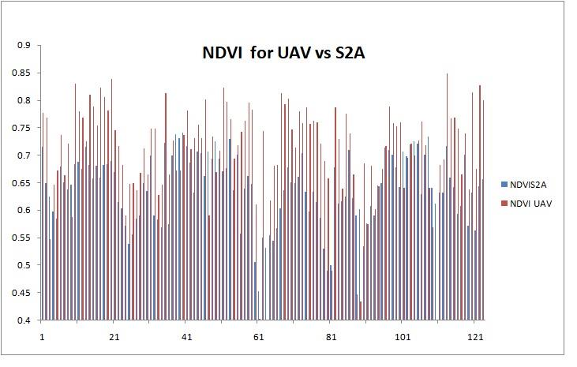
Cont.……
The NDVI correlation value(0.57) shows how much the classification of fused image was strong and appropriate classification for crop type mapping.

Slide 37
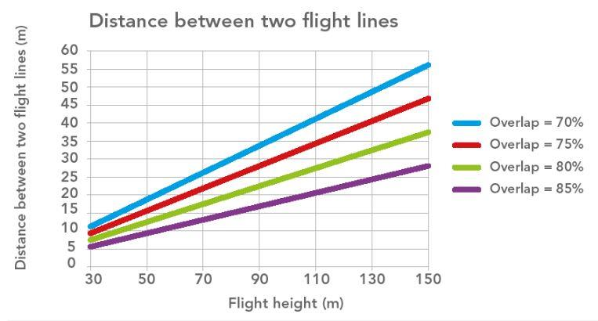
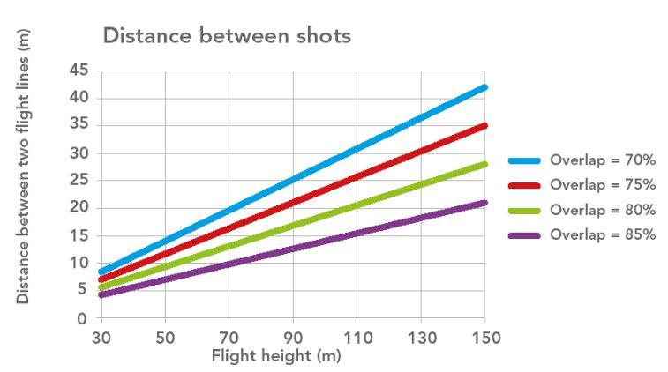
The flight of Parrot blue grass factors

Slide 38
Discussions
In this study the supervised Random forest and the traditional Maximum likelihood classification have used.
RF algorithm is selected because of its high performance in classifying raster images and fragmented crop type landscape components.
Sentinel 2A and UAV has been fused together using Gram Schmidt (GS) technique for crop type mapping.
From the fused approach, the Random forest classification algorithm obtained high classification accuracy 94% ,the maximum likelihood classification accuracy was 90 % and UAV 84%.
The classification was not done only from multispectral image based of the fusion; it needs ground data.

Slide 39
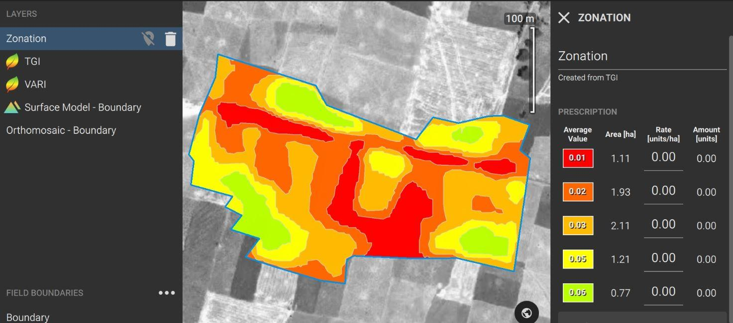
Cont.….
Pix4Dfield preprocess of the raw image have been done and “zonal prescription “that it categorizes and /or classify the study area into regional plots of farmlands.
The purpose of categorized area is to know the high spot areas of diseases, stress

Slide 40
Conclusion
The crop type classification of the fused image performed well, with advanced Random forest to identify and discriminate different crop types in the cluster farmland and machine learning RF algorithm is promising .
RF algorithm is powerful in classification and runout huge amount of data within high accuracy
The overall accuracies from RF approach resulted 94%, this is because of UAV data played a great role in improving the low resolution of sentinel 2A

Slide 41
Recommendations
It is better way if the area of interest is enhanced in Ethiopian agricultural practices, detect stress and crop type mapping by using blending of UVA with the newly launching satellite of Ethiopia.
further studies need to develop a technique capable of accurately analyzing and discriminating the crop types found in small agricultural fields in Ethiopia landscape.
Furthermore, now a days the machine learning in (Digital agriculture) is highly running so that the study strongly recommend that the agriculture sector should to interact, select the good approach for crop type mapping and monitoring
Within integration of high resolution data to detect the weed availability in crop type mapping

Slide 42
Challenges
Drone battery durability per flight ,obstacles frequent crashing's, distance from pilots
Mission flight mistakes
Time of flight ..wind, sun angle, weather(natural problems)
Need to engage experts with diverse specialization
Software capability (limited functionality) and license issue
Computational and storage requirements

Slide 43
Acknowledgements
Special appreciation goes to my Advisor Dr. Binyam Tesfaw Hailu (PhD) for your guidance, knowledge sharing, critical advices, helpful comments and insight in my study.
Secondly, my special thank goes to my co-Advisor Dr. Degefei Tibebe (PhD) ,who propose the title of this thesis and gave me modifications from the beginning to the present form of this thesis.
I am also thankful and recognize my sponsored institution, Ethiopian Institute of Agricultural Research (EIAR), sponsored me for my MSc study, trained me for piloting Unmanned Aerial vehicle and provided me the UAV itself for my primary data collection, encourage me well.

Slide 44
Thank you!!!

