Slide 1
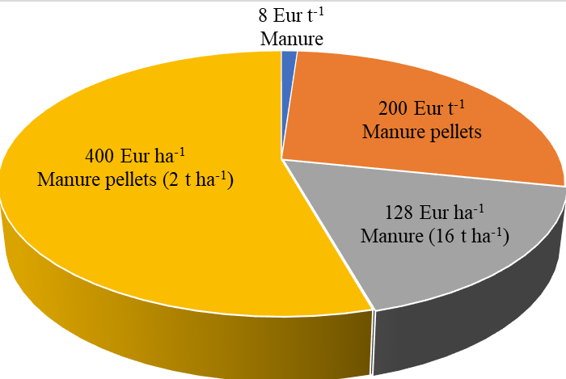
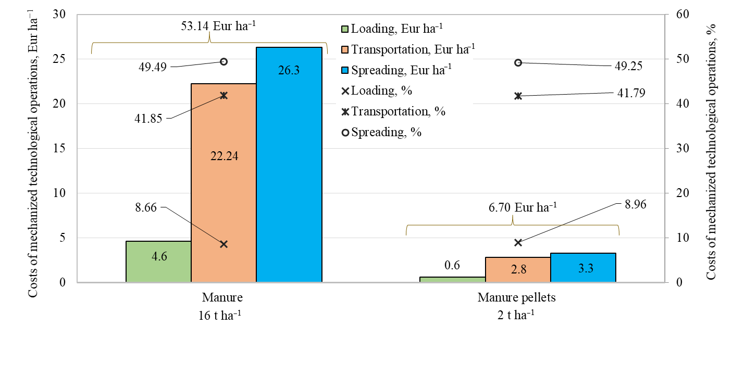
Research on the efficiency of manure and granular manure fertilizers in terms of costs and environmental pollution
Kristina LEKAVIČIENĖ, Vilma NAUJOKIENĖ, Egidijus ŠARAUSKIS, Zita KRIAUČIŪNIENĖ, Eglė JOTAUTIENĖ, Algirdas JASINSKAS, Raimonda ZINKEVIČIENĖ
INTRODUCTION
MATERIALS AND METHODS
Fertilizer is a great and advanced tool to increase productivity [1]. However, some elements of organic and mineral fertilizers are dispersed in the environment during fertilization, into the atmosphere in the form of GHG and in groundwater and surface waters, causing more intensive eutrophication processes and acidification of environmental elements. The increase in the use of chemical fertilizers soil quality deteriorates, increases greenhouse gas emissions into the air, and water pollution [2]. Also, livestock manure increases GHG, mainly due to the emission of dinitrogen monoxide. And the agricultural sector accounts for the largest share of NH₃ emissions in the European Union [3]. It is important to encourage the use of slow-release fertilizers in agricultural production [4]. Therefore, granular organic fertilizers are used to supplement the soil with the necessary substances for plants and reduce the negative effects of chemical fertilizers and livestock manure. The aim of this study is to determine the costs of manure and manure pellet fertilization, as well as the impact on the environment.
1. Prasad, P. 2009. Efficent fertilizer use: The key to food security and better environment. Journal of Tropical Agriculture. 47 (1–2), 1–17.
2. Li, L.; Wu, W.; Giller, P.; O’Halloran, J.; Liang, L.; Peng, P.; Zhao, G. 2018. Life Cycle Assessment of a Highly Diverse Vegetable. Multi-Cropping System in Fengqiu County, China. Sustainability. 10, 983. DOI: 10.3390/su10040983
3. European Union Emission Inventory Report 1990–2016 under the UNECE Convention on Long-Range Transboundary Air Pollution (LRTAP). 2018. Available online: https://www.eea.europa.eu/publications/european-union-emission-inventory-report-1990-2016 (accessed on 12 September 2021).
4. Jensen, L.S., Oelofse, M., Hoeve, M., Bruun, S. 2020. Environmental Impact Assessment on the Production and Use of Biobased Fertilizers. Biorefinery of Inorganics. 1, 329–362.
5. Prices of Mechanized Agricultural Services, Part 1, Main tillage; LIAE: Vilnius, Lithuania, 2018. Available online: https://www.laei.lt/?mt=leidiniai&metai=201 (accessed 14 September 2021)
The research was conducted in Lithuania. Costs are calculated for mechanized technological operations (fertilizer loading, transportation, and spreading) were estimated according to the prices of mechanized agricultural services prepared by the Lithuanian Institute of Agrarian Economics [5]. According to the rates [5], it is known that the normative price of manure varies from 7 to 12 Eur per tonne (accepted 8 Eur t⁻¹), granular organic fertilizer (manure) - from 190 to 220 Eur t⁻¹ (accepted 200 Eur t⁻¹). Different rates of organic fertilizer were used for costs calculation: manure 16.0 t ha⁻¹, manure pellet 2.0 t ha⁻¹.
Experimental research of NH₃ emissions is performed in 6 replicates on a laboratory stand using the mass flow method of laser spectroscopy. Samples were placed in a wind tunnel section and sealed with a cover. A gas analyzer GME700 was used to measure the ammonia gas concentration. At the start of the study, the gas analyzer was programmed to record the average NH₃ gas concentration values every minute. Experimental tests are performed until a crust forms on the surface manure.
RESULTS
In assessing the cost of organic fertilizers, it has been found that manure pellets fertilizer (2 t ha⁻¹) costs 272 Eur ha⁻¹ cheaper than manure (16 t ha⁻¹) (Fig. 1). The cheaper organic fertilizer is manure because it is used as a livestock product and the manure pellets still have to go through a certain technological process before it takes the form of pellets.
Fertilizing with manure are incurred more costs
(46.44 Eur ha⁻¹) compared with manure pellets
(Fig. 2). Fertilization with manure costs is higher
than fertilization with manure pellets due to
higher significantly costs for transport and
spreading. It depands on spreader capacity.
Manure pellet fertilizers are
97.80% more effective in
reducing NH₃ emissions and
negative environmental impact
compared to manure (Fig. 3).
Fig. 1. Costs of manure and manure pellets
REFERENCES
Fig. 2. Dependence of the costs of mechanized technological operations on the application of organic fertilizers
Fig. 3. Average ammonia emissions from manure and manure pellets, mg m⁻² h⁻¹
CONCLUSIONS
Costs have been obtained significantly higher (approximately 87.39 %) for mechanized technological operations when manure is fertilized compared to manure pellets. However, the price of manure is significantly lower (approximately 96 %). The average ammonia emission from manure pellets is significantly lower compared to manure.

