Slide 1
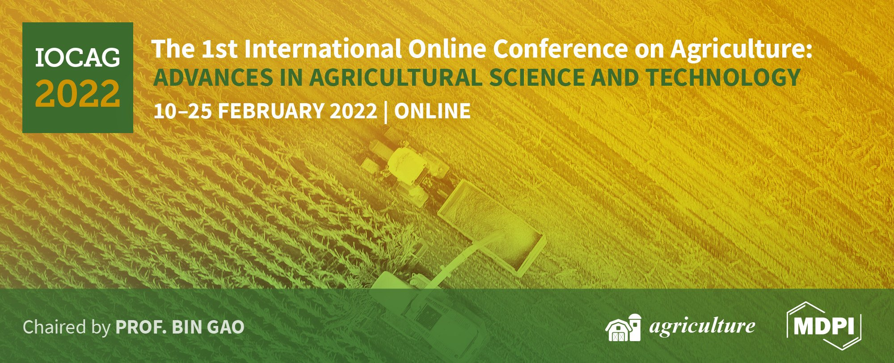
Soil characterization for production of an industrial tomato
variety in South Portugal - a case study
Ana Rita F. Coelho^{1,2}*, Ana Coelho Marques^{1,2}, Cláudia Campos Pessoa^{1,2}, Diana Daccak^{1,2}, Inês Carmo Luís^{1,2}, Maria Manuela Silva^{2,3}, Manuela Simões^{1,2}, Fernando H. Reboredo^{1,2}, Maria F. Pessoa^{1,2}, Paulo Legoinha^{1,2}, José C. Ramalho^{2,4}, Paula Scotti Campos^{2,5}, Isabel P. Pais^{2,5}, José N. Semedo^{2,5} and Fernando C. Lidon^{1,2}
¹ Earth Sciences Department, Faculdade de Ciências e Tecnologia, Universidade Nova de Lisboa, Caparica, Portugal;
² GeoBioTec Research Center, Faculdade de Ciências e Tecnologia, Universidade Nova de Lisboa, Caparica, Portugal;
³ Escola Superior de Educação Almeida Garrett, Lisboa, Portugal;
⁴ PlantStress & Biodiversity Lab, Centro de Estudos Florestais, Instituto Superior Agronomia, Universidade de Lisboa, Oeiras, Portugal;
⁵ INIAV, Instituto Nacional de Investigação Agrária e Veterinária, Oeiras, Portugal;
* Correspondence: arf.coelho@campus.fct.unl.pt;

Slide 2
Soil characterization for production of an industrial tomato variety in South Portugal - a case study
Correlation between pH, organic matter contente, humidity and electrical conductivity
Field
16 soil samples
Intended for Tomato Production
Mineral Content
Colorimetric parameters

Slide 3
Abstract: Appropriate soil conditions are important to the success of tomatoes culture. In fact, there are mineral elements that are essential for the good and healthy development of tomatoes, namely, nitrogen, phosphorus, potassium, calcium, magnesium, sulfur, iron, and zinc. Additionally, organic matter and pH play an important part in the process. In this context, this study aimed to characterize a soil destined to produce an industrial tomato variety in the south of Portugal. As such, mineral elements content, pH, electrical conductivity, humidity, organic matter, and color (with-out humidity and without humidity and organic matter) were analyzed in 16 soil samples before any type of soil preparation was carried out. Through principal components analysis (PCA) was possible to observe that electrical conductivity and humidity are more correlated with each other than pH and organic matter. Yet, pH of soil varied between 6.9 (minimum) and 7.3 (maximum) being in accordance with the ideal range values for tomato production. Also, regarding quantification of mineral elements Fe showed a higher content, followed by K, Ca, P, Mg, S, Zn, and As. However, regarding the color of the soil without humidity and without humidity and organic matter, there were significant differences between CieLab parameters (L, Chroma, and Hue). Nevertheless, soil conditions of the field presented good requirements for tomato production, de-spite the higher levels of Fe in the soil and the presence of As.
Keywords: Lycopersicum esculentum L.; tomato productions; soil analyzes; soil characterization.

Slide 4
Introduction
Conditions of soil are a very important factor in the success of tomatoes culture. This culture grows well on most soils but prefers deep and well-drained, sandy loams soils, being moderately tolerant regarding pH (Naika et al., 2005). Soil chemical (namely, pH) and physical properties can influence water and mineral uptake by plants and therefore the nutritional content of tomatoes (Dorais et al.,2008). For plant growth, there are twelve mineral elements essentials and most of them come from soil (namely, nitrogen, phosphorus, potassium, calcium, magnesium, sulfur, iron, and zinc) (Sainju et al., 2003; Pagani et al., 2013). Nevertheless, without these essential mineral elements, tomatoes can’t grow properly (Pagani et al., 2013). Yet, each mineral element varies according to its mobility within the plant and every crop has different needs (Pagani et al., 2013). For instance, N, P, K, Ca, Mg, and S are needed in large quantities for good crop production, and namely, Fe and Zn are needed in fewer quantities. Additionally, soil cannot provide adequate amounts of N, P, and K there’s a need for soil fertilization to lead to good crop production (Sainju et al., 2003). Also, organic matter of soil is related to crop nutrient composition (Wood et al., 2018) and pH can affect plant growth and influence different soil properties (namely, nutrient absorption) (Minasny et al., 2016).
In this context, this study aimed to characterize soil chemical properties (pH, electrical conductivity, humidity, organic matter, mineral elements content, and color (without humidity and without humidity and organic matter)) from a field in the south of Portugal intended to produce an industrial tomato variety.

Slide 5
Results and Discussion
Figure 2A,B,C. Projection of the factorial plane created by the axes component 1 (or F1) (42.9 % variance) and component 2 (or F2) (68.0 % variance) (A), correlation matrix from ACP analysis (B), and correlation of Pearson (C), pH, organic matter, electrical conductivity, and humidity of soil samples (n=16).
Considering the F1/F2 factorial plane (component 1/component 2), there is a greater correlation between electrical conductivity and humidity (Fig.1 -A) with a correlation matrix of 0.709 (Fig. 1- B). Additionally, through Pearson's correlation, we can also observe that both parameters have the highest correlation value (0.834) (Fig. 1 – C).
In fact, electrical conductivity and humidity showed a greater correlation between each other. This correlation can be due to electrical conductivity being influenced by different properties - namely, clay content and soil water content – (Corwin et al., 2005) since the range of values were very different between both parameters (humidity showed values be-tween 10 and 19.8 % and electrical conductivity varied between 134 and 244 µS.cm-1 – data not shown).

Slide 6
Results and Discussion
Figure 2A,B,C. Mean values ± S.E. of mineral content of soil samples (n=16).
Mineral content of soil was assessed (Fig. 2- A,B,C) and Fe showed the highest content, followed by K, Ca, P, and Mg. Sulfur, Zn and As were the mineral elements presented in lower concentration in the soil samples, being As a contaminating mineral element.
In macro and micro elements of soil, Fe showed a higher content, followed by, K, Ca, P, Mg, S, Zn, and As (Fig. 2). For instance, despite Fe being needed in fewer quantities for good crop production (Sainju et al., 2003), the high content obtained in the soil is due to the rocks of the geological substratum, being located near the Pleistocene zones, having gravels with ferruginous crust, ferruginous impregnations and ferruginous pyoliths. As such, being rich in Pyrite (iron sulfides) – Pyrite Belt – and other minerals that can supply iron in the soil formation process. Additionally, the soil is from the Miocene, corresponding to clays with oysters, clayey stones with hipparion (Schermerhorn et al., 1987).
According to Sainju et al. (2003) our data showed higher content of P, K, Mg, and Ca in soil consider-ing the desirable levels of nutrients for tomatoes production. In fact, P, K, and Ca are absorbed by tomatoes in large amounts and a higher content of Mg can lead to an in-crease the tomato fruit production (Sainju et al., 2003).

Slide 7
Conclusions
The soil samples collected in the experimental field located in São João de Negrilhos (Aljustrel), exhibit different interrelations between pH, organic matter content, electrical conductivity, and humidity (or moisture). A higher correlation was observed between electrical conductivity and humidity probably due to electrical conductivity being influenced by different properties, namely soil water content. Regarding pH was in accordance with the ideal range for tomato production. Overall, soil conditions of the field presented good requirements for tomato production, despite the higher levels of Fe (due to the geological substratum of the region) and the presence of As that were below the critical limits for the pH of the field.

Slide 8
Acknowledgments
The authors thanks to Eng. Valter Lopes and António Vasconcelos (Associação de Beneficiários do Roxo) for technical assistance in the agricultural parcel as well as to project PDR2020-101-030701– for the financial support. We also thanks to the Research centres (GeoBioTec) UIDB/04035/2020, and (CEF) UIDB/00239/2020.

